Slide 1
How to use this template
01
Write each title as the point the slide makes.
“Open access saves ₹3.3 Cr a year”, not “Savings”.
02
One idea per slide.
If a slide needs two titles, make it two slides.
03
Keep to the sizes in the layouts.
If text doesn’t fit, cut words. Don’t make it smaller.
04
Violet is for Neufin.
Our figures, our option, the recommendation. Everything else is black or grey.
05
Read the speaker notes.
Every slide explains when to use it and what to change. Delete this slide before sending.
Notes:
Start here. Duplicate this file for each new deck, then delete this slide.
To add a slide: Slide > New slide, or duplicate the closest example below and change the words. To change a slide’s frame: Slide > Apply layout > a “Neufin ·” layout.
Everything is in Arial (Bold for titles), so the deck looks the same on every computer and in PowerPoint or PDF. Don’t change the font.

Slide 2




Lower power costs
for your offices
Proposal for Company name · October 2026
Client logo
Notes:
The default first slide. Photo above, Electric Violet below, split along the Stripe.
Title: what the client gets, in their words, on two lines: “Lower power costs for your 20 offices”, not “Renewable energy proposal”. Second line: who it’s for and the month.
Client logo: click the white cell, Insert > Image, and fit their logo inside it with space around. If you don’t have a clean logo, delete the cell; never use a blurry one.
Photo: click it, Replace image, pick one from the design system’s Photography page. Keep the sky or a plain area at the top.

Slide 3
Lower power costs
for your offices
Client logo
Proposal for Company name · October 2026
Notes:
Plain cover, when you have no good photo. Title says what the client gets, in their words, on two lines. Second line: who it’s for and the month.
Client logo: fit it inside the white cell top right, or delete the cell.

Slide 4
Agenda
01
What you pay today
02
Where you can save
03
Your options
04
How we deliver
05
Next steps
Notes:
Use only for decks longer than ten slides. Up to six items, each a few words. Match the items to your section dividers.

Slide 5
Where you can save
02
Notes:
Opens a section in a longer deck. Number on the first line, section name below, as on the agenda. Skip dividers in decks under ten slides.

Slide 6






Why companies buy power through Neufin
Up to 40% lower cost
30 days to 15 years
Solar, wind and hybrid
Renewable power below the grid tariff
Contract lengths to suit your plans
Plus biomass, storage and exchange power
16 states
Licensed trader
One platform
One partner for all your sites
CERC Category V trading licence
Every unit tracked in Lumen
Notes:
Use as the one “about us” slide in a first meeting. Keep six facts or remove a row to make three. Each fact: a short claim we can prove, then one line. Update the numbers (states, suppliers) when they change.

Slide 7
Companies across India buy power through Neufin
Logo
Logo
Logo
Logo
Logo
Logo
Logo
Logo
Logo
Logo
Logo
Logo
Notes:
Twelve cells on a fixed grid. To add a logo: click a cell, then Insert > Image, and fit the logo inside the cell with space around it. Never stretch a logo or change its colours. Pick logos the client will recognise, ideally from their industry.
Fewer than twelve? Delete a whole row, not single cells, so the grid stays even. Only use logos of customers who have agreed.

Slide 8
Backed by customers, suppliers and investors
Customers
Logo
Logo
Logo
Logo
Logo
Logo
Power partners
Logo
Logo
Logo
Logo
Logo
Logo
Investors
Logo
Logo
Logo
Logo
Logo
Logo
Notes:
Use when the client asks who we are. Three rows of six on the same grid, so logos line up in columns. Fit each logo inside its cell with space around it; never stretch it. Delete a row you don’t need, then move the rows below up so the gaps stay equal.

Slide 9
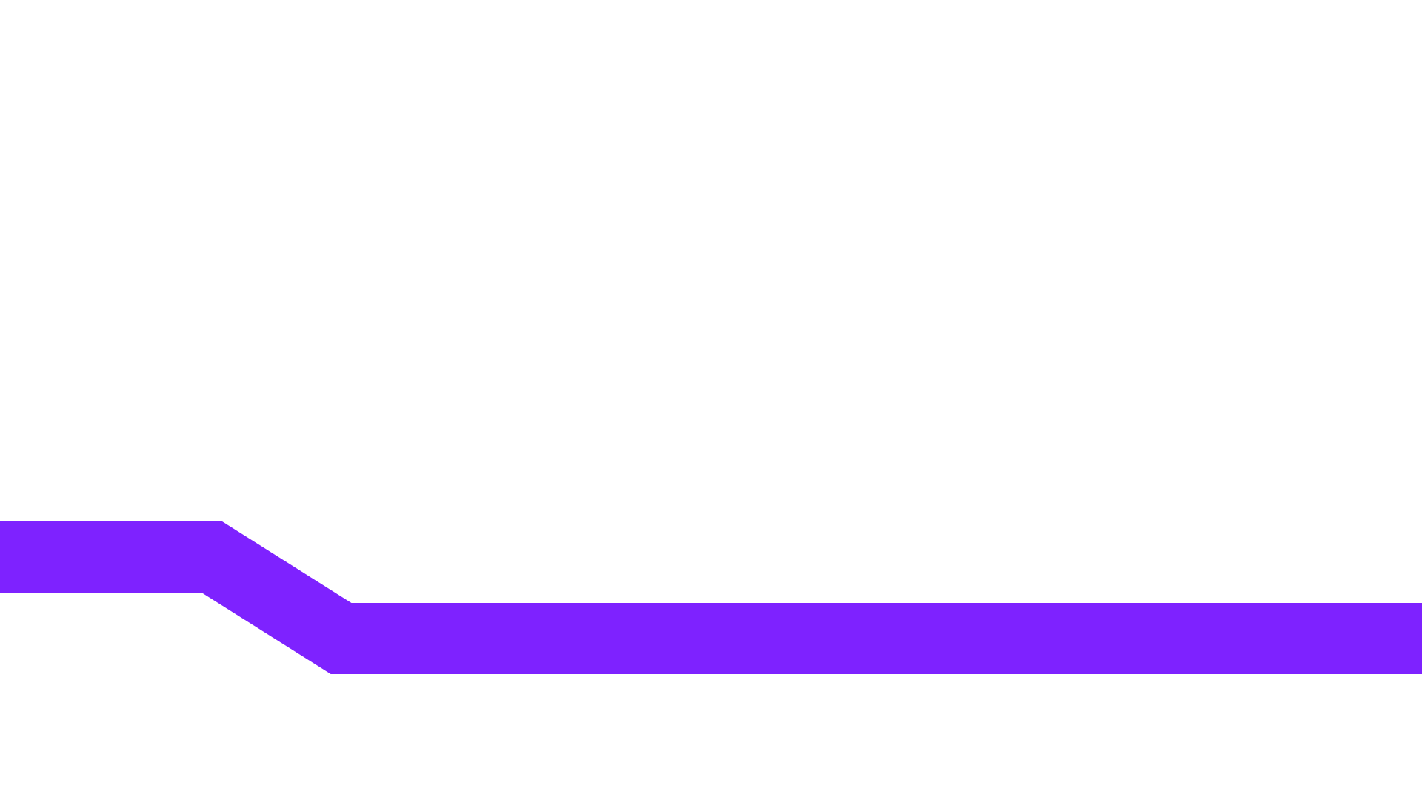
What customers say
“We cut our power bill by a third in the first year.”
Name Surname
Head of Facilities, Company
Notes:
Quote a real customer, word for word, with their permission. One sentence that fits on two lines at this size; cut the rest. Name and role on the right, above the Stripe. No photo needed.

Slide 10

Built for sites that
run around the clock
Factories, offices, hospitals and data centres across 16 states.
Notes:
One big statement over a photo, to open a section or change pace. Keep it to two lines and one supporting sentence.
The photo sits under a Near Black shade so white text stays readable. To change it: click the photo (below the shade), Replace image. Pick a darker photo or one with a plain lower half.

Slide 11
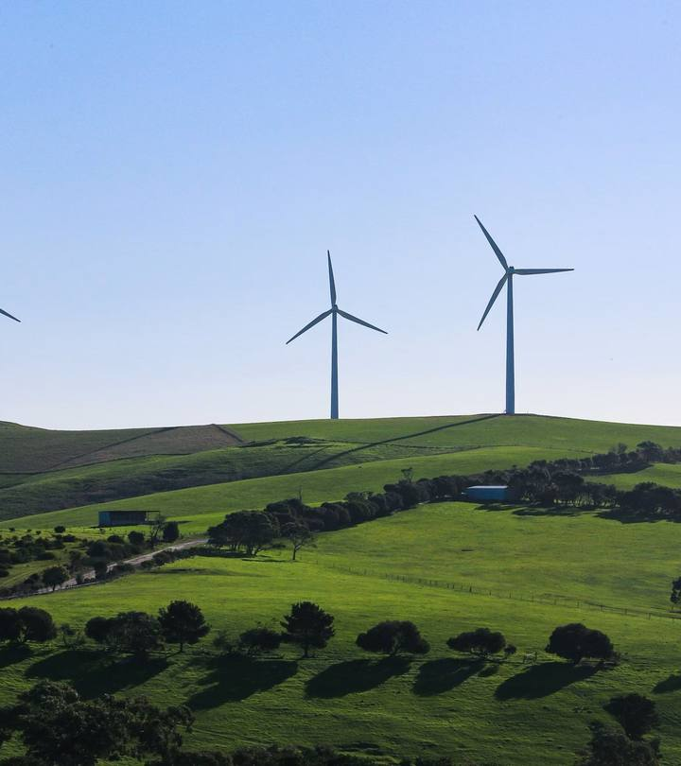
Renewable power now costs less than the grid
In most states, solar and wind bought through open access land below the grid tariff, even after transmission and wheeling charges.
Notes:
One message with one photo, text on the left. To change the photo: click it, then Replace image. Use photos from the design system’s Photography page: real Indian sites, no stock handshakes. Keep the text to two or three lines.

Slide 12
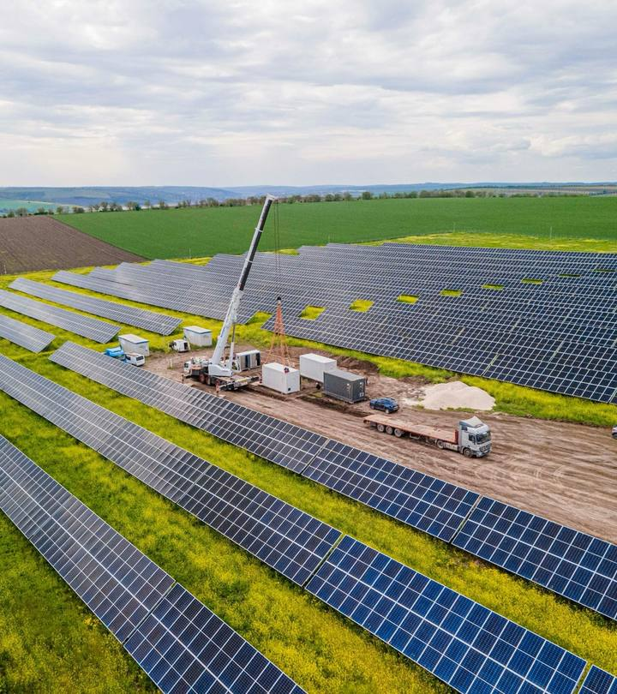
We deliver the project, not just the contract
Our team handles the agreement, the metering and the DISCOM approvals until power starts flowing.
Notes:
The mirror of “Text and photo”. Alternate the two so a deck doesn’t feel repetitive. Same rules: one message, two or three lines, a real photo.

Slide 13
Renewable power in three months, not a year
Decide to buy
Find suppliers
Compare quotes
Negotiate
Sign and connect
Typical: 12 to 15 months
With Neufin: about 3 months
Contracts are pre-negotiated with our suppliers, so you choose terms instead of chasing quotes.
Notes:
Shows the problem and our answer on one slide. Change the stages or months to match the client’s story. Keep the grey bar for their way and the violet bar for ours.

Slide 14
We handle it end to end
01
02
03
04
Design
Discover
Deliver
Optimise
We model your sites and the right mix of sources, in a day.
Choose from 100+ pre-negotiated contracts with 30+ suppliers.
We handle the agreement, metering and DISCOM approvals.
Lumen tracks every unit and keeps your cost per unit low.
Notes:
How we work, in four steps. Use the same four words everywhere: Design, Discover, Deliver, Optimise. Keep each description to one sentence. To show where a client is today, move the violet line to that step.

Slide 15
Ready-to-sign contracts instead of months of quotes
 | Typical market | Neufin
Price | Changes by supplier | Pre-negotiated, bulk pricing
Contract length | 3 to 15 years | Spot, 3 months, 1 to 15 years
Time to sign | 6 to 9 months | About 3 months
Smallest size | 1.5 MWp | 0.5 MWp
Terms | Different for each supplier | Shared before you start
Notes:
Us against the usual way. Neufin is always the last column and the only one tinted violet. Write facts, not adjectives. Up to six rows; use plain words instead of ticks and crosses.

Slide 16
Two ways to work with us
Energy Networks
Advisory
We buy renewable power for you, from design to supply.
We plan your energy transition and report on it.
Open access: group captive and third party
Techno-commercial and regulatory advice
Rooftop and ground-mounted solar
Supplier and asset due diligence
Exchange power and storage
Moving your suppliers to renewables
Notes:
Two offers, products or options side by side. Same structure in both panels: name, one sentence, three points. For three options with prices, use “Three options” instead.

Slide 17
You spend ₹42 Cr a year on power across 18 sites
₹42 Cr
State | Sites | Demand | Units a month | ₹ per kWh
Maharashtra | 7 | 7.6 MVA | 12.0 L | 8.4–18.9
Tamil Nadu | 4 | 3.9 MVA | 5.2 L | 8.6–15.8
Gujarat | 2 | 2.4 MW | 3.8 L | 10.2
Karnataka | 2 | 1.8 MVA | 2.6 L | 9.1
Others | 3 | 3.2 MVA | 4.9 L | 6.1–11.0
A year, across 18 sites in 6 states
Notes:
Starts the client’s part of the deck: what they spend today, from the bills they shared. One big number on the left, the breakdown on the right.
Figures here are examples. Replace every one, and check totals add up. Write money as ₹ with Cr or L; units as kWh, MW or MVA.

Slide 18

Your cost per unit drops by a third
₹9.40
₹6.20
Grid tariff today, per kWh
With Neufin, per kWh
Notes:
The one number that matters, drawn with the Stripe: the price steps down at the angle of the Neufin symbol. Use once per deck, for the headline saving.
Change the two prices and the title. Keep the old price on the left and the new one on the right; don’t move the Stripe.

Slide 19
Your monthly bill falls by a third after the switch
Grid tariff
With Neufin
30 L
20 L
10 L
Apr
May
Jun
Jul
Aug
Sep
Oct
Nov
Dec
Jan
Feb
Mar
Notes:
Change over time, month by month. Grey bars for before, violet for after Neufin. Up to 12 bars.
The bars are shapes, so edit them directly: change each bar’s height so 10 L is the same height everywhere (the grey lines are 10, 20, 30 L). Replace the example months and values.

Slide 20
Two thirds of your power will come from the sun and wind
Solar
46%
68%
Wind
22%
from renewables
Grid
32%
Solar and wind through open access. The rest from the grid, mostly at night.
Notes:
Parts of a whole, such as the power mix. Three parts at most; group the rest as “Other”. Violet for Neufin’s sources, grey for the grid.
The ring is three arc shapes: drag each yellow handle to change its size, and keep the gaps. Update the big number and the list to match.

Slide 21
Grid prices keep rising. Your contract price doesn’t.
Today
₹12
Grid ₹11.30
₹8
Neufin ₹6.30
₹4
2021
2022
2023
2024
2025
2026
2027
2028
2029
2030
2031
Grid tariff after 2026 projected at 5% a year. ₹ per kWh.
Notes:
A trend over time: what they pay now against what they would pay with us. Black line for the grid, violet for Neufin. Two lines at most.
The lines are shapes: move each point’s end to its new value, using the ₹4, ₹8 and ₹12 lines as a guide. Always say which values are projections.

Slide 22
Open access lands ₹2.49 below the grid rate
₹8.78
₹2.49 less per unit
+0.38
+0.21
₹6.29
+0.50
+0.55
+0.15
₹4.50
PPA tariff
Losses
Transmission
Wheeling
Cross-subsidy
Other
Landed
Grid rate
Notes:
Shows how the open-access price is built up, ending against the grid rate. Violet bars are Neufin’s price; grey bars are the charges added on top; the black bar is what they pay today.
The bars are shapes, so you can change them directly: edit the labels, then resize each bar so 1 ₹ = the same height everywhere. Replace the example values with the client’s.

Slide 23
Open access saves ₹3.8 Cr a year across six sites
Site | State | Units a month | Grid ₹/kWh | Neufin ₹/kWh | Annual saving
Pune office | Maharashtra | 2.1 L | 10.80 | 6.60 | ₹1.06 Cr
Mumbai office | Maharashtra | 1.8 L | 11.40 | 6.70 | ₹1.02 Cr
Ahmedabad office | Gujarat | 1.2 L | 10.20 | 6.40 | ₹0.55 Cr
Chennai office | Tamil Nadu | 1.4 L | 9.60 | 6.10 | ₹0.59 Cr
Noida office | Uttar Pradesh | 0.9 L | 8.80 | 6.30 | ₹0.27 Cr
Bengaluru office | Karnataka | 0.8 L | 9.40 | 6.50 | ₹0.28 Cr
Total |  | 8.2 L |  |  | ₹3.77 Cr
Notes:
Full-width table for site-by-site numbers. Thin grey lines between rows, numbers right-aligned, Neufin’s column in violet, total in the last row on Warm White.
Up to eight rows; put longer lists in an appendix. Add or remove rows with right-click > Insert row / Delete row so the style carries over.

Slide 24
Pick the contract length that suits your plans
Contract | Length | Investment | ₹ per kWh | Best for
Exchange | Day to day | None | Market price | Trying open access
Short term | 3 months to 1 year | None | 7.0–8.0 | Flexible needs
Medium term | 3 to 5 years | None | 6.5–7.2 | Most offices
Long term | 10 to 15 years | Optional | 5.8–6.6 | Lowest price per unit
Group captive | 20 to 25 years | 26% equity | 5.5–6.7 | Large, steady demand
Notes:
Full-width table with soft stripes instead of lines, for options or plans read across a row. The row we recommend is tinted violet.
Up to six rows. To move the recommendation, change the violet row back to white or Warm White and tint the new one Violet 100.

Slide 25
8 of your 20 sites can switch to open access now
20
sites checked
8
ready to switch
12
not yet
Site | State | DISCOM | Ready | Why not yet
Pune office | Maharashtra | MSEDCL | Yes
Ahmedabad office | Gujarat | Torrent Power | Yes
Chennai office | Tamil Nadu | TNPDCL | Yes
Nashik office | Maharashtra | MSEDCL | Not yet | Consumption too low for open access
Mumbai office | Maharashtra | BEST | Not yet | DISCOM doesn’t allow open access
Kolkata office | West Bengal | WBSEDCL | Not yet | State rules not yet favourable
Notes:
Which of the client’s sites qualify. Title gives the answer. Counts on top, then sites below: “Yes” rows first, in violet. Up to seven rows here; put the full list in an appendix slide using the same table.
Never show customer numbers or account numbers on a slide.

Slide 26
Three ways to buy power for your Maharashtra sites
Recommended
Group captive
Third party
Third party
Solar and wind hybrid
Solar
Solar and wind hybrid
6.55–6.69
9.29–12.22
9.34–11.96
Landed tariff, ₹ per kWh
Landed tariff, ₹ per kWh
Landed tariff, ₹ per kWh
PPA tariff
₹4.00
PPA tariff
₹4.00
PPA tariff
₹4.00
Annual saving
₹3.3 Cr
Annual saving
₹0.7 Cr
Annual saving
₹1.4 Cr
Investment
₹1.2 Cr equity
Investment
None
Investment
None
Term
25 years
Term
20–25 years
Term
20–25 years
Indicative tariffs for discussion only, not an offer. Final tariffs depend on capacity, sites, supplier, contract and charges at signing.
Notes:
Options for one state or group of sites. Up to three cards. Put the one we recommend first, with the violet outline and “Recommended”; the others stay grey.
Figures are examples. Keep the same four rows in every card so they compare line by line. Keep the footnote whenever tariffs are shown.

Slide 27
Next steps
This week
Share 12 months of bills for each site
You
Week 2
Detailed model and supplier shortlist
Neufin
Week 4
Choose an option and sign the term sheet
You and Neufin
Month 3
Power supply starts
Neufin
Notes:
End every proposal with dates and owners, agreed in the meeting if you can. Up to five rows. The first step should be one the client can do this week.

Slide 28
Send us your
latest power bill
We’ll show you what you could save.
Firstname Lastname
name@neufin.energy · +91 00000 00000
Notes:
Last slide. One request in the title, one line on what happens next, and your name, email and phone on the Stripe. Not “Thank you” and not “Questions?”.

