Slide 1
Analysis for TV Shows
GROUP-5
SADHANA BURLA (02069182)
SREEYA NIMMAGADDA(02040498)

Slide 2
Introduction
The dataset we have collected from Kaggle will contains many TV shows from the Netflix, Hulu, Disney and prime video streaming services. In contains the information of name of TV shows, age, group, IMDB rating, TV show produced year. For rating purpose, we have selected some stop words from data set. We have created app using D3.js which contains TMDB reviews where reviews include title of movie, Release date, vote count, vote average, genres.
Analyze the title names of TV shows.
Title word frequency
Analyze numeric Data which contains general timelines of TV show
production.
IMDB data rating for best and worst rating shows.
Cluster based on TV show rating.
Release year Vs number of movies count
Analysis based on IMDB for each platform and titles.
Analysis of TMDB reviews based on release date, vote count, vote average
and genres.

Slide 3
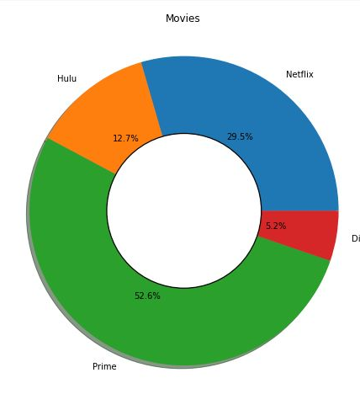
Movies released in different platform
Identified data from various platforms like Hulu, Netflix, prime video.
According to the comparison Prime has the maximum number of movies.

Slide 4
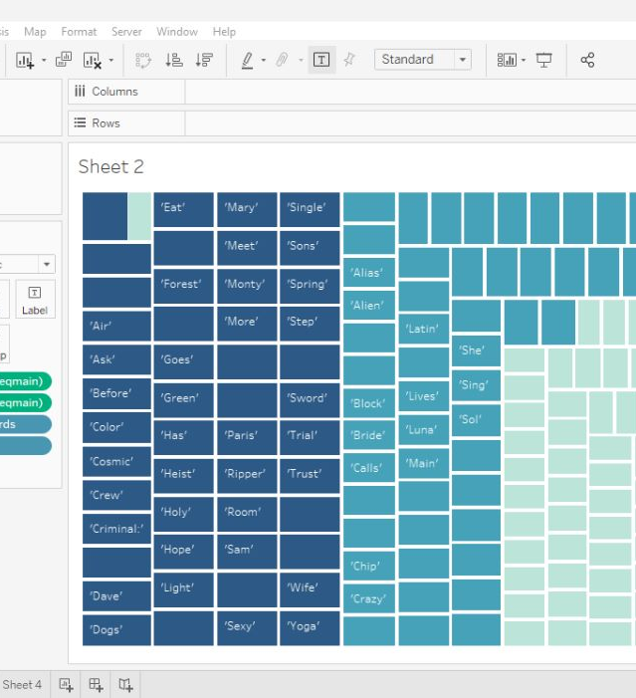
Frequency of stop words in movie titles
Here we have wide range of movie titles.
Identified some stop words which are most commonly used.
Compared stop words with movie titles

Slide 5
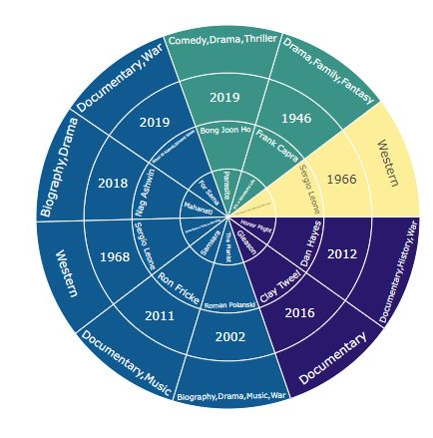
Movie Recommendation
Movies with the highest IMDb rating on each platform and genres.
The resultant output gives the recommendations for movie type, year of release.

Slide 6
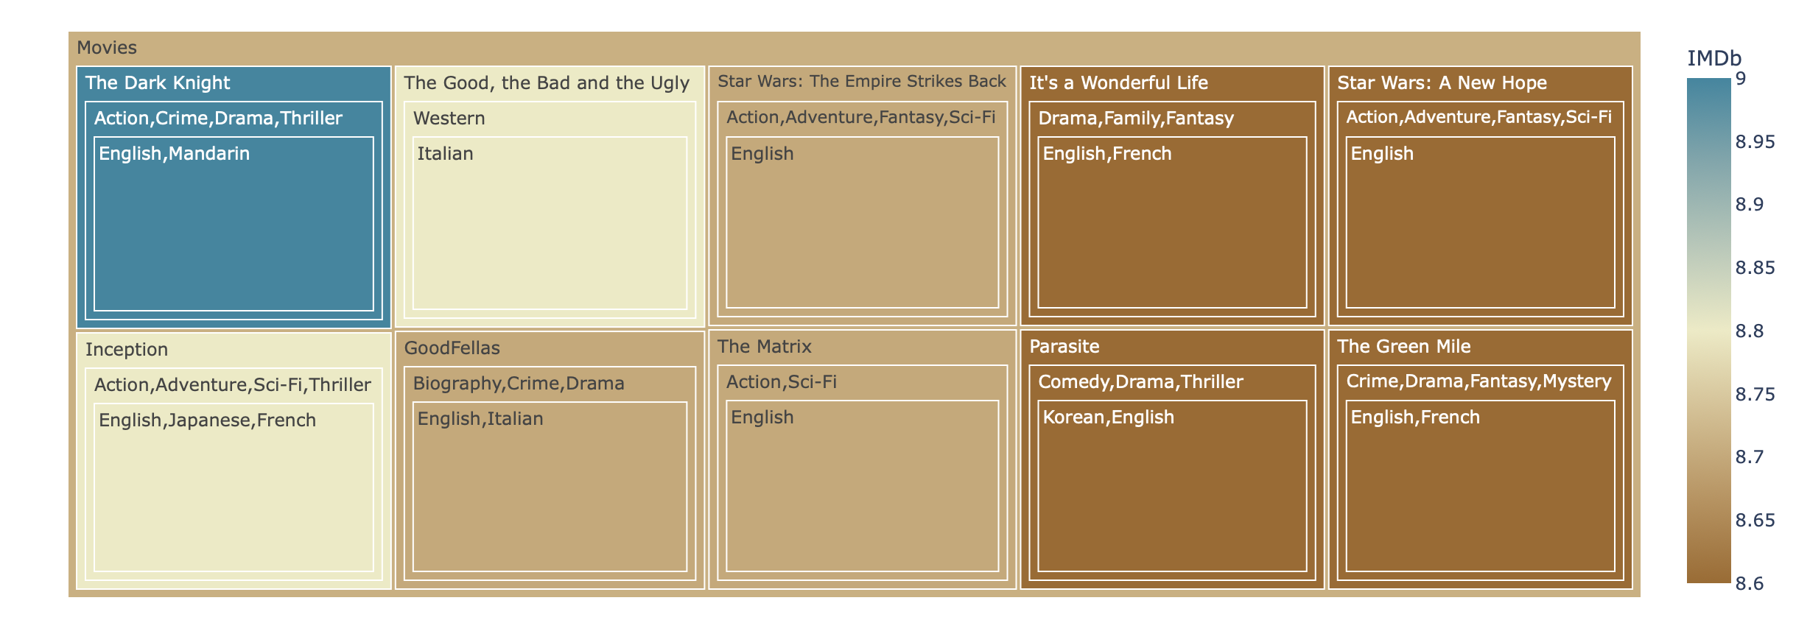
IMDB using tree map
According to high IMDB rating we have categorized and plotted tree map.
Here, we have different kinds of movies with different genres and titles.

Slide 7
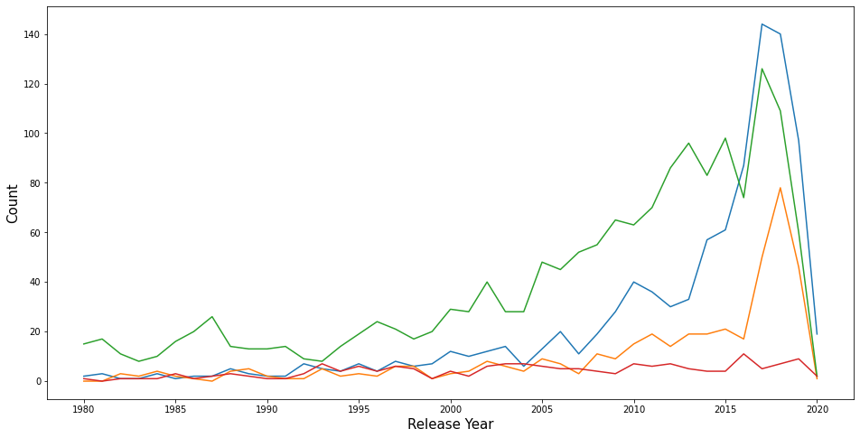
IMDB using line chart
Here, we have used bar plot which has the comparisons for IMDB rating with different platforms and gives the highest rating using line chart.

Slide 8
Expected final look
Here, we have achieved goals from phase-I to current work. In phase-I, we have done tableau work for comparisons of IMDB data with various case scenarios. In phase-II, we have completed python code for movie recommendation system. In current phase we have done with D3.js movie comparison in TMDB data.
In further as extension of this project we can change it to charts with comparing same data.

Slide 9
References
https://github.com/codingtechonline/movies
https://www.kaggle.com/datasets/ruchi798/tv-shows-on-netflix-prime-video-hulu-and-disney

