Slide 1
Plastic Waste Calculator & Recycling Guide
Name: Nimmy Rose Vinson
Guide: Mr. Nithin Rajan
Roll No: 23

Slide 2
Objective
To develop an interactive web application that empowers individuals to reduce plastic waste by calculating their plastic footprint, promoting recycling habits, providing recycling centres, and encouraging community participation through gamification.

Slide 3
Existing System
1. Lack of Awareness: Current systems do not adequately educate users on their plastic consumption or provide clear insights into its environmental impact.
2. Limited Access to Recycling Information: Users face challenges in understanding which plastics are recyclable and locating nearby recycling centers.

Slide 4
Existing System
3. Absence of motivation for change: there is no community-driven system that encourages users to adopt sustainable habits.

Slide 5
Proposed System
1. Plastic Waste Calculator: Calculates daily/weekly plastic usage in kilograms and provides environmental impact insights. Generates Report in pdf format.
2. Recycling Guide: Educates users on recyclable plastics, suggests nearby recycling centers.
3. Community challenges: Introduces gamified challenges like Quiz.

Slide 6
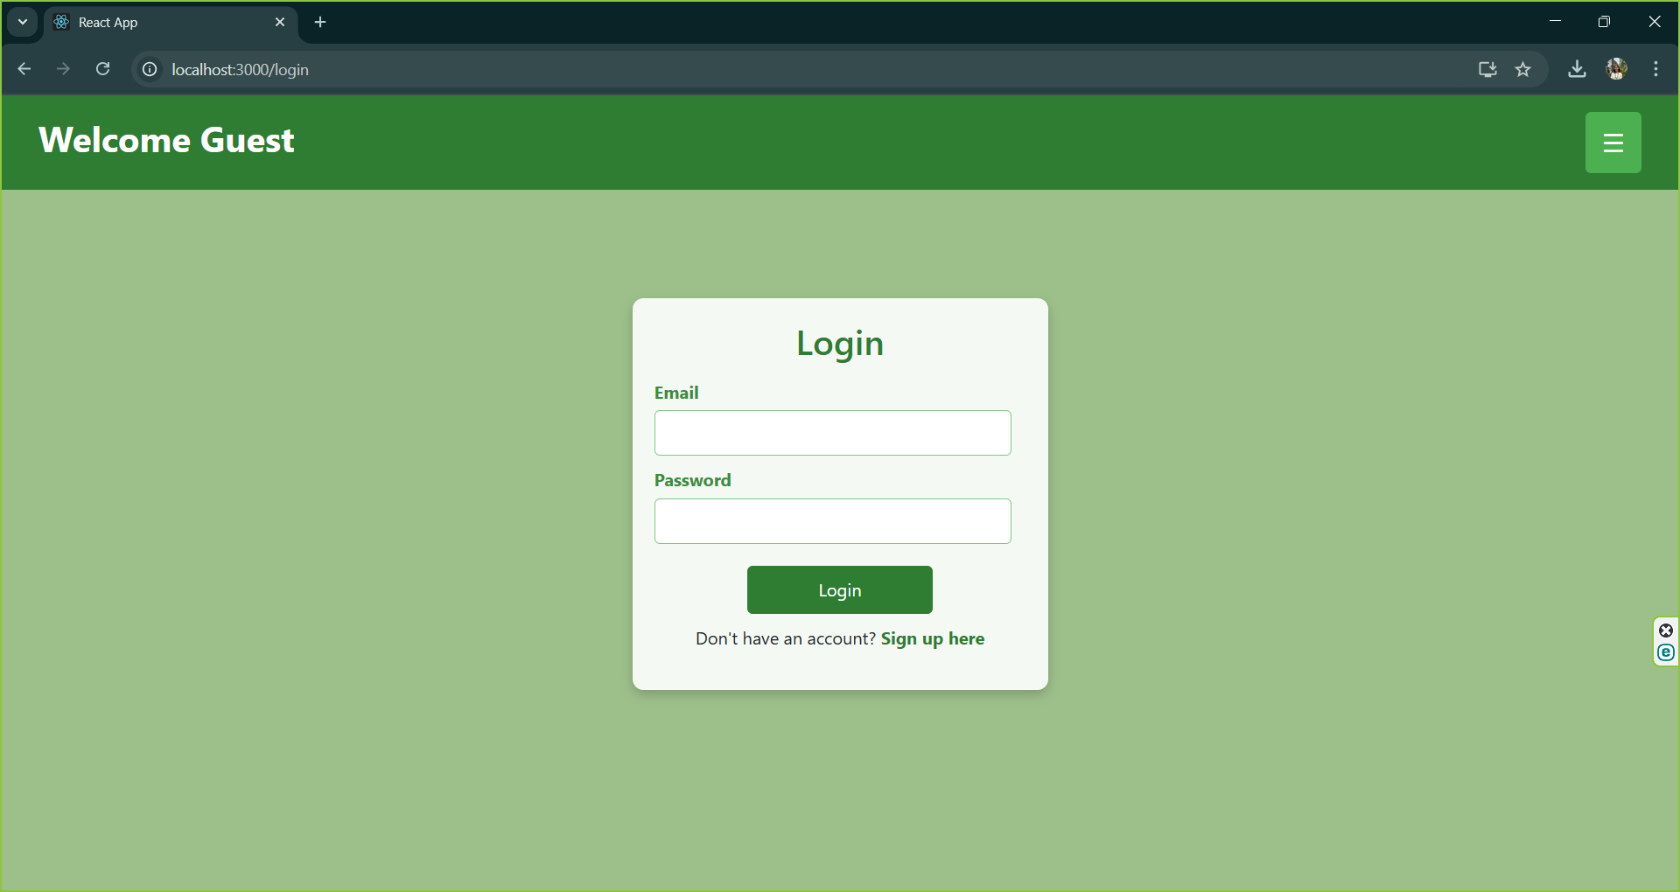
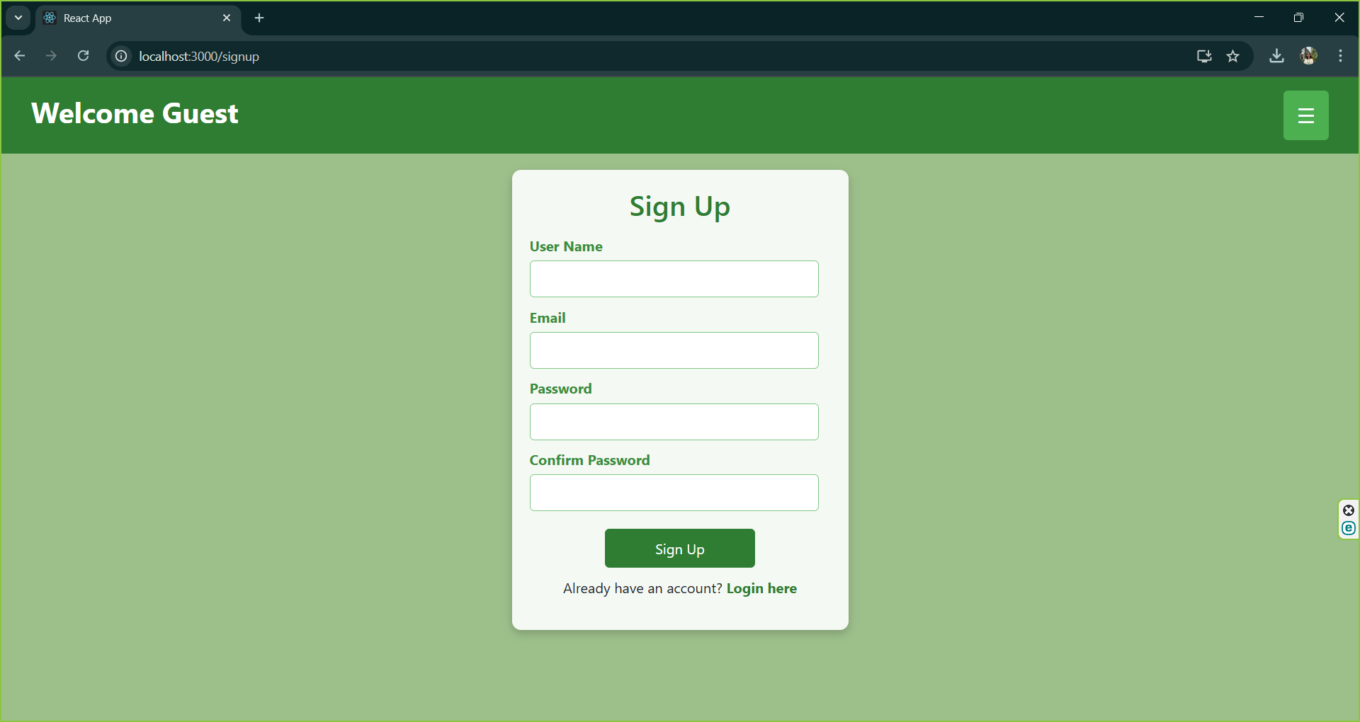
Modules
1.User Login and Signup.

Slide 7
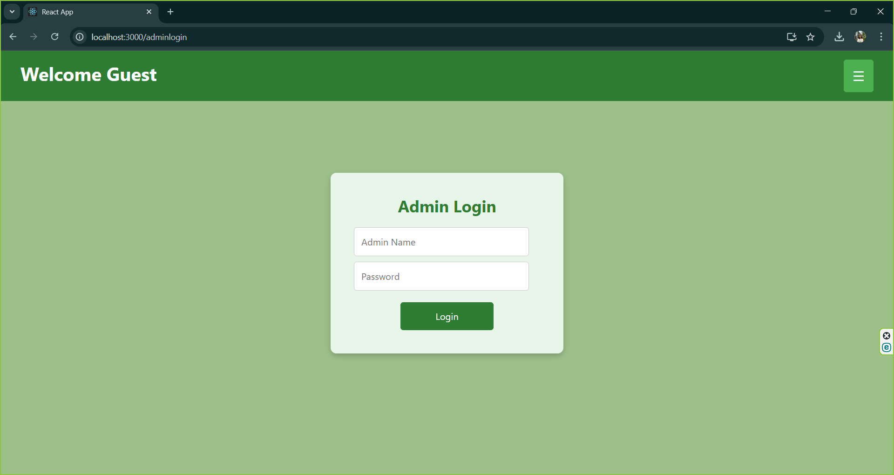
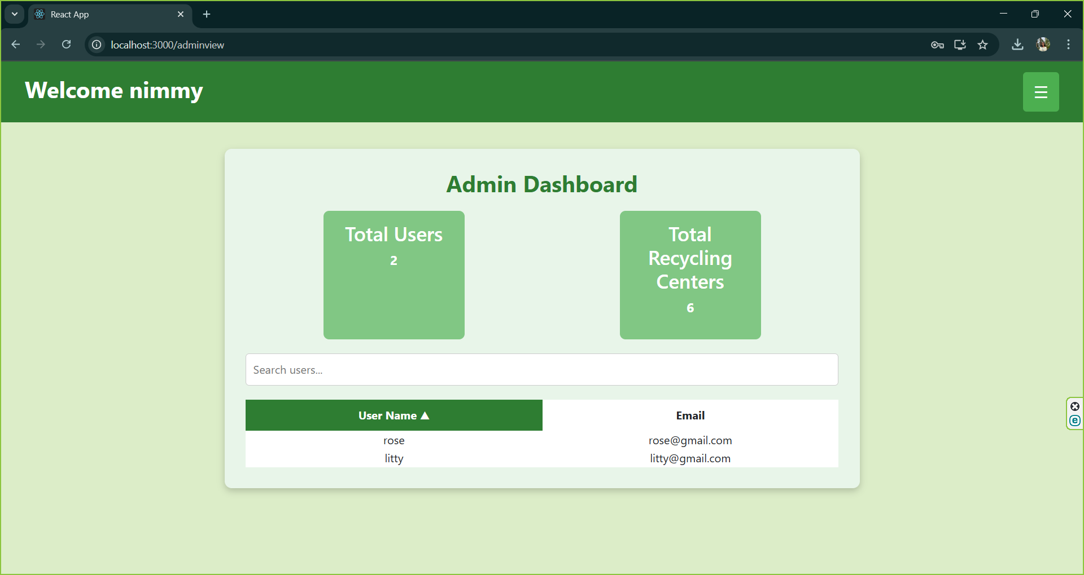
2.Admin Login and Admin View.

Slide 8
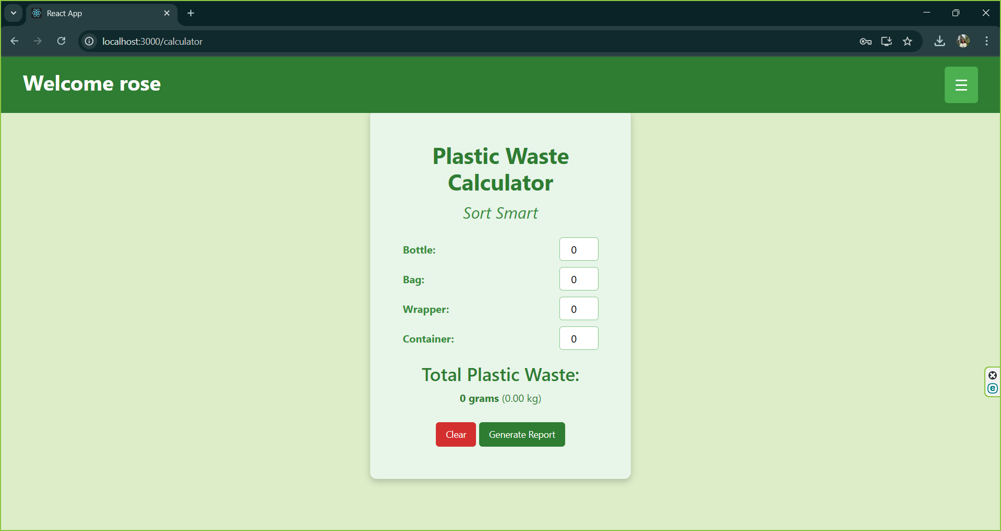
3. Plastic Waste Calculator:
- Users can input their plastic usage to calculate their plastic footprint in kilograms.
- Provides Report in PDF format.

Slide 9
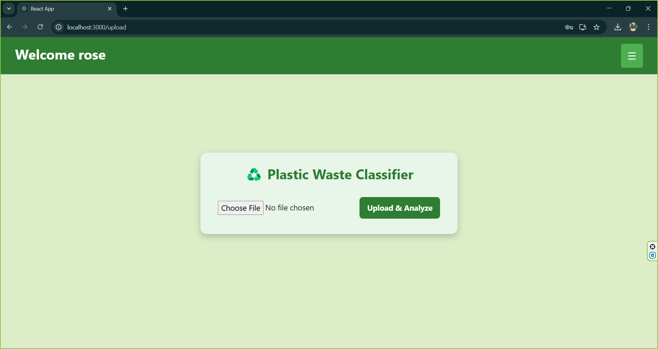
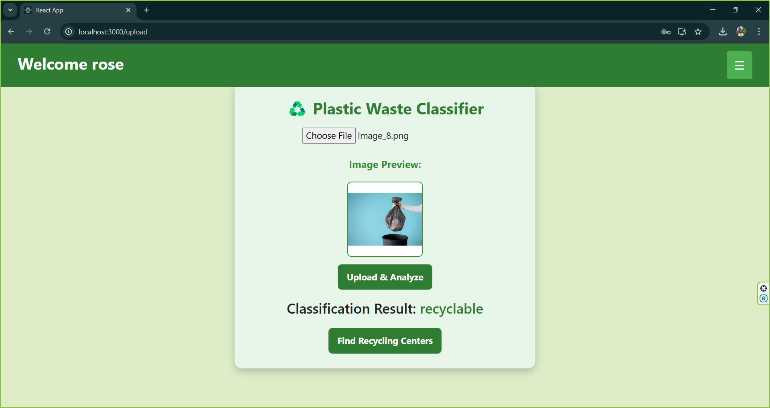
4. Recycling Guide:
- Predict whether the plastic waste is recyclable or not

Slide 10
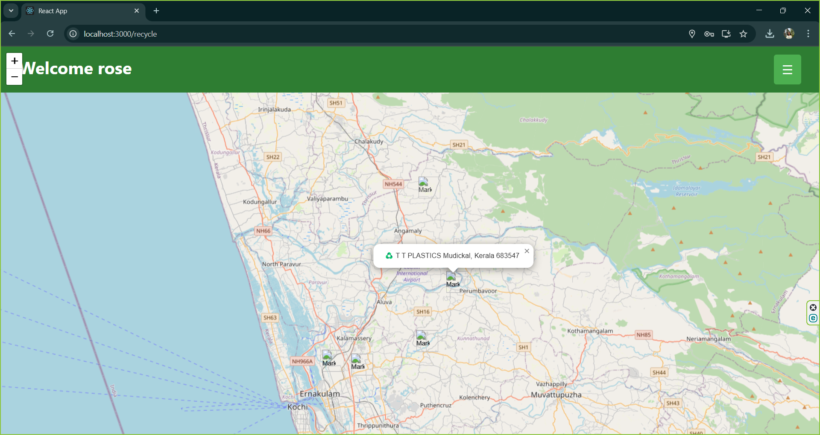
- Suggests nearby recycling centers based on location.

Slide 11
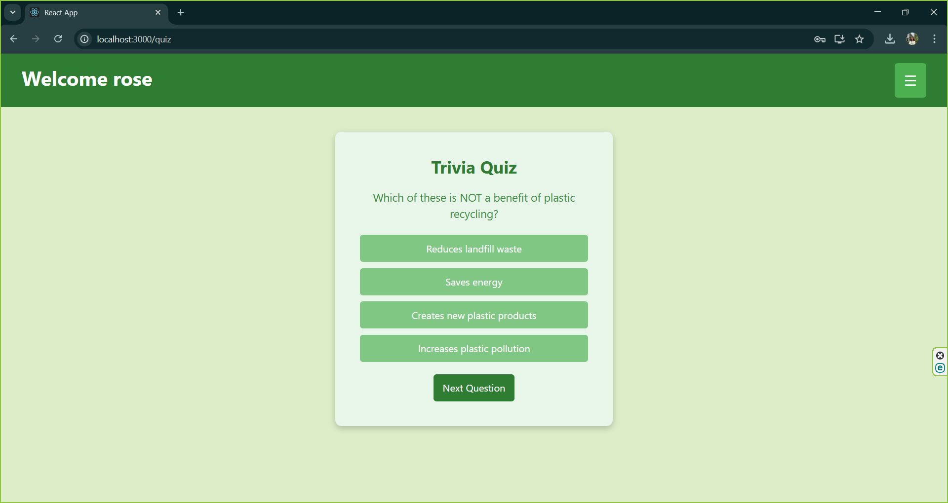
5. Community challenges:
- Gamification like Trivia Quiz Questions.

Slide 12
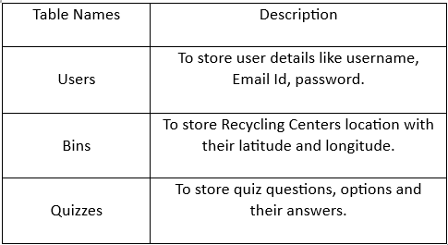
Database

Slide 13
Technologies Used
1. Frontend: React.js.
2. Backend: Node.js and Express.js for API development.
3. Database: MongoDB.
4. Machine Learning: TensorFlow.js or Python for plastic item recognition.
5. APIs: In the frontend Geolocation API is used and plot it on Leaflet Map for location-based services.

Slide 14
Conclusion
This project aims to create an impactful platform that raises awareness about plastic pollution, educates users about recycling, and motivates them to adopt sustainable habits through gamified challenges and community engagement. By bridging the gap between knowledge and action, this solution can contribute to reducing plastic waste and promoting a healthier environment for future generations.

Slide 15
THANK YOU

