Slide 1

VIVID
Submitted By: Nimmy Saju Project Guide: Sheena Jabar
Course: MCA S6
NO: 38

Slide 2
contents
Abstract
Modules
Technology hierarchy
System specification
Table Design
UML
Forms

Slide 3
ABSTRACT
VIVID app is a customized mobile application that can help you in various ways. The main language of programming will be android. Its main aim is simplifying and improve the selling process for the owner.
Minimize manual data entry and ensure data accurancy and security.
Customer will able to view product menus and their price, according to their interest. Admin can view the details of selling buying, stock, report generation.

Slide 4
Module description
Mobile application ( android & IOS application)
Web portal
Mobile application ( android & IOS application)
Stock details
Report Generation

Slide 5
Stock
Stock Section contain the stock details of the shop if a salesman search the stock details when the customer orders flower more than the stock. It displays the order is out of the stock to the salesman.
Report Generation
It will displayed the total amount of flowers including if their any decoration fee, and their will be a facility to make a printed Report.

Slide 6
Web Portal
Admin Login
Salesman registration
Flower Registration
Stock

Slide 7
Admin Login
The Admin can login with their user name and password. They can view flower details, Stock details and employee Details.
Flower Registration
Admin can add, delete, edit the flower details.
Salesman Registration
Admin can add, delete, edit the Salesman details.
Stock
Stock Section contain the stock details of the shop if a salesman search the stock details when the customer orders flower more than the stock. It displays the order is out of the stock to the salesman.

Slide 8
Technology hierarchy
MOBILE APPLICATION – HYBRID
Ionic 3
Angular JS version .1
HTML
WEBPORTAL – RESPONSIVE
HTML
CSS
JQuery
BACKEND
Wordpress
PHP
MySQL

Slide 9
Introduction to PHP
PHP is a server-side scripting language designed for web development but also used as a general-purpose programming language. PHP code is usually processed by a PHP interpreter, which is usually implemented as a web server's native module or a Common Gateway Interface (CGI) executable. After the PHP code is interpreted and executed, the web server sends resulting output to its client, usually in form of a part of the generated webpage; for example, PHP code can generate a web page's HTML code, an image, or some other data. PHP has also evolved to include a command-line interface (CLI) capability and can be used in standalone graphical applications.

Slide 10
My SQL
Structured Query Language (SQL), in computer science, a database sub language used in querying, updating and managing relational databases. MY SQL Server is a relational database management system for distributed Client-Server computing. Like all other database management systems, it provides the following features:
A variety of user interfaces
Physical data independence
Logical data independence
Query optimization
Data integrity
Concurrency control
Backup and recovery
Security and authorization

Slide 11
Android
Android is a mobile operating system developed by Google, based on the Linux kernel and designed primarily for touch screen mobile devices such as smart phones and tablets. Android's user interface is mainly based on direct manipulation, using touch gestures that loosely correspond to real-world actions, such as swiping, tapping and pinching, to manipulate on-screen objects, along with a virtual keyboard for text input.

Slide 12
NETBEANS
Netbeans is an integrated development environment (IDE) for developing primarily with Java, but also with other languages, in particular PHP, C/C++, and HTML5.It is also an application platform framework for Java desktop applications and others. The NetBeans IDE is written in Java and can run on Windows, OS X, Linux, Solaris and other platforms supporting a compatible JVM. The Net Beans Platform allows applications to be developed from a set of modular software components called modules
Among the features of the platform are:
User interface management (e.g. menus and toolbars)
User settings management
Storage management (saving and loading any kind of data)
Window management

Slide 13
IONIC FRAMEWORK
Ionic is a powerful HTML5 SDK that helps you build native-feeling mobile apps using web technologies like HTML, CSS, and JavaScript.Ionic is focused mainly on the look and feel, and UI interaction of your app. That means we aren't a replacement for PhoneGap or your favourite JavaScript framework. Instead, Ionic simply fits in well with these projects in order to simplify one big part of your app: the front end. We recommend reading, Where does the Ionic Framework fit in? to get a good understanding of Ionic's goals.

Slide 14
System specification
Hardware specification
Processors : Intel Premium Pro or Processor running at 133 MHz
Hard Disk : 1.2 GB Hard Disk
RAM : Client Level – Minimum 128MB
Recommended Requirements for peak performance
RAM : Client Level – Minimum 512MB
Display Type : SVGA Colour Enhanced Monitor
Mouse : PS/2 2 Button

Slide 15
Software specification
Front End Tool : HTML, JavaScript, CSS, Android, Ionic
Back End Tool : PHP, MySQL
Development tools : Net Beans
Operating System : Windows XP 7 Professionals and Higher
Browse : Google Chrome. Mozilla Firefox

Slide 16
Table design
Tbl_commentmeta
FIELD | KEY | TYPE
Comment - id | PK | bigint(10)
Comment-post-id | FK | bigint((20)
Meta-key | no | bigint(20)
Meta-value | no | Varchar(255)

Slide 17
Tbl_flower
FEILD | KEY | TYPE
flower_id | PK | int
flower_name | NO | Varchar(50)
flower_color | NO | Varchar(50)

Slide 18
Tbl_users
FIELD | KEY | TYPE
id | PK | bigint(20)
user_login | No | Varchar(60)
user_pass | NO | Varchar(255)
User_email | NO | Varchar(100)
User_url | NO | Varchar(100)
User_status | NO | Int(111)

Slide 19
Tbl_order
FEILD | KEY | TYPE
order_id | PK | Int
order_quantity | No | Int
price_id | FK | Int
flower_id | FK | Int
order_discount | No | Int
order_total | No | int

Slide 20
Tbl_comments
FIELD | KEY | TYPE
Comment-id | PK | Bigint(20)
comment_post-id | FK | Bigint(20)
Comment-author | No | Varchar(20)
Comment-author-email | No | Varchar(100)
Comment-author-url | No | Varchar(200)
Comment-author-ip | NO | Varchar(100)
Comment-date | NO | Date time
Comment-content | NO | Varchar(250)
Comment-approved | NO | Varchar(20)

Slide 21
Tbl_links
FIELD | KEY | TYPE
link-id | PK | bigint(10)
link-url | No | Varchar(100)
link-name | No | Text
link-image | No | Text
link-target | NO | bigint(10)
Link-description | NO | Varchar(255)
Link-visible | NO | Varchar(20)
Link-owner | NO | Bigint(20)
Link-rating | NO | Int(11)
Link-updated | NO | Datetime
Link-rel | NO | Varchar(255)
Link-notes | NO | Varchar(255)
Link-rss | No | Varchar(255)

Slide 22
Tbl_option
FIELD | KEY | TYPE
option_id | PK | bigint(20)
Option_name | No | varchar(191)
Option_value | No | Varchar(255)
autoload | No | Varchar(20)

Slide 23
Tbl_postmeta
FEILD | KEY | TYPE
Meta_id | PK | bigint(10)
Post_id | FK | bigint(20)
Meta_key | No | Varchar(255)
Meta_value | No | Varchar(250)

Slide 24
Tbl_temmeta
FEILD | KEY | TYPE
meta_id | PK | bigint(10)
Term_id | No | Bigint(20)
Meta_key | No | Varchar(255)
Meta_ value | No | varchar(100)

Slide 25
Tbl_posts
FIELD | KEY | TYPE
post_id | PK | bigint(20)
post_author | NO | varchar(220)
post_date_gmt | No | Datetime
post_content | No | datetime
post_title | No | varchar(250)
post_excerpt | No | varchar(250)
post_status | No | varchar(20)
post_password | No | varchar(20)
Post_name | NO | Varchar(250)
post_modified | NO | Varchar(200)
Post_parent | NO | datetime
Post_type | NO | Varchar(10)

Slide 26
Tbl_term
FEILD | KEY | TYPE
Term_id | PK | bigint(20)
field_id | FK | bigint10)
term_taxonamy | NO | bigint(20)
term_order | No | Int (11)

Slide 27
Tbl_term_taxonamy
FEILD | KEY | TYPE
term_taxonamy_id | PK | bigint(20)
term_id | FK | bigint(20)
taxonamy | No | varchar(30)
description | NO | Varchar(20)
parent | NO | bigint(20)
count | NO | bigint(20)

Slide 28
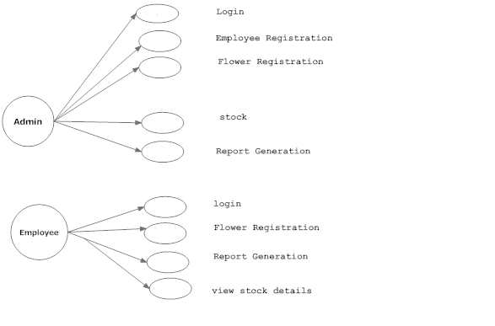
UML

Slide 29
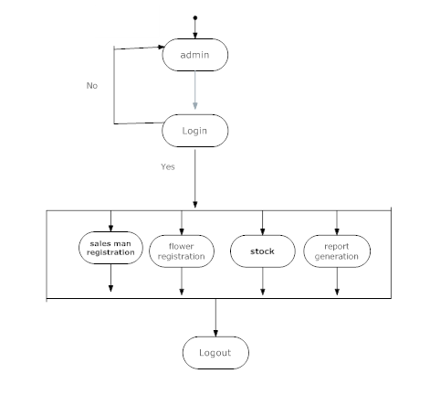
Activity diagram
ADMIN-SIDE

Slide 30
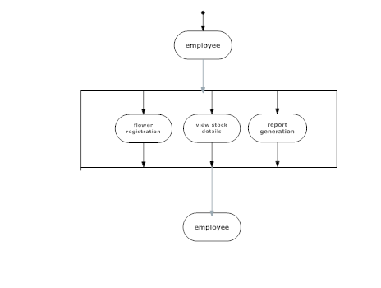
EMPLOYEE SIDE

Slide 31
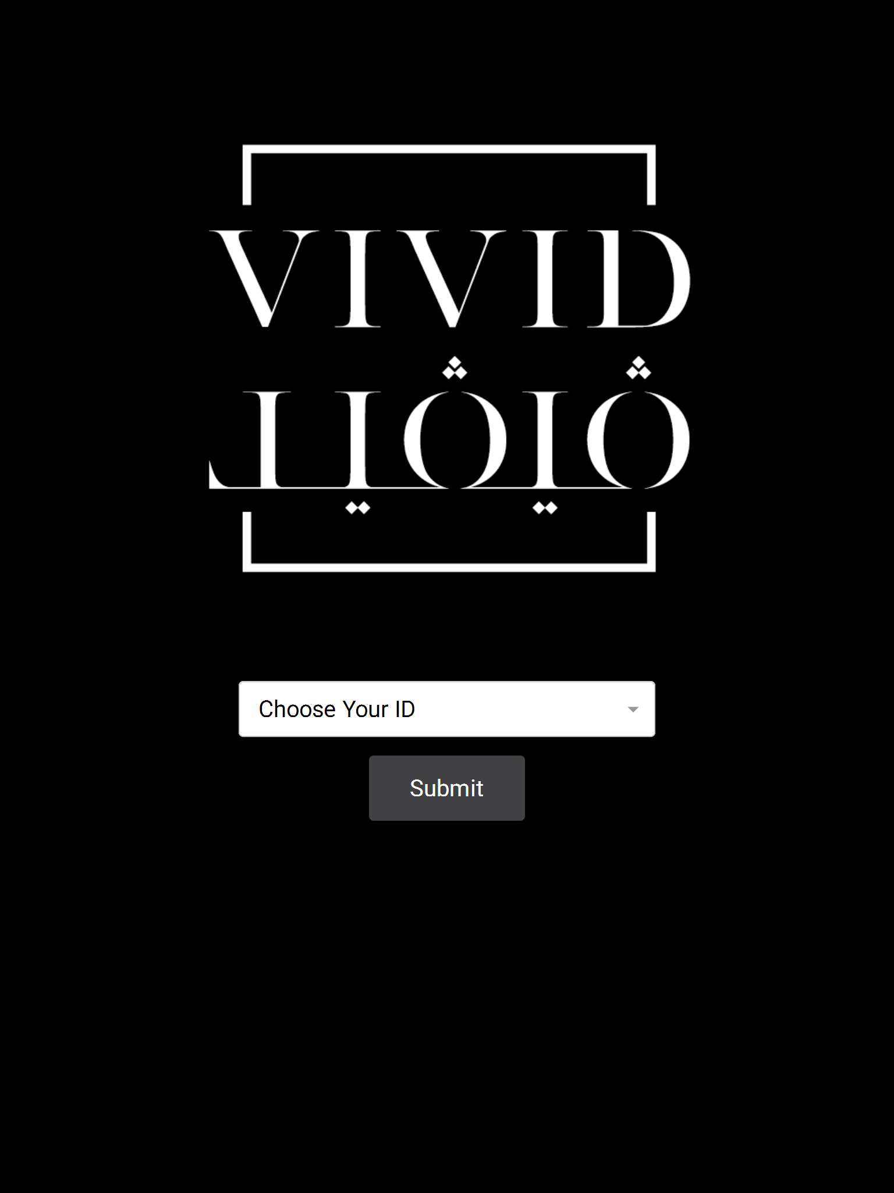
Forms

Slide 32
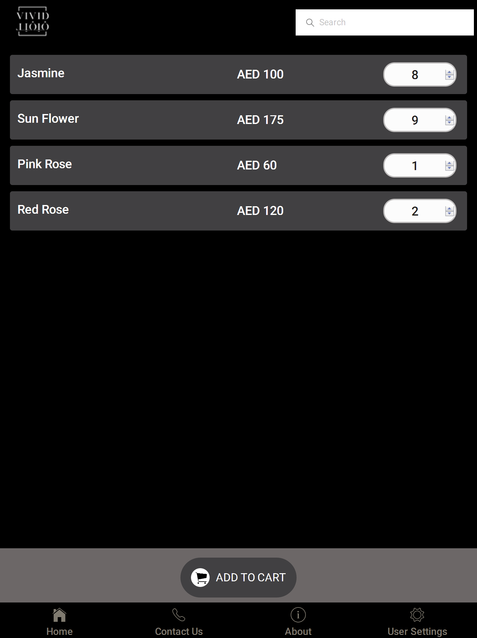

Slide 33
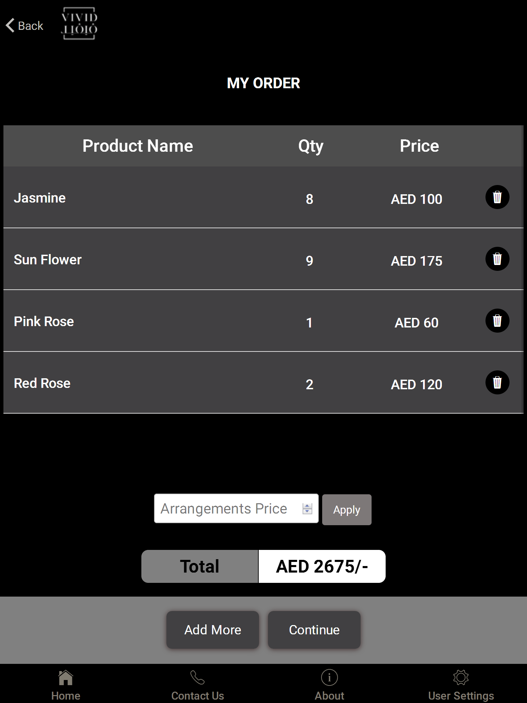

Slide 34
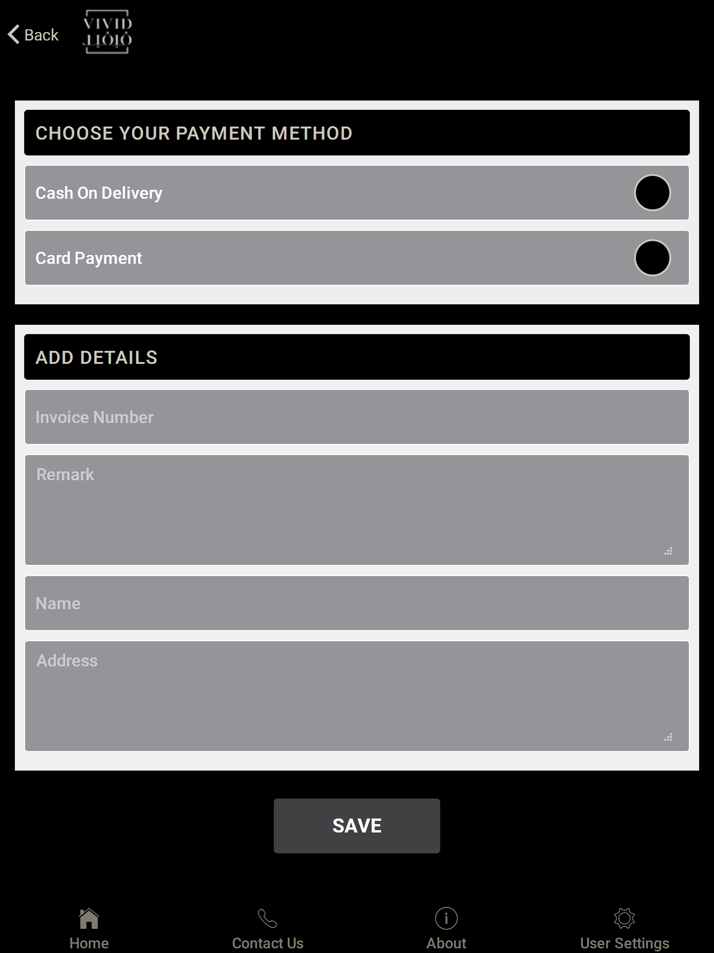

Slide 35
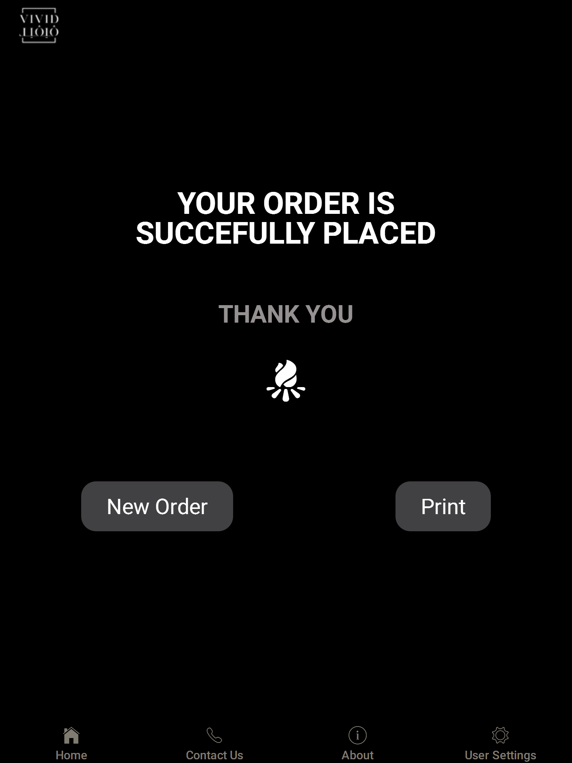

Slide 36
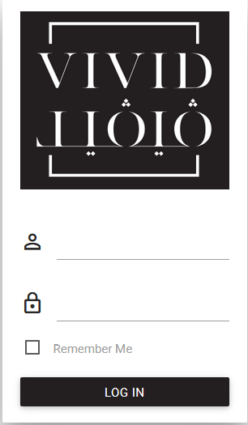

Slide 37
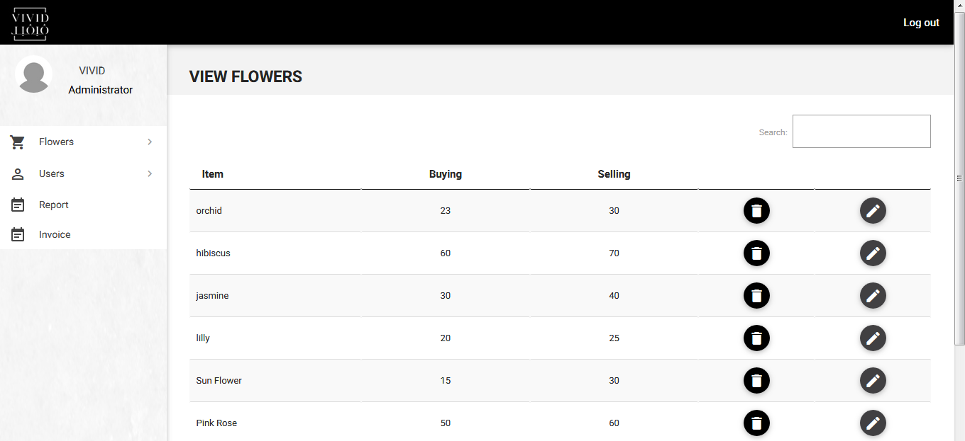

Slide 38
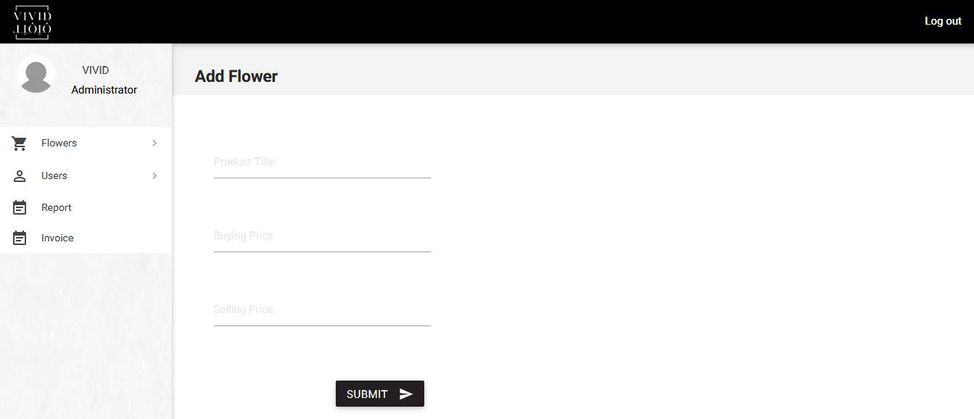

Slide 39
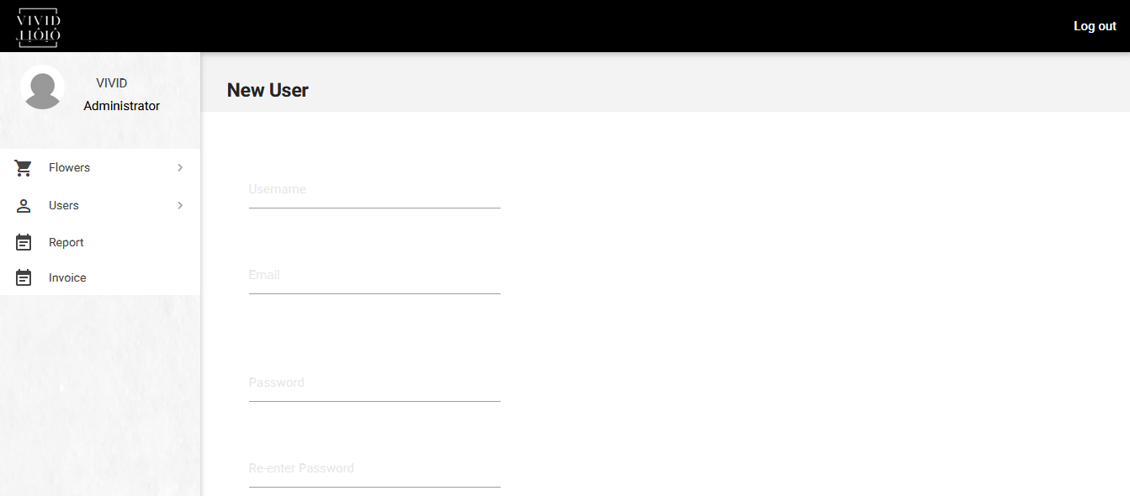

Slide 40
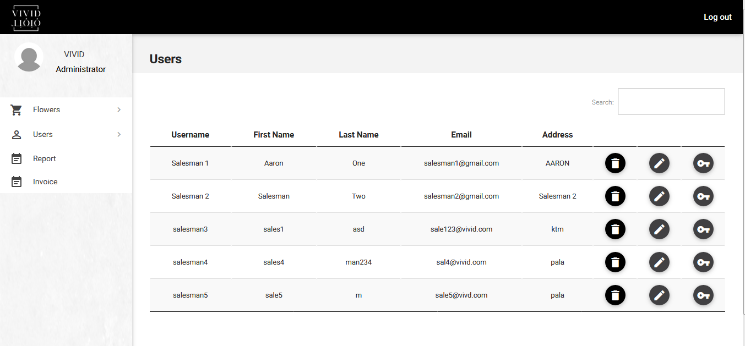

Slide 41
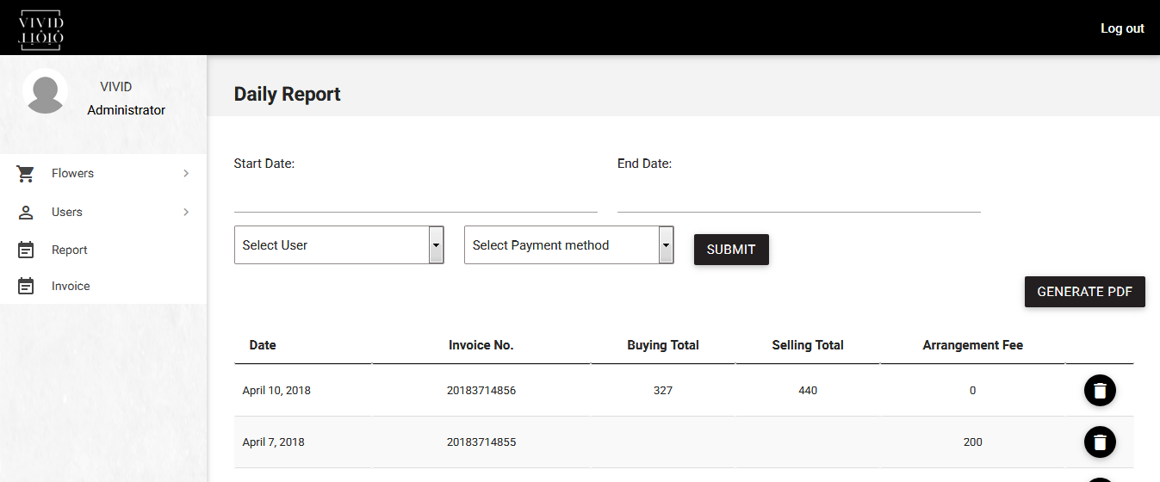

Slide 42


