Slide 1


SIBA
SENTIVIEW:
TRANSFORMING STUDENT FEEDBACK INTO INSIGHTFUL VISUAL NARRATIVES WHILE PRESERVING SENTIMENTS
01

Slide 2
SIBAU
Meet Our Team
Authors
Supervisor
Nimra
Dr. Sher Muhammad Doudpota
Lareb
Zahira Parveen
02

Slide 3

SIBAU
Agenda
Introduction
Problem statement
Methodology
Outcomes
Timeline
03

Slide 4
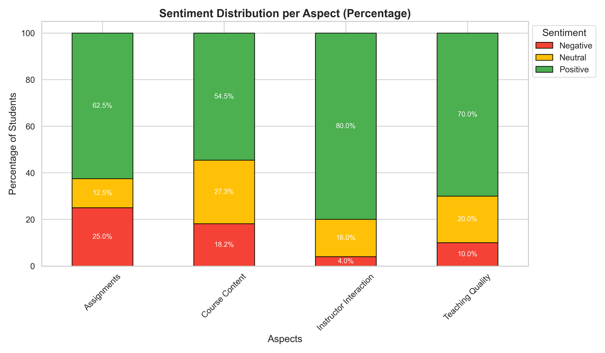
SIBAU
Introduction
Why Sentiview
Student feedback is key to evaluating faculty performance.
Traditional methods for feedback analysis are time-consuming and prone to bias (Gupta et al., 2019).
Existing methods miss specific aspects like teaching methods or knowledge (Hajrizi & Nuçi, 2020).
Direct sharing of harsh or aggressive comments with teachers can be discouraging that may hinder constructive reflection (Hill, 2024)
04

Slide 5
SIBAU
Introduction...
Why Sentiview
Need of interactive system that can
extract useful insights from the student feedback
leverage LLMs and NLP techniques for extracting the crucial aspects and their sentiments
paraphrasing harsh feedback while preserving its meaning that that promotes growth by constructive reflection
05

Slide 6
SIBAU
Problem Statement
Vast student feedback data exists, but institutions lack efficient tools to process it.
Manual analysis misses specific aspects like teaching quality, clarity, and engagement.
Harsh feedback shared directly can be discouraging.
Solution Needed
Automated system using LLMs for aspect-based analysis.
Intuitive GUI to present actionable, visualized insights.
06

Slide 7
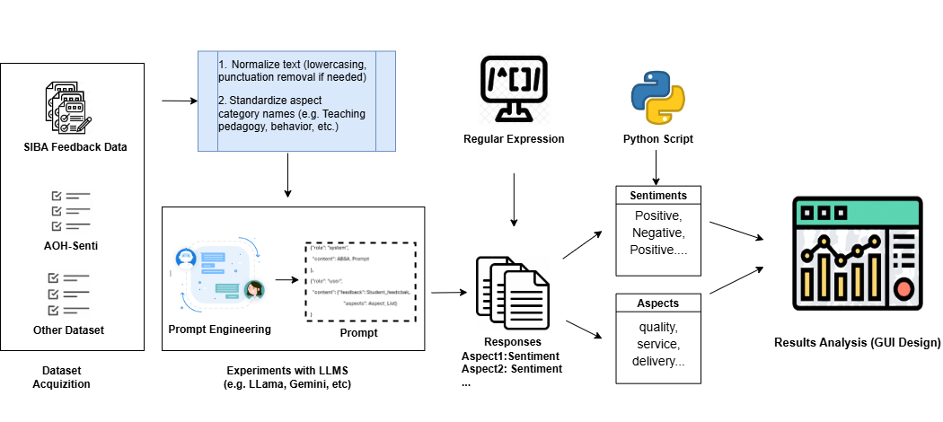
SIBAU
Methodology
07

Slide 8
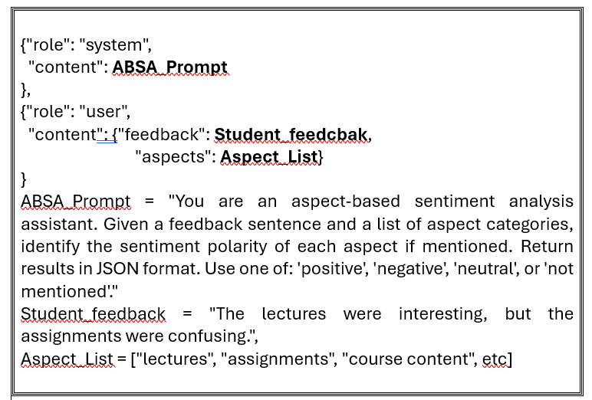
SIBAU
Methodology
08

Slide 9
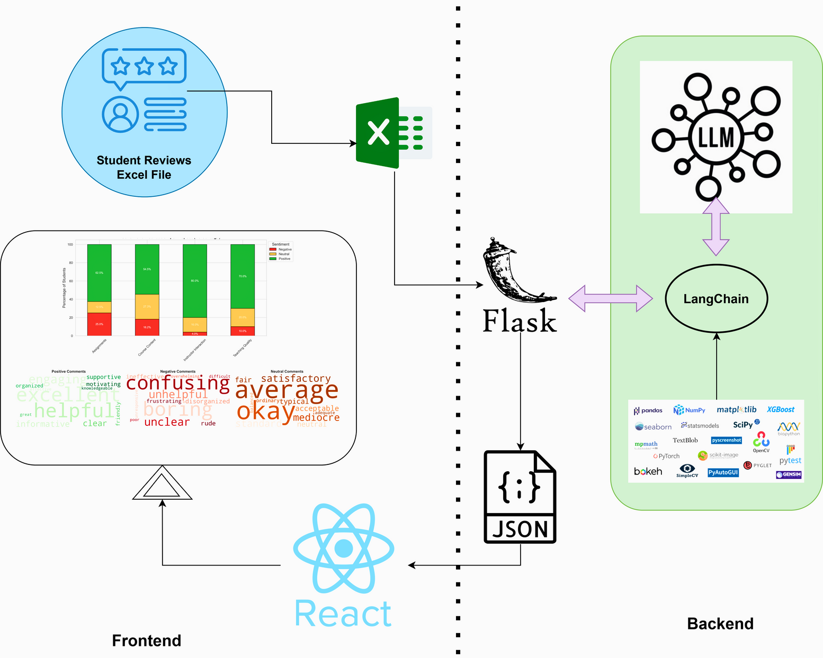
SIBAU
Methodology
09

Slide 10
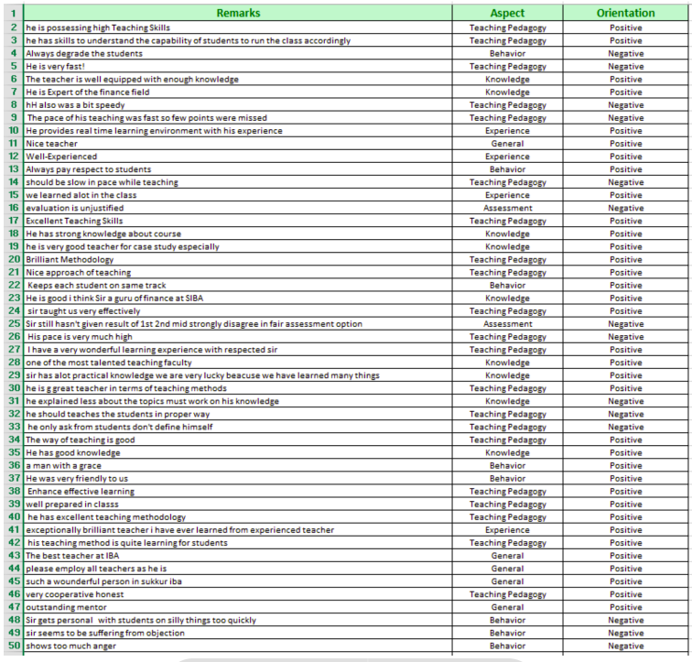
SIBAU
Dataset Overview
by (Sindhu et al., 2019)
Stats:
01
2,180 student reviews.
5,015 sentences.
6 aspects: Teaching Pedagogy, Knowledge, Experience, Assessment, Behavior, General.
3 sentiment categories: Positive, Negative, Neutral.
02
Purpose:
Comprehensive insight into faculty performance.
10

Slide 11
SIBAU
Major Outcomes
Aspect-level sentiment analyzer system
Qualitative feedback analysis, overcoming manual challenges
An interactive website for one-click exploration of teacher reviews by subject.
Improved faculty assessment with detailed, actionable insights.
7. Improved Faculty Assessment
11

Slide 12


SIBAU
PROJECT TIMELINE
ABSA model generation
Frontend
Development
Report Generation
Phase 2
Phase 4
Phase 6
Week1
Week2
Week3
Week 3-4
Week 4-5
Week 5-6
Phase 1
Phase 3
Phase 5
Planning& Setup, Data Preparation
Testing and optimization
Backend
Development
12

Slide 13
SIBAU
Thank You
13

