Slide 1
KMP ALGORITHM
Presented by:
Nimra Maqbool (BSCE21012)
Fatima Ehsan (BSCE21016)

Slide 2
Table of contents
Disadvantages of basic pattern searching algorithm
What is KMP algorithm?
Concept of Longest Prefix Suffix (LPS)
Code implementation
Time and space complexity

Slide 3
Disadvantages of basic searching algorithm
String:
0 1 2 3 4 5 6 7 8 9 10 11
a | b | c | d | a | b | c | a | b | c | d | f
i
i
i
i
i
i
i
i
i
i
i
i
a | b | c | d | f
Pattern:
0 1 2 3 4
Time complexity:
O(m*n)
a | b | c | d | f
j
j
j
j
j

Slide 4
What is KMP algorithm? Concept of LPS (Longest Prefix Suffix)
0 1 2 3 4 5 6
x | x | x | x | x | x | x
lps[6] = 3
0 1 2
4 5 6
x | x | x
x | x | x
The first and last 3 indexes have the same elements.

Slide 5
KMP Algorithm
String:
1 | 2 | 3 | 4 | 5 | 6 | 7 | 8 | 9 | 10 | 11 | 12 | 13 | 14 | 15
a | b | a | b | c | a | b | c | a | b | a | b | a | b | d
i | i | i | i | i | i | i | i | i | i | i | i | i | i | i
i
Pattern:
j | j | j | j | j | j
0 | 1 | 2 | 3 | 4 | 5
a | b | a | b | d
0 | 0 | 1 | 2 | 0

Slide 6
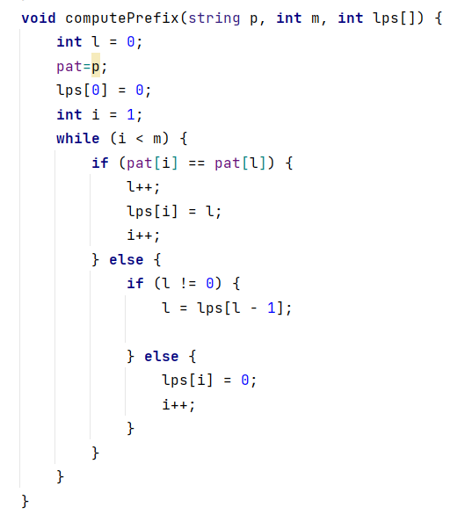
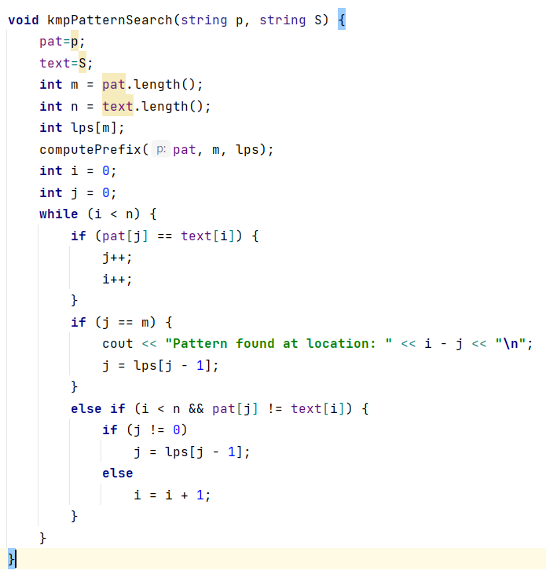
Code Implementation

Slide 7
Time Complexity
The time complexity of computePrefix method =O(m).
Space complexity is also O(m).
Time complexity of kmpPatternSearch() =O(n).
Space complexity is also O(n).
Total time average case complexity =O(m+n), as m is the size of the pattern and n is the size of the text.
Best case time complexity of kmp =O(m).
Space complexity =O(m).
Worst case time complexity =O(m*n).

Slide 8
THANK YOU!
Any questions?

