Slide 1
Toyo Toys
1rst semester Bootstrap website project under aptech supervision

Slide 2
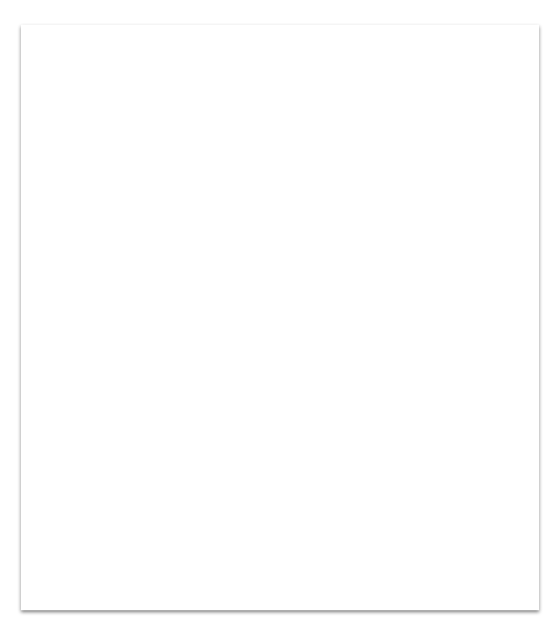
Languages &framework
HTML
CSS
BOOTSTRAP
Visual studio

Slide 3
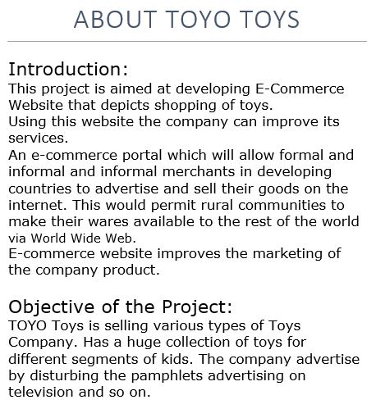
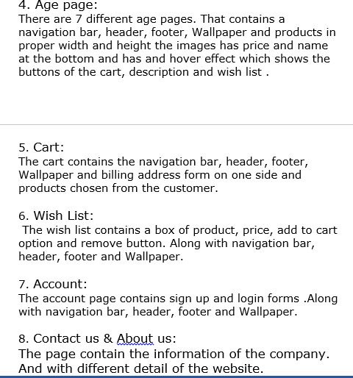

Slide 4
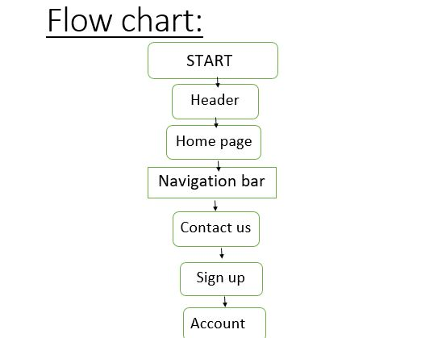

Slide 5
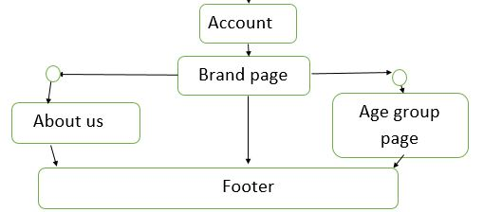

Slide 6

Be More Aware
1 home
2 age group pages
3 brand pages
4 comparison pages
5 login
6 wishlist
7 contactus

Slide 7
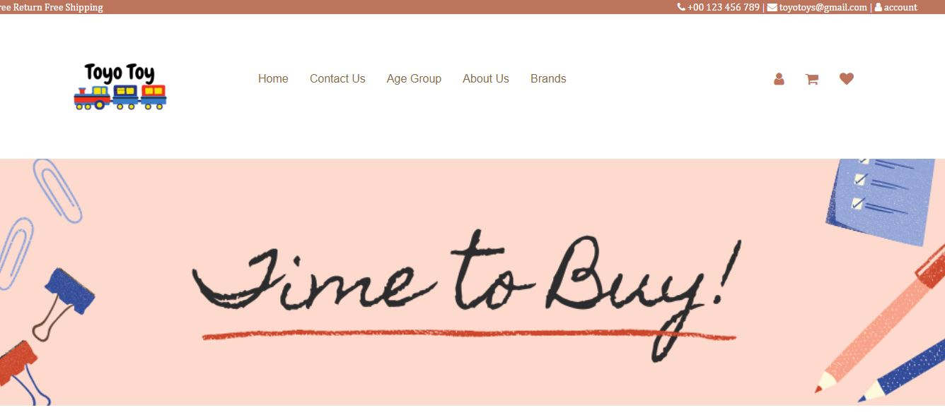

Slide 8


Slide 9
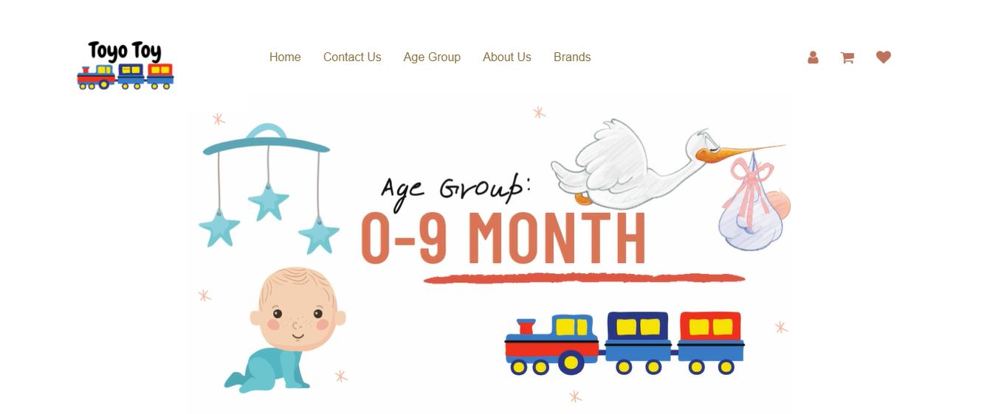

Slide 10
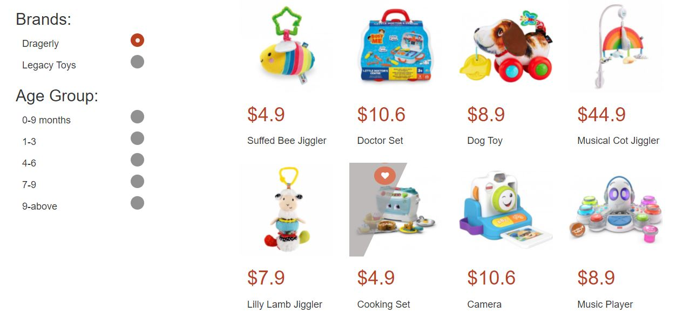

Slide 11
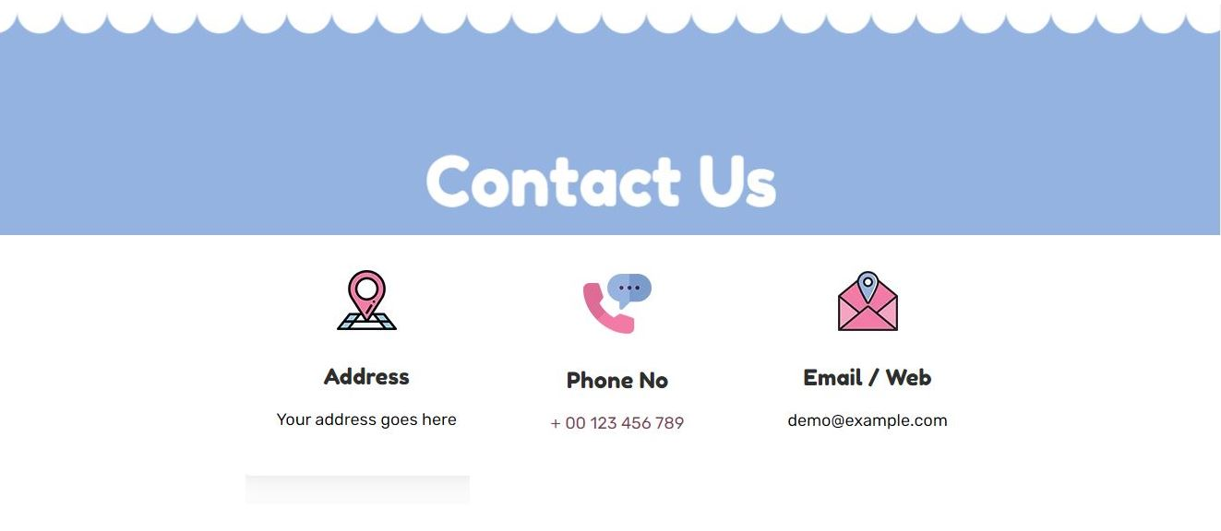

Slide 12
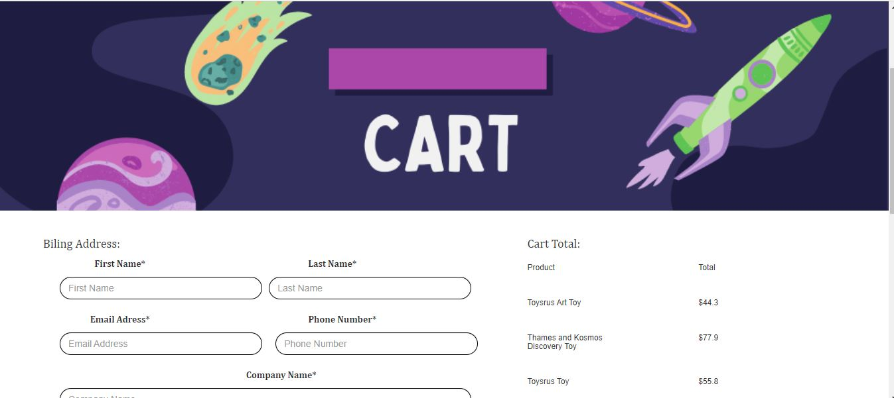

Slide 13


