Slide 1
ECO346 | ECONOMETRICS
Annual Earnings in KP Urban
Assignment 1 • Distribution, age patterns, and reproducibility
REGISTRATION NUMBER
VARIANT
SAMPLE
FA24-BED-061
5
678 earners
KP Urban
Age 15–64; annual earnings > 0
Weighted summaries use household weights; results describe association, not causation.
ECO346 Econometrics • Assignment 1 • Variant 5: KP Urban • FA24-BED-061
1

Slide 2
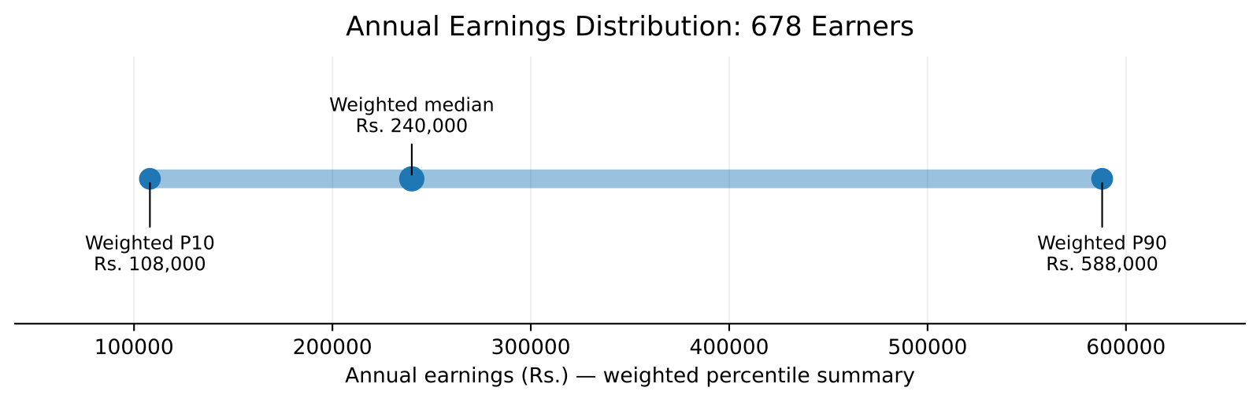
Q2 • Annual Earnings Distribution
KP Urban earners aged 15–64 with positive annual earnings
UNWEIGHTED MEDIAN
Rs. 240,000
WEIGHTED MEDIAN
Rs. 240,000
P90 / P10 RATIO
5.44
588,000 ÷ 108,000
Weighted P10 = Rs. 108,000 • Weighted P90 = Rs. 588,000 • 1 observation outside the plotting range (Rs. 5,000) excluded.
Interpretation: the 90th-percentile earner has about 5.44 times the annual earnings of the 10th-percentile earner.
ECO346 Econometrics • Assignment 1 • Variant 5: KP Urban • FA24-BED-061
2

Slide 3
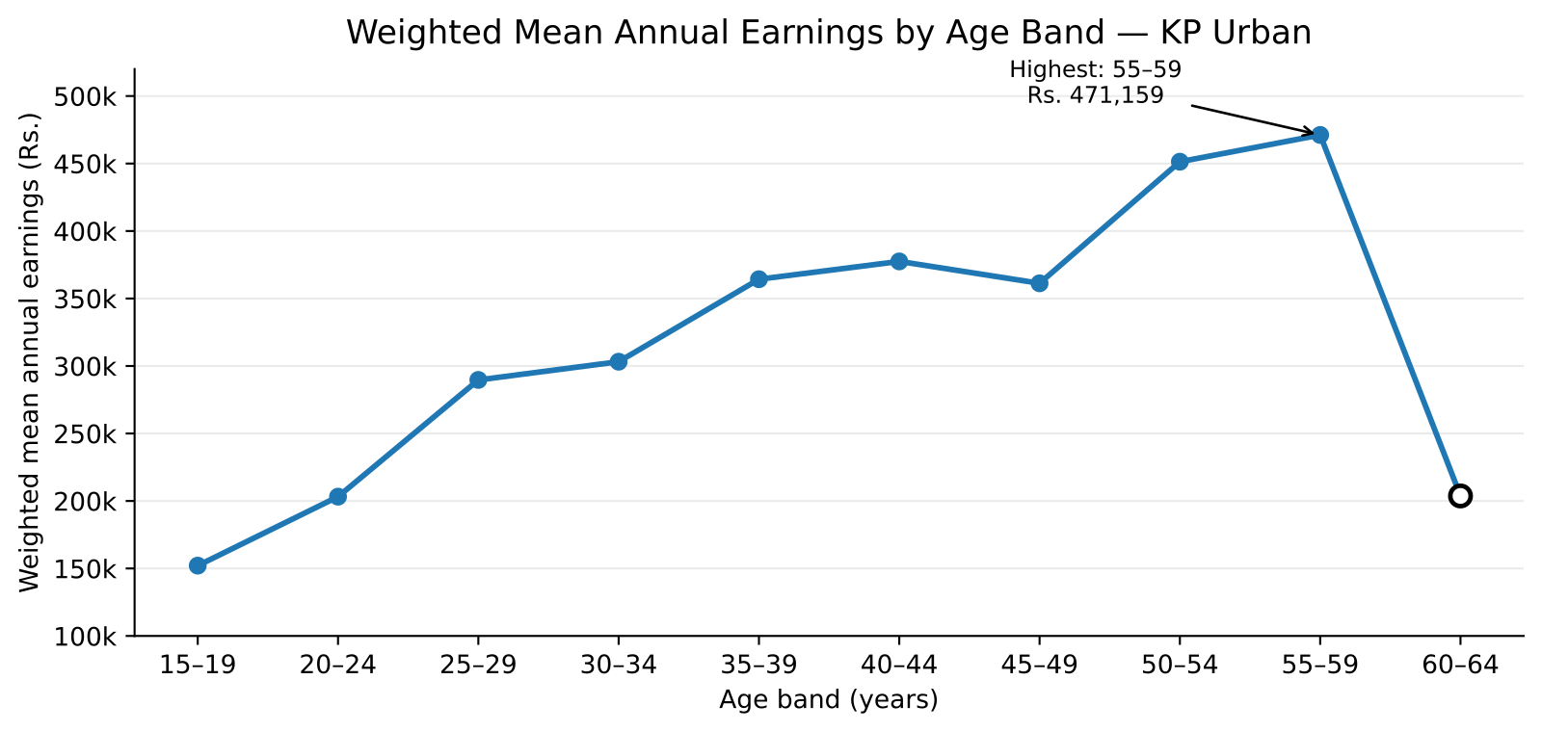
Q3 • Earnings Across Age Bands
Weighted mean annual earnings; hollow markers denote thin bands (fewer than 30 earners)
AGE 25–29
Rs. 289,679
AGE 45–49
Rs. 361,264
HIGHEST MEAN: 55–59
Rs. 471,159
The 60–64 mean drops to Rs. 203,724, but this band has only 15 earners.
ECO346 Econometrics • Assignment 1 • Variant 5: KP Urban • FA24-BED-061
3

Slide 4
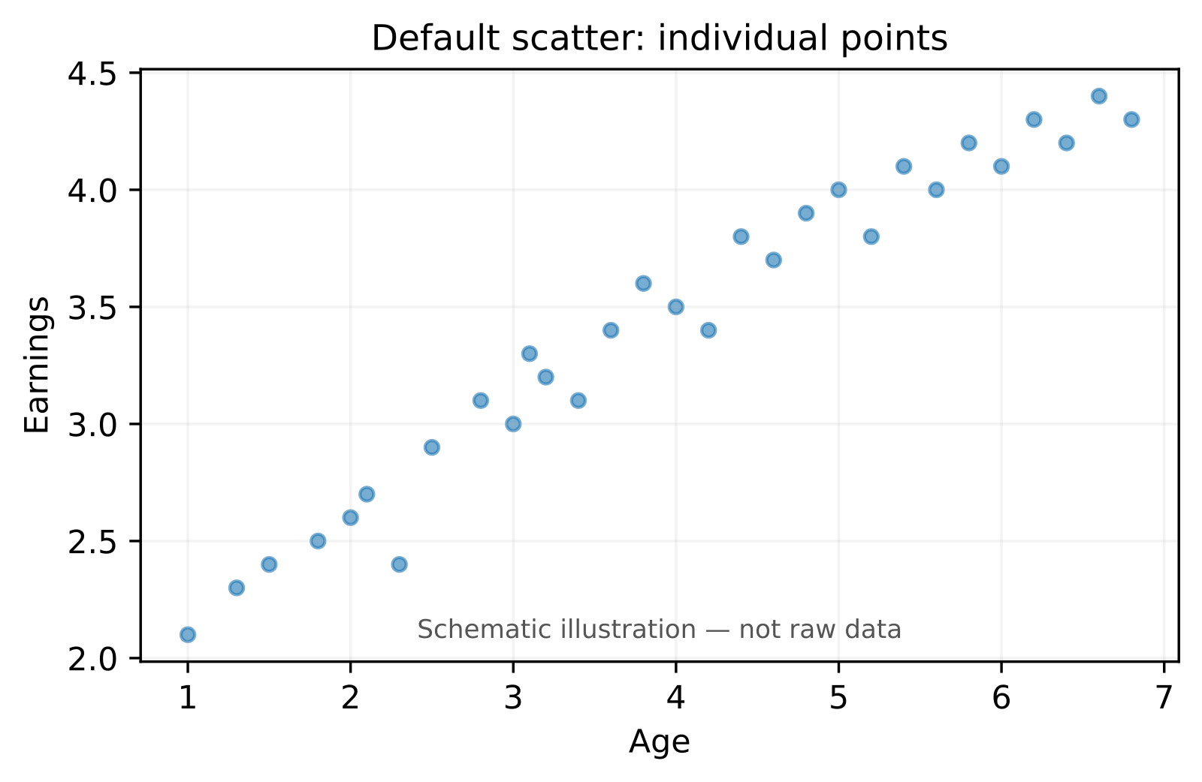
Q4–Q5 • From Default Plot to Clearer Evidence
Design choices improve readability; Python independently verifies the age-band summary
DEFAULT VIEW (SCHEMATIC)
REDESIGNED VIEW
Default: individual points can overlap; the overall pattern is harder to see.
Redesign: log scale, transparency, weighted means, connected age-band markers, and hollow markers for thin bands.
Python check: age 25–29 weighted mean = Rs. 289,679, matching R; all 10 age-band means match after applying the same sample rules.
ECO346 Econometrics • Assignment 1 • Variant 5: KP Urban • FA24-BED-061
4

