Slide 1
object-oriented- programming in c++
By Nimra Fatima

Slide 2
defining a class
In OOP C++

Slide 3
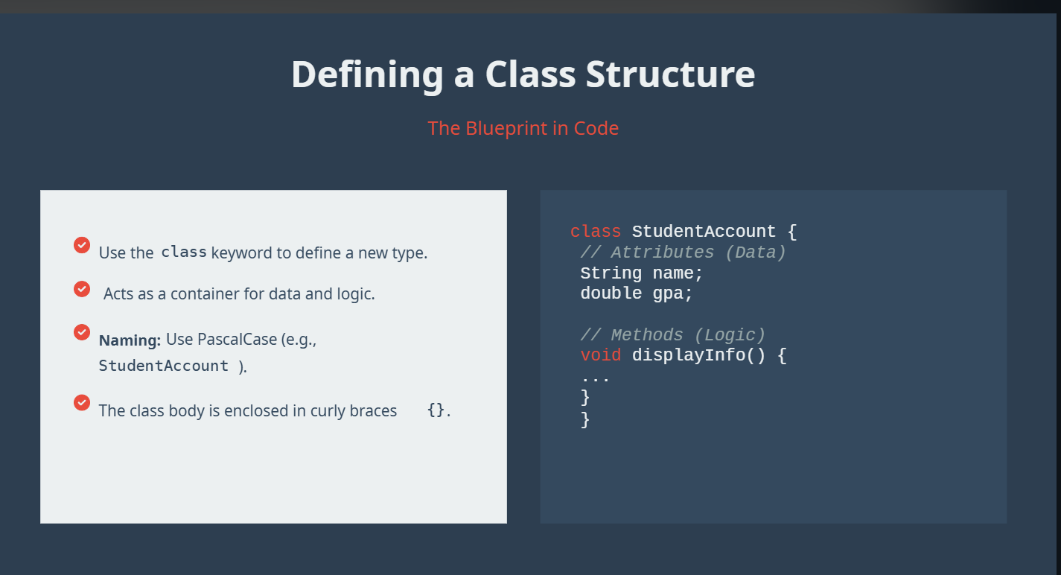

Slide 4
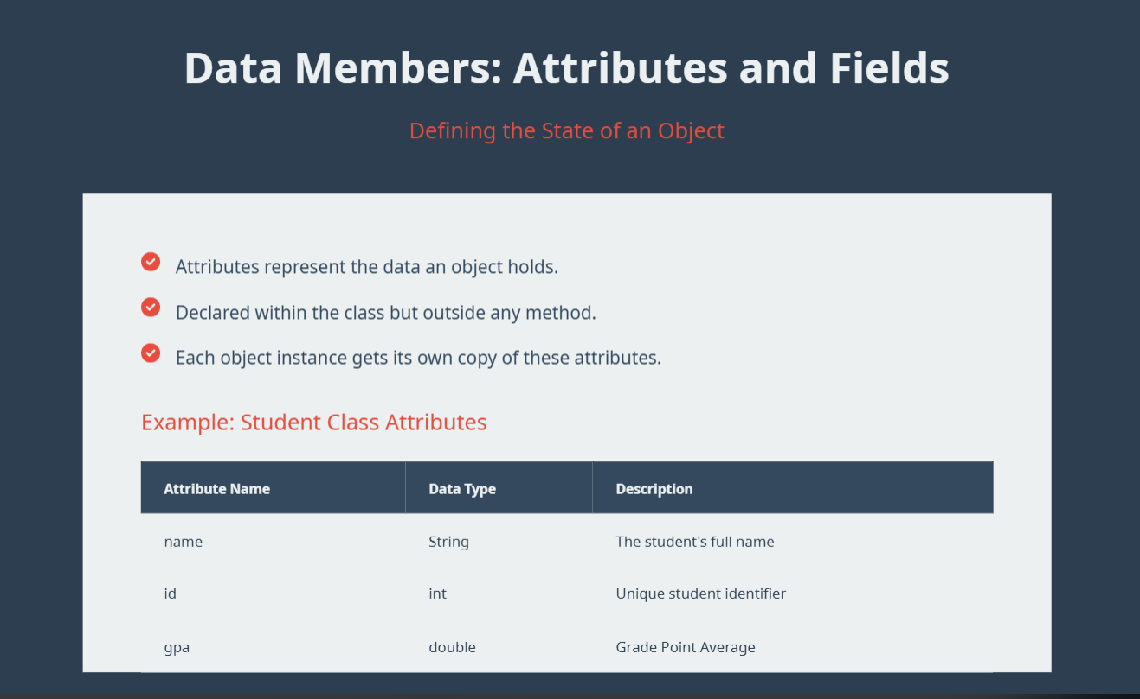
Notes:
GPA should have either float or double as a data type not int as gpa is written in points and int truncate the values after decimal point, results in data loss

Slide 5
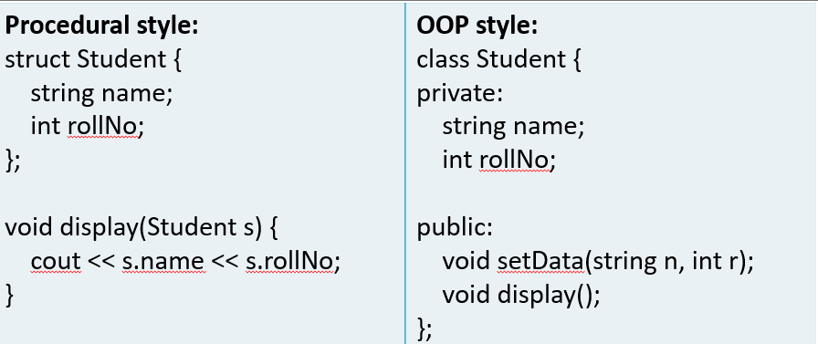
Why we need classes?
Problems with Procedural Programming:
  • Data and functions are separate
  • No data protection
  • Difficult to manage large systems
  Example (Structure Based Code)
  struct Student { string name; int rollNo; };

Slide 6
What Is a Class?
Blue print for creating objects
A class is the logical template or a “map” that defines how object will look like or how it behaves
It is abstract and only exist in code
Defines methods(functions declared inside the class) and attributes(data)
Objects are instances(real thing made from the class , a blueprint) of class
Class is memoryless , no memory assigned to it until object is created.
Notes:
Compiler /run-time system allocates memory at the time of object creation on the basis of the class definition(data members)

Slide 7
Defining a class
A class is called a user-defined data type because it allows the programmer to create a new data type that groups data members and functions together.
class = blueprint to create a new type of data.

Slide 8
Syntax of class
Syntax:
Class Teacher{
private:
String name;
Public:
Void setdata( string n){
Name = n;
}
Void display(){
Cout << name << endl;
}
} ;

Slide 9
Critical thinking question
If built-in data types have fixed memory sizes, how does the compiler determine the memory size of objects created from a user-defined data type (class)?
The compiler determines the memory size of a class object by adding the sizes of all the data members defined inside the class.
Key Point
Memory is not assigned to the class itself, but to the objects created from that class, based on the combined size of its data members.

Slide 10
Example, Class as user-defined data type
class Student {
public:
int rollNo;
float marks;
};
The compiler calculates the size like this:
int rollNo → 4 bytes
float marks → 4 bytes
Total size of Student object = 4 + 4 = 8 bytes
When an object is created:
Student s1; the compiler allocates 8 bytes of memory for s1.

Slide 11
does constructor actually assigns memory
No, a constructor does NOT assign memory.
🔹 What actually happens?
👉 Memory allocation happens before the constructor is called.
👉 The constructor’s job is to initialize that already allocated memory.
🔹 Step-by-step process (very important for exams)
When you create an object like:
Student s1;
Memory is allocated (by compiler/runtime)
Constructor is called
Constructor assigns values / initializes variables
Simple analogy
Think of it like this:
🏠 Memory allocation = building a house
🎨 Constructor = decorating & arranging inside the house
👉 Constructor doesn’t build the house, it just sets things inside it
Who allocates memory?
→ Compiler / runtime system
When?
→ At object creation
Then why constructor?
→ To make object usable by giving it initial state
Notes:
“No, memory is allocated before constructor execution. Constructor is used to initialize the allocated memory.”
Memory is allocated at object creation on the basis of the size of data members defined in the class. Constructors do not allocate memory; they only initialize it.

Slide 12
Memory of member function
🔹 Important point (VERY EXAM IMPORTANT)
👉 Member functions (including constructor) do NOT take memory per object
Only data members take memory
Easy Breakdown of Class Memory in C++
Think of a class as a blueprint.
class Student {
int rollNo;
float marks;
public:
void display() {}
};
Now suppose we create objects:
Student s1;
Student s2;
STEP 1 — What Happens to Data Members?
Data members are the variables inside the class.
int rollNo;
float marks;
Each object gets its own separate copy.

Slide 13
…
Memory View
Object s1
Total ≈ 8 bytes
Object s2
Total ≈ 8 bytes
Important Idea
Each object stores its own data.
So:
s1.rollNo = 1;
s2.rollNo = 2;
Both values must be stored separately.
Variable for object 1 | Memory
rollNo | 4 bytes
marks | 4 bytes
Variable for object 2 | Memory
rollNo | 4 bytes
marks | 4 bytes

Slide 14
…
STEP 2 — What Happens to Member Functions?
Function:
void display() {}
is NOT copied into every object.
Only one copy of the function exists in program memory.
All objects share it.
Memory Concept
Data Members → inside object
Member Functions → outside object
(stored once in code/text segment)
Visual Representation
OBJECT s1
-------------
rollNo
marks
-------------
OBJECT s2
-------------
rollNo
marks
-------------
Functions are stored separately:
Program Code Area
------------------
display()
------------------
Both s1 and s2 use the same function.

Slide 15
…
Real-Life Analogy
Imagine:
Objects = Students
Function = Teacher
Every student has:
their own notebook
their own marks
But one teacher teaches all students.
The teacher is not copied for every student.
Similarly:
Data members are separate for every object
Member functions are shared
Important Formula
Object Memory =
Memory of Data Members
Padding (sometimes)
NOT member functions.

Slide 16
…
Example
class Test {
int a; // 4 bytes
char b; // 1 byte
public:
void show() {}
};
Expected Memory
a = 4 bytes
b = 1 byte
You may think:
Total = 5 bytes
But compiler may add padding.
So actual size may become:
sizeof(Test) = 8
Why Function Doesn't Increase Size?
Because if function memory were copied for every object:
Test t1, t2, t3, t4, t5;
then the same code would be copied again and again.
That would waste memory.
So C++ stores only one shared copy

Slide 17
…
CLASS
+------------------+
| Data Members |
| Member Functions |
+------------------+
↓
OBJECT CREATED
+------------------+
| Data Members | ← stored
+------------------+
Functions are NOT stored here.
Special Case: Virtual Functions
If class has virtual functions:
class A {
public:
virtual void show() {}
};
then object contains a hidden pointer:
vptr
So object size increases.
But still:
function code is shared
only pointer is added

Slide 18
…
Final Concept
Toppers Exam Statement
Data members occupy memory separately for each object, while member functions are stored only once in program memory and shared by all objects of the class.
Thing | Stored in Object? | Separate Copy for Every Object?
Data Members | Yes | Yes
Member Functions | No | No
Static Members | No | No
Virtual Function Pointer (vptr) | Yes | Yes

Slide 19
padding
Extra unused bytes added by the compiler inside an object to make memory access faster and more efficient.
Why Padding is Needed?
Computer memory works faster when data is stored at certain addresses called aligned addresses.
For example:
So compiler may insert empty bytes between variables.
Data Type | Preferred Alignment
char | 1 byte boundary
int | 4 byte boundary
double | 8 byte boundary

Slide 20
…
Easy Example
class Test {
char a; // 1 byte
int b; // 4 bytes
};
You may think:
1 + 4 = 5 bytes
But actual size is usually:
sizeof(Test) = 8
Why 8 Bytes?
Because compiler adds padding.
Memory Breakdown
Without Padding (slow access)
Address
1000 → a (1 byte)
1001 → b starts
Problem:
int prefers to start at address multiple of 4.
But 1001 is not multiple of 4.
So CPU access becomes slower.
Compiler Adds Padding
1000 → a (1 byte)
1001 → padding
1002 → padding
1003 → padding
1004 → b starts (4 bytes)
1005
1006
1007
Now b starts at aligned address.
Total = 8 bytes.
Visual Diagram
+----+----+----+----+----+----+----+----+
| a |pad |pad |pad | b |
+----+----+----+----+----+----+----+----+
Important Point
Padding bytes:
do not store useful data
are automatically added by compiler
improve speed/performance

Slide 21
…
Simple Rule
Padding depends on:
compiler
system architecture
data type alignment rules
order of variables
Important Trick
Changing variable order can reduce padding.
Final Easy Definition
Padding is extra unused memory added by the compiler between or after data members to properly align data in memory for faster CPU access.
One-Line Exam Definition
Padding is the unused memory added by the compiler to satisfy memory alignment requirements and improve execution speed.

Slide 22
Access specifiers
In OOP C++

Slide 23
Access specifiers
Access Specifier – Definition
Access specifiers are keywords in C++ that control the visibility and accessibility of class members (attributes and methods) to other parts of the program.
They decide who can access what in a class.
Private → only inside class
Protected → class + derived
Public → everywhere
👉 Real-life: Personal data vs family vs public info
Private = maximum security
Protected = inheritance control
Public = full access

Slide 24
1. Private
Members declared private can only be accessed inside the class.
Derived classes cannot access them.
Protects sensitive data from outside modification.
Example: Password in a bank account class.

Slide 25
2. Public
Members declared public can be accessed anywhere.
No restrictions for classes or objects.
Used for features meant to be openly available.
Example: Username visible to everyone in an app.

Slide 26
3. Protected
Members declared protected can be accessed inside class and derived classes.
Cannot be accessed by outside objects directly.
Useful in inheritance for controlled access.
Example: Family details passed to children classes but hidden from outsiders.

Slide 27
Differences between access specifiers
Specifier | Inside Class | Derived Class | Outside | Real-world Example
Private | ✔ | ❌ | ❌ | ATM balance (controlled via functions)
Protected | ✔ | ✔ | ❌ | Family info (used by children classes)
Public | ✔ | ✔ | ✔ | Username in app (visible to all)

Slide 28
Access specifier
Specifier | Access | Code | Real-world Flow
Private | Inside class only | private:int bal; | ATM balance → accessed only via deposit/withdraw methods (encapsulation).
Protected | Inside + derived | protected:int maxSpeed; | Car base speed used by child class SportsCar internally; outsiders cannot access.
Public | Anywhere | public:string username; | App username visible to everyone; no restriction.
Derived class + access: Private → cannot access, Protected → can access, Public → can access anywhere.
Why method is public/private: Controls data flow and security.

Slide 29
Introduction to objects
In OOP C++

Slide 30
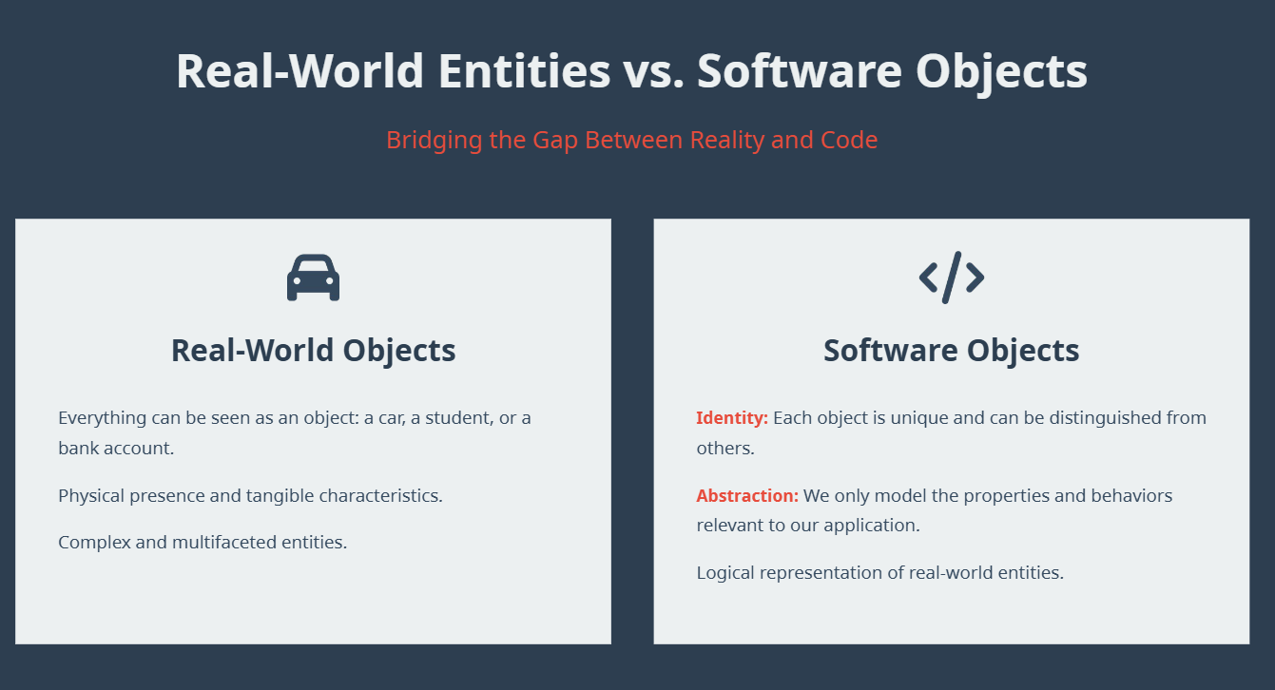
Notes:
Tangible = their presence can be detected by touch multifaceted = having many different sides or aspects

Slide 31
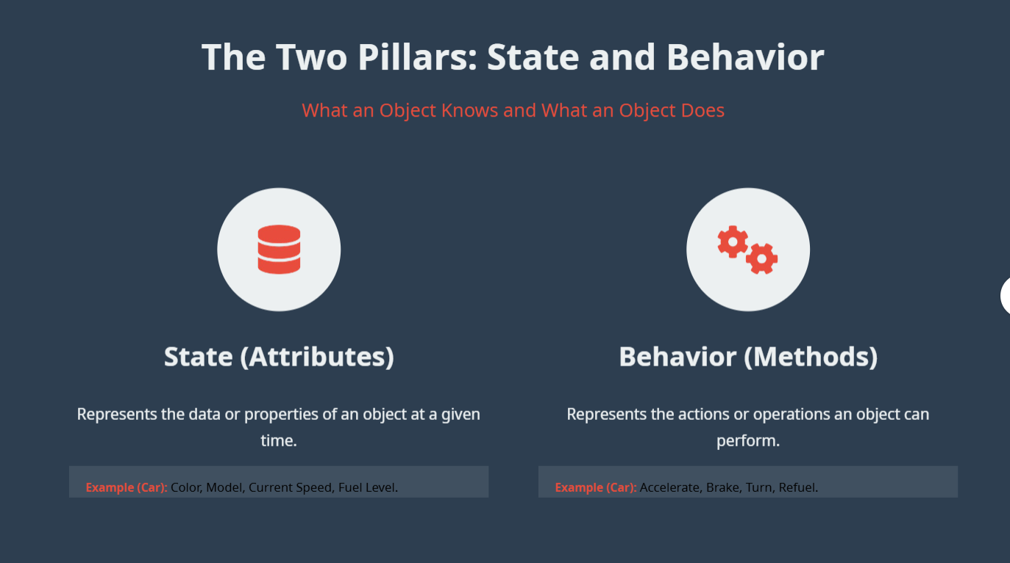

Slide 32
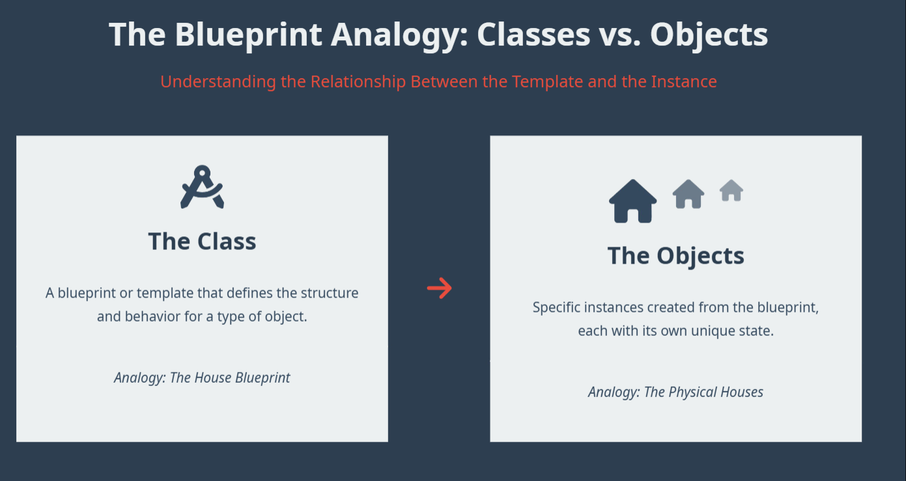

Slide 33
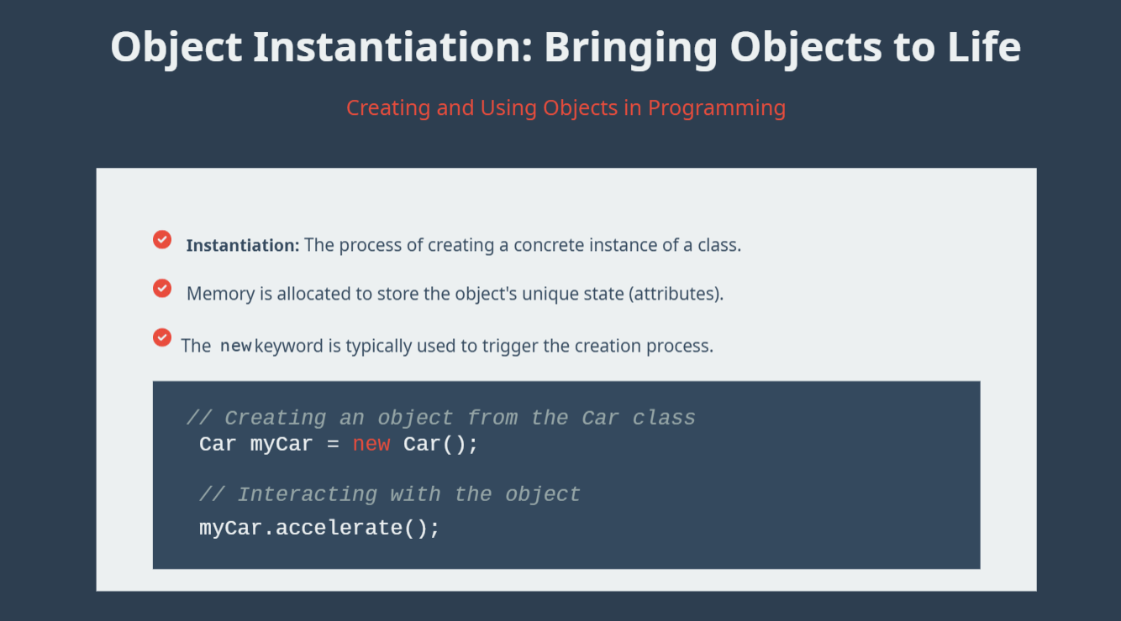
Notes:
Bringing objects to life means assigning memory to it
Instantiation brings software objects to life

Slide 34
What is an object?
Represents real world entity
Has state(data/attributes/properties)
Has behavior(methods/function)
Class → blueprint or template
Object → actual thing made from that blueprint

Slide 35
Creating objects and the ‘dot’ operator
Instantiation
This is the process of creating a real Object from a Class blueprint. It's like building the house from the map.
Lamp myLamp; // Object created!
Memory Allocation: When you instantiate, the computer sets aside space in memory to store that object's specific data.
The Dot Operator
The dot operator is used to access the properties and behaviors of an object. Think of it as "pointing" to a feature.
myLamp.turnOn(); // Call behavior
myLamp.color = "Yellow"; // Set property
Analogy: If the object is a TV, the dot operator is like pressing a specific button on the remote to change the channel.

Slide 36
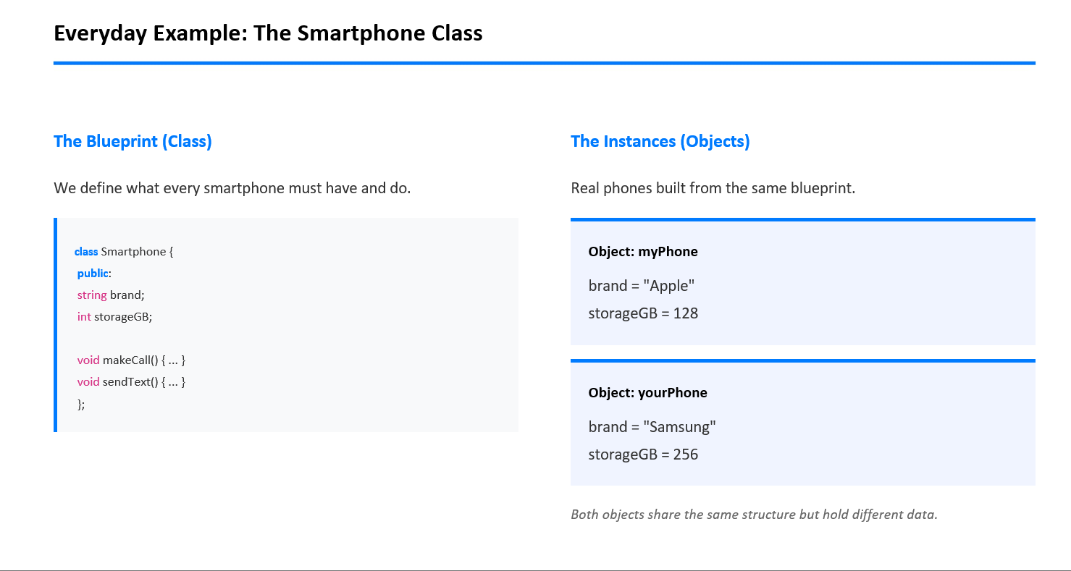

Slide 37
Methods or member functions
In OOP C++

Slide 38
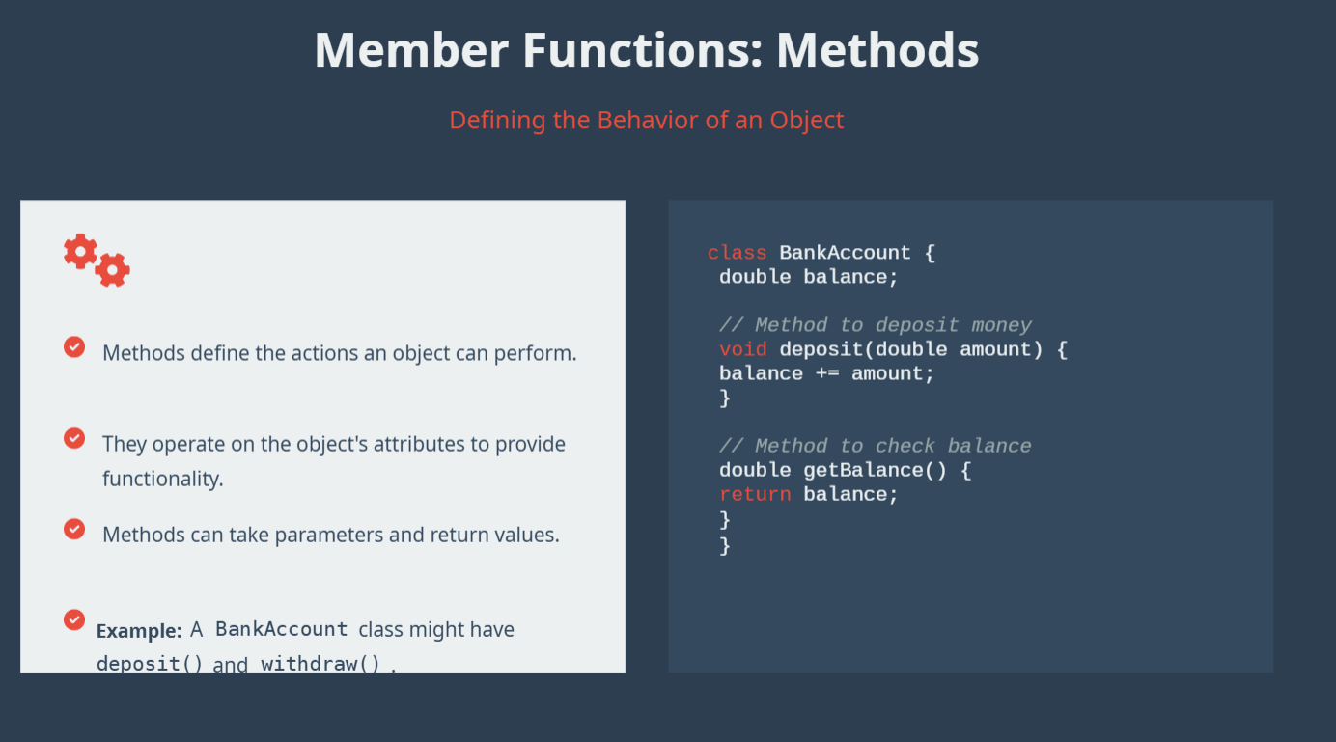

Slide 39
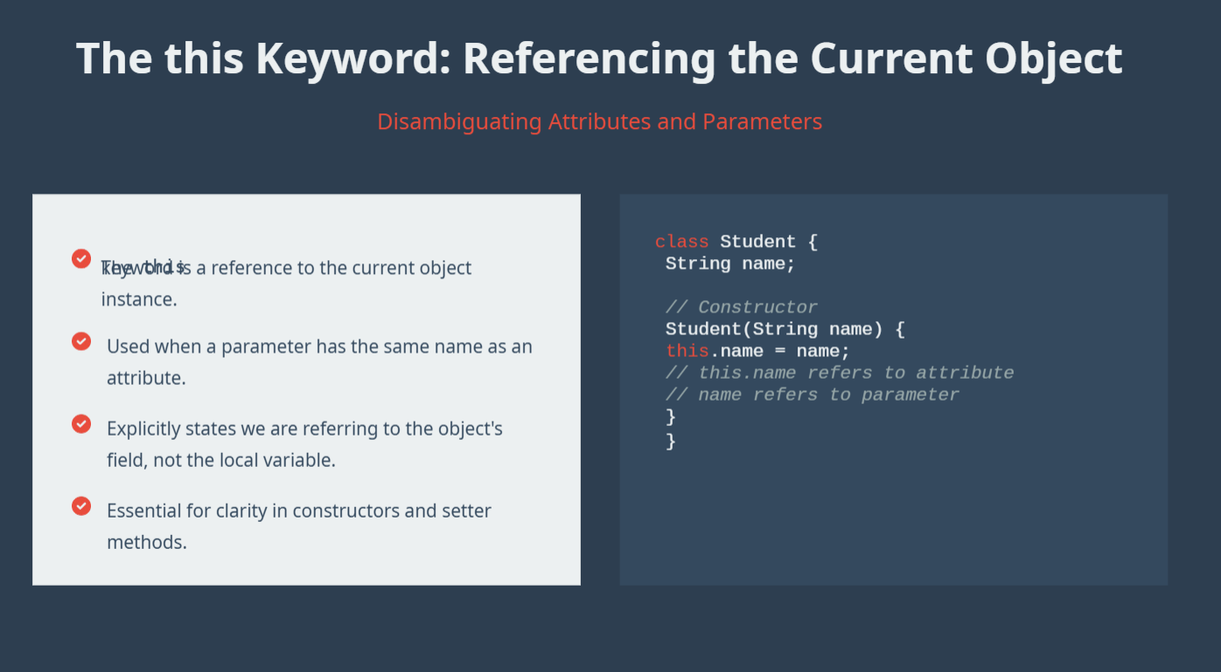

Slide 40
Member functions
1️⃣ Defined Inside Class:
A function written inside the class body.
Can access or modify the class’s data members.
(i.e., belongs to the class and works directly on its objects’ data)
2️⃣ Defined Outside Class (Using Scope Resolution Operator ::) :
A function declared inside a class but defined outside the class body.
Uses ClassName::FunctionName to link it to the class.
Can also access or modify the class’s data members.
(i.e., function belongs to the class, but definition is separate for clarity or organization)

Slide 41
comparison
Feature / Aspect | Defined Inside Class | Defined Outside Class (::)
Definition Location | Inside the class body | Outside the class body
Declaration Needed | No separate declaration required | Must be declared inside the class first
Access to Data Members | Can access and modify directly | Can access and modify directly
Use of Scope Resolution :: | Not needed | Required to link the function to the class
Readability / Organization | Simple, good for small functions | Helps organize larger codebases
Example | void display() { cout << marks; } | void Student::display() { cout << marks; }

Slide 42
Scope resolution operator(1)
Definition:
The scope resolution operator is used to explicitly specify the ownership of a variable or function by connecting it to its defined scope.
Scope can be:
Local scope→ Inside a function or block; variable is accessible only there.
Global scope→ Outside all functions; accessible everywhere, but can be hidden by local variables.
Class scope→ Belongs to a class; functions or static members may need ClassName:: to access.
Use of :: – To specify which scope a variable or function belongs to when there is ambiguity(same name) or when accessing class/namespace members.
Intuitive Example — Folder System
Imagine your computer:
You have:
Documents → report.txt
Downloads → report.txt
If you say:
Open report.txt
System gets confused.
So you specify:
Documents::report.txt
Downloads::report.txt
Now there is no confusion.

Slide 43
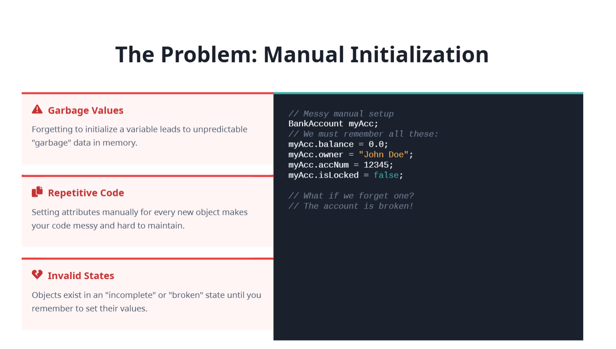

Slide 44
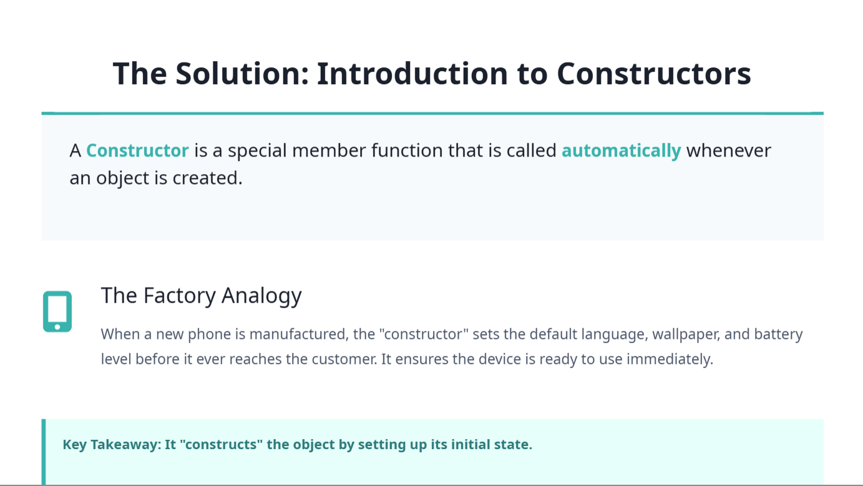

Slide 45
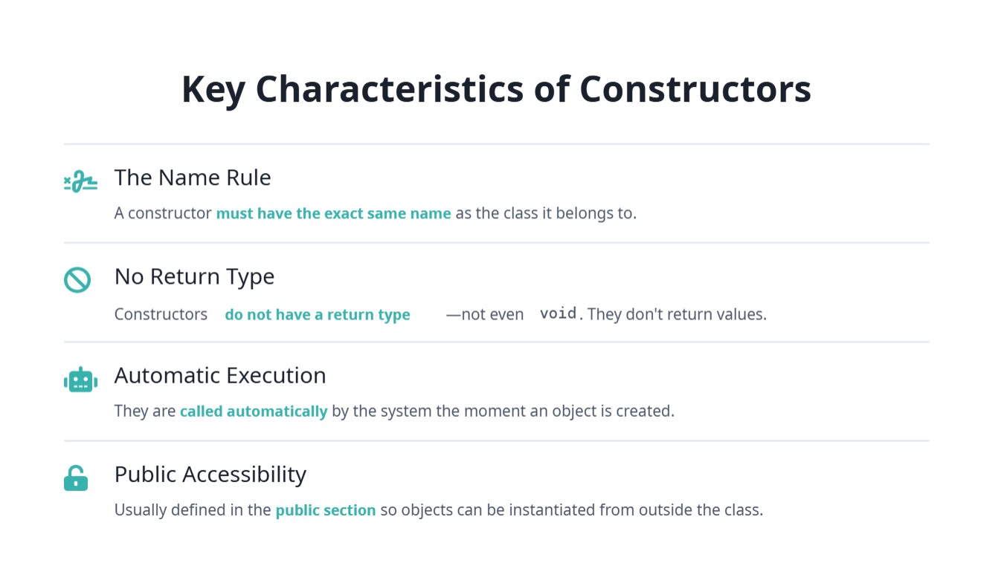

Slide 46
constructor
What is a Constructor?
A constructor is a special member function of a class that:
Always declared public
– Has the same name as the class
– Has no return type (not even void)
– Is automatically executed when an object is created
– Is used to initialize data members
IMPORTANCE:
Prevents garbage value
Syntax:
Class name(){
}
No semi colon after the curly braces of the constructor

Slide 47
Constructor overloading

Slide 48
Types of constructors
Typically, we deal with these three types:
Default
constructor
Parametrized
constructor
Copy constructor

Slide 49
Copy constructor
Definition: A constructor that initializes an object using another object of the same class.

Slide 50
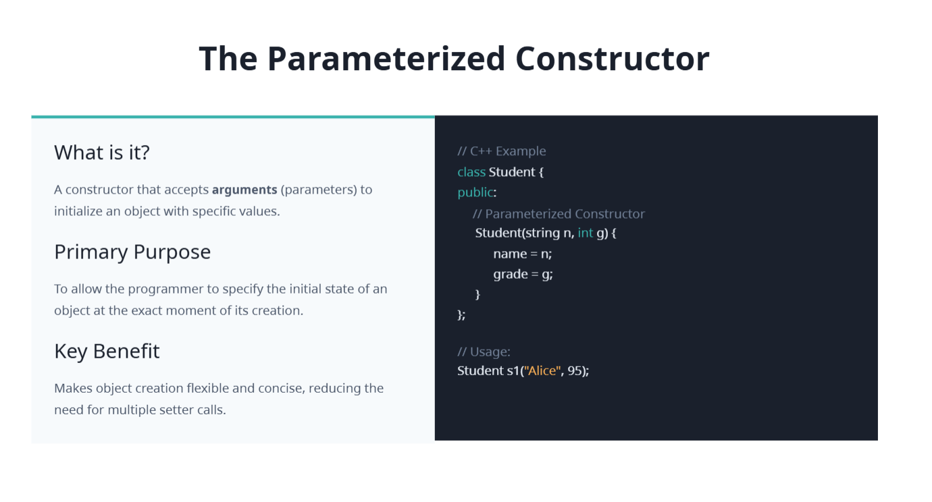

Slide 51
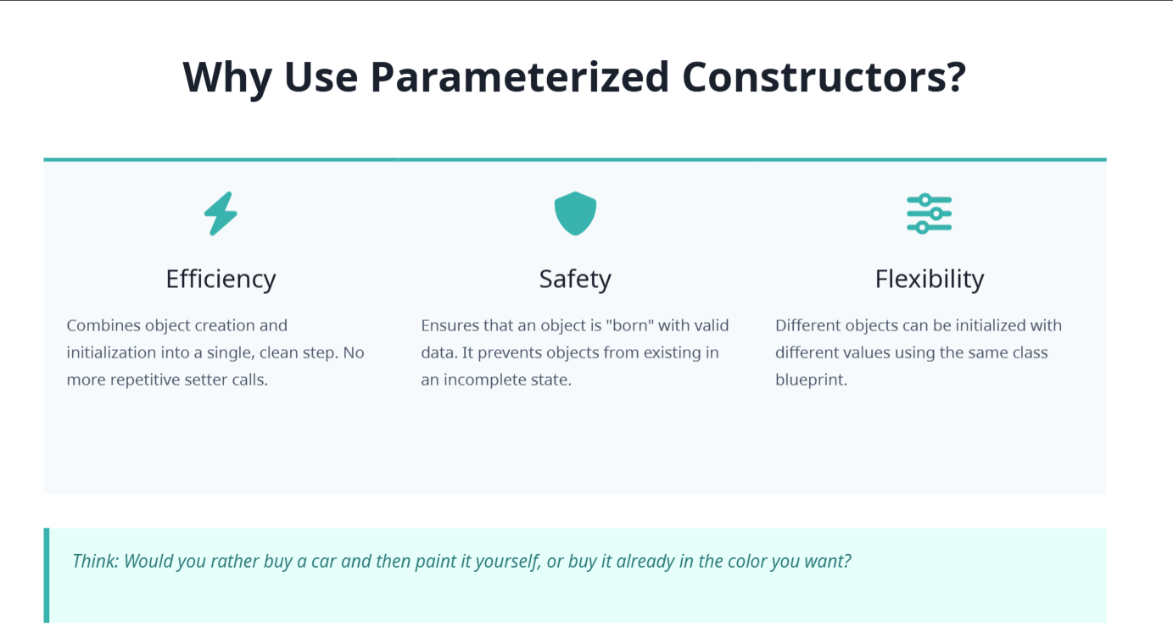

Slide 52
Default constructor
Constructor with no parameters
What is it?
A constructor that takes no arguments. It is called when you
create an object without passing any values.
The "Hidden" Constructor
If you don't write any constructor, the compiler provides a
default one automatically to allocate memory.
  class Employee {
  public:
  Double salary; // When there is no constructor defined, the object’s data members (like int age) are not initialized and may contain garbage values.
  };
  class Student {
  public:
  int age;
  Student() {
  age = 18; // user defined value
  }
  };
  Student s1; // default constructor called
  Auto- called (by compiler when we have not explicitly written any constructor in our code)
  Initializes objects
  A default constructor initializes objects with default values, either system-defined (like 0, null) or user-defined values if explicitly coded.
  If no constructor is defined, the data members of an object are not initialized and may contain garbage values, except for static or global objects which are initialized to zero.

Slide 53
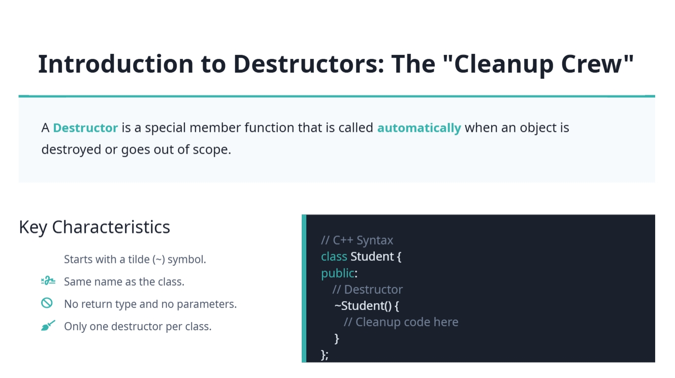
Notes:
There is always one destructor per class but program can have multiple destructors.as program have multiple classes and therefore each class may define its own destructor. A class can contain only one destructor because destructors cannot be overloaded in C++. Because its name and signature are fixed, C++ cannot overload destructors

Slide 54
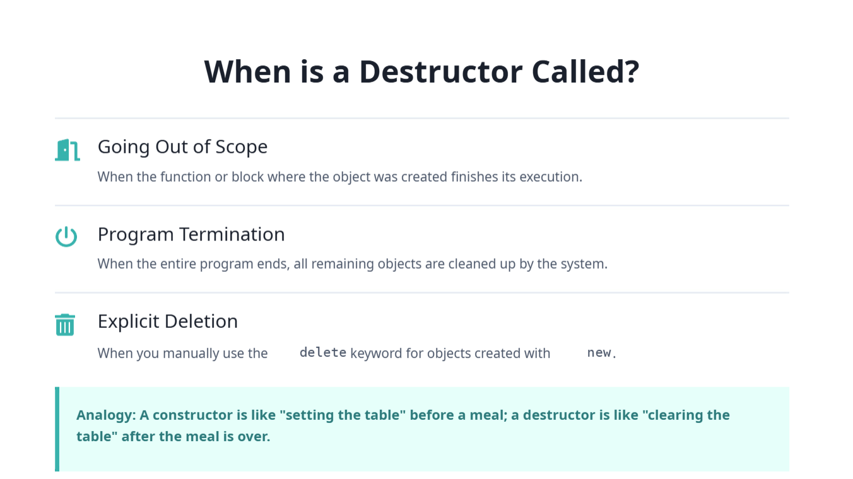

Slide 55
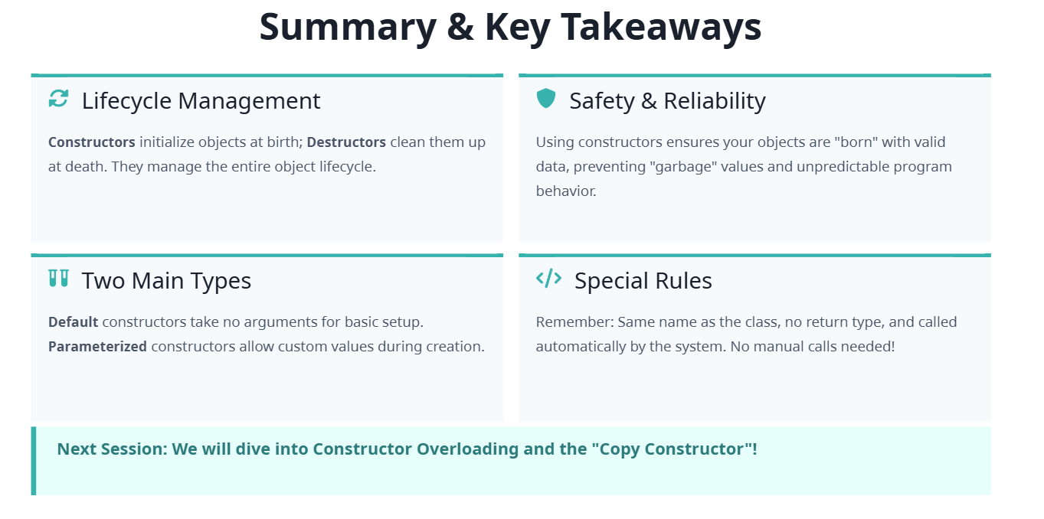

Slide 56
destructor
Why is a Destructor Needed?
To free allocated memory
  Releases memory created using new
To prevent memory leaks
  Avoids wastage of memory after object is destroyed
To close resources
  Closes files, database connections, etc.
For automatic cleanup
  Called automatically when object goes out of scope
To improve program efficiency
  Keeps system fast and stable
To manage object lifecycle properly
  Ensures clean ending of an object

Slide 57
Number of destructors…
Class can have only one destructor
Why Only One?
Destructor:
has fixed name → ~ClassName()
has no return type
takes no parameters
Because its name and signature are fixed, C++ cannot overload destructors.
Important Concept
A class may have:
many constructors (constructor overloading)
but only ONE destructor
Why Constructor Overloading Works?
Constructors can have different parameters:
Test()
Test(int x)
Test(int x, int y)
So compiler can distinguish them.
But Destructor?
Destructor always looks like:
~Test()
No parameters allowed.
So only one version can exist.
Real Purpose of Destructor
Destructor is automatically called when object is destroyed.
Used for:
releasing memory
closing files
freeing resources
Notes:
A class can contain only one destructor because destructors cannot be overloaded in C++.

Slide 58
Predict output…
Predict output order and explain: class Test { public: Test() { cout << "Construct\n"; } ~Test() { cout << "Destruct\n"; } }; int main() { Test a; { Test b; } Test c; }
🔹 Output Order
Construct
Construct
Destruct
Construct
Destruct
Destruct
🔹 Step-by-Step Explanation
Test a;
  Object a is created
  Constructor runs → Construct
Inner block { Test b; }
  Object b is created
  Constructor runs → Construct
End of inner block
  Object b goes out of scope
  Destructor runs → Destruct
Test c;
  Object c is created
  Constructor runs → Construct
End of main()
  Objects are destroyed in reverse order of creation (LIFO)
  First c destroyed → Destruct
  Then a destroyed → Destruct
🔹 Key Concept (Important)
👉 Destructors are called in reverse order of object creation (Last In, First Out).
Q9: Why constructor of base class is called first?
👉 Because derived class depends on base class, so base must initialize first.
❓ Q10: Why destructor of derived class is called first?
👉 Because object is destroyed in reverse order (LIFO).

Slide 59
Main pillars of oop
Encapsulation
Abstraction
Inheritance
Polymorphism

Slide 60
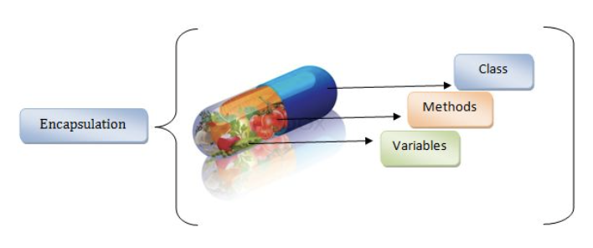
encapsulation
Encapsulation means:
  Binding data (state) and methods (behavior) together in a class
  Restricting direct access to internal data
  Enforcing controlled interaction through public interfaces
Achieved using access specifiers:
private, protected, public
Without Encapsulation (Problematic)
class BankAccount {
public:
double balance;
};
BankAccount acc;
acc.balance = -5000; // Invalid state allowed
No control, no validation, unsafe design
Notes:
Encapsulation is the OOP principle of bundling data (state) and methods (behavior) into a single unit (class) and controlling how that data is accessed.
Encapsulation: Protecting data through access control.

Slide 61
Encapsulation continuation…
With Encapsulation
class BankAccount {
private:
double balance; // hidden state
public:
BankAccount() : balance(0.0) {}
void deposit(double amount) {
if (amount > 0)
balance += amount;
}
double getBalance() const {
return balance;
}
};
BankAccount acc;
acc.deposit(1000);
cout << acc.getBalance();
✔ State can only change through validated methods

Slide 62
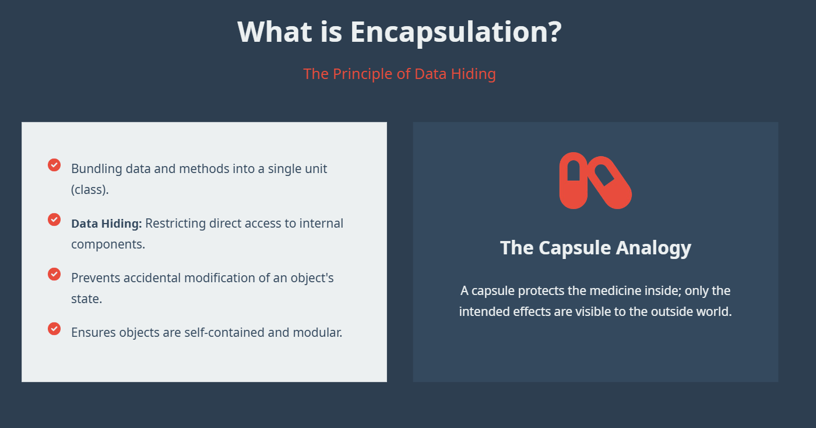

Slide 63


Slide 64
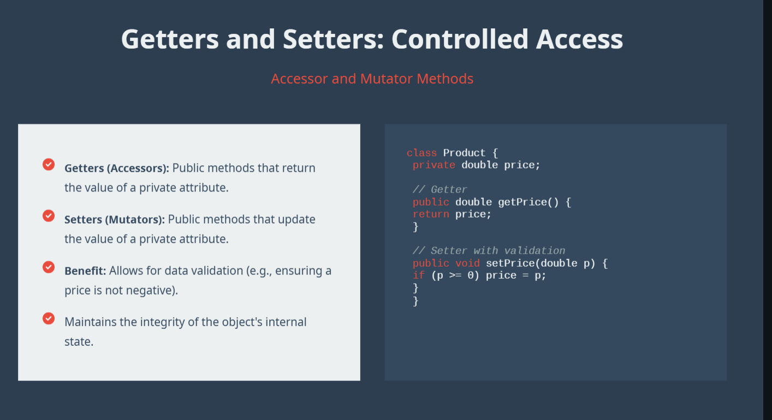
Notes:
Getters/Setters: Controlled access to private data.

Slide 65
Constructor v/s setters
Yes, constructors can be used like setters, but there is an important difference.
First Understand Setter
A setter assigns value after object creation.
class Student {
int age;
public:
void setAge(int a) {
age = a;
}
};
Usage:
Student s;
s.setAge(20);
Constructor Also Assigns Values
class Student {
int age;
public:
Student(int a) {
age = a;
}
};
Usage:
Student s(20);
Here constructor initializes the object directly.

Slide 66
Constructor
Setter
Runs automatically
Used during object creation
Usually for initial values
Called once at creation
Called manually
Used after object creation
Usually for changing values later
Can be called many times

Slide 67
Setter v/s constructor
Example Comparing Both
class Student {
int age;
public:
// constructor
Student(int a) {
age = a;
}
// setter
void setAge(int a) {
age = a;
}
void show() {
cout << age;
}
};
Usage:
Student s(18); // constructor initializes
s.setAge(21); // setter changes later
Important Concept
Constructors are mainly for:
object initialization
Setters are mainly for:
modifying values later
Real-Life Analogy
Constructor
Like filling a registration form when entering university.
Setter
Like updating your information later.
Special Advantage of Constructors
Constructors can initialize:
const data members
reference members
which setters cannot properly initialize later.
Notes:
Final Conclusion
Constructors can perform the job of assigning values like setters, but constructors initialize objects during creation, whereas setters modify values after the object is already created.

Slide 68


Slide 69
abstraction
In C++ OOP

Slide 70
abstraction
Showing only important details
Hiding implementation complexity from the user
Defining common interfaces for different implementations
Focusing on what an object does, not how it does it
Achieved in C++ using:
  Abstract base classes
  Pure virtual functions
  Step 1: Abstract Class (What to do)
  class Shape {
  public:
  virtual double area() = 0;
  };
  ✔ Tells what every shape must do
  ✔ No formula here

Slide 71
Abstraction…
  Step 2: Concrete Class (How to do it)
  class Rectangle : public Shape {
  double length, width;
  public:
  Rectangle(double l, double w) {
  length = l;
  width = w;
  }
  double area() {
  return length * width;
  }
  };
  Using the Abstraction
  Shape* s = new Rectangle(4, 5);
  cout << s->area();
  ✔ User only knows: “Shape has area()”
  ✔ User does NOT care how it is calculated

Slide 72
…final for exam
Abstraction is the process of hiding internal implementation details and showing only essential features to the user.
It helps reduce complexity and improves security.
In C++, it is achieved using abstract classes (pure virtual functions) and access specifiers.
Example: Using a Shape class with a virtual function draw(), where derived classes implement it.
Abstraction is shown in the base class where the function is declared but its implementation is hidden, and provided later by derived classes.

Slide 73

Abstract class
An abstract class is a class that cannot be instantiated (no objects can be created) and at least contains one pure virtual function is used as a base class for other classes.
It provides a common structure (template) for derived (child) classes.
  it can have :
  Abstract (pure virtual) functions → no body
  Normal functions → with implementation
Child classes must override (implement) abstract functions
IMPORTANCE:
Enforces rules for child classes
Helps achieve abstraction
Improves design consistency
class Shape {
public:
virtual void draw() = 0; // pure virtual function
};
👉 = 0 makes it an abstract class
Cannot create object of abstract class ❌
Must contain at least one pure virtual function
Used only as a base class
Supports runtime polymorphism

Slide 74
Pure virtual function
A pure virtual function is a function declared in a base class without implementation, forcing child classes to define it.
Makes class abstract
Forces derived classes to implement the functions
virtual void show() = 0;
virtual → supports runtime polymorphism
= 0 → means no body (pure virtual)
👉 Any class containing this becomes an abstract class
It fits Inside base classes
Used in inheritance + polymorphism
Importance:
Enforces uniform structure
Ensures every child class implements required behavior
Helps in flexible and scalable design
⚠️ Important Concept
If child class does NOT implement pure virtual function:
👉 It also becomes abstract class
🔥 Quick Memory Trick
= 0 → “No body → must override”
Pure virtual → forces implementation
Abstract class → cannot create object

Slide 75
Comparison b/w encapsulation and abstraction
encapsulation
abstraction
✔ Concept:
Wrapping data + methods into a single unit (class)
Restricting direct access using access specifiers
✔ If removed:
Data becomes public
Anyone can modify → invalid state
🎯 KEY LINE
Encapsulation ensures security and controlled access to data.
✔ Concept:
Showing only important details
Hiding implementation complexity
🎯 KEY LINE
Abstraction reduces complexity and improves usability.

Slide 76
Mind traps❓…🔥
Q1:If encapsulation already hides data, why do we still need abstraction?
Q2:Is encapsulation only about “wrapping” or something more?
Q3:What will happen if we remove encapsulation?
Q4:If user doesn’t see implementation, how does program still work?
Q5:Is abstraction possible without encapsulation?
Q6:Give real-life example of abstraction

Slide 77
Answers…
A1:
A2:Encapsulation is not just wrapping
It also provides data hiding and access control
👉 Example:
Private variables cannot be accessed directly
A3:Data becomes public
Anyone can modify → invalid state
A4:user interacts with interface
Internal working is hidden but still executed
👉 Example:
ATM → you don’t know internal code
A5:❌ No abstraction isn’t possible without encapsulation
Because hiding requires control → given by encapsulation
A6:

Slide 78
inheritance
In C++ OOP

Slide 79
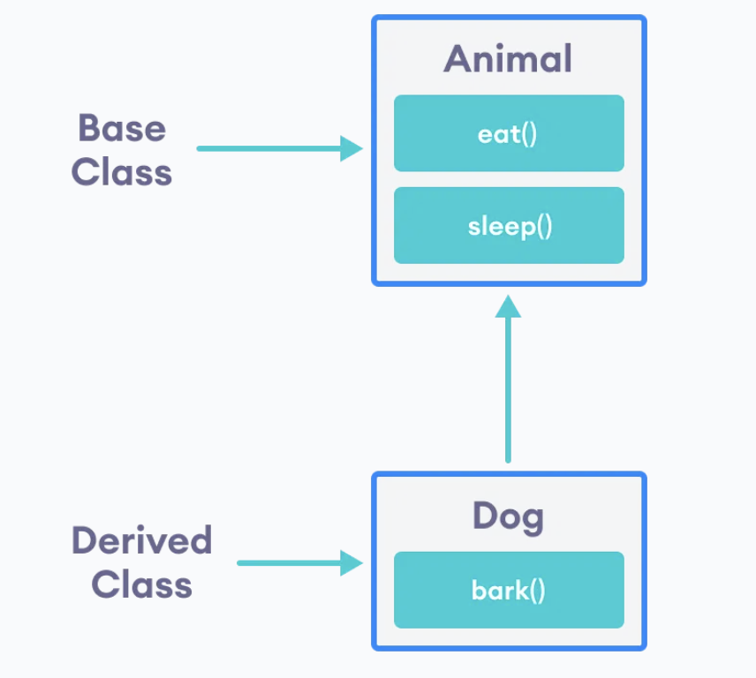
inheritance
Inheritance means:
  One class reuses data and functions of another class
  Helps avoid code duplication
  Represents an is-a relationship
Simple Real-World Idea
  A Student is a Person
  A Car is a Vehicle
  Base Class (Parent)
  class Person {
  public:
  void speak() {
  cout << "I can speak" << endl;
  }
  };
  Derived Class (Child)
  class Student : public Person {
  public:
  void study() {
  cout << "I can study" << endl;
  }
  };
  Using Inheritance
  Student s;
  s.speak(); // inherited from Person
  s.study(); // Student’s own function
  ✔ Student automatically gets speak()
  ✔ Code is reused

Slide 80
polymorphism
In C++ OOP

Slide 81
polymorphism
Polymorphism is the ability of a function, object, or operator to take multiple forms depending on the context.
One interface, multiple implementations
Compile-time and run-time polymorphism
Achieved through method overloading and overriding
IMPORTANCE:
Makes code flexible
Reduces duplication
Supports extensibility
Real-Life Example
👉 A person can be:
Student
Teacher
Employee
Same person → different roles (forms)

Slide 82
Types of polymorphism
1. Compile-Time Polymorphism (Static)
2. Run-Time Polymorphism (Dynamic)
Achieved by Function Overloading / Operator Overloading
Decision made at compile time
👉 Example:
int add(int a, int b);
double add(double a, double b);
Example:
int add(int a, int b);
double add(double a, double b);
Achieved by Function Overriding
Uses inheritance + virtual functions
Decision made at runtime
👉 Example:
class Animal {
public:
virtual void sound() {
cout << "Animal sound";
}
};
class Dog : public Animal {
public:
void sound() {
cout << "Dog barks";
}
};

Slide 83
Difference between compile and run time
Compile-Time
Run-Time
Happens before the program runs (during compilation). Errors and decisions are detected by the compiler.
Happens while the program is running. Decisions are made dynamically during execution.
Real-Life Analogy
Compile-Time: Like preparing a recipe before cooking → ingredients measured, steps planned
Run-Time: Like cooking the recipe → adjusting spices or timing depending on taste
Notes:
Compile-time occurs before program execution and is static, while run-time occurs during execution and is dynamic.

Slide 84
Key Differences between compile time and run time
Feature | Compile-Time | Run-Time
When | Before execution (compilation) | During execution
Examples | Function overloading, syntax errors, type checking | Function overriding, memory allocation, input/output errors
Decision Making | Static (fixed by compiler) | Dynamic (depends on program state)
Inheritance Needed | Not required | Required for overriding
Error Detection | Caught by compiler | Detected while running the program
Performance | Faster (decisions already made) | Slightly slower (decisions made at runtime)
Notes:
Compile-time occurs before program execution and is static, while run-time occurs during execution and is dynamic.

Slide 85
1. Static
Definition:
Fixed at compile-time
Known before the program runs
Decisions, memory allocation, or behavior is determined in advance
Key Points:
Faster execution
Less flexible
Used in Compile-Time Polymorphism, constants, static variables
Example:
int add(int a, int b); // Compiler knows which function to call
Analogy:
Like pre-booking a movie ticket → fixed seat, time known before arriving

Slide 86
. Dynamic
Definition:
Determined at run-time
Unknown until the program is running
Behavior or decision can change depending on the situation
Key Points:
Slightly slower
More flexible
Used in Run-Time Polymorphism, dynamic memory allocation
Example:
Animal *a = new Dog();
a->sound(); // Decision of which sound() executes happens at runtime
Analogy:
Like choosing a taxi on the spot → decision depends on availability

Slide 87
Object-oriented design(ood) process
The Object-Oriented Design (OOD) process is a step-by-step way to design software using objects, classes, and their interactions.
1. What is OOP Design Process?
It is the method of converting a problem (requirements) into a structured design using classes and objects before coding.
OOP Design Process is the systematic approach of identifying classes, objects, their attributes, methods, and relationships to model a problem before implementation.
👉 In simple words:
Problem → Objects → Classes → Relationships → Code

Slide 88
🔷 Steps of OOP Design Process
Requirement Analysis → understand the problem
Identify Classes & Objects →main entities
Identify Attributes → data members
Identify Methods → actions
Define Relationships → how classes connect
Design UML Diagram → structure
Implementation (Coding) → coding
Testing & Refinement → check & refine

Slide 89
Steps
✅ Step 1: Requirement Analysis
Understand the problem carefully
Identify:
  Inputs
  Outputs
  Constraints
👉 Example: Library system → books, users, issue system
✅ Step 2: Identify Classes & Objects
Extract nouns from the problem → usually classes
👉 Example:
Book
Student
Librarian

Slide 90
…
✅ Step 3: Identify Attributes (Data Members)
What data each class will store
👉 Example:
Book → title, author, price
Student → name, ID
✅ Step 4: Identify Methods (Functions)
What actions each class can perform
👉 Example:
Book → displayDetails()
Student → borrowBook()

Slide 91
…
✅ Step 5: Define Relationships
How classes are connected
Types:
Association → Student borrows Book
Inheritance → Student & Teacher → Person
Aggregation/Composition → Library has Books
✅ Step 6: Design Class Diagram
Draw structure (like UML diagram)
👉 Shows:
Classes
Attributes
Methods
Relationships

Slide 92
…
✅Step 7: Implement (Coding)
Convert design into code (C++, Java, etc.)
✅ Step 8: Testing & Refinement
Check if design works correctly
Improve if needed

Slide 93
Unified modeling language
🔷 What is a UML Class Diagram?
A UML (Unified Modeling Language) Class Diagram is a visual representation of:
Classes
Attributes (data)
Methods (functions)
Relationships between classes
-------------------------
| ClassName |
-------------------------
| - attribute1 |
| - attribute2 |
-------------------------
| + method1() |
| + method2() |
-------------------------
Symbols:
+ → Public
- → Private

Slide 94
Conceptual Questions (20 Marks)
1. Why are data members declared private?
2. When is a constructor executed?
3. What is the purpose of the scope resolution operator?
4. Difference between function and member function?
Answer Guide:
1. To enforce encapsulation and prevent unauthorized direct access.
2. Automatically when an object is created.
3. To define a member function outside the class definition.
4. A member function belongs to a class and operates on its data.
Part 3: Student Task
1. Create a class named Car
2. Add data members: model, speed
3. Add a function display()
4. Create an object and display details
Viva Questions
- What is OOP?
- What is a class?
- What is an object?
- Why do we use OOP?
Define a Rectangle class with width and height attributes. Implement a calculateArea()
method that returns the area of the rectangle.

Slide 95
Pass by value
Pass by value is a concept in programming where a copy of a variable’s value is passed to a function, rather than the original variable itself.
Simple explanation
When you pass a variable by value:
The function gets its own separate copy
Any changes made inside the function do NOT affect the original variable
void changeValue(int x) {
x = 10;
}
int main() {
int a = 5;
changeValue(a);
// a is still 5, not 10
}

Slide 96
…
What’s happening?
a is 5
changeValue(a) sends a copy of a to x
Inside the function, x becomes 10
But a remains unchanged because it was never directly modified
Key idea
👉 Pass by value = copy is used, original stays safe

Slide 97
Copy constructor
Definition: A constructor that initializes an object using another object of the same class
A copy constructor is a special constructor that creates a new object by copying the contents of an existing object.
Syntax in C++
ClassName(const ClassName& obj);
#include <iostream>
using namespace std;
class Student {
public:
string name;
Student(string n) {
name = n;
}
// Copy constructor
Student(const Student& s) {
name = s.name;
}
};
int main() {
Student s1("Ali");
Student s2 = s1; // Copy constructor is called
cout << s2.name << endl; // Output: Ali
}

Slide 98
Copy constructor…
How it works
s1 is created with the name "Ali".
s2 = s1 creates a new object s2.
The copy constructor copies the data from s1 into s2.
When is a copy constructor called?
A copy constructor is typically invoked:
When an object is initialized from another object:
Student s2 = s1;
When an object is passed to a function by value:
void display(Student s);
When an object is returned from a function by value

Slide 99
Copy constructor…
Default vs. User-Defined Copy Constructor
Default Copy Constructor
If you don't write one, C++ automatically provides a copy constructor that performs a member-wise copy.
Student s2 = s1;
User-Defined Copy Constructor
You write your own when the class manages resources such as:
Dynamic memory (new/delete)
File handles
Network connections

Slide 100
Ways to invoke copy constructor
1. Object initialization from another object
When a new object is created and initialized using an existing object of the same type.
2. Passing by value
When an object is passed as an argument to a function by value (not by reference).
3. Return-by-value
When a function returns an object by value to the caller.

Slide 101
1. Object initialization from another object
1. Object initialization from another object
Teacher t1("Nimra", "CS", 1200.23, 12345);
Teacher t2(t1); // copy constructor
Teacher t3 = t1; // copy constructor
Both create a new object by copying an existing one.

Slide 102
2. Pass-by-value
When an object is passed to a function by value, a copy of the object is created.
void printTeacher(Teacher t) {
t.displayinfo();
}
int main() {
Teacher t1("Nimra", "CS", 1200.23, 12345);
printTeacher(t1); // copy constructor called
}
Here t is a copy of t1.

Slide 103
Returning by value
3. Return-by-value
When a function returns an object by value, the copy constructor may be involved.
Teacher createTeacher() {
Teacher t("Nimra", "CS", 1200.23, 12345);
return t;
}
In modern C++ (C++17 and later), the compiler often performs copy elision or uses a move constructor, so you may not actually see the copy constructor run even though the code logically returns by value.

Slide 104
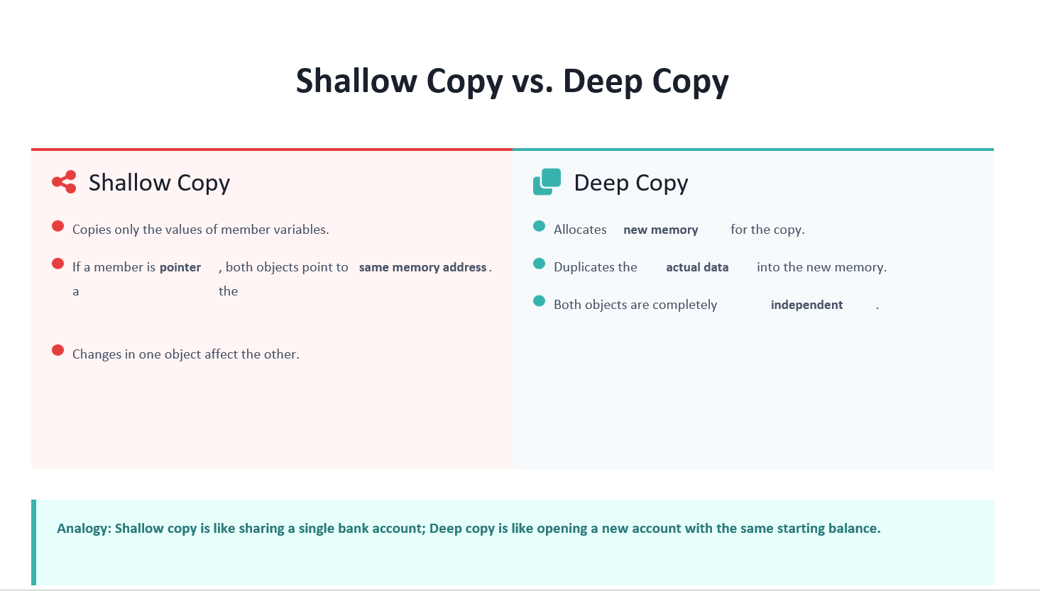

Slide 105
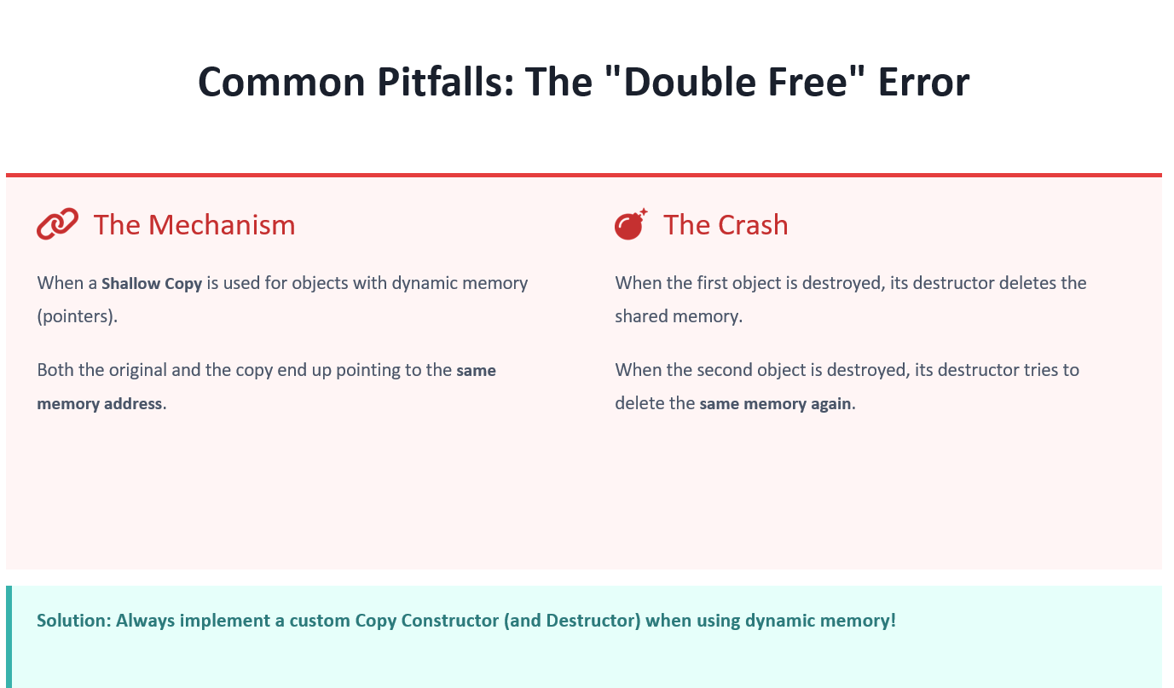

Slide 106
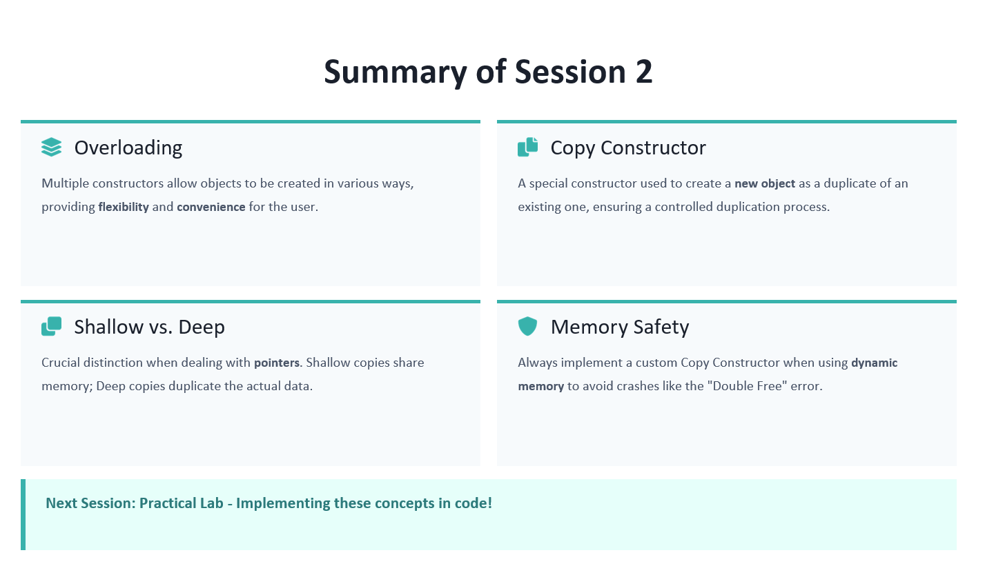

Slide 107

Operator overloading
Function/method overriding
Exception handling and polymorphism
Inheritance and polymorphism

Slide 108
Operator overloading

Slide 109
Operator overriding
Function overriding is an OOP feature in which a derived class provides its own implementation of a function that is already defined in the base class using the same name, return type, and parameter list.
Important Condition
For overriding:
Function name must be same (in both parent and child class)
Parameters must be same( same as above)
Return type should be compatible( ,, )
Notes:
Inheritance + Same Function Signature + New Implementation in Child = Function Overriding.

Slide 110
…
Ask yourself:
Does the parent already have a function? ✔
Does the child define a function with the same signature? ✔
Does the child want different behavior? ✔
If all three answers are yes, then function overriding is taking place.

Slide 111
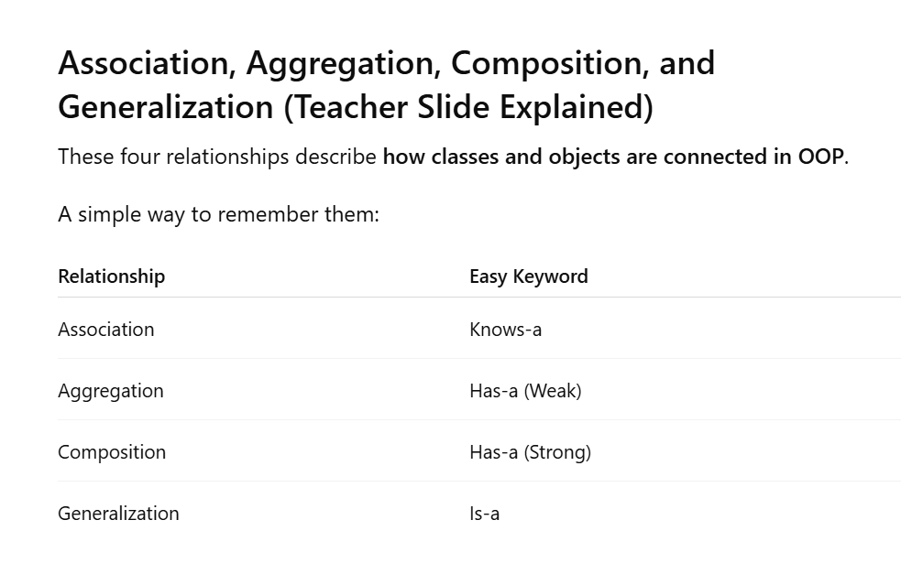

Slide 112
association— "Knows-a" Relationship
Definition
Association is a relationship where one object knows about or uses another object, but neither owns the other.
Both objects can exist independently.
Real-Life Example
Doctor and Patient
Doctor treats Patient.
Patient visits Doctor.
Doctor can exist without Patient.
Patient can exist without Doctor.
They only interact.
Doctor <-------> Patient
void treat(Patient* p);
void visit(Doctor* d);
Doctor knows about Patient.
Patient knows about Doctor.
Both communicate using pointers.

Slide 113
Association (Bidirectional or Unidirectional)
type
meaning
Unidirectional Association
Bidirectional Association
One object knows about another object
Both objects know about each other
One-line Definition
Unidirectional Association: One class has a reference/pointer to another class.
Bidirectional Association: Both classes have references/pointers to each other.
Key Implementation: Uses pointers or references to link objects.
Lifecycle: Neither object "owns" the other; they are created and destroyed independently.

Slide 114
2. Aggregation — "Has-a" Weak Relationship
Definition
Aggregation is a special type of association where one object contains another object, but does NOT own it.
The contained object can exist independently.
Department has-a Professor
Aggregation
Department --------> Professor
The Department contains or uses Professors, but does not own them.
👉 Aggregation is a weak "has-a" relationship where the contained object can exist independently of the container, meaning there is no strong lifetime dependency.
Aggregation = Weak = independent life
Composition = Strong = dependent life
Aggregation is a weak Has-a relationship in which the part can exist independently of the whole.
Notes:
👉 Yes, aggregation can be bidirectional if both objects reference each other but still remain independent in lifetime and ownership.
It mainly differs from association due to the relation called whole-part(has-a) relationship like obj1 will be the part of obj2 and vice versa but non of them will own each other and will have separate life cycles. While in association one object knows the other, there is no whole-part(has-a) relation.

Slide 115
Aggregation (Special Type of Association)
Aggregation means:
One object has another object as a part/member, but does not own it.
Department <>------ Professor
(UML uses a hollow diamond ◇ on the Department side.)
Characteristics:
Objects are independent.
No ownership.
Whole–Part relationship exists.
The contained object can exist without the container.
class Department
{
Professor* prof;
};
A Department has a Professor.
The Professor can still exist if the Department is destroyed.
Aggregation
Even though both are independent, Aggregation additionally says:
"One object contains or is made up of the other object."
That whole-part ("has-a") idea is the main difference between Association and Aggregation.

Slide 116
Key Difference
Association = "Uses/Knows"
Doctor -------> Patient
Doctor interacts with Patient.
Patient is not really a part of Doctor.
Aggregation = "Has-a"
Department <>------ Professor
Professor is considered part of the Department structure, but is not owned by it.
Real-Life Examples
Association
Teacher -------> Student
Teacher teaches Student.
Student is not a part of Teacher.
Aggregation
Library <>------ Book
(or Department–Professor)
Library has books.
Books can exist outside the library.
There is a whole-part relationship.

Slide 117
Key concept summary
Key Concept Summary
1. Arrow Direction ≠ Ownership
The arrow shows who knows about whom, not who owns whom.
Department -----> Professor
means:
✅ Department can access Professor
❌ Professor cannot directly access Department
2. Single Arrow = Unidirectional
Department -----> Professor
Only one side knows the other.
3. Double Arrow = Bidirectional
Department <-----> Professor
Both sides know each other.
4. Independence = Lifecycle
When we say objects are independent:
Destroy Department → Professor survives
Destroy Professor → Department survives
This is about lifecycle, not arrows.
5. Aggregation's Main Idea
Department has-a Professor
Department contains/uses Professor.
Department does NOT own Professor.
Both can exist independently.
One-Line Exam Rule
Arrow = navigability (who knows whom).
Aggregation = independent lifecycles with a has-a (whole-part) relationship.
So:
Department -----> Professor
means:
Department knows Professor (unidirectional aggregation), while both objects remain independent.

Slide 118
Concept | Meaning
Arrow direction | Who knows/uses whom
Aggregation | Independent lifecycles
Composition | Dependent lifecycles
Single arrow | Unidirectional relationship
Double arrow | Bidirectional relationship
Feature | Association | Aggregation
Relationship | Knows-a / Uses-a | Has-a
Ownership | No | No
Lifecycle | Independent | Independent
Whole-Part Relationship | No | Yes
Example | Doctor–Patient | Department–Professor

Slide 119
3. Composition — "Has-a" Strong Relationship
Definition
Composition is a strong Has-a relationship where the whole object owns its parts.
If the whole dies, the parts die too.
Real-Life Example
House and Room
A room belongs to a house.
Without the house, the room has no separate existence in this model.
House ♦------ Room
(Black Diamond = Strong Ownership)
Notes:
Composition is a strong Has-a relationship where the whole owns the part, and the part cannot exist independently.

Slide 120
…
Teacher's Code
class Room {
public:
Room() {
cout << "Room created\n";
}
~Room() {
cout << "Room destroyed\n";
}
};
House
class House {
Room livingRoom;
public:
House() {
cout << "House created\n";
}
~House() {
cout << "House destroyed\n";
}
};
Notice:
Room livingRoom;
No pointer.
No reference.
Actual object is inside House.
Object Creation
House h1;
Output:
Room created
House created
Room created automatically.
Object Destruction
When:
h1
goes out of scope:
House destroyed
Room destroyed
Room automatically dies with House.
Why Strong Ownership?
Because House created and owns Room.
Room cannot be separated.
Lifecycle
House exists
↓
Room exists
Destroy House:
House destroyed
Room destroyed
Dependent lifecycle.

Slide 121
Relationship | Classification | Ownership | Lifetime
Department – Teacher | Aggregation | No ownership | Independent
Department – Office | Composition | Department owns Office | Dependent
Student – Course | Aggregation | No ownership | Independent
Exam Keywords
Aggregation: Weak relationship, no ownership, independent lifetime.
Composition: Strong relationship, ownership exists, dependent lifetime.

Slide 122
Relationship | Type
Company – Employee | Aggregation
Team – Player | Aggregation
University – Professor | Aggregation
Department – Teacher | Aggregation
Student – Course | Aggregation / Association
House – Room | Composition
Building – Room | Composition
Car – Engine | Composition
Human – Heart | Composition
Order – OrderItem | Composition

Slide 123
4. Generalization — "Is-a" Relationship
Generalization is another name for Inheritance.
Definition
A specialized class inherits from a more general class.
Car is a Vehicle
Vehicle
↑
Car
Why Use Generalization?
1. Code Reuse
Write common features once.
2. Hierarchy
Organize related classes.
3. Polymorphism
Enables runtime polymorphism using virtual functions.
Generalization is an Is-a relationship in which a derived class inherits properties and behaviors from a base class.

Slide 124
Feature | Association | Aggregation | Composition | Generalization
Keyword | Knows-a | Has-a (Weak) | Has-a (Strong) | Is-a
Ownership | None | Partial | Full | Inheritance
Lifecycle | Independent | Independent | Dependent | Shared through inheritance
Uses Pointer? | Usually Yes | Usually Yes | Usually No
Creates Part? | No | No | Yes | N/A
Destroys Part? | No | No | Yes | N/A
Example | Doctor-Patient | Department-Professor | House-Room | Car-Vehicle

Slide 125
Increasing ownership:
Association → only knows
Aggregation → has but doesn't own
Composition → has and owns
And separately:
Generalization = Inheritance = Is-a
One-line revision
Association: Doctor knows Patient.
Aggregation: Department has Professor.
Composition: House owns Room.
Generalization: Car is a Vehicle.

Slide 126
Entity Relationship Diagram (ERD)
Since you are studying OOP relationships (Association, Aggregation, Composition, Generalization), it's important to know that ERD (Entity Relationship Diagram) is mainly used in Database Design, not OOP.
What is an ERD?
ERD (Entity Relationship Diagram) is a graphical representation of:
Entities (objects/data)
Attributes (properties)
Relationships (connections)
It helps us design a database before creating tables.

Slide 127
Main Components of ERD
1. Entity
An entity represents a real-world object.
Examples:
Student
Teacher
Course
Hospital
Representation:
+-----------+
| Student |
+-----------+
(Rectangle)

Slide 128
2. Attribute
Attributes are properties of an entity.
Example:
Student has:
StudentID
Name
Age
Name
|
Student--Age
|
StudentID
(Oval in traditional ERD)

Slide 129
3. Relationship
Shows how entities are connected.
Example:
A Student enrolls in a Course.
Student ------ Enrolls ------ Course
(Diamond in traditional ERD)
Entity Relationship Diagram (ERD) is a graphical model used in database design to represent entities, their attributes, and the relationships among them.

Slide 130
Function Overriding
Definition
Function overriding is the process in which a derived class provides its own implementation of a virtual function that is already defined in the base class. It enables runtime polymorphism.
The derived class redefines the inherited behavior.
Why Do We Need Overriding?
Suppose every animal makes a sound, but different animals make different sounds.
Animal -> Generic Sound
Dog -> Woof
Cat -> Meow
Instead of creating different function names:
dogSound();
catSound();
we use one common function:
makeSound();
and let each class define its own version.
This is called runtime polymorphism.
Why Do We Need Overriding?
Suppose every animal makes a sound, but different animals make different sounds.
Animal -> Generic Sound
Dog -> Woof
Cat -> Meow
Instead of creating different function names:
dogSound();
catSound();
we use one common function:
makeSound();
and let each class define its own version.
This is called runtime polymorphism.

Slide 131
Conditions for Overriding
For overriding to happen:
1. Inheritance must exist
class Derived : public Base
2. Base function must be virtual
virtual void display();
3. Function signature must match
✔ Correct
void display()
✘ Wrong
void display(int x)
because parameters are different.
Overriding
Inheritance required.
Same name ✔
Same parameters ✔
Different class ✔
overloading
Usually inside the same class.
Same name ✔
Different parameter list ✔
Compile-time polymorphism ✔

Slide 132
Role of virtual
class Base {
public:
virtual void display() {
cout << "Base";
}
};
virtual tells the compiler:
"This function may have different versions in derived classes. Decide at runtime which version to call."
Without virtual, C++ uses compile-time binding.
With virtual, C++ uses runtime binding (dynamic dispatch).
For a function to be overridden in a derived class, it must be declared as virtual in the base class. • The virtual keyword signals that this function might have different implementations in derived classes. It enables dynamic dispatch (or late binding), meaning the function call is resolved at runtime based on the actual object type. • • Without virtual, the function call would be resolved at compile time (static dispatch), potentially leading to incorrect behavior.

Slide 133
…
Explain the virtual keyword in C++. Explain how virtual supports dynamic binding in inheritance. (3 Marks)
Answer
The virtual keyword is used in a base class to declare a function that can be overridden in derived classes.
class Animal {
public:
virtual void makeSound() {
cout << "Animal Sound";
}
};
The virtual keyword enables dynamic binding (runtime polymorphism). When a virtual function is called
through a base-class pointer or reference, C++ determines at runtime which version of
the function to execute based on the actual object type, not the pointer type.
Example:
Animal* ptr = new Dog();
ptr->makeSound();
Since makeSound() is virtual, Dog::makeSound() executes even though ptr is an Animal*.
Conclusion
Thus, the virtual keyword supports dynamic binding by allowing function calls to be resolved at runtime according to the actual derived object, enabling runtime polymorphism.

Slide 134
Role of override
void display() override
override is optional but highly recommended.
It tells the compiler:
"I intend to override a base-class virtual function."
If you make a mistake, the compiler catches it.
The override specifier (C++11) explicitly indicates that a member function is intended to override a virtual function in a base class.
Compiler Error Checking: If the function signature doesn't exactly match a virtual function in the base class, the compiler will issue an error.
Readability: Clearly communicates the programmer's intent to other developers.
Prevents Bugs: Helps catch common mistakes like typos in function names or incorrect parameter lists.

Slide 135
…
One-Line Exam Definitions
Function Overriding
Function overriding is the process in which a derived class provides its own implementation of a virtual function already defined in the base class.
Virtual Function
A virtual function is a base-class function declared with the virtual keyword that allows runtime polymorphism.
Override Specifier
The override specifier indicates that a derived-class function is intended to override a virtual function from the base class.
Runtime Polymorphism
Runtime polymorphism is the ability to call different implementations of the same function through a base-class pointer or reference depending on the actual object type at runtime.
Virtual Destructor
A virtual destructor ensures that the correct destructor sequence executes when deleting a derived object through a base-class pointer.

Slide 136
code
class Animal {
public:
virtual void makeSound() {
cout << "Generic Sound"; }
};
class Dog : public Animal {
public:
void makeSound() override {
cout << "Woof!"; }
};
class Cat : public Animal {
public:
void makeSound() override {
cout << "Meow!"; }
};
Animal* ptr;
Dog d;
ptr = &d;
ptr->makeSound();
Cat c;
ptr = &c;
ptr->makeSound();

Slide 137
q1
Explanation
When ptr points to the Dog object (ptr = &d), the call ptr->makeSound() executes Dog::makeSound(), producing "Woof!".
When ptr points to the Cat object (ptr = &c), the call ptr->makeSound() executes Cat::makeSound(), producing "Meow!".
This happens because makeSound() is declared virtual in the base class Animal. The virtual keyword enables runtime polymorphism (dynamic dispatch), so the function call is resolved according to the actual object type at runtime rather than the pointer type.
The override keyword in Dog and Cat tells the compiler that these functions are intended to override a virtual function from the base class.
override improves correctness by allowing the compiler to detect mistakes such as misspelled function names or incorrect parameter lists, preventing accidental errors.
Output
Woof!
Meow!
Conclusion
Because makeSound() is virtual, the version belonging to the actual object (Dog or Cat) runs at runtime. The override keyword ensures that the derived classes correctly override the base-class function and helps catch programming errors during compilation.

Slide 138
Important for answer
Complete Output
i am car
i am bike
Why does this happen?
The function startengine() is declared with the virtual keyword:
virtual void startengine()
This enables runtime polymorphism (dynamic dispatch). The function call is resolved at runtime based on the object being pointed to, not the pointer type.
Why is override used?
void startengine() override
The override keyword tells the compiler that this function is intended to override a virtual function from the base class.
Benefits:
Catches spelling mistakes.
Catches incorrect parameter lists.
Improves readability.
Prevents accidental bugs.

Slide 139
…
When ptr points to the car object, car::startengine() executes and displays "i am car". When ptr points to the bike object, bike::startengine() executes and displays "i am bike". This occurs because startengine() is declared as a virtual function in the base class, enabling runtime polymorphism. The function call is resolved according to the actual object type at runtime rather than the pointer type. The override keyword ensures that the derived-class function correctly overrides the base-class virtual function and helps the compiler detect signature mismatches and programming errors.

Slide 140
Multi-level inheritance
Multilevel inheritance occurs when a class inherits from another derived class, creating a chain of inheritance.
Animal
↓
Mammal
↓
Dog
Here:
Animal = Grandparent/Base Class
Mammal = Parent/Derived Class
Dog = Child/Derived Class
Why is it used?
It allows gradual specialization.
Each level adds new features while keeping previously inherited features.
Think:
Living Thing
↓
Animal
↓
Mammal
↓
Dog
Every new class becomes more specific.
Teacher's Example
Step 1
class Animal {
public:
void eat() {
cout << "Eating...";
}
};
Animal knows how to eat.
Step 2
class Mammal : public Animal {
public:
void breathe() {
cout << "Breathing...";
}
};
Mammal inherits Animal.
Therefore Mammal has:
eat()
breathe()
Step 3
class Dog : public Mammal {
public:
void bark() {
cout << "Woof!";
}
};
Dog inherits Mammal.
Since Mammal already inherited Animal, Dog gets everything.
Dog contains:
eat() ← Animal
breathe() ← Mammal
bark() ← Dog

Slide 141
…
Important Interview / Exam Questions
Q1. What is Multilevel Inheritance?
Inheritance where a derived class inherits from another derived class, forming a chain.
Q2. What is Multiple Inheritance?
Inheritance where one class inherits from more than one base class.
Q3. What is the Diamond Problem?
When multiple inheritance causes two copies of the same base class to appear in the final derived class, creating ambiguity.
Q4. Why does the Diamond Problem occur?
Because the derived class receives duplicate copies of the common base class through different inheritance paths.
Q5. How is the Diamond Problem solved?
Using virtual inheritance.
class B : virtual public A {};
class C : virtual public A {};

