Slide 1

ARCITECTURE DIAGRAMS
GROUP MEMBERS:
NIMRA MAQBOOL F2023266852
HAREEM FATIMA F2023266767
SABA YASEEN F2023266411
KHALIDA SAKHI F2023266299

Slide 2
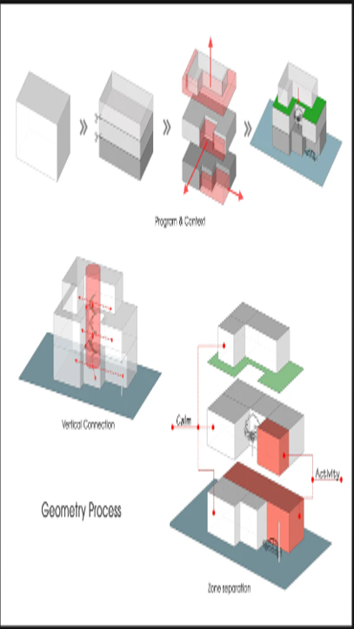
WHAT ARE ARCITECTURE DIAGRAMS?
“An architecture diagram visually represents the relationships, components, and structure of a system, making it easier for teams to understand and design the system effectively.”
Source: nulab.com

Slide 3
Types of Architecture Diagrams
Layered Architecture Diagram
Client-Server Architecture Diagram
Microservices Architecture Diagram
“This diagram shows the system broken down into separate layers like Presentation, Business Logic, and Data Layers.”
Example:
Presentation Layer: Handles UI (HTML, CSS, JavaScript).
Business Logic Layer: Processes operations (Java/Python).
Data Layer: Stores data in databases (MySQL/PostgreSQL).
Source: Lucidchart blog on Layered Architecture
“This diagram illustrates communication between clients (devices) and servers over a network”
Example:
A browser (client) sends a login request to the server, which processes it and returns the user profile.
Source:Medium - Client-Server Architecture
“This diagram represents a system as independent, smaller services, each handling a specific function.”
Example:
Order Service: Manages orders.
Payment Service: Processes payments.
Notification Service: Sends alerts.
Source:Martin Fowler’s Microservices Overview.

Slide 4

Real-life Example: Architecture Diagrams as City Maps
Imagine you are visiting an unknown city. Without a map, navigating the city is confusing and time-consuming. A city map shows you the layout, including roads, landmarks, and key connections, helping you understand where you are and how to get to your destination . Now, think of an architecture diagram as a map for a system:
City Layout: Represents the structure of the system (e.g., components like servers, databases, and services).
Landmarks: Represent important system modules or key functionalities.
Roads: Represent the communication or flow of data between components.
Architecture diagrams are like city maps, helping teams understand and navigate complex systems.
(Source: arXiv.org)

Slide 5
Components for Architecture Diagrams
.
.
.
Nodes:
Represent physical/logical components such as
servers,
applications modules
Labels
Provide descriptive names and explanations for components and their connections
Artifacts
Represent tangible elements such as documents , data base schemas or deployment packages.
Connections
Show interactions like data flow, API calls, or network links between components.
Boundaries
Define scope of system or subsystems indicating what is inside or outside

Slide 6
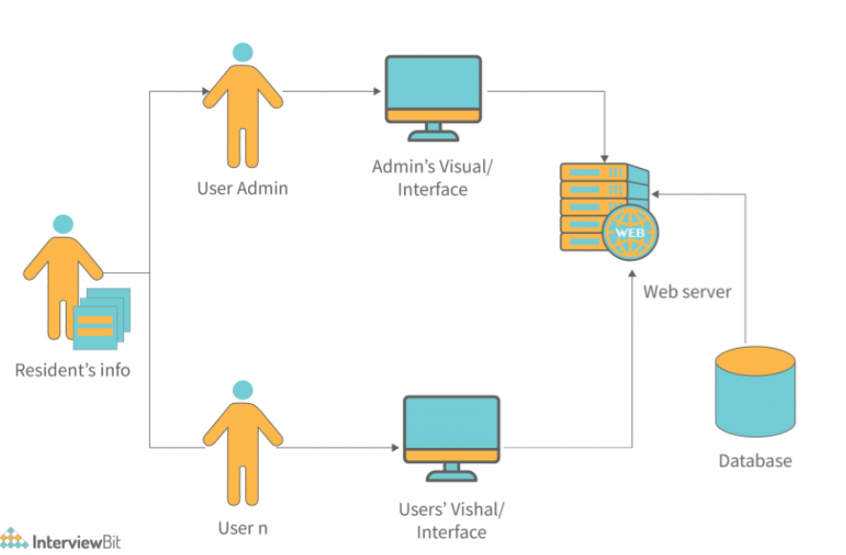
Architectural diagrams are essential because
•understand even the most complex software setups.
•make it easier to make decisions.
•show the whole system
•play a critical role in developments of projects
Source: miro.com

Slide 7
How is architecture diagram helpful? ►Designing ,communication and understanding the system: •act as blueprints for system design •planning layout •ensuring seamless interactions ►They help to understand the system in following ways: •1)Conceptual arcitecture Provides high-level system overview •2)Logical architecture focuses on the relationships and interactions between system components 3) Physical Architecture represents the system's actual implementation, covering hardware, software, and network configurations. Source: meduim

Slide 8

Why we need architectural diagram ?
allow stakeholders to identify efficient ways to scale a system
For example, a diagram may show if a system's architecture is centralized or distributed. Since distributed components scale more efficiently, monolithic components can be updated or replaced in time.

Slide 9
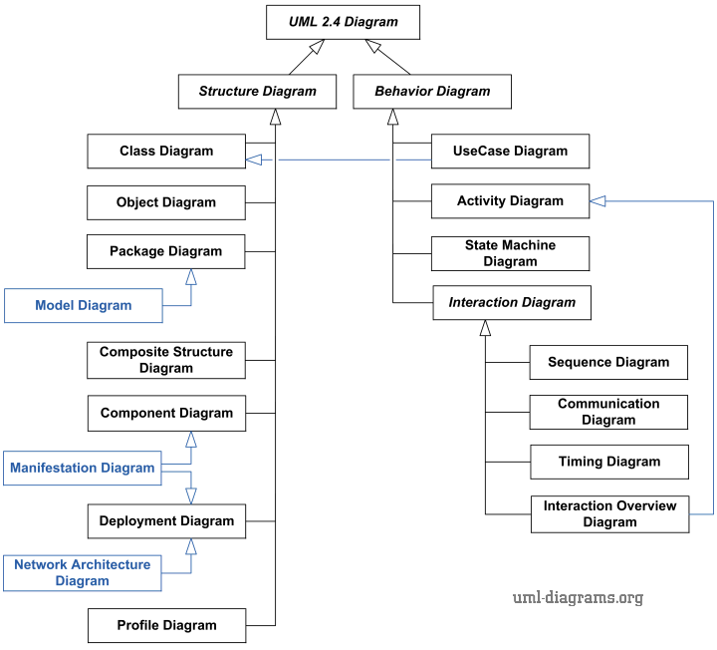
How to Create an Architecture Diagram Using UML?
First we understand the concept of UML
UML stands for Unified Modeling Language.
It is different from the other common programming languages such as C++, Java, COBOL,etc.
It is a pictorial language used to make software blueprints.
UML is not a programming language but tools can be used to generate code in various languages using UML diagrams.
The UML diagrams are categorized into structural diagrams, behavioral diagrams, and also interaction overview diagrams

Slide 10
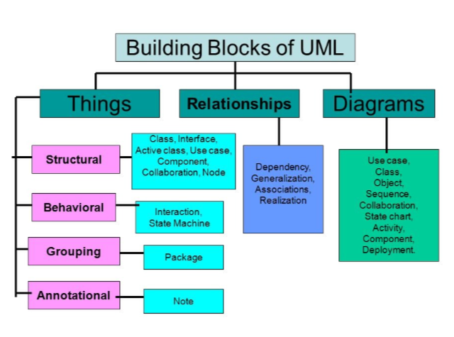
BUILDING BLOCKS OF UML
UML is composed of three main building blocks, i.e., things, relationships, and diagrams.
Building blocks generate one complete UML model diagram by rotating around several different blocks.
It plays an essential role in developing UML diagrams. The basic UML building blocks are enlisted below:
Things.
Relationships.
Diagrams.

Slide 11
Why WE USE UML? UML diagrams are used in enterprise architecture to visually represent and communicate various aspects of a system or process. They help in understanding, analyzing, and documenting the structure, behavior, and relationships within an enterprise. It can help combine visualization with standardization to result in higher quality, better compliance and enhanced productivity You already know that UML diagrams are useful for software development, but they’re especially handy for tackling large-scale projects with intricate architectures. For example, when starting a new software project, teams use UML diagrams to sketch out the system's blueprint. Several tools are available to create UML diagrams, such as: Lucid chart Microsoft Visio,Draw.io,StarUML,PlantUML. REFERENCE : TUTORIALS POINT ,JAVATPOINT ,GOOGLE

Slide 12
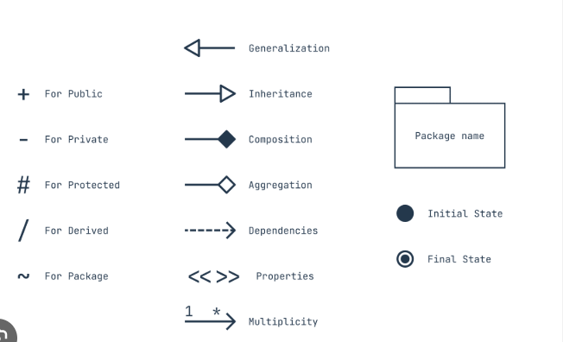
SIGNS/NOTATIONS of UML DIAGRAM
In UML, visibility modifiers control access levels: + (Public) is accessible to all, - (Private) is restricted to the class, # (Protected) allows subclass access.
In UML: Generalization (▲) shows inheritance, Composition (◆) indicates strong ownership, Aggregation (◇) shows a weaker relationship, and Dependencies (➔) represent a "uses" relationship. These symbols define interactions in a system.

Slide 13
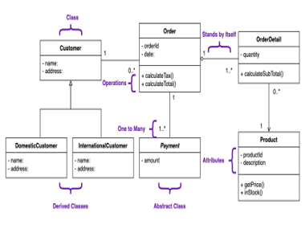
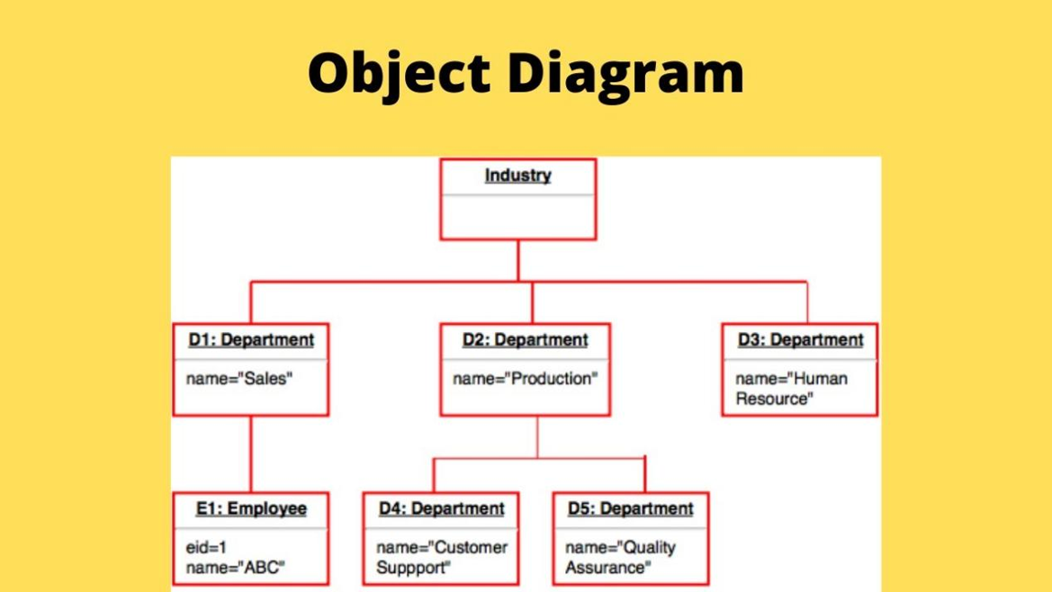
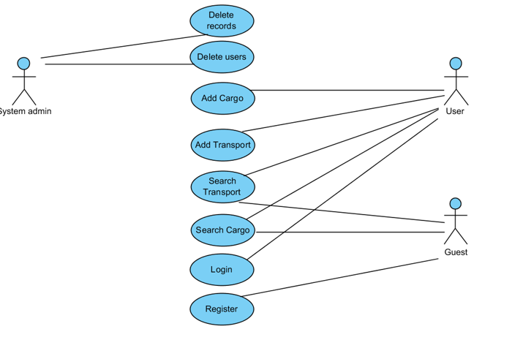
EXAMPLES OF UML DIAGRAM

Slide 14
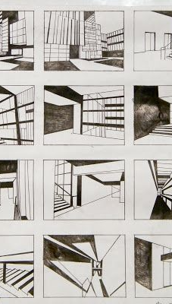
Benefits
Benefits of using Architecture Diagramm in communication

Slide 15
Benefits Of using Architecture Diagram For Communication
Clarity and understanding
Efficient Communication
Documentation
They provide a visual representation of complex systems, making it easier for stakeholders to grasp the overall structure and components
Visuals can convey information more quickly and effectively than text alone, reducing the chances of misunderstandings.
They serve as a valuable reference for future documentation and maintenance, ensuring that everyone is on the same page

Slide 16
Benefits of using Architecture Diagramm in communication
TRAINING and Onboardig
COLLABORATION
DECISION making
New team members can get up to speed more quickly by referring to architecture diagrams, which help them understand the system's layout and functionality.
They facilitate collaboration among team members by providing a shared visual language, which is especially helpful in cross-functional teams
Clear diagrams can aid in making informed decisions by highlighting dependencies, risks, and the impact of changes within the system

Slide 17
Benefits of using of using Architecture Diagramm in communication
Stakeholder Engagement
Visualizing Complex Interactions
Problem Identifications
They can be used to communicate with non-technical stakeholders, helping them to understand the technical aspects of the project.
They help in visualizing interactions between different components or subsystems, making it easier to understand how everything fits together.
By mapping out the architecture, potential issues and bottlenecks can be identified and addressed early in the development process

Slide 18


