Slide 1
Dependency Injection What ? Why ? Where? When?
What is Dependency Injection?
Dagger
ButterKnife

Slide 2
What problems do dependencies create?
Code is tightly coupled
Difficult to isolate when testing
Difficult to maintain
If I change one component how do I know what else it will affect? Did I break anything?
If tests are in place they can be your safety net

Slide 3
What is Dependency Injection?
The ability to supply (inject) an external dependency into a software component.
Instead of creating a dependency by yourself, ask 3rd party object or framework to create for you

Slide 4
Database db;
class FetchData {
public String fetchFromDB() {
db = new Database();
return db.getMyValue;
}
}

Slide 5
1) Setter Injection
Database db;
public void setDatabase(Database db) {
this.db = db;
}
class FetchData {
public String fetchFromDB() {
return db.getMyValue;
}
}

Slide 6
Database db;
class FetchData {
public void FetchData(Database db) {
this.db = db;
}
public String fetchFromDB() {
return db.getMyValue;
}
}

Slide 7
Dagger
Dagger 2 is dependency injection framework. It is based on the Java Specification Request (JSR) 330. It uses code generation and is based on annotations. The generated code is very relatively easy to read and debug.
Dagger 2 uses the following annotations:
@Module and @Provides: define classes and methods which provide dependencies
@Inject: request dependencies. Can be used on a constructor, a field, or a method
@Component: enable selected modules and used for performing dependency injection

Slide 8
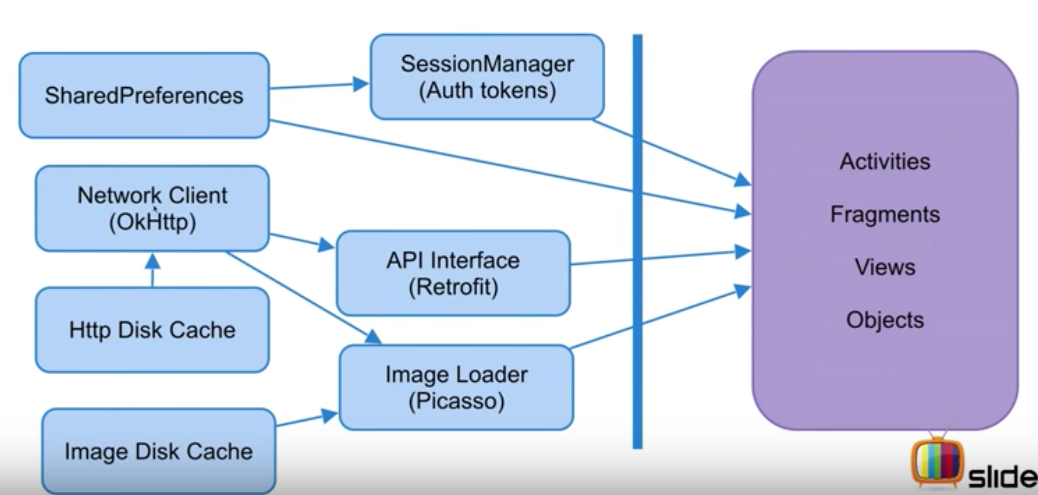
Before DI

Slide 9
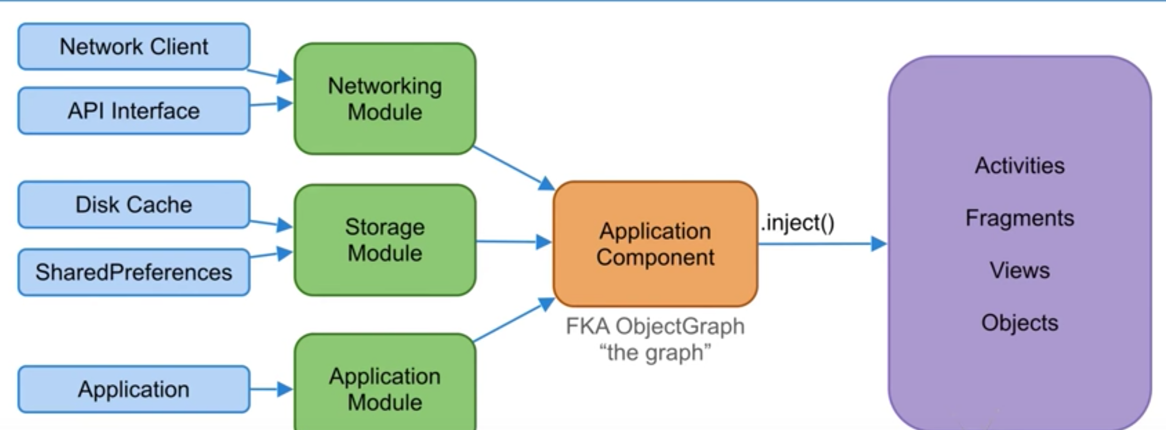
After DI

