Slide 1
Impact of Custom Activation Function on Image Classification Tasks using Deep CNN
Navid Imran, Sahil Nowkhal, Lokesh Das
Department of Computer Science
Date: December 5, 2021

Slide 2
Motivation
Image classification has lots of practical applications in computer vision related tasks
Improving accuracy in classification tasks is one of the main challenges
Different architectures, training methods and optimization procedures have been used
Existing CNN architectures do not guarantee better accuracy on all datasets.

Slide 3
Objectives
Design our own activation activation function which will perform same or better compared to existing ones.
Find the optimal parameters for the proposed activation function on studied dataset.
Compare the performance of ResNet50 with custom activation with transfer learning (fine-tuning) of ResNet50.

Slide 4
Methodology
Import necessary packages and libraries
Load dataset, preprossed and divide into training, testing, and validation sets
Load pretrained model weights for transfer learning
Alternatively build model layer by layer for regular ResNet50
Freeze some layers of the pretrained model and compile the model
Perform data augmentation if needed
Train the model with specified number of epochs and other parameters
Save the model for future predictions
Evaluate the model for loss and accuracy
Make predictions for the test data and compare with original

Slide 5
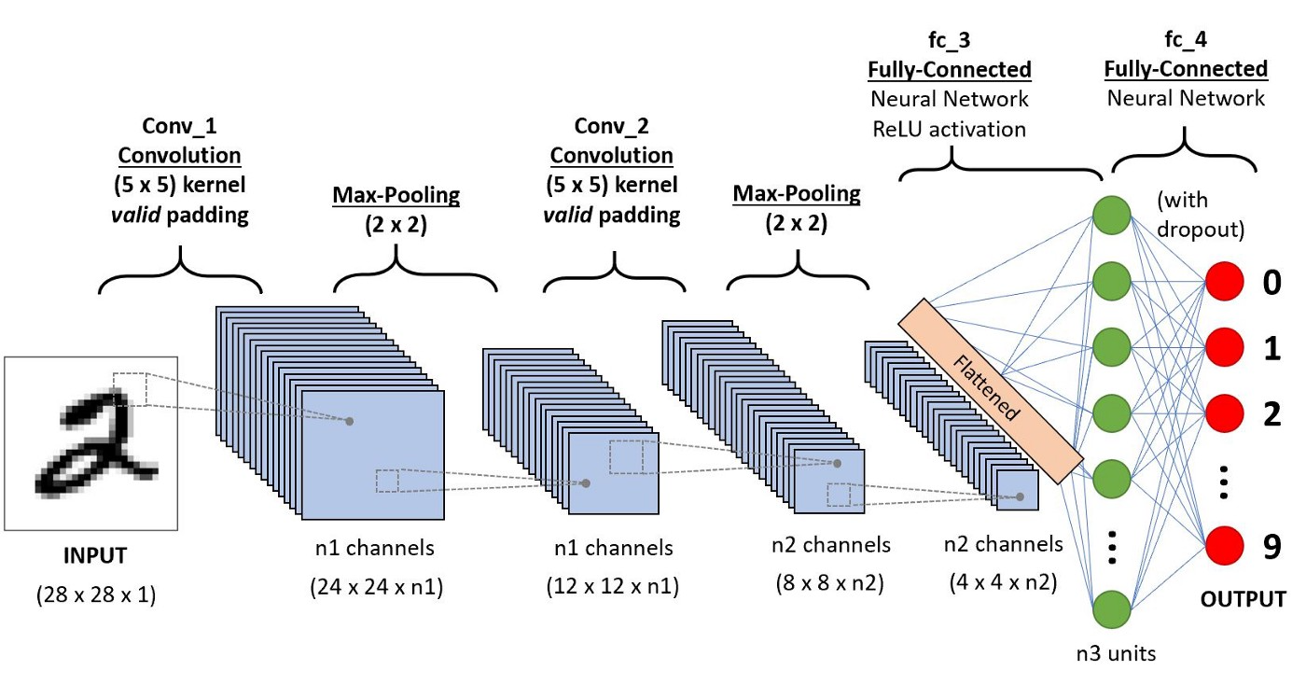
Deep Learning Architecture
Deep Neural Network has more than one hidden layers
Deep CNN performs convolutional operation with kernels
Subsampling is used to reduce the feature map sizes
Flatten feature maps to the fully-connected layers
Output layer do the classification

Slide 6
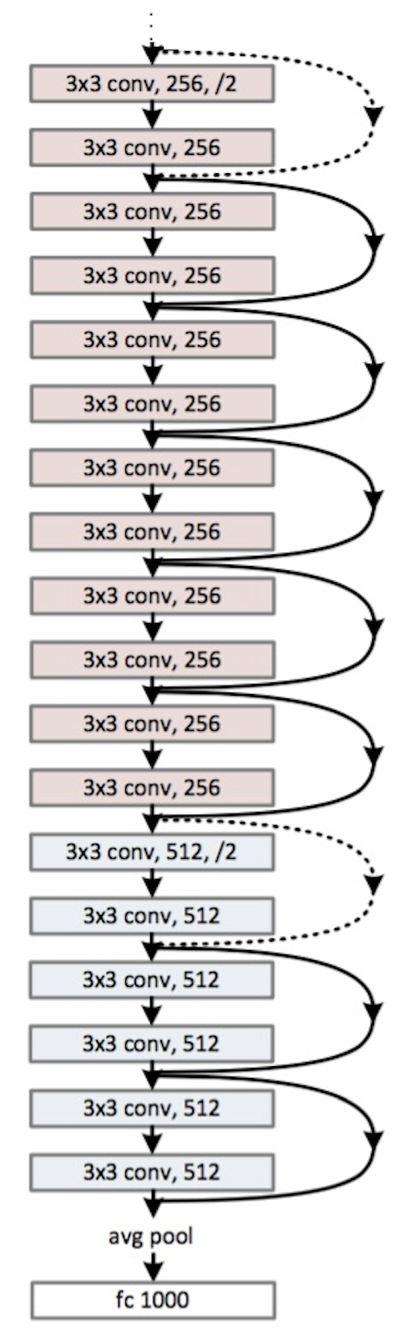
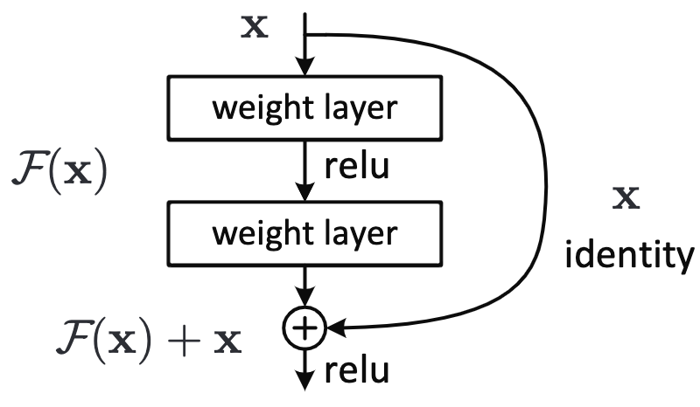
Deep Learning Architecture (contd.)
ResNet can handle a very large number of layers, yet avoid the vanishing gradient problem and the degradation problem using skip-connection
With the network depth increasing, accuracy get saturated and degrades rapidly
Resnet solves this with identity mapping

Slide 7
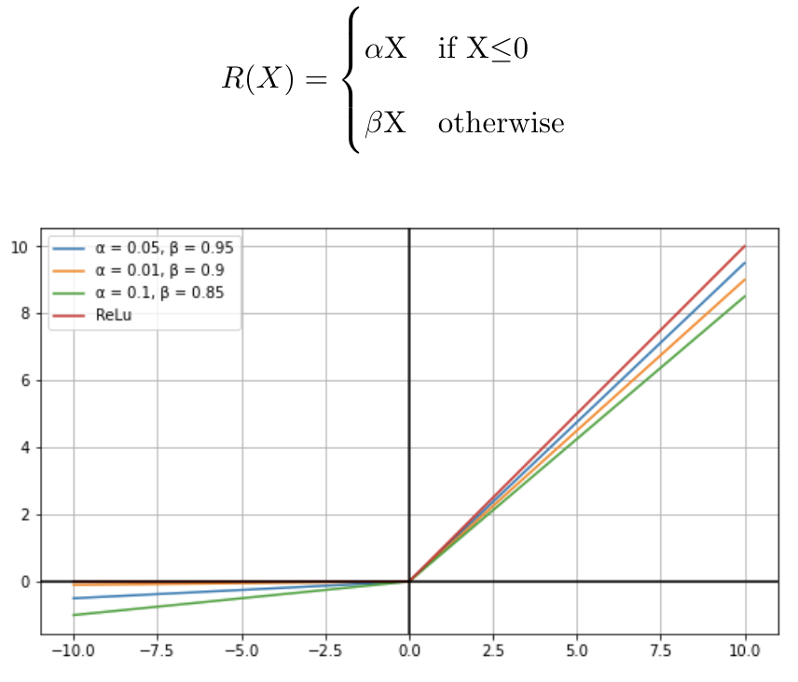
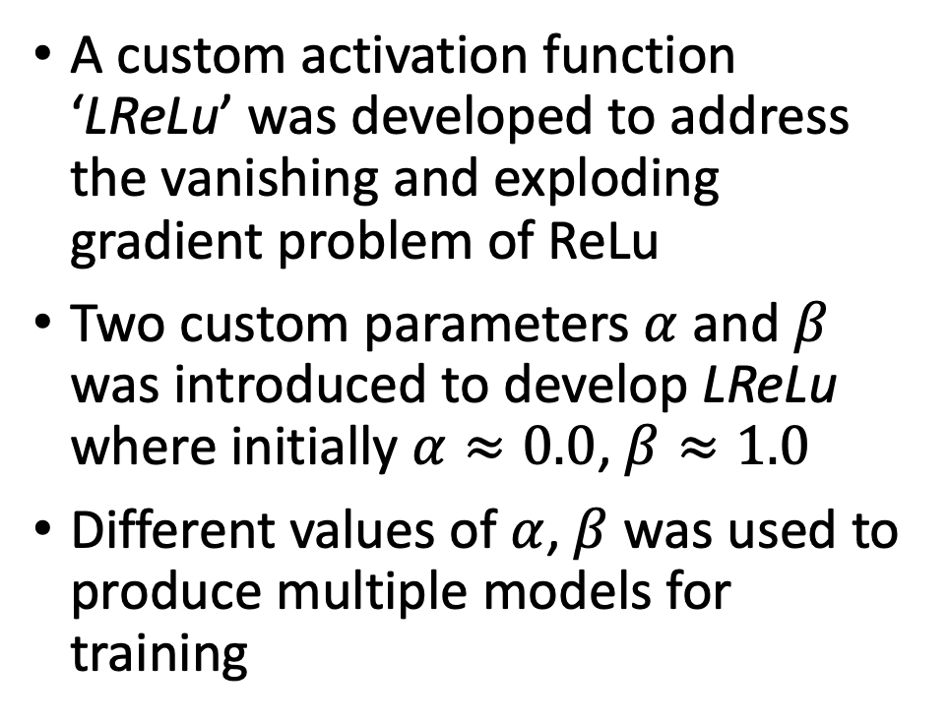
Research Contribution
A custom activation function ‘LReLu’ was developed to address the vanishing and exploding gradient problem of ReLu
Two custom parameters $α$ and $β$ was introduced to develop LReLu where initially $α≈0.0$, $β≈1.0$
Different values of $α$, $β$ was used to produce multiple models for training

Slide 8
Experimental Setup
For transfer learning, ResNet50 with pre-trained ‘Imagenet’ weights was used
Fine-tuned last 3 layers of ResNet50 with added dense and global average pooling layers
The model was trained with Google colab pro
Dataset | Number of Classes | Training size | Testing size | Total
Fruit-360 | 131 | 67,692 | 22,688 | 90,483
Parameters | Values
Batch Size | 256/512
Optimizer | Adam
Learning Rate | 0.001
Loss | Categorical Crossentropy
Number of Epoch | 100

Slide 9
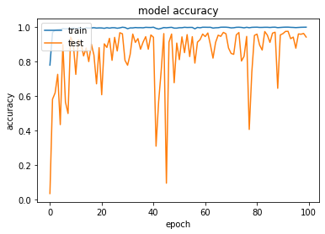
Results(Transfer Learning & LReLu)
Training/Testing accuracy for Resnet50 Transfer Learning
Training/Testing accuracy for Resnet50 with LReLu

Slide 10
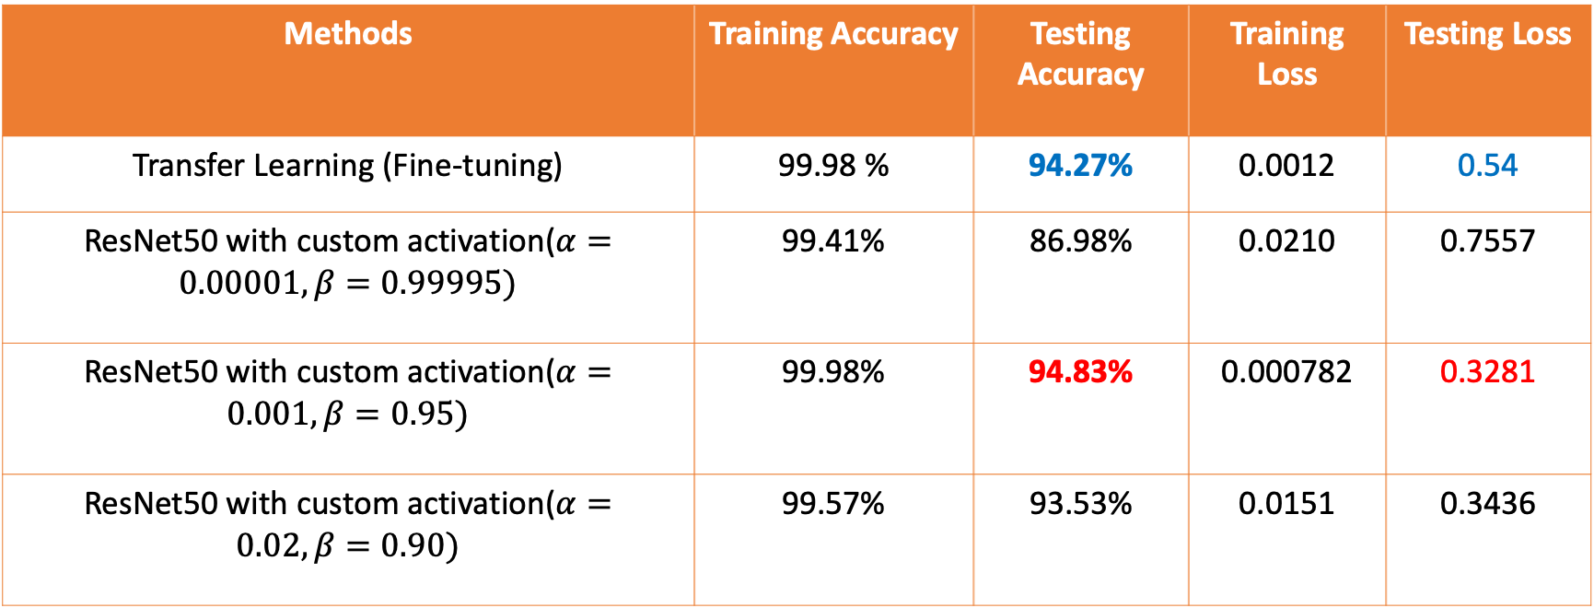
Results(Summary)
Methods | Training Accuracy | Testing Accuracy | Training Loss | Testing Loss
Transfer Learning (Fine-tuning) | 99.98 % | 94.27% | 0.0012 | 0.54
ResNet50 with custom activation($α=0.00001, β=0.99995)$ | 99.41% | 86.98% | 0.0210 | 0.7557
ResNet50 with custom activation($α=0.001, β=0.95)$ | 99.98% | 94.83% | 0.000782 | 0.3281
ResNet50 with custom activation($α=0.02, β=0.90)$ | 99.57% | 93.53% | 0.0151 | 0.3436

Slide 11
Challenges
While writing our custom activation function in Keras, got many bugs regarding “get_custom_objects”
Preprocessing and data augmentation of fruit-360 dataset was a bit time consuming
Training Deep Neural Network on Google Colab was very time consuming and tedious

Slide 12
Conclusion
Developed a new custom activation function LReLu followed by Relu and LeakyReLu activations
Developed ResNet50 from scratch with LReLu and trained on fruit-360 dataset
Our activation function has shown competitive performance in line with ReLu and Transfer Learning

Slide 13

Future Work
Validate the effectiveness and performance of LReLu on other CNN architecture with more challenging datasets
Find optimal range of values for $α$ and $β$

