Slide 1
Predicting Sales Price of Homes
Thalia Rahim, Nimrit Cheema, Ben Rafael

Slide 2
Motivation
Housing prices are inevitably dictated by high income areas, school districts, major metropolitan area etc., but there are other factors that contribute to the listing price of a home that is not related to income or neighborhood
We wanted to further examine how characteristics of a house affect the sale price in order to find how to predict a house’s value in the future
Our overall goal while building our models was to determine the most impactful factors in deciding the selling price of a home

Slide 3
Variables:
Condition1- proximity to various conditions
BldgType- type of building
HouseStyle- style of building
Pool
OverallQuality- rates material and finish of house 1-10
YearBuilt
YearRemodeled
FullBath- number of full baths
KitchenAbvGr
KitchenQual- kitchen quality
Fireplaces- number of fireplaces
GarageCars
GarageArea
OpenPorchSF- open porch area SF
MiscVal- misc features (elevator shed, tennis court, etc)
Furnished
TotalSqFt
SalesPrice (our Y)
MSZoning- zoning classification
LotFrontage-linear ft of street connected to property
LotArea- lot size in sq
GrLivArea-
LotShape-general shape of property
LotConfig- lot configuration
Neighborhood- names of neighborhood

Slide 4
Dataset Cleaning
Renamed y-variable to “SalesPrice”
Since most of our variables are categorical, we transformed them to factors using as.factor()
Created new column, TotalSqFt
TotalSqFt = 1stFlrSF + 2ndFlrSF + TotalBsmtSF
Identified lots of perfect collinearity issues-
-BsmtFinSF1, BsmtFinSF2, 1stFlrSF, 2ndFlrSF, TotalBsmtSF
Removed BsmtFinSF1 and BsmtFinSF2 columns because they equal TotalBsmtSF

Slide 5
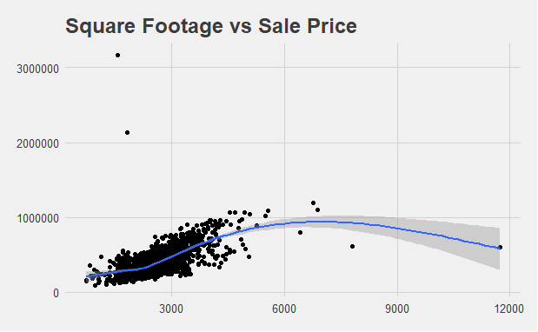

Slide 6
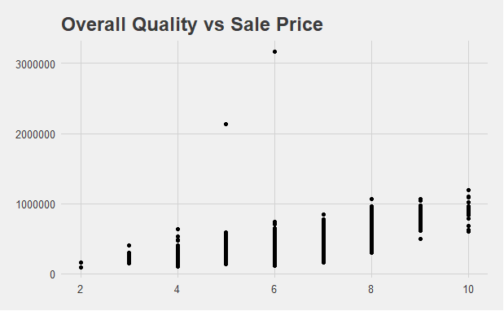

Slide 7


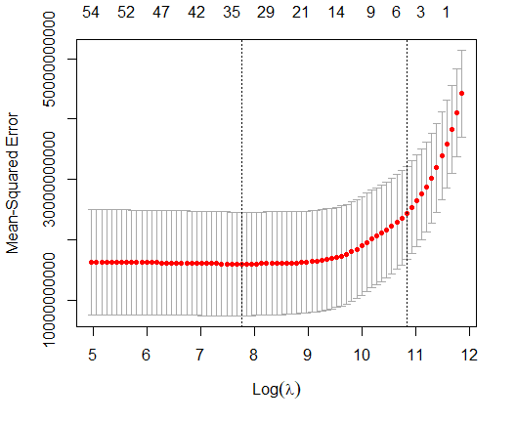

Lasso
Predicted Sales Price against all the variables of the dataset in order to see which ones lasso classifies as important
Chose to use lambda.1se in order to have a parsimonious model with only 11 variables

Slide 8
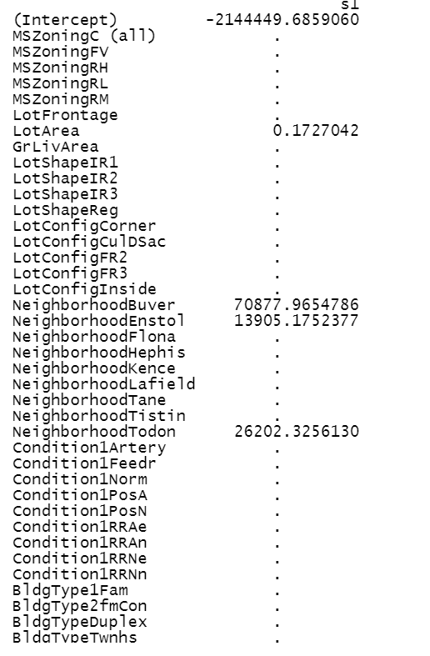
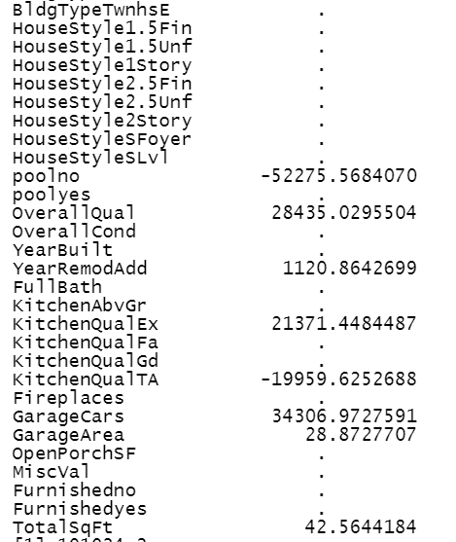
Lasso Coefficients:
NeighborhoodBuver (base variable)
NeighborhoodEnstol
NeighborhoodTodon
PoolNo
KitchenQualEx(excellent) (base variable)
GarageArea
OverallQual
YearRemodAdd
KitchenQualTA (typical/average)
GarageCars
TotalSqFt
Test RMSE: 175,894.3
Train RMSE: 101,024.2
- Model is underfit

Slide 9
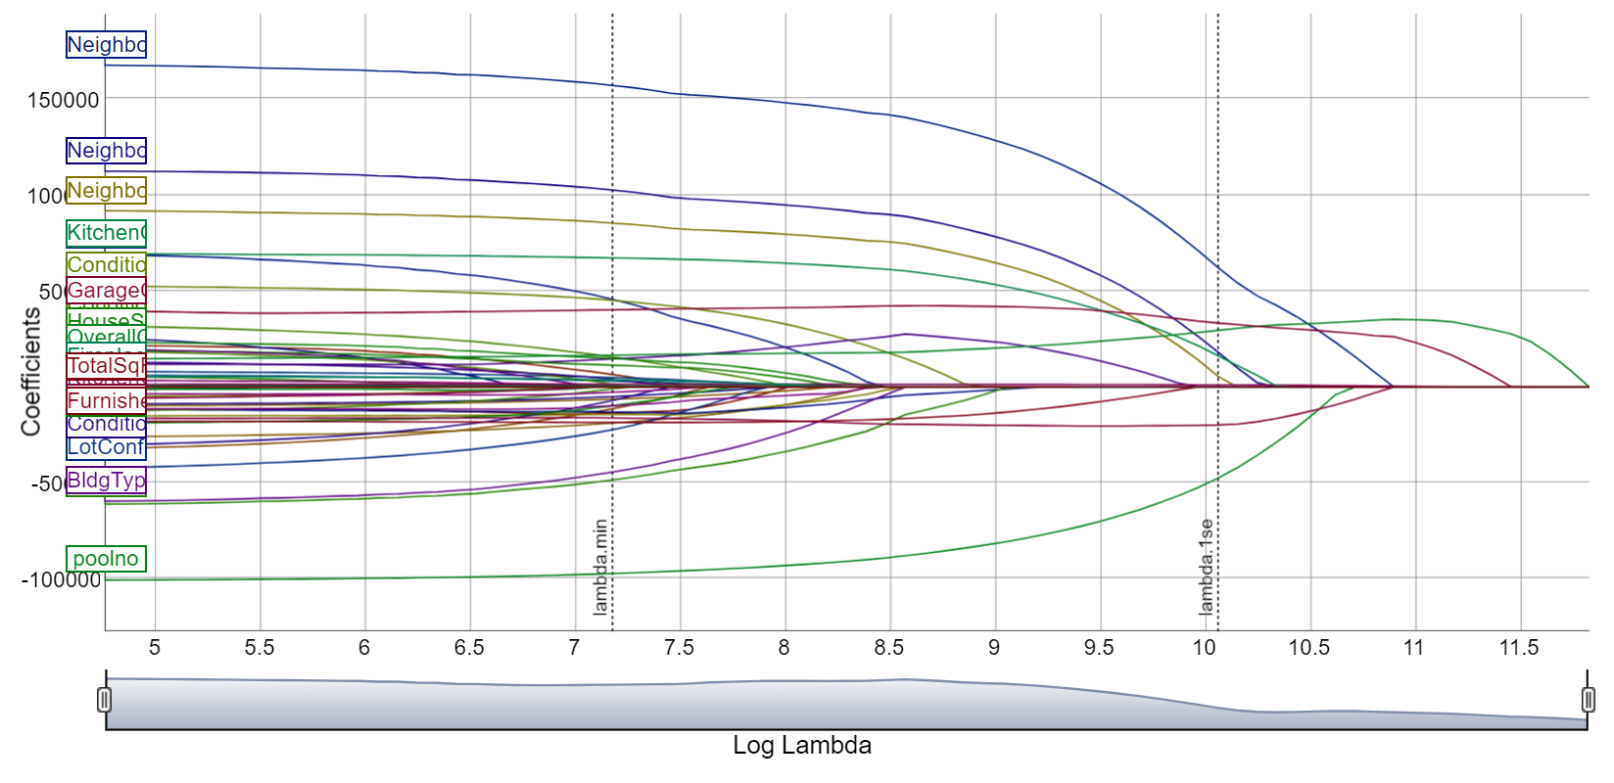

Slide 10
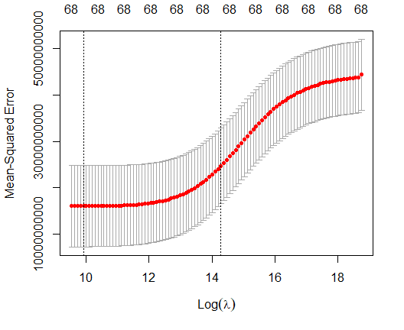
Ridge
Again predicted Sales Price against all the variables of the dataset in order to see how ridge compares to our lasso model
Test RMSE: 176,660.7
Train RMSE: 103,094.2
Virtually the same results as lasso

Slide 11
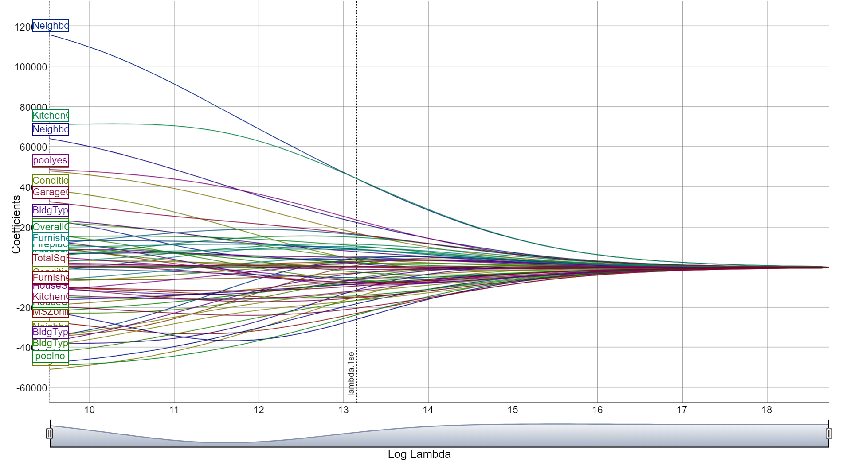

Slide 12
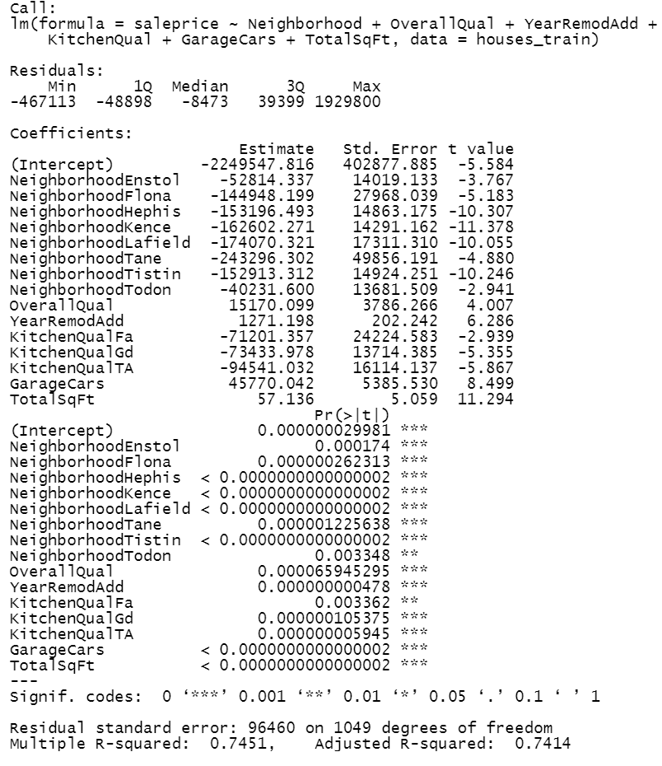
Linear Model
Predicted sales price against the six variables that remained using lambda.1se of our lasso model
NeighborhoodBuver, OverallQual, YearRemodAdd, KitchenQualTA (typical/average), GarageCars, TotalSqFt
R^2 of 0.74

Slide 13
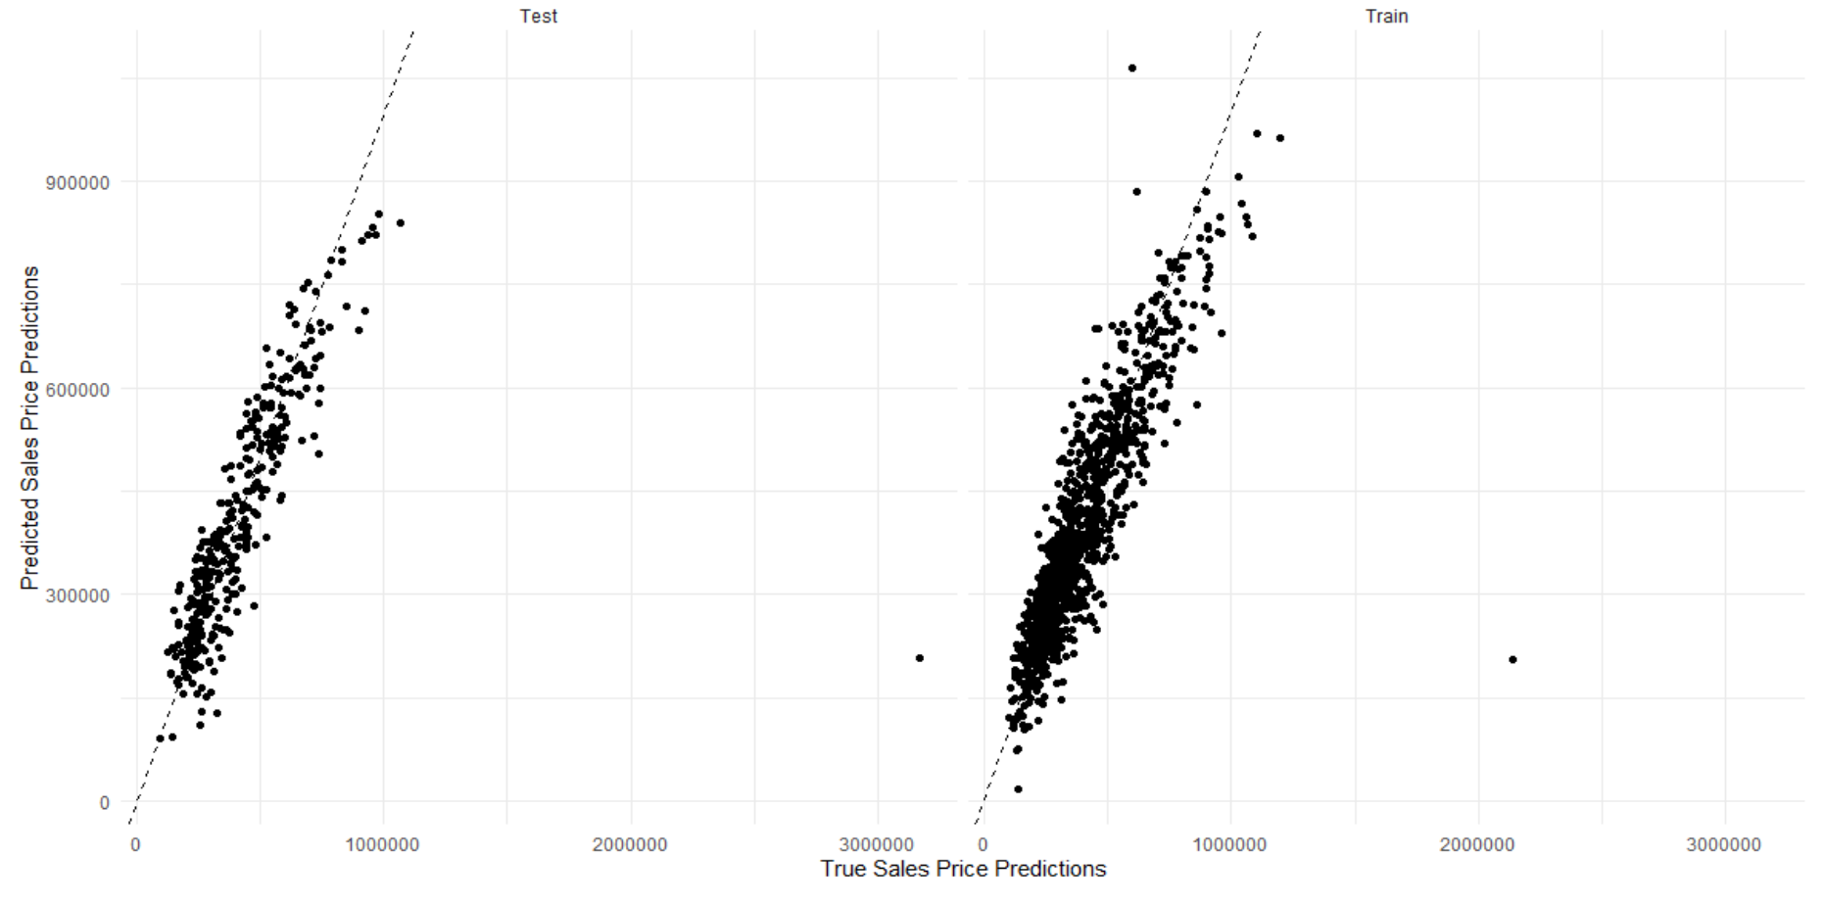
Predicted vs True Sales Price

Slide 14
Comparing Models-
Lasso :
Test RMSE: 175,894.3
Train RMSE: 101,024.2
Ridge:
Test RMSE: 176,660.7
Train RMSE: 103,094.2
Linear:
Test RMSE: 171,877.4
Train RMSE: 95,731.07

Slide 15
Conclusion/Limitations
Linear model would be the most adequate model given the R2 of 0.74 and lower RMSE values
Limitations: missing meaningful variables in dataset such number of bedrooms, mean income in neighborhood, school district, population, tax brackets, etc
Year this data is based off of is unknown, making it hard to determine whether the current housing market relates to our findings

Slide 16
https://github.com/nimritcheema/MGSC-310-Final-Project

Slide 17
Thanks for listening! Questions?

