Slide 1
Weighted Fair Queuing
“A Generalized Processor Sharing Approach to Flow Control in Integrated Services Networks”,
A. Parekh, R. Gallager, IEEE/ACM Trans. on Networking June 1993, April 1994
“WF²Q: Worst Case Fair Weighted Fair Queuing”,
Jon Bennett, Hui Zhang, IEEE INFOCOM 1996

Slide 2
Generic Switch Structure
A Scheduling Discipline resolves contention. Decides who’s next?
Can differentiate users / classes of traffic.
Switch Output Module
Queue 1
Session 1
Output Line
Queue 2
Session 2
Scheduler
Queue 3
Session 3
Queue 4

Slide 3
Scheduling
Desired Properties
  Fair resource sharing.
  Performance guarantees.
  Offer different users different quality of services
Where?
  Wherever contention for resources occurs.
  We will concentrate on the output of a network layer switch.

Slide 4
Max-Min Fairness
Assume all users have equal rights (priority) to a resource:
  Each connection gets no more than what it wants.
  Excess is distributed evenly across connections.
Possible to generalize for the weighted case: Some connections are more important than others.
Total Demand > capacity
Total Demand < Capacity

Slide 5
Fairness
Fairness is intuitively a good idea.
But it also provides protection
  traffic hogs cannot overrun others
  No need to be aggressive to get what you want.
100
200
100
Queue 1
Scheduler
Queue 2
200

Slide 6
Outline
Introduction to Link Scheduling
Generalized Processor Sharing (GPS)
Weighted Fair Queuing
Worst Case Fair WFQ (WF²Q)
GPS Performance Guarantees
Real World Use

Slide 7
Bit Round Robin Scheduling
t
t
t

Slide 8
Bit Round Robin Scheduling
t
t
t

Slide 9
Bit Round Robin Scheduling
t
t
t

Slide 10
Bit Round Robin Scheduling
t
t
t

Slide 11
Bit Round Robin Scheduling
t
t
t

Slide 12
Bit Round Robin Scheduling
t
t
t

Slide 13
Bit Round Robin Scheduling
t
t
t

Slide 14
Bit Round Robin Scheduling
t
t
t

Slide 15
Bit Round Robin Scheduling
t
t
t

Slide 16
Bit Round Robin Scheduling
t
t
t

Slide 17
Bit Round Robin Scheduling
t
t
t

Slide 18
Bit Round Robin Scheduling
t
t
t

Slide 19
Bit Round Robin Scheduling
t
t
t

Slide 20
Bit Round Robin Scheduling
t
t
t

Slide 21
Bit Round Robin Scheduling
t
t
t

Slide 22
Bit Round Robin Scheduling
t
t
t

Slide 23
Bit Round Robin Scheduling
t
t
t

Slide 24
Bit Round Robin Scheduling
t
t
t

Slide 25
Bit Round Robin Scheduling
t
t
t

Slide 26
Bit Round Robin Scheduling
t
t
t

Slide 27
Bit Round Robin Scheduling
t
t
t

Slide 28
Bit Round Robin Scheduling
t
t
t

Slide 29
Bit Round Robin Scheduling
t
t
t

Slide 30
Bit Round Robin Scheduling
t
t
t

Slide 31
Bit Round Robin Scheduling
t
t
t

Slide 32
Bit Round Robin Scheduling
t
t
t

Slide 33
Bit Round Robin Scheduling
t
t
t

Slide 34
Bit Round Robin Scheduling
t
t
t

Slide 35
Bit Round Robin Scheduling
t
t
t

Slide 36
Bit Round Robin Scheduling
t
t
t

Slide 37
Bit Round Robin Scheduling
t
t
t

Slide 38
Bit Round Robin Scheduling
t
t
t

Slide 39
Bit Round Robin Scheduling
t
t
t

Slide 40
Bit Round Robin Scheduling
t
t
t

Slide 41
Bit Round Robin Scheduling
t
t
t

Slide 42
Bit Round Robin Scheduling
Round Number
(“Virtual Time”)
Slope
=
t
1/Number of
active sessions
t
t

Slide 43
Generalized Processor Sharing
Can add weights to each flow:
  A flow with weight “2” gets to send two bits per round.
Processor Sharing - send a small fraction of a bit each round
  Like having multiple flows sharing the output line at the same time.
  No flow has to wait for “its turn”.
  Is perfectly fair at all times.
PS
BRR
t

Slide 44
PS - Another Example
Packet A arrives at time 0
Packet B arrives at time 50
Both packets are 100 bits long.
Output line rate is 1 b/s.

Slide 45
PS - Another Example
S_{A}(t)
100
75
50
t
50
100
150
200
S_{B}(t)
100
50
25
t
50
100
150
200
V(t)
150
100
75
75
50
t
50
100
150
200

Slide 46
GPS - A Weighted Example
100
W_{A}=1
S_{A}(t)
60
70
50
F_{A} = V(0) + L / W_{A}
= 0 + 100 / 1
= 100
t
50
100
150
200
S_{B}(t)
80
100
W_{B}=4
40
F_{B} = V(50) + L / W_{B}
= 50 + 100 / 4
= 75
t
50
100
150
200
V(t)
100
70
75
50
60
t
50
100
150
200

Slide 47
Fair Queuing
Cannot implement GPS
  No way to serve more than one flow at a time.
  Would rather not break packets to small pieces (overhead).
  No real discipline can be as fair as GPS: when flow A is served we are unfair to all other flows.
Can try to emulate GPS
  Bounded approximation error.
  Keep implementation cost low.
“Weighted Fair Queuing”, S. Keshav 1989.
(Packet GPS in Parekh terminology)

Slide 48
FQ - Basic issues
Basic Idea
  Serve packets in order of their finish time had we been doing GPS.
  Cannot always do this unless we know the future.
Implementation
  Key idea: Round number (Virtual time) is an increasing function of time.
  Can calculate finish number of packet when it arrives.
  Send packets in order of their finish numbers.
  Need to keep track of current round number V(t).

Slide 49
FQ - Example
Note that FQ (unlike packet by packet round robin) handles variable packet sizes.
Packets are sent in order of departure in the corresponding
PS system
FQ
PS

Slide 50
FQ - Implementation
When a packet of flow f arrives calculate its finish round number:
  If flow f is active, F(f, k) = F(f, k-1) + L(k)
  Otherwise, F(f, k) = V(t) + L(k)
Need to keep track of virtual time V(t)
  Slope of 1/N(t)*r
  Slope may change whenever a packet arrives (in GPS) or departs.
Must keep track of active sessions in the simulated GPS systems
  Next(t) = t + [ F_{min} - V(t) ]N(t)*r
  Computationally expensive.

Slide 51
FQ - Implementation
When the line becomes idle, transmit the packet with the smallest finish number.
  V(t) is an increasing function of time.
  If F_{A} > F_{B}, GPS will finish sending packet A after packet B.

Slide 52
WFQ and GPS
GPS is not ahead of WFQ by more than one packet (in terms of transmitted bits up to time t).
Packets in WFQ are not delayed more than one packet relative to GPS:
  S_{GPS} (f, t) - S_{WFQ}(f, t) ≤ L_{max}
  D_{WFQ} (f, k) - D_{GPS} (f, k) ≤ L_{max} / r

Slide 53
Delay Bound
FQ
PS
When WFQ and GPS finish packets at the same order,
WFQ will never lag behind GPS.
(And may sometimes be ahead of GPS).

Slide 54
Delay Bound
FQ
Error term does not accumulate over time.
May accumulate over multiple network hops.
PS
When a packet arrives too late, it may
have to wait for the current packet to finish
transmission, hence L_{max}/r delay.

Slide 55
Worst Case WFQ (WF²Q)
Contrary to popular belief WFQ does not approximate GPS to within a difference of one packet.
  No lower bound:
  S_{WFQ} (f, k) - S_{GPS} (f, k) ≤ L_{max}
  In fact WFQ might be well ahead of GPS!
Less delay, but..
More jitter,
Difficult to estimate available bandwidth.
  Necessary for best-effort traffic.

Slide 56
W²FQ - Example
11th packet
S1
R1=0.5
S2
S3
S4
R2=R3=…=R11=0.05
S5
S6
S7
S8
Packet lengths: 1 sec
S9
S10
S11
t
0
1
10

Slide 57
GPS Service Order
11th packet
S1
S2
S3
S4
S5
S6
S7
S8
S9
S10
S11
t
0
10
20

Slide 58
WFQ Service Order
11th packet
S1
S2
S3
S4
S5
S6
S7
S8
S9
S10
S11
t
0
10
20

Slide 59

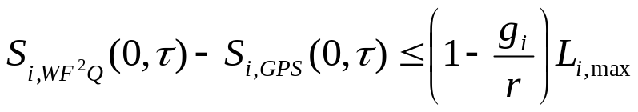
WF²Q Basics
In WFQ the scheduler selects next packet with minimal finish number, among all available packets.
To minimize difference between packet system and fluid-GPS, scheduler should consider only packets that have started in the emulated GPS system.

Slide 60
W²FQ Service Order
11th packet
S1
S2
S3
S4
S5
S6
S7
S8
S9
S10
S11
t
0
10
20

Slide 61
Implementation: Rate Controlled Scheduling
Regulator holds packets until they are eligible for transmission.
Scheduler decides which eligible packet should be transmitted next.
Switch Output Module
Queue 1
Regulator
Queue 1
Queue 2
Regulator
Queue 2
Scheduler
Queue 3
Regulator
Queue 3
Queue 4
Regulator
Queue 4

Slide 62
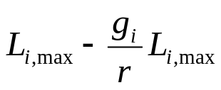
WF²Q Properties
Discipline is work-conserving:
  Rate controller + GPS scheduler is the same as GPS alone.
  Replace GPS with WFQ (both work conserving) to get WF²Q.
Lower bound
  WF²Q starts sending packet no earlier than GPS.
  GPS may take more time to transmit the packet (depending on allocated and available bandwidth).
r
WF²Q
g_{i}
GPS

Slide 63
What next?
WFQ (or WF²Q) approximate GPS service to within a constant error term.
GPS is much simpler to analyze (fluid model).
Strategy
  Determine performance bounds for networks of GPS schedulers.
  Use our previously derived bounds to bound the performance of a corresponding WFQ network.

Slide 64
GPS Performance Analysis
Analyzing Networks of GPS schedulers.

Slide 65
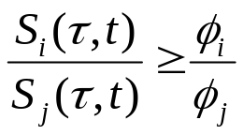
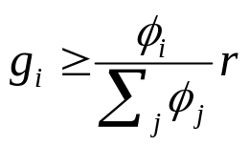
GPS - Mathematical Model
Generalized Processor Sharing is defined by
  Assuming session i is backlogged.
Session ‘i’ is guaranteed a rate of
Protected from other sessions.
Can reduce delays for a session by increasing its weight φ.
  Corresponding increase in delay for other sessions.
  Less impact on other sessions when the better treated session is steady.

Slide 66


Weights Allocation
Session 1 is a steady source (delay sensitive real time traffic).
Session 2 is a bursty source (best effort traffic).
5
Stream 2
5
Stream 2
4
4
3
3
2
2
1
1
0
0
1
2
3
4
5
6
7
8
9
10
0
0
1
2
3
4
5
6
7
8
9
10
5
Stream 1
5
Stream 1
4
4
3
3
2
2
1
1
0
0
1
2
3
4
5
6
7
8
9
10
0
0
1
2
3
4
5
6
7
8
9
10

Slide 67
Guaranteed Performance
Delay depends on arrival functions of all sessions.
May also help bound the maximum queue length (I.e, size of buffers needed by the switch for every session).
A_{i}(0,t)
S_{i}(0,t)
D_{i}(a)
Q_{i}(a)
t

Slide 68
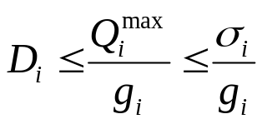
Networks of GPS Servers
Assume session ‘i’ is leaky bucket constrained:
  A_{i} ~ ( σ_{i}, ρ_{i} )
  Other sessions are not constrained.
  Network may not even be stable.
Assume g_{i} is the minimum guaranteed bandwidth allocated to
session ‘i’ along its path.
  Session is locally stable: g_{i} ≥ ρ_{i}
Session ‘i’ can be guaranteed maximum delay:

Slide 69
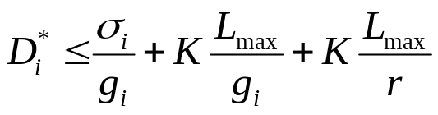
WFQ End-to-End Delay
When the servers are WFQ:
First error term due to store & forward delay
  Packets are processed by the scheduler when their last bit arrives.
WFQ error term
  Negligible when line rate is high.

Slide 70
A Simple Example
Given:
  A constrained connection A ~ ( 16 KByte, 150 Kbps )
  10 network hops (rate 45 Mbps)
  Packet size are up to 8 KB
  Total propagation delay: 30 ms.
What is the required guaranteed bandwidth to get an end-to-end delay not more than 100 ms?
Solution: 12.87 Mbps!
  S&F delay contributes 46 ms to delay!
  All other terms: 24 ms

Slide 71
Leaky Bucket Constrained Sources
To reduce delays for a given session, we must increase its weight.
  Increases guaranteed bandwidth for this session.
  Reduces network capacity.
  May overload the network turning it unstable.
When is it possible to reduce delay while still maintaining stability?

Slide 72
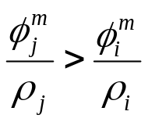
Consistent Relative Session Treatment (CRST)
Assume all sources are leaky bucket constrained A_{i} ~ ( σ_{i}, ρ_{i} )
Definition:
  Session j is said to impede session i at node m if:
Definition: Consistent Relative Session Treatment (CRST)
  A GPS weight assignment for which:
  If session i impedes session j at node m, then session i impedes session j at any other node where they contend for bandwidth.

Slide 73
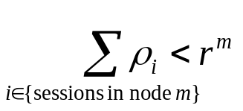
Stability Condition
Theorem:
  A CRST GPS network is stable if the utilization at every node is less than one.
Finding D* and Q* for a general GPS network is a complex optimization problem.
It turns out that it is easily bounded for CRST networks.
In the following slides we will sketch an outline of the proof.

Slide 74
The Single Node Case
Assume all sources are leaky bucket constrained A_{i} ~ ( σ_{i}, ρ _{i})
Definition: Greedy Source
  A leaky bucket constrained source is greedy starting at time t if its arrival function is maximal for all time τ > t.
  Uses all available tokens and maximum rate ρ_{i}
Theorem:
  For every session D* and Q* (worst delay and backlog) are achieved when all sessions are greedy starting at time 0, the beginning of a system busy period.

Slide 75
Greed...
Intuitively simple:
  When all sessions are greedy starting at time 0,
  maximum traffic is entering the network in (0,t).
  All sessions are active, therefore each one is allocated minimal guaranteed bandwidth.
  Result: maximum backlog and delay.
No need to solve a difficult optimization problem to determine Q* and D*.

Slide 76
Single Node - Delay and Backlog
Two greedy streams, φ₁ / φ₂ = 2
6
Note that D* and Q* may not be achieved at the same time!
  D depends on backlog size and clearing rate.
5
A₁(0,t), A₂(0,t)
4
Q₁(0,t)
S₁(0,t)
3
2
1
0
0
2
4
6
8
10
12
t

Slide 77
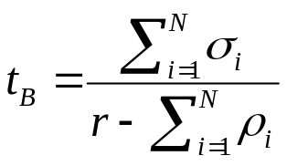
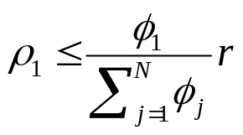
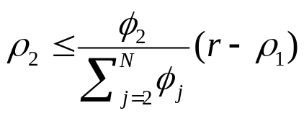
Feasible Ordering
Assume all sessions are greedy starting at time 0.
Server will finish serving all backlog at time:
Number the sessions according to the order in which their backlog is cleared.
For the first session:
The second:
There may be more than one possible feasible ordering.
The one that comes into play at time 0 depends on the σ_{i} ‘s.

Slide 78
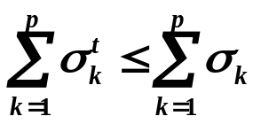
An Important Inequality
Theorem:
  Let 1,..,N be a feasible ordering, then for any time t and session p:
  I.e, burstiness is not increased by the GPS server.

Slide 79


Output Burstiness
Maximum output burst (for session i) results when:
  Backlog is maximal (Q*)
  Session i is the only active session (highest output rate).
Other direction:
Calculate Q* and determine output burstiness.

Slide 80
Network Internal Burstiness
Following Cruz, we compute the burstiness at the output of every node on the session’s path.
If session i does not impede session j at node m then σ_{j}^{out} is independent of σ_{i}^{out}
Iterative procedure computes σ^{out} for all sessions at all nodes
  Characterizes traffic entering every network node.

Slide 81
Computing Bounds for Networks with Known Internal Burstiness
Maximum delay is achieved when all sessions entering a node are greedy at the same time, but…
Network topology may preclude certain arrival functions.
Should compute maximum delay over all possible arrival functions of all sessions at all nodes.
  Difficult optimization problem.

Slide 82

Independent Sessions Relaxation
When computing session i’s delay and backlog assume all others sessions (independent sessions) can send traffic at (σ_{j}^{m} ,ρ_{j} ).
Session i traffic is constrained to flow along its route so that:
Upper bounds the delay and backlog of session i.
  Every arrival function allowable in the network is allowed under the relaxation too.

Slide 83






Independent Sessions
Other leaky bucket constrained sources
sharing the links with session i
1
2
K

Slide 84
More Complications...
A₁
Q* and D* are not necessarily achieved with the same arrival functions.
Session 2 becomes greedy at t₁
Q*
S₁²
t₁
A₁
D*
S₁²
Session 2 becomes greedy at t₁’
t'₁

Slide 85
The Universal Service Curve
We are looking for:
  End-to-end delay (D*)
  Q* = Q¹+Q²+… (total session i traffic in the network)
Crucial insight:
  Session i will always be limited by the slowest link on its path.
  The set of all feasible rates for session i on link m is given by the slopes of S_{i}^{m}(0,t) (assuming all sessions are greedy).
Solution:
  Construct the universal curve G_{i}(0,t) by concatenating the segments of all S_{i}^{m}(0,t) in increasing slope order.

Slide 86
Universal Curve - An Example
A_{i}
A_{i}²
The Universal Curve makes calculating D* and Q* easy!
σ_{i}
σ_{i}²
σ_{i}²
S_{i}¹
S_{i}²
t₁
t₁^{B}
t₂
t₂^{B}
G_{i}(0,t)
Q*
A_{i}(0,t)
σ_{i}
D*

Slide 87
Summary - GPS Networks
If all sources are known to be leaky bucket constrained,
  And we limit ourselves to CRST networks…
  We can control each session’s delay by adjusting the weights at each GPS node.
  We can easily bound the delay and backlog.
If only some sources are leaky bucket constrained,
  Bandwidth and delay are coupled.
  Can reduce delay for a session only by increasing its allocated bandwidth, thereby wasting network resources!
  GPS protects sessions from bandwidth hogs.

Slide 88
Integrated Services in the Internet
Resource Reservation Protocol (RSVP)

Slide 89
Signaling
Users need to communicate their bandwidth / delay requirements to the network.
  Call setup.
  Connection teardown.
  Renegotiation.
Switches communicate to select a path with enough resources.

Slide 90
Real World Use - RSVP
Each router implements WFQ or other per-flow scheduling discipline.
Resource Reservation Protocol used to request bandwidth allocation.
Source specifies Flowspec ( σ_{i}, ρ_{i} ).
Destination requests bandwidth (affects delay).
Reservation request propagates from destination to source allocating bandwidth in each link (assigning weights).
If bandwidth is not available, request is denied (admission).

Slide 91
Scaling
Needs a QoS-capable routing protocol to select paths with available bandwidth.
  More information to distribute through the network.
  More changes as flows are started and destroyed.
All routers must store per-flow information.
  Less robust.
  Difficult to implement at high speed (Internet backbones).

Slide 92
Aggregation
More aggregation:
  Less sessions to consider in backbone switches.
  Less signaling.
  BUT: less isolation!
Solution:
  Aggregate to a class.
  Members of the same class have similar performance requirements.
  Police traffic at the edge of the network (no protection inside network between sessions of the same class).

Slide 93
The End

Slide 94
Work Conserving vs. Non Work Conserving Service Disciplines
Work conserving scheduler is never idle when there are packets in the queue.
GPS, WFQ, WF²Q are all work conserving disciplines.
Non work conserving schedulers hold packets in queue until their eligibility time is reached (e.g., TDM).

Slide 95
Non Work Conserving Disciplines
Reduce network internal burstiness.
  Smaller buffers needed at switches.
Increases mean delay.
  Not a problem for playback applications.
  Does not hurt worst-case performance.
Wastes bandwidth.
  Can serve best effort traffic when idle.
High implementation costs at every switch (regulators).

