Slide 1

Fine-Tuning LLMs
Using Parameter-Efficient QLoRa
Nimu Sidhu | GAIT 2 | July 2023

Slide 2
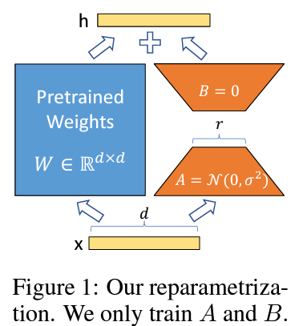
Why Parameter Efficient Fine Tuning?
Fine-tune only a fraction of an open-source LLM’s parameters
Fine-tuning billions of parameters can be extremely resource intensive in terms of both compute and storage
E.g. PEFT method Low-Rank Adaptation adds a tiny amount of trainable parameters, i.e., adapters, for each layer of the LLM and freezes original parameters. Fine-tuning only updates the adapter weights

Slide 3
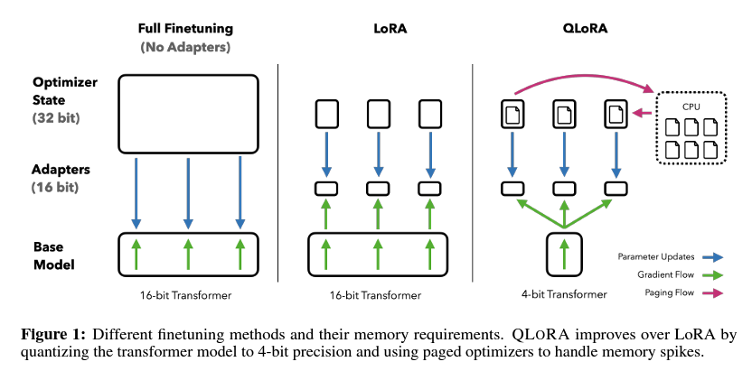
Quantized and Low-Rank Adapters
Quantization reduces the number of bits that represent model weights, dramatically reducing storage

Slide 4
Demo: Fine-tuning MPT-7B-instruct using Finance Alpaca Q&A

Slide 5
References
LoRa: Low-Rank Adaptation of LLMs
QLoRa: Efficient Finetuning of Quantized LLMs
Making LLMs even more accessible with bitsandbytes, 4-bit quantization and QLoRA
Understanding 4bit Quantization: QLoRA explained
MPT-7B
Finance Alpaca
How to Fine-Tune Open-Source LLMs Locally Using QLoRa

Slide 6
Thank You

