Slide 1








4COSC001W: Lecture Week 3
Conditionals
• Problem Solving
• Use of flowcharts in programming
• Boolean variables and expressions
• Relational operators
• if • if-else
• elif • Booleans: and, or, not
Software Development 1

Slide 2
Problem Solving: Flowchart Diagrams
Before you write code, you can use a flowchart to create a diagram of the steps in your algorithm.
A flowchart shows the structure of decisions and tasks to solve a problem, linked to indicate flow of control.
Flowchart Diagrams advantages: Decomposition: breaking down a problem into smaller sub problems.
Algorithm design: the ability to build a step-by- step process to solve a particular problem.
Software Development 1

Slide 3



Problem Solving: Flowchart Diagrams
Symbol | Purpose | Description
 | Flow line | Used to indicate the flow of logic by connecting symbols.
 | Terminal(Stop/Start) | Used to represent start and end of flowchart.
 | Process | Used for arithmetic operations and data- manipulations.
 | Decision | Used to represent the operation in which there are two alternatives, true and false.
 | Input/Output | Used for input and output operation (optional)
Software Development 1

Slide 4
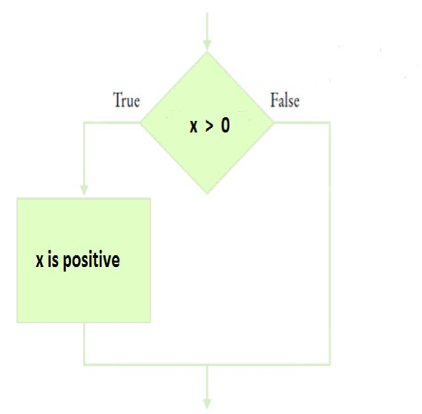
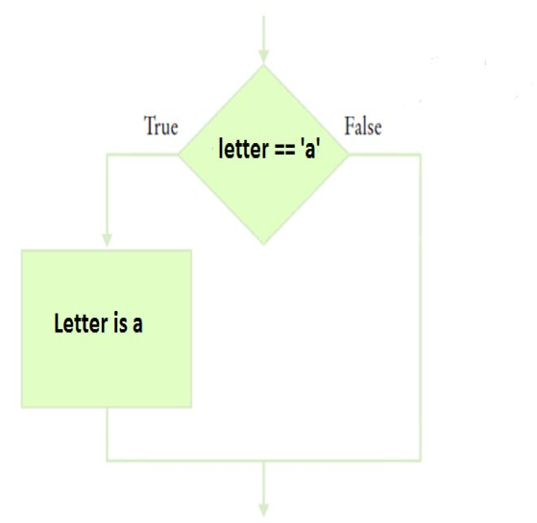
Flowchart Examples
Example 1
Example 2
Software Development 1

Slide 5
Boolean types and expressions
• Python provides the boolean type that can be either
set to True or False. E.g., finished = True
– We will use the Boolean type during the later loop lecture.
A boolean expression evaluates to one of two states
# the operator == tests if two values are equal
print(5 == 5) # produces True
print(5 == 6) # produces False
Software Development 1

Slide 6
Conditional Statements
Sometimes we only want a program to execute code under certain circumstances.
Conditional statements give us the ability to write programs that do different things based on different conditions.
– if – if-else
– elif
Note: You may have used a switch case statement in other programming languages. Python does not have a switch case statement.
Software Development 1

Slide 7
Conditional Statements
• Conditional statements - simplest form is if:
if x > 0:
print('x is positive’)
• Condition - the boolean expression after if. • If it is true, the indented statement runs. • If not true, nothing happens.
• Indent your print statement so that the program knows that it is part of the if statement. 4-spaces is common choice.
Software Development 1

Slide 8
Conditional Statements
if - Example 2a
letter = “a”
if letter == “a”:
print(“Letter is a”)
The if must be in lower case. You must add a colon at the end of the statement.
Using one = is setting a variable!
Using two == tests for equality
You must indent your print statement so that it is part of the if statement block
Software Development 1

Slide 9
Conditional Statements
if - Example 2b
• Now if we change the program 2a slightly:
letter = “b”
if letter == “a”:
print(“Letter is a”)
• Because the answer is false it does not print anything
Software Development 1

Slide 10
Use of Indentation
letter = “a”
if letter == “a”:
print(“Letter is a”)
print(“Prints if letter is a”) print(“Always prints as not in if block”)
The print statement needs to be indented to be applied to the if statement block.
• If not indented it is not part of the if block.
Software Development 1

Slide 11
Relational Operators
• Conditional expressions can be formed using the following operators:
Operator | Meaning
== | Equal to
!= | Not equal to
< | Less than
> | Greater than
<= | Less than or equal to
>= | Greater than or equal to
Software Development 1

Slide 12
Relational Operators
• Conditional expressions can be formed using the following operators:
Expression is True or False?
Expression |  | True or False
a) | 3 <= 4
b) | 3 =< 4
c) | 3>4
d) | 4<4
e) | 4 <=4
f) | 3 == 5 - 2
g) | 3!= 5-1
Software Development 1

Slide 13
Practice Exercise
A number a user enters is stored in a variable called number.
Check if number is equal to 10.
If true, display message…
‘number is equal to 10’.
a) Draw the flowchart first.
b) Then write the program.
Software Development 1

Slide 14
Practice Exercise 2
What is the final value of b ?
a=3 if a==3 :
b=a*2
if a < 4:
b=a+2
if a > 2:
b=a*2
Software Development 1

Slide 15
Practice Exercises 3
Which are true if a is 3 and b is 4?
a) a + 1 <= b
b) a + 1 >= b
c) a + 1 != b
What is the error in this statement:
if scoreA = scoreB :
print(“Tie”)
Software Development 1

Slide 16
Tutorial Question (1b)
Write a program to read in someone’s age. Display ‘can vote’ if they are old enough.
First create the flowchart (lecture)
Write the program (tutorial)
Software Development 1

Slide 17
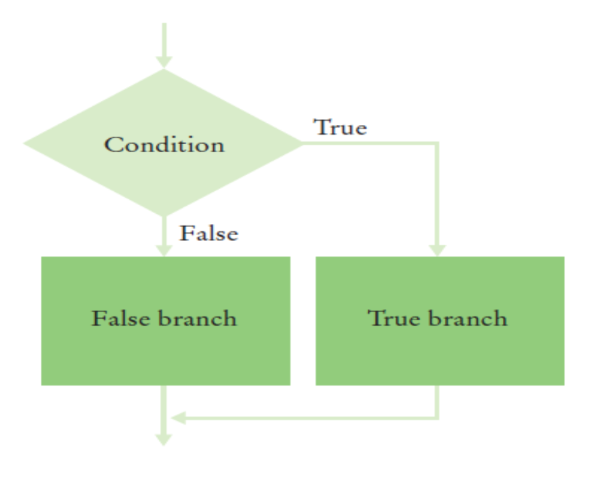
If – else statements
• Two Outcomes - Get the program to do something if statement is false.
• Flow chart:
Software Development 1

Slide 18
Tutorial Example 1b
• Get the program to do something if statement is false using “else” keyword.
a = int(input('Enter number: ‘))
if a == 10:
print('a is equal to ten’)
else:
print('a is not equal to ten’)
print('Not in the if or else block’)
• Print first message if expression is true, otherwise print second message.
Software Development 1

Slide 19
If-else Example 1
• Get the program to do something if statement is false using “else” keyword.
a = int(input('Enter number: ‘))
if a == 10:
print('a is equal to ten’)
else:
print('a is not equal to ten’)
print('Not in the if or else block’)
• Print first message if expression is true, otherwise print second message.
Software Development 1

Slide 20
If-else Example 2
• Remember ZeroDivisionError? – Error if attempt to divide by zero.
• Here is an example solution.
b = int(input("Number for division: "))
if b != 0 :
x = 100/b else:
print("Could not divide by zero")
Software Development 1

Slide 21
Tutorial Q2b
• Tutorial Q2b. Write a program to display “FAIL” if the mark entered is less than 40, otherwise it should display “PASS”.
Create the flowchart (lecture).
Then write the code (tutorial).
Software Development 1

Slide 22
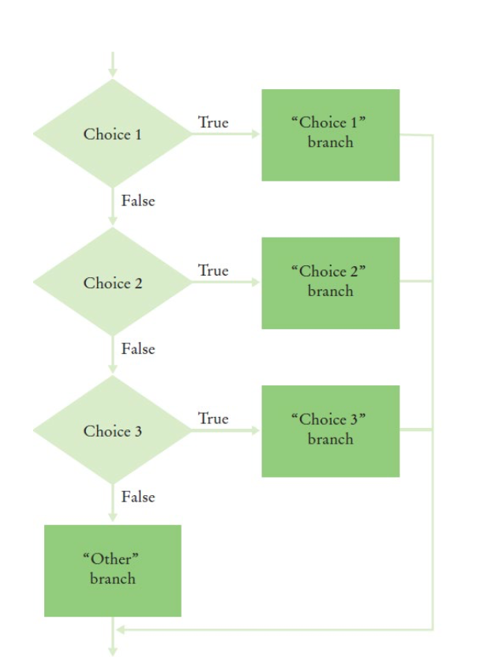
elif Additional Conditions
Give the program additional conditions.
See general flowchart on the right.
Software Development 1

Slide 23
elif Example 1
elif allows you to give the program another condition to try.
If none match then run else-block (optional)
letter=“c”
if letter == “a”:
print (“Letter is a”)
elif letter == “b”:
print(“Letter is b”)
else:
print(“Letter is not a or b”)
Software Development 1

Slide 24
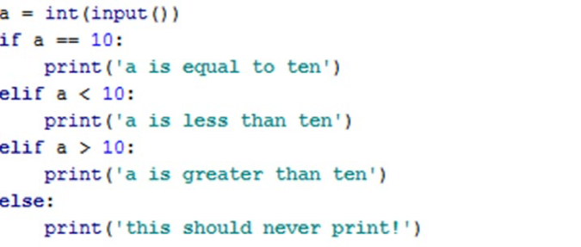
elif Example 2
Software Development 1
Can use multiple elif’s.
Test conditions for the first match. Only the first true branch runs (even if other conditions true).
If none match then run else-block (optional).

Slide 25
Practice Quiz Question
mark = int(input('Enter Mark’))
if mark >= 40:
print('Satisfactory result’)
else:
print('You have failed’)
• Amend the above to display a message for high marks (70 or above)..... Two options on next slide.
Software Development 1

Slide 26
Practice Quiz Question- Which is correct?
#1 if mark >= 70:
print(’Exceptional result’)
if mark >= 40:
print(’Satisfactory result’)
else:
print(’You have failed’)
#2 if mark >= 70:
print(’Exceptional result’)
elif mark >= 40:
print(’Satisfactory result’)
else:
print(’You have failed’)
Software Development 1

Slide 27
Practice Quiz
• Add an additional condition at the start of the program to check if the exam mark is invalid (less than 0 or greater than 100):
if mark >= 70:
print(’Exceptional result!’)
elif mark >= 40:
print(’Satisfactory result!’)
else:
print(’You have failed.’)
Software Development 1

Slide 28
Testing
• Testing your programs
– Include a test of the boundary of your program
decisions.
– E.g., if a decision checks whether an input is less than 100, test with an input of 99 and 100.
Software Development 1

Slide 29
Boolian Values (and)
• Evaluate two expressions. Evaluates to True if both of
the two values are True.
x = 10 y = 20 print(x == 10 and y == 20) #True
A and B | Evaluates to
True and True | True
True and False | False
False and True | False
False and False | False
Software Development 1
Truth table:

Slide 30
Boolian Values (and)
• This program validates user input
x=int(input(“Enter a number between 1 and 100:”))
if x>=1 and x<=100:
print(“Valid number”)
else:
print(“Your number is not valid”)
• Trace which lines would be printed for x: 0, 1, 100, 101
Software Development 1

Slide 31
Boolian Values (or)
• Evaluate two expressions. Evaluates to True if either of
the two values is True.
x = 10 y = 20 print(x == 3 or y == 20) #True
A or B | Evaluates to
True or True | True
True or False | True
False or True | True
False or False | False
Software Development 1
Truth table:

Slide 32
Boolian Values (not)
• not operator evaluates to the opposite Boolean value – Inverts a condition.
• True expressions evaluate to False • False expressions evaluate to True.
x = 10
print(not x == 10) #False
print(not x == 3) : #True
not A | Evaluates to
not True | False
not False | True
Software Development 1
Truth table:

Slide 33
Boolean Variable/ Operators:
• This tests whether both x and y are zero:
x == 0 and y == 0
1. Now state how you test whether at least one of x and y is zero.
2. Which is correct- a, b or c?
a) age < 17 or > 150 #don’t drive
b) age < 17 or age > 150 #don’t drive
c) age < 17 and age > 150 #don’t drive
Software Development 1

