Slide 1
4COSC001W: Lecture Week 4
Loops
The range( ) function
This section introduces the range() function and includes examples of using range() to specify how many times a for loop will be repeated.
The range() function can be used to create a sequence of numbers.
The structure of the function is range(start, stop, step).
start (optional): starting number of sequence. The default is 0.
stop: generate sequence up to, but not including the specified number.
step (optional): number specifies the sequence incrementation. The default is 1.
The augments, start, stop, and step, must be integers.
Software Development 1

Slide 2
Range Examples
range(1, 5)
generates sequence of integers 1, 2, 3, 4. From 1 up to, but not including, 5.
range(7)
produces: 0,1,2,3,4,5,6 (default start argument is 0)
range(1, 7)
Sequence generated: 1,2,3,4,5,6 (setting the start number to 1)
Software Development 1

Slide 3
range( ) with a ‘for’ loop
for i in range(10):
print(i)
The number passed to the range function tells the program how many times to loop.
The sequence generated is: 0, 1, 2, 3, 4, 5, 6, 7, 8, 9
The sequence automatically starts at 0. The high value (10) is never part of the sequence.
Software Development 1

Slide 4
range( ) with a ‘for’ loop
for i in range(5, 10):
print(i)
range() with ‘for’ loop
Sequence generated: 5,6,7,8,9 (setting the start number to 5).
Remember, the end point (10) is never part of the
generated sequence.
Software Development 1

Slide 5
range( ) with a Third Parameter
range(0, 7, 2)
The third argument specifies the sequence incrementation (step).
The sequence generates the sequence in steps of 2. The default is 1.
Generates sequence: 0, 2, 4, 6
for i in range (0,50,5):
print(i)
Third argument specifies the sequence incrementation (step).
The first number is the start number
Second number is the stop number
Sequence generated: 0, 5, 10, 15, 20, 25, 30, 35, 40, 45
Software Development 1

Slide 6
range( ) Counting in Fives, Counting Backwards
for i in range (0,50,5):
print(i)
Sequence generated: 0, 5, 10, 15, 20, 25, 30, 35, 40, 45
print("Counting Backwards")
for i in range (10, 0, -1):
print(i)
Third argument specifies the sequence incrementation (step).
As well as positive numbers you can also program the computer to loop backwards with a negative number.
Sequence generated: 10, 9, 8, 7, 6, 5, 4, 3, 2, 1
Software Development 1

Slide 7
range( ) Try it yourself
What happens if you give range only one argument? E.g., range(4)
It will generate a sequence starting at 0, with every number included up to but not including the argument it was passed.
It will generate a sequence starting at 1, with every number up to but not including the argument it was passed.
It will generate a sequence starting at 1, with every number including the argument it was passed.
It will cause an error: range always takes exactly 3 arguments.
Software Development 1

Slide 8
More ‘for’ loops
Also known as a count controlled loop.
Repeats part of a program for a stated number of times.
Repeats its loop body for each element of the sequence in order.
The loop ends when it reaches the number of times it was set to loop.
In Python, for loops are constructed like this:
for [iterating variable] in [sequence]: [do something]
The for and in are key words that are inbuilt commands.
The iterating variable will hold the values of the generated sequence which is stepped through. E.g.,
for i in range(10):
print(i)
Software Development 1

Slide 9
More ‘for’ loops – Nested Iteration
A nested iteration is a loop within a loop.
for i in range(3): # 0,1,2 for
j in range(2): # 0,1
print(i, j)
We could call these the outer iteration and the inner iteration.
The program first encounters the outer loop (for i), executing its first iteration (0). The first iteration triggers the inner loop (for j) which then runs to completion.
Program then returns back to outer loop for next iteration.
For each value of i, all values of j will occur: 00 01 10 11 20 21
Software Development 1

Slide 10
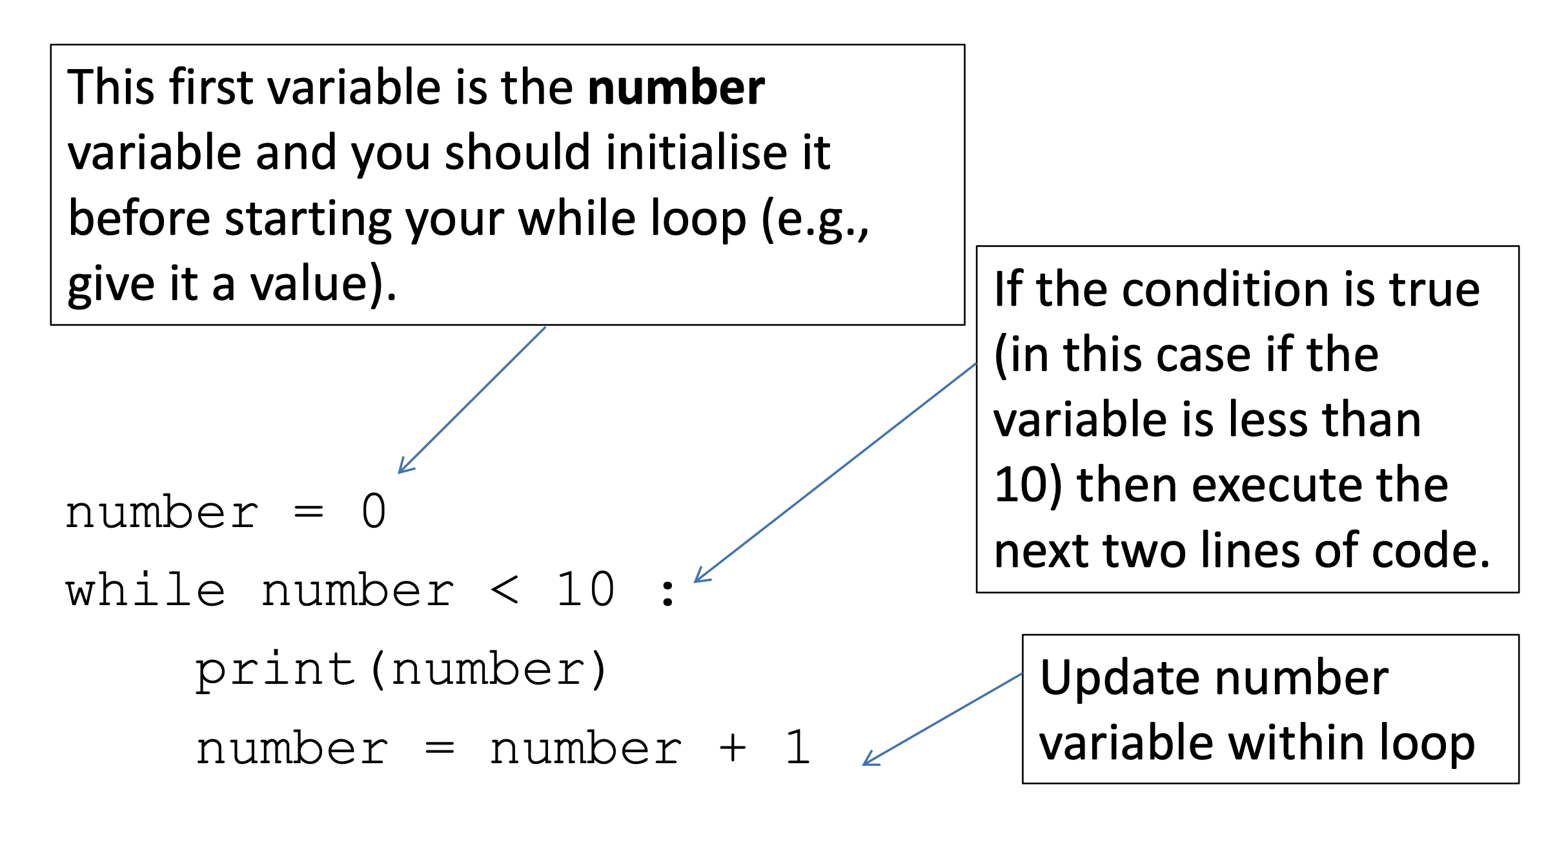
Condition Controlled ‘while’ loops
E.g., print out the value of a number.
A condition controlled loop will continue to execute as long as its defined condition is True
Software Development 1

Slide 11
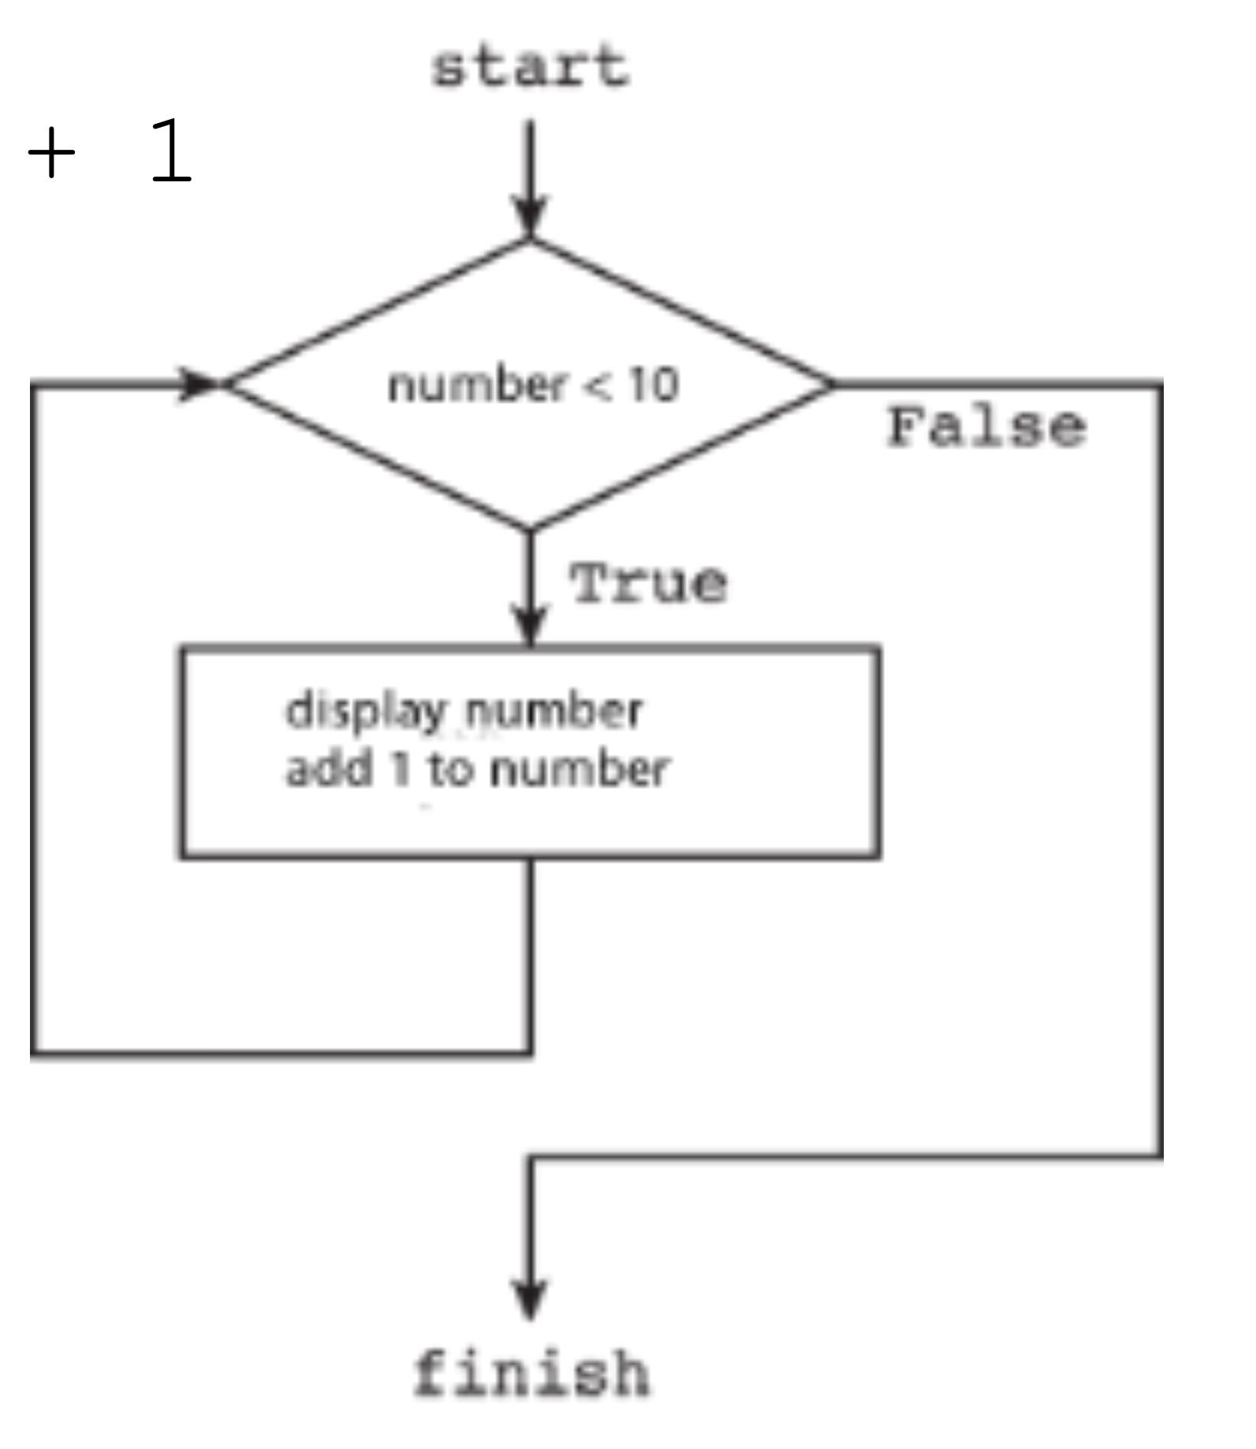
Condition Controlled ‘while’ loops
number = 0 while number < 10 : print(number)
number = number + 1
Software Development 1

Slide 12
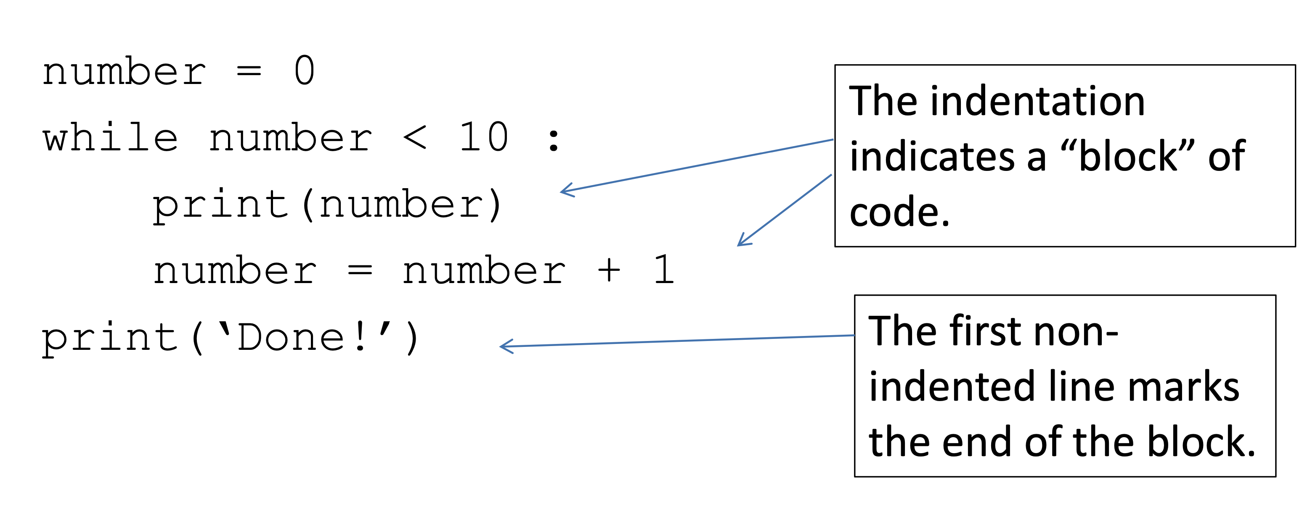
Python’s use of indentation
The Python indentation for the while “block” is not cosmetic. A sequence of lines that have the same indentation forms a block. Here, both lines get run or neither of them do. The block is ended by the first line that follows it with no indentation.
Software Development 1

Slide 13
Some Common Errors - Infinite Loops
counter = 1
while counter <= 10 : # Executes 5 passes
print(counter)
counter = counter + 2
counter = 1
while counter != 10 : # loops forever (why?)
print(counter)
counter = counter + 2
counter = 1
while counter != 9 : # loops forever (why?)
print(counter)
counter = counter + 2
Software Development 1

Slide 14
Some Common Errors – “Off by One” error
counter = 0
while counter = 10 : # q1 How many passes
<do something>
counter = counter + 1
counter = 1
while counter <= 10 : # q2 How many passes
<do something>
counter = counter + 1
counter = 1
while counter < 10 : # q3 How many passes
<do something>
counter = counter + 1
counter = 0
while counter <= 10 : # # q4 How many passes
<do something>
counter = counter + 1
Software Development 1

Slide 15
ANSWERS – “Off by One” error
counter = 0
while counter = 10 : # A1 Executes 10 passes
<do something>
counter = counter + 1
counter = 1
while counter <= 10 : # A2 Executes 10 passes
<do something>
counter = counter + 1
counter = 1
while counter < 10 : # A3 Executes 9 passes
<do something>
counter = counter + 1
counter = 0
while counter <= 10 : # # A1 Executes 11 passes
<do something>
counter = counter + 1
Software Development 1

Slide 16
while Loop Summary
Initialize variables before you test
- The condition is tested BEFORE the loop body
- Something inside the loop should change a variable used in the test
Watch out for common errors: - Infinite loops,
- Off-by-One Errors,
Software Development 1

Slide 17
Loops – ‘while’ Loops versus ‘for’ Loops
Which is the best solution?
i=1
while i < 10 :
print(i) i=i+1
Or…
for i in range(1, 10) :
print(i)
Software Development 1

Slide 18
Loops – ‘while’ Loops or ‘for’ Loops - Answer
Both produce the same result.
The while loop has a condition and it runs until the condition is false (condition controlled).
Use the for loop (count controlled) when you know how many items the loop should execute.
for i in range(1, 10) :
print(i)
Software Development 1

Slide 19
Breaking a Loop
If you need to break out of a loop there are two important keywords: continue and break.
Continue
When it gets executed the loop will stop the current iteration where it is without executing anything after the continue statement and go on to the next iteration of the loop.
Break
When it gets executed it will break out of the loop and continue executing from the first instruction after the loop.
Software Development 1

Slide 20
Breaking a Loop Examples
break What will this example print?
count = 0
while True:
print(count)
count += 1
if count >= 5:
break
continue What will this print?
for x in range(10):
if x % 2 == 0:
continue
print(x)
Software Development 1

Slide 21
Breaking a Loop Answers
break What will this example print?
count = 0
while True:
print(count)
count += 1
if count >= 5:
break output -> 0,1,2,3,4
continue What will this print?
for x in range(10):
if x % 2 == 0:
continue
print(x) output -> 1,3,5,7,9
Software Development 1

Slide 22
Summary
while loop vs for loop
while loop - condition controlled
for loop - count controlled
Use of continue:
skips the current iteration and goes to the next iteration of the loop
Use of break: terminates the loop execution.
Software Development 1

Slide 23
Sentinel Values
A sentinel value can guarantee termination of a loop when processing sequential data. The sentinel value can detect the end of the data set when there is no other means to do so.
It denotes the end of a data set, but it is not part of the data.
What value will end this loop?
salary = 0.0
while salary >= 0 :
salary = float(input())
if salary >= 0 :
total = total + salary
count = count + 1
Software Development 1

