Slide 1
4COSC001W: Lecture Week 7 Lists, Tuples, Dictionaries
As well as holding dynamic content as a single variable we can group our related variables together.
This allows us to store and manage our data more efficiently.
In Python the primary data types for storing groups of related variables are..
Lists - for when we want to access and modify our variables dynamically
Tuples – for when we stored data to be protected
Dictionaries – When we want to store data values with an accompanying ‘key’
Software Development 1

Slide 2
Lists
Lists are used to store multiple items in a single variable.
Each value has its index (starting at zero) and can appear in the list multiple times.
A list is defined as a comma-separated list of values, enclosed in square brackets:
x =[18, 20, 25, 29, 31]
Software Development 1

Slide 3
List indexing (1)
x =[18, 20, 25, 29, 31]
To access the list elements use indices. The first element has index zero, the second one has index 1, etc.
print(x[0]) #18
print(x[1]) #20
Negative indices: -1 to access the last element, -2 for the • the second-to-last element, and so on.
print(x[-1]) #31
print(x[-2]) #29
Indexing a non-existent list element will result in an error. print(x[5])
#IndexError: list index out of range
Software Development 1

Slide 4
List indexing (2)
x =[18, 20, 25, 29, 31]
The same indexing that we have used to read the elements of a list can be used to change them:
x[3] = 26
x[-1] = 33
print(x)
#[18, 20, 25, 26, 33]
Software Development 1

Slide 5
List Elements
In some languages the elements of a list have to be of a same type. However, in Python, the list elements can be any type.
[10, 20, 30, 40]
['apple', 'pear', 'banana’]
And can be mixed type: ['spam', 2.0, 5, [10, 20]]
A string, a float, an integer, and another list
Lists inside lists are known as nested lists.
Software Development 1

Slide 6
Lists Vs. Strings
Both lists and strings are sequences, and the [ ] operator is used to access an element in any sequence
There are two differences between lists and strings:
Lists can hold values of any type, whereas strings are
sequences of characters
Strings are immutable - you cannot change the characters in the sequence:
greeting = "Hello, world!"
greeting[0] = 'J' # ERROR!
Lists are mutable:
numbers = [42, 123]
numbers[1] = 5 # [42, 5]
Software Development 1

Slide 7
Looping Over the Index Values
We can loop through the list items in values by referring to their index number. Use the range()and len()functions to create the iterable.
for i in range(len(values)):
print(i, values[i])
Or print all items in the list, one by one:
for element in values :
print(element)
Software Development 1

Slide 8
List Operations
Appending / Extending
Finding an Element
pop() and remove()
Inserting an Element at specific position
Sorting
Copying Lists
Slices of a List
Software Development 1

Slide 9
1. Appending / Extending
Add a single element to the end of a list with append()
x = [18, 20, 25] print(len(x)) #3 x.append(29)
print(x) #[18, 20, 25, 29]
print(len(x)) #4
To append more than one element to the list use extend()
x = [18, 20, 25] print(x) #[18, 20, 25]
x.extend([29,31])
print(x) #[18, 20, 25, 29, 31]
Software Development 1

Slide 10
2. Finding an Element
in operator - to know whether an element is present in a list:
x =[18, 20, 25, 29, 31]
print("18 in x?", 18 in x) #True print("19 in x?", 19 in x) #False print("31 in x?", 31 in x) #True print("31 not in x?", 31 not in x) #False
Use the index() method to know the position at which an element occurs . Yields the index of the first match
print("Index of 18:", x.index(18)) # 0
print("Index of 25:", x.index(25)) # 2
Software Development 1

Slide 11
Self Check Question
The following code would cause an error:
x =[18, 20, 25, 29, 31]
print("Index of 35:", x.index(35))
# ValueError: 35 is not in list
What additional code could you use to ensure that an error is not displayed?
Software Development 1

Slide 12
3. pop( ) and remove( )
pop() - removes the element at a given position (if you know the index of the element.)
pop() - with an empty parameter will remove the last element
q = ['a', 'b', 'c', 'd’]
q.pop(1) print(q) # ['a', 'c’, 'd’]
q.pop()
print(q) # ['a', 'c’]
remove() - if you do not know the index, this will remove
the first matching element.
q = ['a', 'b', 'c', 'd’]
q.remove('b’)
print(q) # ['a', 'c’, 'd’]
Software Development 1

Slide 13
3. pop( ) review
What is printed by the following?
alist = [4, 2, 8, 6, 5]
alist.pop(2)
alist.pop()
print(alist)
Software Development 1

Slide 14
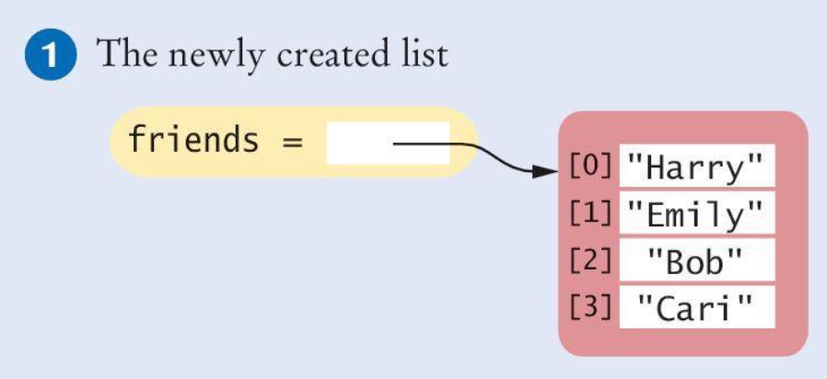
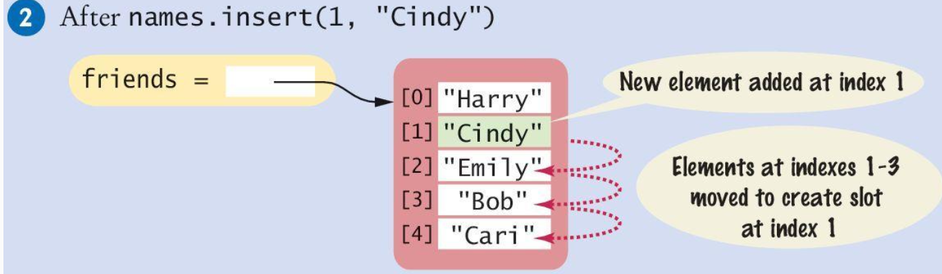
4. Insert an Element at specific position
Sometimes the order in which elements are added to a list is important A new element has to be inserted at a specific position in the list:
#1
friends = ["Harry", "Emily", "Bob", "Cari"]
#2
friends.insert(1, "Cindy")
Software Development 1

Slide 15
5. Sorting Lists
The sort( ) method sorts a list of numbers or strings. It modifies the list.
values = [1, 16, 9, 4] values.sort() #[1, 4 , 9, 16]
values.sort(reverse=True)# descending
print(values) #[16, 9, 4, 1]
The sorted( ) method creates a new list containing a sorted version of the list. The original list is unsorted.
values = [1, 16, 9, 4]
sorted(values) #[1, 4 , 9, 16]
print(values) #[1, 16, 9, 4]
Software Development 1

Slide 16
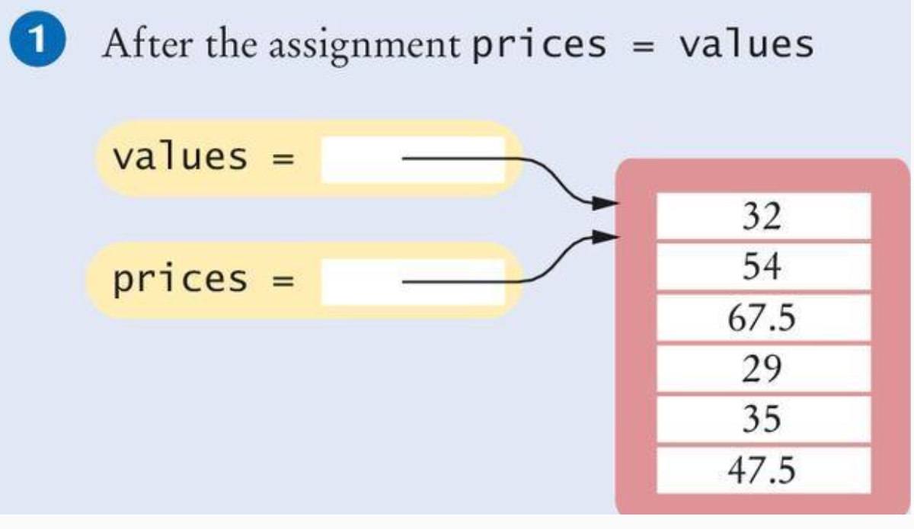
6. Copying Lists
• List variables do not themselves hold list elements
• They hold a reference to the actual list
• If you copy the reference, you get another reference to the same list:
prices = values
Software Development 1

Slide 17
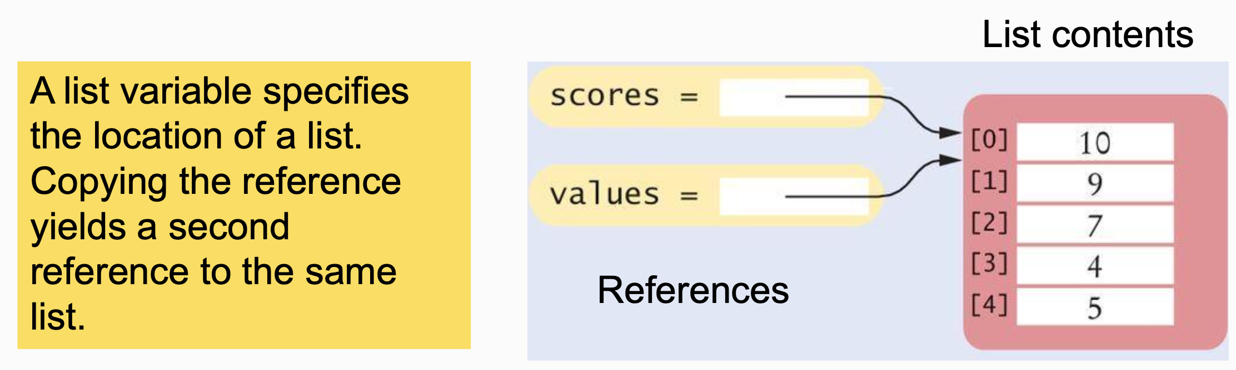
List Aliases
When you copy a list variable into another, both variables refer to the same list
The second variable is an alias for the first because both variables reference the same list.
scores = [10, 9, 7, 4, 5]
values = scores #Copying list reference
Software Development 1

Slide 18
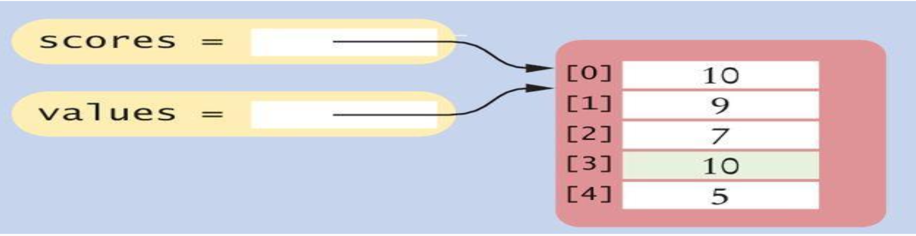
Modifying Aliased Lists
You can modify the list through either of the variables:
scores[3] = 10
print(values[3]) # Prints 10
Software Development 1

Slide 19
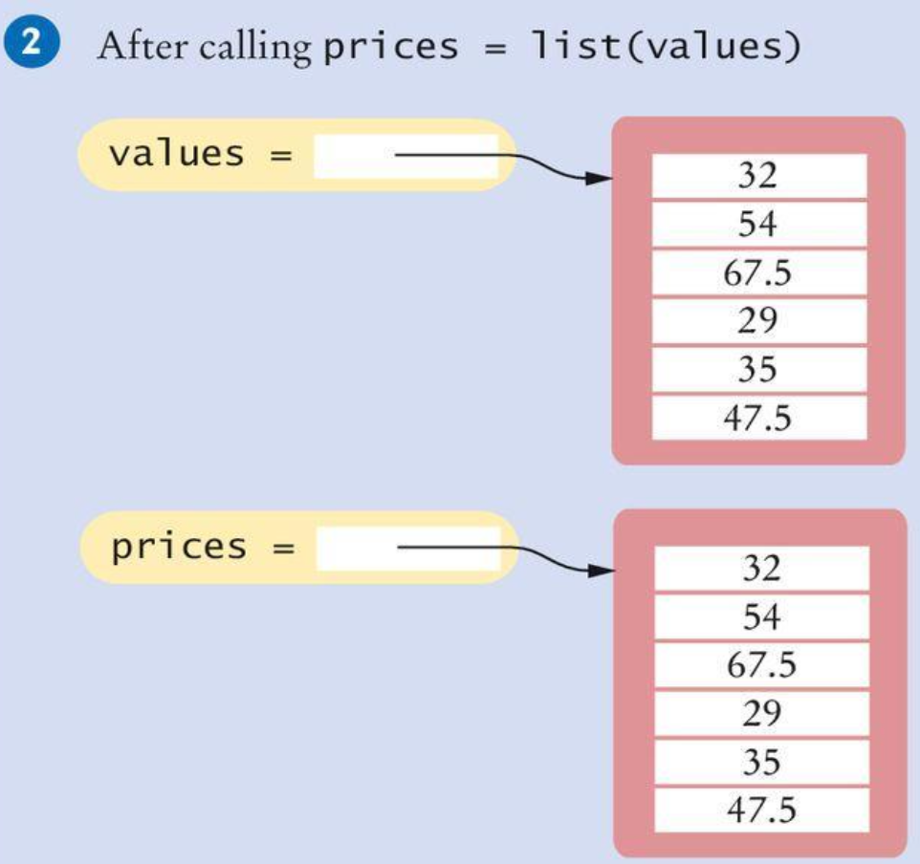
6. Copying Lists
Sometimes, you want to make a copy of a list; that is, a new list that has the same elements in the same order as a given list
Use the list( ) function:
prices = list(values)
Software Development 1

Slide 20
7. Slices of a List
A list of temperatures, one per month:
temp = [18, 21, 24, 33, 39, 40, 39, 36, 30, 22, 18]
To obtain temperatures for the third quarter, with index values 6, 7, and 8 use the slice operator:
thirdQuarter = temp[6 : 9]
To replace the values in elements 6, 7, and 8: temp[6 : 9] = [45, 44, 40] # [18, 21, 24, 33, 39, 40, 45, 44, 40, 22, 18]
Which elements would the following slices obtain?
temp[ : 6] temp[6 : ]
Software Development 1

Slide 21
NESTED LISTS
Nested lists
A nested list is a list that appears as an element in another list. In this list, the element with index 3 is a nested list:
If we output the element at index 3, we get:
To extract an element from the nested list:
This expression gets the 3’th element of nested and extracts the 1’th element from it.
nested = ["hello", 2.0, 5, [10, 20]]
nested[3][1] # 20
(nested[3]) # [10, 20]
Software Development 1

Slide 22

NESTED LISTS Matrices
Nested lists are often used to represent matrices. For example, the matrix:
might be represented as:
mx = [[1, 2, 3], [4, 5, 6], [7, 8, 9]]
mx is a list with three elements, where each element is a row of the matrix. We can select an entire row from the matrix in the usual way:
print(mx[1]) # [4, 5, 6]
Or we can extract a single element from the matrix using the double-index form:
The first index selects the row, and the second index selects the column.
Software Development 1
print(mx[1][2]) # 6

Slide 23
Exercises 1-7
What will be the output of the following program?
Create a list "mylist" containing integers: 1, 2, 3, 4, 5
Print the second item in the list.
Use a negative index to print the second-to-last element.
Use list slicing to print the second to the fourth item in the list. E.g., [2, 3, 4]
Replace the first list item with the value 10.
Append the number 11 to the list.
my_list = ["Westminster", [2, 4, 8, 16]]
print(my_list[0])
print(my_list[0][1])
print(my_list[1][3])
Software Development 1

Slide 24
Tuples
A tuple is similar to a list, but once created, its contents cannot be modified
A tuple as immutable (unchangeable) version of a list.
A tuple is created by specifying its contents as a
comma-separated sequence enclosed in parentheses:
triple = (5, 10, 15)
If you prefer, you can omit the parentheses:
triple = 5, 10, 15
A tuple with one value must have an ending comma:
single = 5,
Software Development 1

Slide 25
Tuples
Processing a tuple in the same ways as a list:
a_tuple = (17, 13, 19, 23)
print(a_tuple[0]) #17
print(a_tuple[-1]) #23
print(a_tuple[1:-1]) #(13, 19)
print(sorted(a_tuple)) #[13, 17, 19, 23]
print(17 in a_tuple) # True
However, tuple values are immutable. This means tuple items cannot be added, removed or replaced.
This is useful if you want to store data that you want to remain fixed during a program.
Also, they are faster type than lists for Python to process.
Software Development 1

Slide 26
Tuples
Therefore, the following are not possible:
a_tuple[2] = 5 # error
a_tuple.sort() # error
a_tuple.extend([34, 54]) # error
a_tuple.insert(1, 39) # error
a_tuple.append(400) # error
a_tuple.pop() # error
• We can convert a tuple to a list: a = list(a_tuple) print(a) #[17, 13, 19, 23]
• We can convert a list to a tuple: b = tuple(a) #(17, 13, 19, 23)
Software Development 1

Slide 27
Summary: Lists & Tuples
Lists - comma-separated sequence enclosed in square brackets []. Mutable. Some built-In list operations:
append() inserts a new element at the end of the list.
index() to know the position of an element.
pop() removes an element.
remove() if you know the element but NOT the index.
insert() to insert a new element at a position in a list.
list() function to copy lists.
Tuple - comma-separated sequence enclosed in parentheses( ). Immutable - useful if you want to store data that you want to remain fixed during the run of a program. Faster processing.
Software Development 1

Slide 28
Dictionaries
• Strings, lists, and tuples are sequence types - the items in the collection are ordered from left to right and they use integers as indices to access the values they contain.
• A Dictionary in Python is a collection of data values.
• They map (associate) a key with a value.
• In other languages, they are called associative arrays.
Software Development 1

Slide 29
Dictionaries
A dictionary to translate English words to Spanish. In this example, both keys and values will be strings.
To create dictionary- Method One:
eng2sp = {}
eng2sp["one"] = "uno"
eng2sp["two"] = "dos"
• Start with an empty dictionary named eng2sp.
• Then add new key:value pairs to the dictionary.
Software Development 1

Slide 30
Dictionaries - Printing / len()
• Print the current value of the dictionary:
print(eng2sp)
# {'one': 'uno', 'two': 'dos’}
• key:value pairs are separated by commas. • Each pair contains a key and value separated by a colon.
• len() function returns the number of key:value pairs:
len(eng2sp) # 2
Software Development 1

Slide 31
Dictionaries
• To create dictionary - Method Two:
eng2sp = {"one":"uno", "two":"dos", "three":"tres"}
• Create list and provide initial list of key:value pairs. • The order of the pairs does not matter – values are accessed with keys,
not with indices. Using a key to look up the corresponding value:
print(eng2sp["two"]) # dos
Software Development 1

Slide 32
Dictionaries – del statement
• The del statement removes a key:value pair. • E.g., dictionary contains fruits and number of each fruit in stock:
stock = {"apples": 430, "bananas": 312, "pears": 217}
• If all pears are bought - remove the entry from the dictionary:
del stock["pears"] print(stock) # {'apples': 430, 'bananas': 312}
Software Development 1

Slide 33
Dictionaries Are Mutable
• Dictionaries are like lists – they are both mutable. To change a value:
stock["pears"] = 0 print(stock)
# {'apples': 430, 'bananas': 312, 'pears': 0}
• A new shipment of bananas could be handled like this:
stock["bananas"] += 200
print(stock)
# {'apples': 430, 'bananas': 512, 'pears': 0}
Software Development 1

Slide 34
Dictionaries Key / Value Rules
Dictionary Keys: •Must be unique •Of immutable data type such as Strings, Integers and tuples
Dictionary Values: •May contain repeating values
•Can be of any type
Software Development 1

Slide 35
Revision: Questions 1&2
Question 1 - What is printed?
mydict = {"cat":12, "dog":6, "elephant":23} print(mydict["dog"])
A) True B) 6 C) dog : 6 D) Error
Question 2 - What is printed?
mydict = {"cat":12, "dog":6, "elephant":23} mydict["mouse"] = mydict["cat"] + mydict["dog"] print(mydict["mouse"])
A) 12 B) 0 C) 18 D) Error – no mouse key
Software Development 1

Slide 36
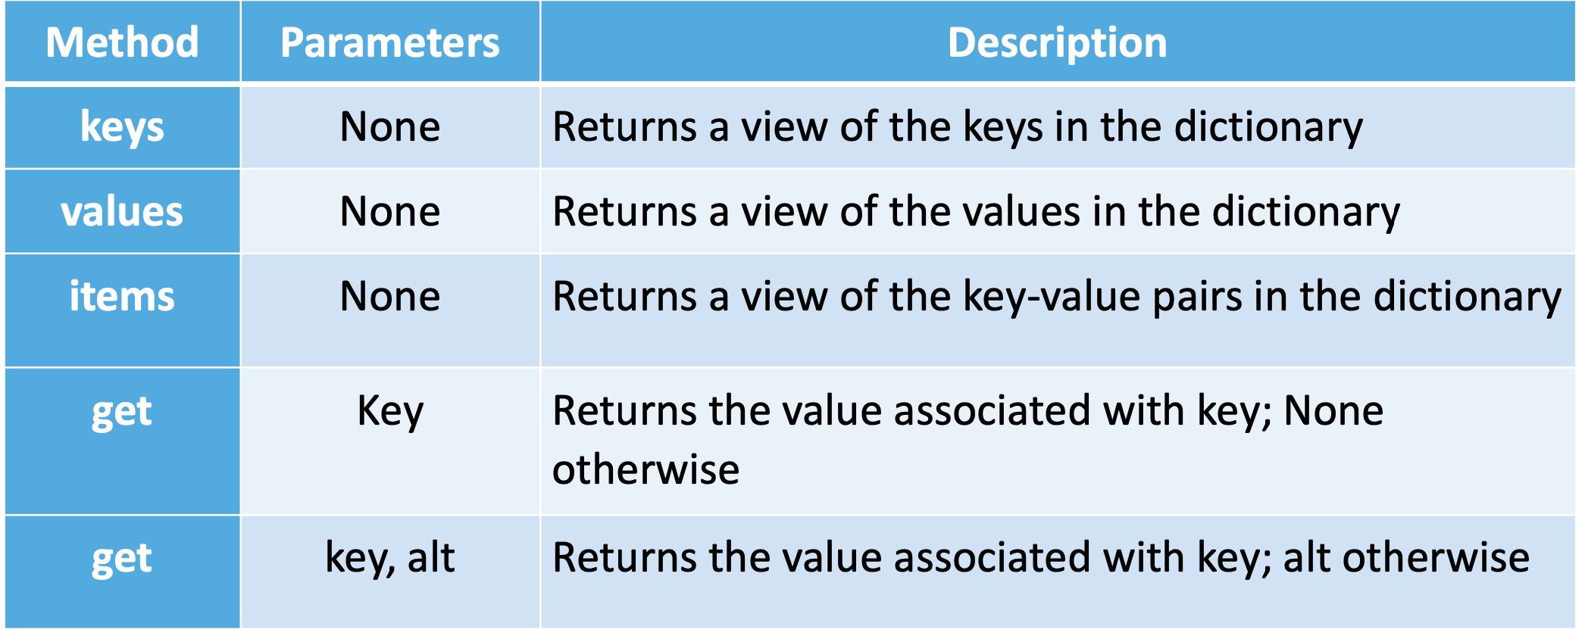
Dictionary methods
Software Development 1

Slide 37
Dictionary method: keys()
keys() returns a view of its underlying keys. Iterating over the view:
eng2sp = {"one":"uno", "two":"dos", "three":"tres"}
for k in eng2sp.keys():
print("Got key", k, "maps to value", eng2sp[k])
Output:
Got key one maps to value uno
Got key two maps to value dos
Got key three maps to value tres
Software Development 1

Slide 38
Dictionary method: keys()
• We can turn the view into a list by using the list conversion function.
ks = list(eng2sp.keys())
print(ks)
#['one', 'two', 'three’]
• We can omit the keys method call in the for loop — iterating over a dictionary implicitly iterates over its keys:
for k in eng2sp:
print("Got key", k)
Software Development 1

Slide 39
Dictionary method: values()
• The values method is similar; it returns a view
which can be turned into a list:
list(eng2sp.values())
#['uno', 'dos', 'tres']
Software Development 1

Slide 40
Dictionary method: items()
• Method items() returns a list of tuples, one tuple for each key:value
list(eng2sp.items())
#[('one', 'uno'), ('two', 'dos'), ('three', 'tres’)]
• Tuples are useful for getting both the key and the value while looping:
for (k,v) in eng2sp.items():
print("Got",k,"that maps to",v)
Output: Got one that maps to uno
Got two that maps to dos
Got three that maps to tres
Software Development 1

Slide 41
Dictionary operators: in/not in
• in and not in can test if a key is in the dictionary:
"one" in eng2sp # True "six" in eng2sp # False "tres" in eng2sp # False 'in' tests keys, not values
• Useful, since looking up a non-existent key in a dictionary causes an error.
Software Development 1

Slide 42
Dictionaries – Revision Question 3
mydict = {"cat":12, "dog":6, "elephant":23, "bear":20} keylist = list(mydict.keys()) keylist.sort() print(keylist[3])
What is printed
cat
dog
elephant
bear
Software Development 1

Slide 43
Dictionary method: get()
• The get( ) method accesses the value associated with a key. • Similar to the [ ] operator. However, get() will NOT cause an error if the key
is not present - will return None.
stock = {'apples': 430, 'bananas': 312, 'pears': 217} print(stock.get("apples")) # 430
print(stock.get("cherries")) # None
• An optional second parameter provides an alternative return value where
the key is not present. E.g., as “cherries” is not a key, return 0 (instead of None).
print(stock.get("cherries", 0)) # 0
Software Development 1

Slide 44
Dictionaries – Revision Question 4
mydict = {"cat":12, "dog":6, "elephant":23, "bear":20} answer = mydict.get("cat") + mydict.get("dog")
print(answer)
What is printed?
A) 126 B) 18 C) catdog D) Error, + is not a valid on dictionaries
Software Development 1

Slide 45
Dictionaries – Revision Questions 5 & 6
• Question 5 - What is printed – True or False?
mydict = {"cat":12, "dog":6, "elephant":23, "bear":20}
print("dog" in mydict)
• Question 6 - What is printed – True or False?
mydict = {"cat":12, "dog":6, "elephant":23, "bear":20} print(23 in mydict)
Software Development 1

Slide 46
Dictionaries – Revision Questions 7
total = 0 mydict = {"cat":12, "dog":6, "elephant":23, "bear":20}
for akey in mydict:
if len(akey) > 3: total = total + mydict[akey]
print(total)
What is printed? A) 18
B) 43
C) 0
D) 61
Software Development 1

Slide 47
Dictionaries - Aliasing and copying
• As with lists, dictionaries are mutable - be aware of aliasing. Whenever two
variables refer to the same object, changes to one affect the other.
• To modify a dictionary and keep a copy of the original, use copy().
opposites = {"up": "down", "right": "wrong", "yes": "no"}
alias = opposites
copy = opposites.copy()
• alias and opposites refer to the same object. If we modify alias, opposites is
also changed. However, if we modify copy, opposites is unchanged.
Software Development 1

Slide 48
Python f-string and dictionaries
• We can work with dictionaries in f-strings.
user = {'name': 'John Doe', 'occupation': 'gardener'}
print(f"{user['name']} is a {user['occupation']}")
• The example evaluates a dictionary in an f-string.
Output:
John Doe is a gardener
Software Development 1

Slide 49
Summary - Python Dictionary
A collection of data values.
They map (associate) a key with a value.
Dictionary methods:
• keys() - Returns a view of the keys in the dictionary
• values() - Returns a view of the values in the dictionary • items() - Returns a view of the key-value pairs in the dictionary
• get() - Returns the value associated with key
Dictionaries are mutable - Aliasing and copying
Software Development 1

