Slide 1
US CELLPHONE MARKET ANALYSIS
NIMYA GEORGE

Slide 2
AGENDA
Objective
Background
Findings
Recommendations
Appendix
Data Source
Data model assumptions
Model

Slide 3
OBJECTIVE
Increase the market share as well as the brand value of our product.
To know the competitors and preferences of features by users which would help to design new products optimally.
Find strength and weakness of competitors and close the demand-supply gap.
Finding better pricing strategies.

Slide 4
BACKGROUND
Company is a mobile manufacturer based in the US, which entered the market 3 years ago. As they are a new entrant in the sector, they want to understand their competitors and preferences of their users so that they can design their strategies accordingly.
They want to tweak the marketing strategies to add more value to their brand, provide features to customers that add the most value, and close the demand-supply gap.
In the world of digitization, industries are trying to fine-tune their strategies to suit the consumer needs based on the insights available from their choices and selections during their online presence.

Slide 5
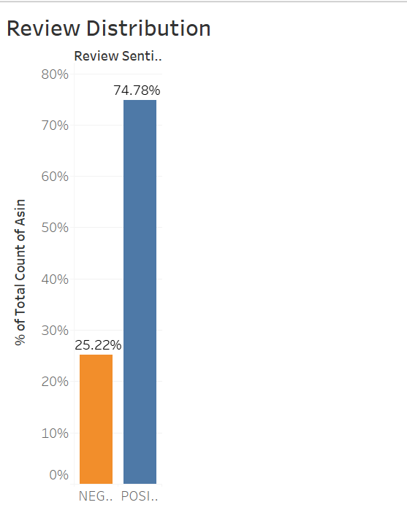
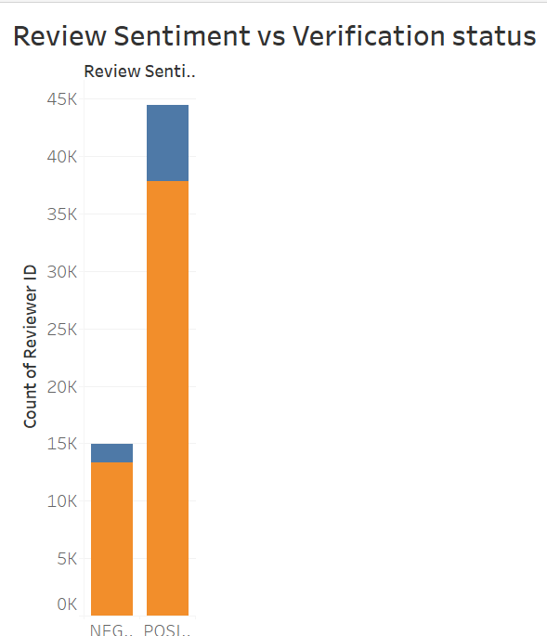
REVIEW STATUS
Customers giving negative reviews were too low in comparison with customers giving positive reviews.

Slide 6
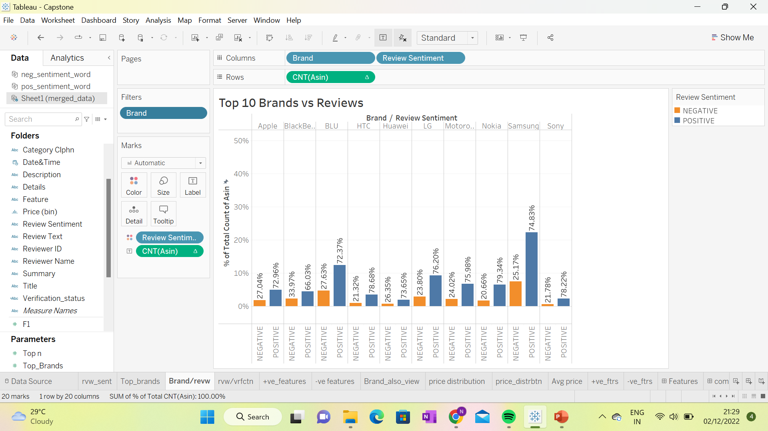
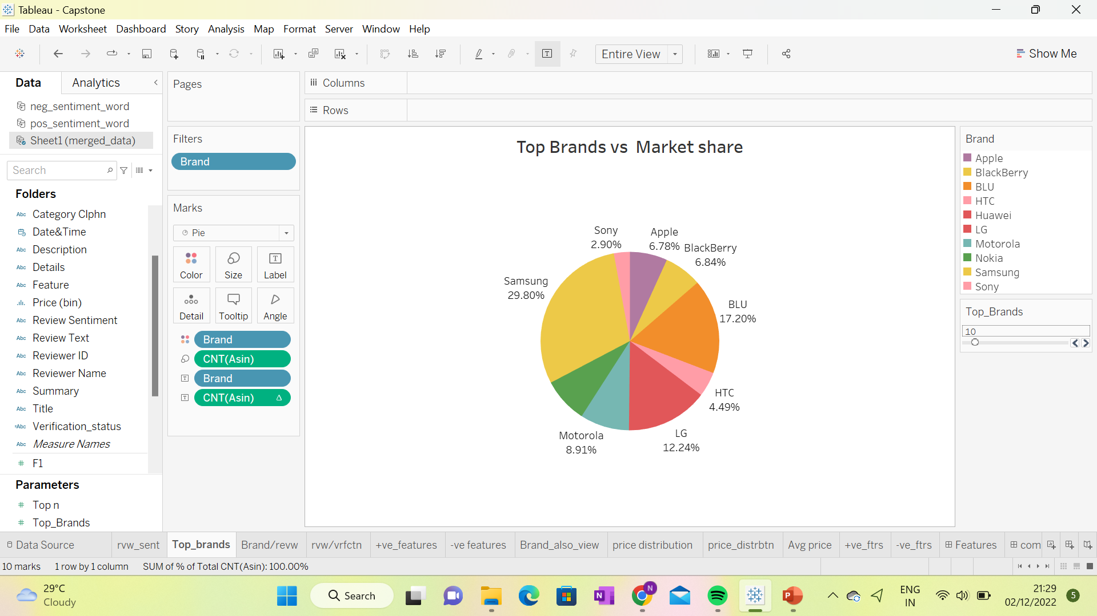
COMPETITORS
Top companies in the US cell phone market are Samsung(29.80%) with high percentage of positive reviews then BLU with 17.20% of market share.
Lowest market share is for Sony(2.90), HTC(4.49), BlackBerry(6.48) and also it has the highest percentage of negative reviews.

Slide 7
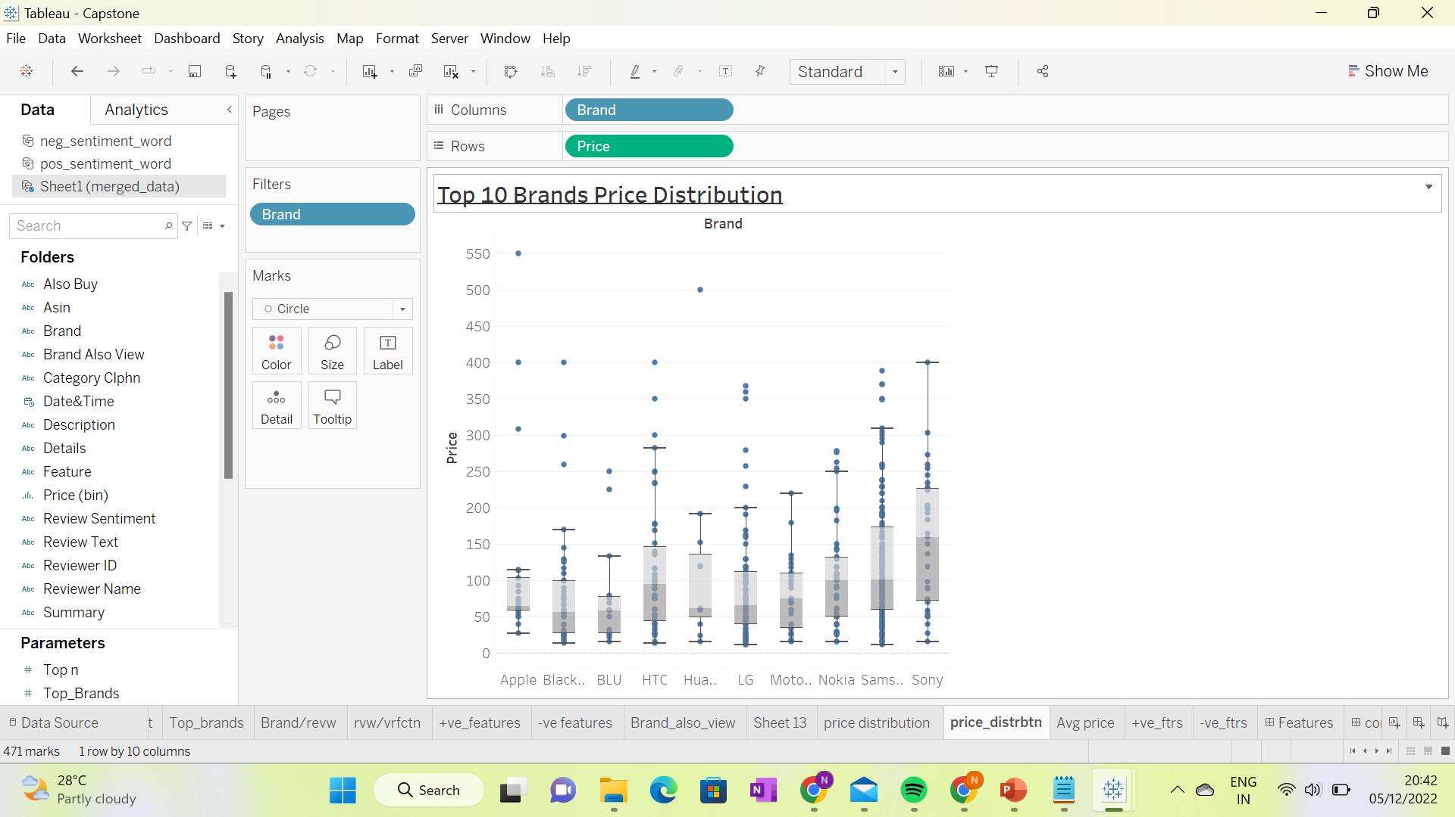
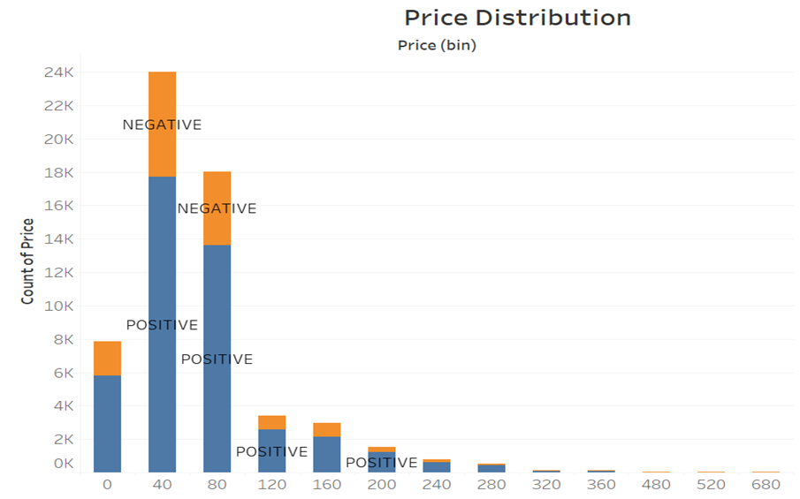
PRICE DISTRIBUTION
Mostly customers buy products in the range $40-$80 which is seconded by $80-$120,so it will be wise if we stick on to this price range.
Even though average price of Samsung is higher, the price distribution of Sony have highest price range.
BLU have their products within a small range and for Samsung they have both high end and low end products.

Slide 8
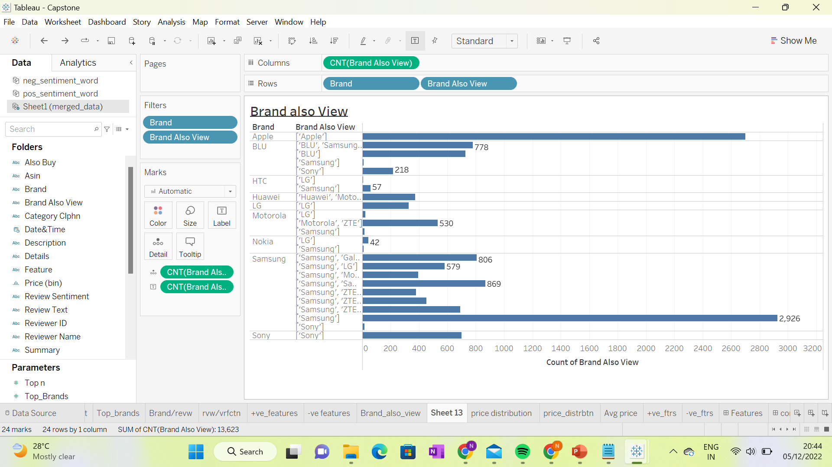
VIEWED BRANDS
Before purchasing any product, we all look at similar products in various brands. Here Samsung tops in that list too.
Samsung, Apple and Sony has more loyal customers.

Slide 9
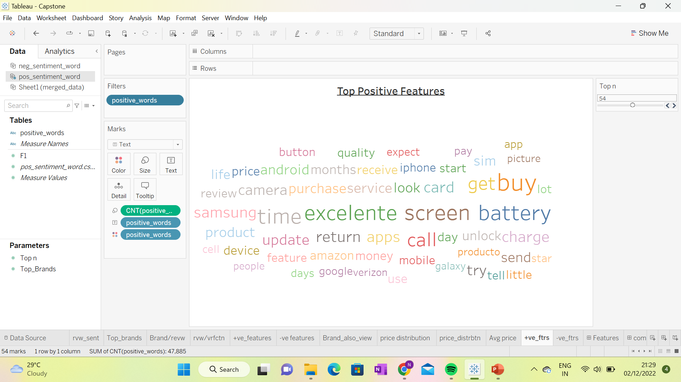
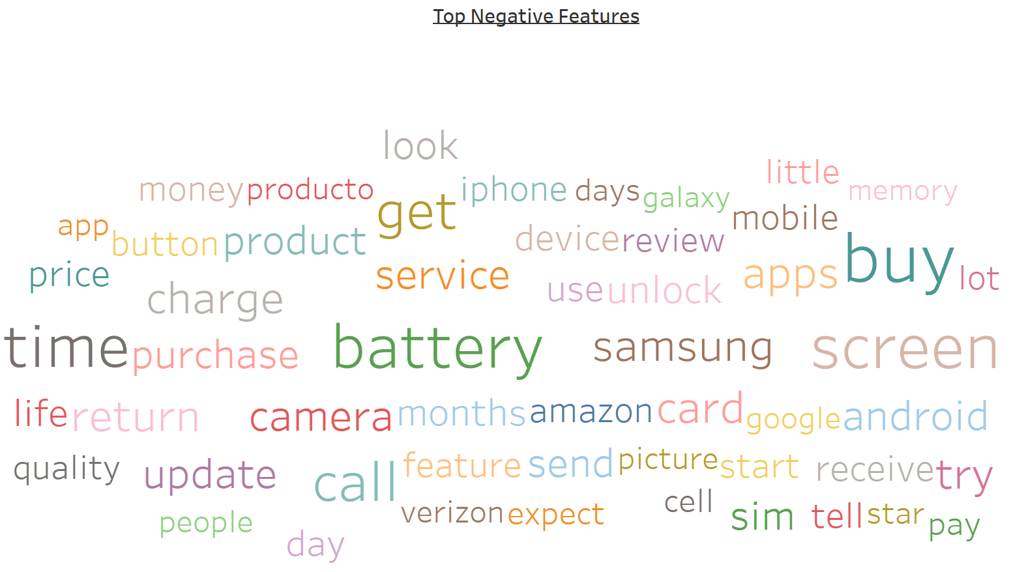
FEATURES
From top positive and negative features most talked features are battery, screen and camera which shows that customer are more incline towards good battery , HD screen display and high-resolution camera.

Slide 10
RECOMMENDATIONS
Price range for the cell phone should be with in range $40-$60 or $80-$100.
Features that company should focus are long lasting battery, High resolution camera and HD display.
To capture the market which is dominated by top ten brands, company should enter with a strategy to provide similar features at lower price along with some distinct features which makes it different.
Notes:
10

Slide 11
APPENDIX : DATA SOURCE
Data source:
We used amazon website data between the years1996 and 2018 for different cellphone and accessories.
Data dictionary
Data contains important information about cell phone and its customer review, which includes also_view, brand purchased, rate, reviews of customers etc.

Slide 12
APPENDIX : Data Model Assumptions
The demand of a particular brand is considered as the number of reviews of that particular brand.
Blank value in ‘Also_View’ column implies that the customer didn’t viewed any other items while buying the cellphone.
Missing price of item is imputed with average price of that particular brand.

Slide 13
APPENDIX : Model
Naive Bayes is one of the widely used text classification algorithms which is used for sentiment analysis. We have build naive bayes model for given data set .
Model has evaluated on base of following matrix
Accuracy(85.45%),sensitivity (95.15%),specificity(57.06%)
precision(86.58%), F1 score(90.66%)
The matrix shows that the model can identify positive and negative reviews correctly.

Slide 14
THANK YOU

