Slide 1
Team
Team Name – Shooting Stars
Vision and Mission
We strongly believe that building a social infrastructure though a welcoming, engaged, and diverse
community is the key to support others for a noble cause. We specifically want to make our farmers
stop suffering and make them economically strong and want to serve them a better scenario. We want
to make them earn the profits that they deserve and support their families, and make their lives better.

Slide 2
Who we are?
We are a bunch of students wanting to strengthen our community with our efforts.
Our team, Shooting Stars, consists of students –
Shriyansh Jain (Team Lead)
Prakash Ujjwal
Edwin Toppo
Prince Bansal
Bharat Goyal
Pritika Sabharwal

Slide 3
Problem
Nowadays farmer’s are committing suicides due to the losses incurred which is a huge problem in India.
The farmers are not able to incur all of the profits that they deserve due to the involvement of lots of
middlemen and corruption that arises while selling the yield in Mandi.
Gap between the farmers and the government causes unavailability of help from the government due to
lack of communication and details about the issues faced by the farmers.
Lack of smart farming knowledge which includes amount of fertilizer to be used, type of crop to be
sown after the nutrient content and texture of soil changes costs heavily to farmers.
It is necessary to account the soil quality, productivity of that land during previous years, location, the
effectiveness of the current methodologies as it affects the profitability of land. But such information is
not easy to obtain. Manual assessment takes time, money, and effort at time to time basis.
There is also less awareness about various beneficiary schemes existing for farmers.

Slide 4
Solution
To overcome the problem, crop and land usage will be monitored in real time using the satellite images
in accordance to the field coordinates as these are cheaper and effective methods, and doesn’t require
manual effort to check the field.
We’ll be designing a progressive web application that revolves around the following :
Farmers can use the platform to monitor weather conditions for minimizing related risks, plan and
manage field works to prevent losses. Vegetation Indices will be used for analysis of the field and
related information will be displayed for proper decision making and act as a supportive
mechanism for yield prediction.
Insurers will be able to extract historical information about the field vegetation, climate/ weather
data, and assess land usage without visiting these fields as these can be easily monitored directly
from the platform.
Traders can improve their logistic plans, track the land usage, predict yields to estimate their future
income expenses and monitor weather conditions to prevent crop losses.
Government officials in-charge can monitor lands of the farmer’s submitting issues using the portal.
In this way, they will be able to implement the schemes for farmer in a efficient way.

Slide 5
Mobile App will be developed for numerous tasks :
To locate their fields and mark their coordinates in the database as all the data regarding field and
land will be saved keeping coordinates as a key.
For a serious issue, some expert could go to the location as submitted by the farmer, examine the
field, take picture and gives feedback on the state of the crops of the issue to be solved. These will
be stored in the database for the government to look forward on these issues.
To view the website on the phone, an option will be there which will overlay the website over the
app.
Both the website and mobile app will be bilingual i.e. English and Hindi so that both the it would be
suitable for all the farmers.

Slide 6
Market Size
Size of market
Our goal is to reach all of the 118.7 million plus unaccounted farmers in India so that they could be
benefited from this method and earn the profits that they deserve. But before expanding, we want to
start it from the major states such as Punjab and Uttar Pradesh.
Sales and distribution
We have nothing to sell but have many things to make aware to the farmers, insurers, and traders as well. We have make aware of our web portal and app to the farmers as well as the authorities so that our work could act as a bridge between government and farmers.
One team would look towards the distribution of app and familiarity of web portal in farmers and traders and try to attract them to trade in our portal cutting involvement of middlemen. Another team would look upon the insurance companies and make them familiar with our mission, and try to attract them so that farmer in need could be assisted.
Farmers getting connected to us will also be distributed sensors to get accurate details about the soil, weather, etc. All the expenses will be procured majorly from the government and little contribution from the traders while trading.

Slide 7
Market Validation
Development time will be affected by following things :
Collection of data and training the machine learning model for crop yield estimation and crop
prediction.
Development of web portal and app.
Testing each of them and improving the models to get accurate results. This will take most part of
our development time.
Developing the web application and app, and all of the machine learning models would take around
one month based on the intense and sole work, and testing would take another half to one month of
time in case any fault is observed.

Slide 8
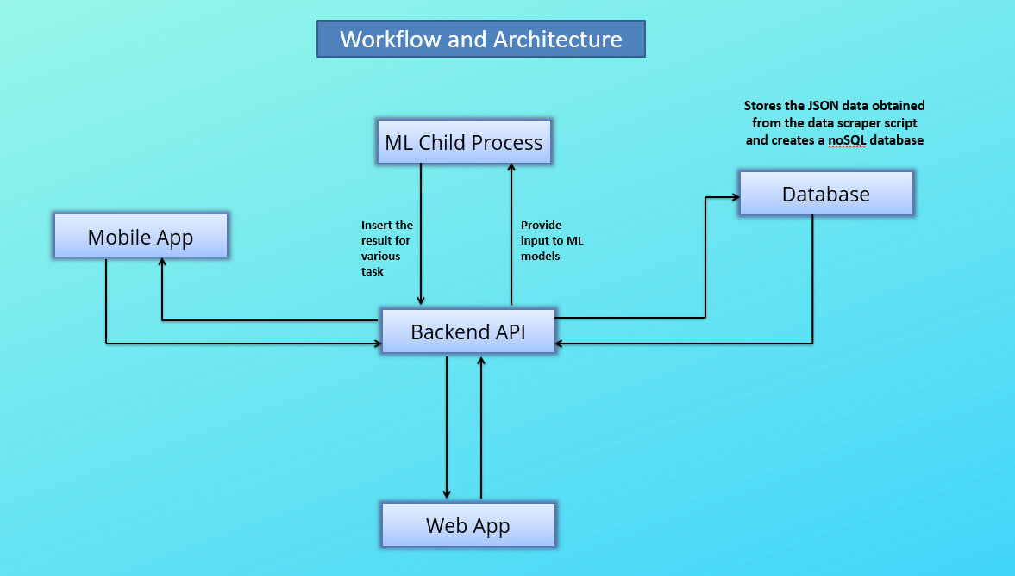
Product

Slide 9
Business Model
Opportunities
Our project opens up to great opportunities for enhancing the efficiency of crop and land usage monitoring at cheaper costs without any manual effort. We will also provide specific tools for brief assessment of land, soil, and crops, and also extract forecasts for government, traders, and insurance companies.
Sources of revenue
We don’t believe in earning while working towards the noble cause but for specific equipments and purposes we do need some amount to spend. Most of our earnings will revolve around the commission from the dealers, insurance companies, and government, as a compensation to our efforts. A specific cost will also be procured from the companies asking some of our technology to use for their own purposes.
Intended customer base
Most of our customers will consist of farmers, dealers, insurance companies, and involvement of government, but if any non-profit organizations wants to join us, they will also be welcomed.

Slide 10
Financial model and projections
Investment to develop- Material and manpower
To develop our dream project, we need a team to develop a web portal and mobile app to connect it to a database so that both are interactable. A team is also needed to see towards the machine learning models, train and test it to obtain accurate results, and a team to implement a mechanism to collect satellite data at a specific interval like 1 or 2 days. To enhance our project, we will need help of sensors installed on our customer’s field. For sensors, we need expenses to build and instalment of these in fields. For first few cases, we will be investing our own money until traders and insurance companies are involved.
Assumptions
We hope that upon investing cost of sensors and manpower, we expect double or triple of the amount invested per sensor incurred from various sectors. If our project flourishes, we are expecting as far as five times.
Return on Investment
Return on investment = Expected double or triple the amount invested / amount invested
= 2 or 3 (5 in extreme case)

Slide 11
Summary
Crop and land usage will be monitored in real time using the satellite images in accordance to the field coordinates as these are cheaper and effective methods and doesn’t require manual effort to check the field.

Slide 12
Q&A
Answered the questions and answers in a separate document.

