Slide 1

The Impact of Bike-Sharing Ridership on Air Quality:
A Scalable Data Science Framework
Nina Hua, Rebecca Reilly, Victoria Suarez, Philip Trinh
Mentors: Paul Intrevado, Diane Myung-kyung Woodbridge

Slide 2


Agenda
Intro
Workflow
Data
Experiment Output
Conclusion

Slide 3


Intro
We explored the relationship between daily air quality indicator (AQI) values and the daily intensity of bike-share ridership
Vehicle emissions are a main cause of increased atmospheric CO₂
A rider on a bicycle will generate 80% less emissions per kilometer than a passenger car
Notes:
Bike sharing has many additional redeeming qualities, including health benefits to riders, a reduction in automobile congestion and providing an additional, highly affordable mode of transportation for those who lack access to other forms of transportation
We aimed to demonstrate that the intensity of bike-share usage on a given day is a strong predictor of daily AQI in major urban areas

Slide 4
Workflow
Amazon Web Services | MongoDB | Apache Spark | Python
Create Computer Instances | Distributed Database | Distributed Computing Framework | Popular Data Science Programming Language
Ease of System Setup | Improved Query Performance | Divide, Compute, Collect | Orchestrate Processes

Slide 5
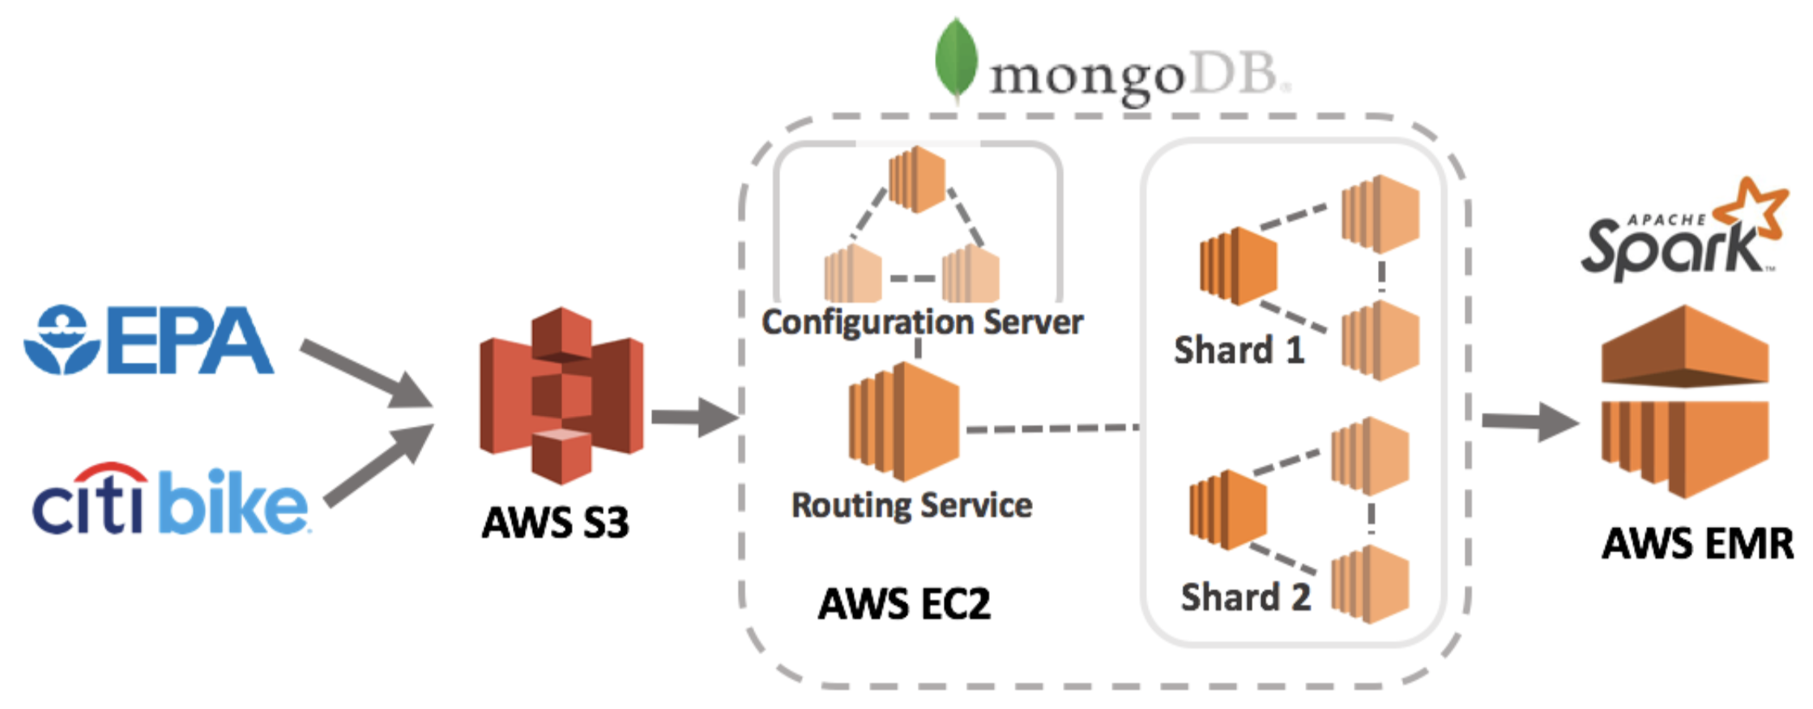
Workflow
Storage and Retrieval
Data
Manipulation
Collection
10 GB
Modeling
4 Computer Instances
10 Computer Instances

Slide 6
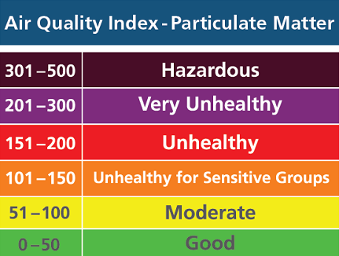
Data
CitiBike (9GB)
12,000 bicycle
750 stations
EPA (1GB)
Air Quality Index (AQI)
3 years (2016 - 2018)
Notes:
CitiBike, the provider of New York City’s bike-sharing program, has a fleet of 12,000 bicycles and 750 unique pick-up/drop-off docking stations across Manhattan, Brooklyn, Queens, and Jersey City

Slide 7
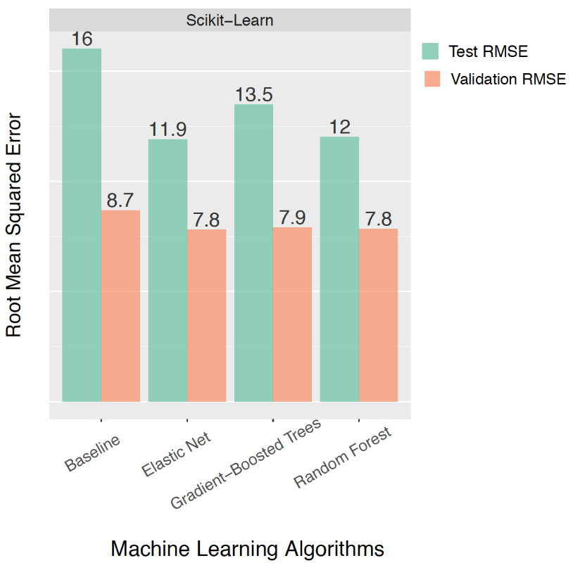
Experiment Output
Algorithms:
Elastic Net
Gradient-Boosted Trees
Random Forest
Features:
Seasonal Indicator
Previous day’s AQI
Total # of bike-sharing rides per day

Slide 8

Conclusion
Established inverse relationship between daily AQI and bike-share ridership
Recommend distributed platforms for pre-processing data
Encourage continuation of research on the relationship between modes of transportation and AQI

Slide 9
Thank You

