Slide 1
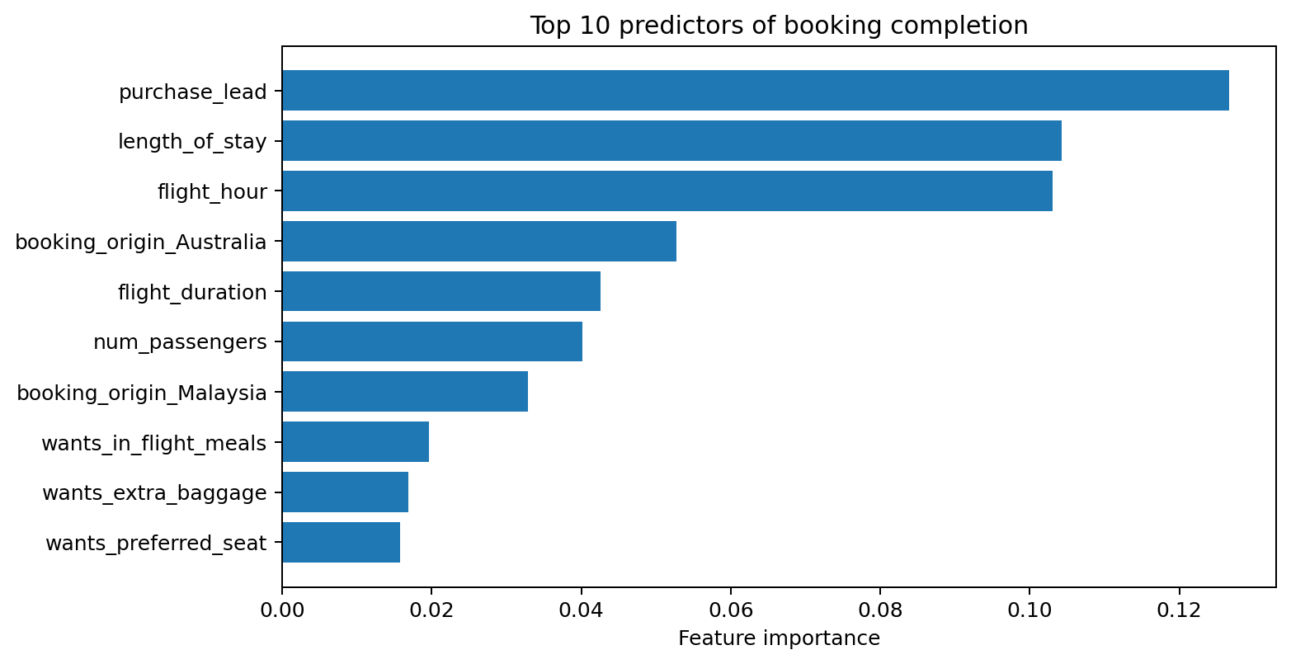
Predictive modeling of customer bookings
Nina Nguyen
nguyenbillie25@gmail.com
Random Forest model identifies useful booking signals, but completed-booking detection remains the key improvement area.
0.793
Test ROC-AUC
0.786
5-fold CV ROC-AUC
42%
Precision — completed
38%
Recall — completed
Key findings
• Purchase lead, length of stay and flight hour are the strongest model predictors.
• Booking origin also contributes materially; Australia and Malaysia appear among the top signals.
• Ancillary preferences (meals, baggage, seat) add smaller predictive value.
Model interpretation
• Cross-validation is highly consistent across shuffled stratified folds (mean ROC-AUC 0.786).
• Accuracy alone is misleading because only ~15% of test bookings are completed.
• Feature importance indicates predictive contribution, not causal impact.
Business recommendation
• Use the model as a targeting/ranking signal rather than an automated decision rule.
• Improve minority-class recall through threshold tuning, class-balancing experiments and further validation before deployment.
Dataset: 50,000 customer booking records | Model: RandomForestClassifier | Target: booking_complete

