Slide 1

Environment Kuznets curve
for CO₂ emissions: A co-integration analysis for China
組員：
B05507059蕭廷融 /B04507001 陳煒元 B06505014黃奕翔 / B10508055李宛樺
B10508040鄭雅馨 / B10508038王舒憶 B10508023何晨怡 / B10515057顧學元

Slide 2

Presentation Outline
Background Information
The Original Tests
Our Own Results

Slide 3
Background
Information

Slide 4

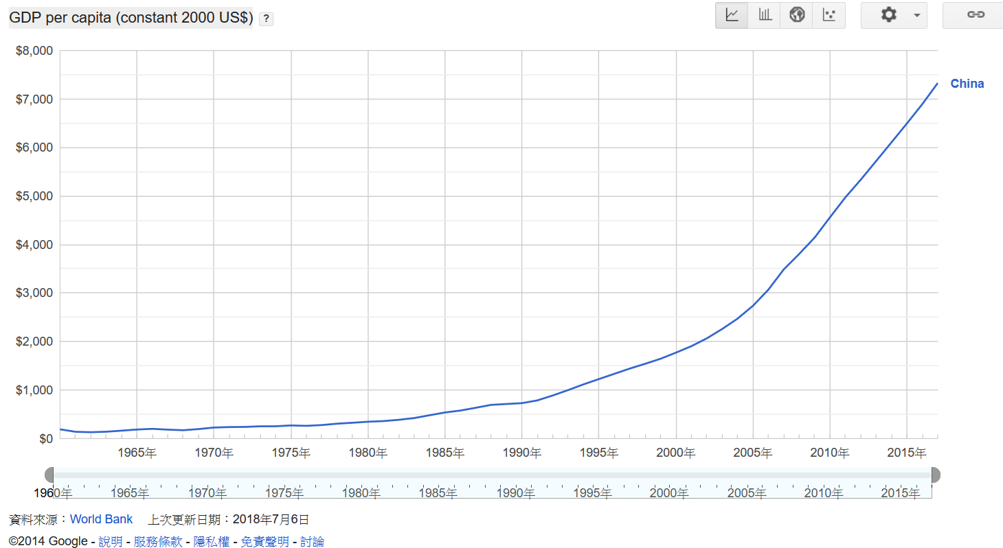
GDP per capita
以西元2000年為基準年、美元計價
第二大經濟體
第一大工業國/第一大農業國
第二大服務業國/世界最大貿易國

Slide 5
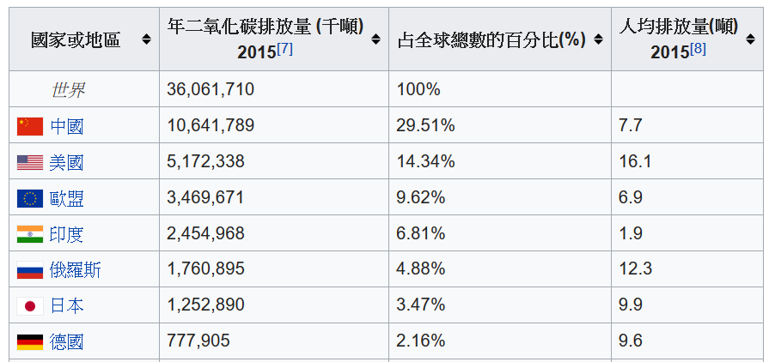
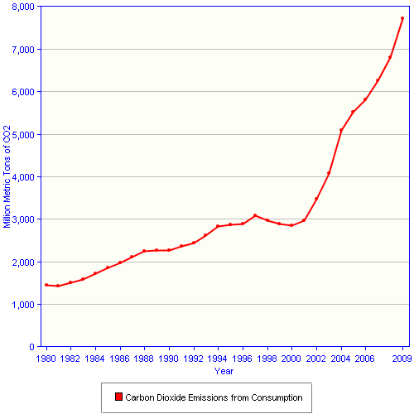

國家或地區二氧化碳排放量排名
2004-2009
中國二氧化碳排放量
年增長率約為11％
2015年中國CO₂排放量為
全球第一
約佔全球CO2排放量的三成

Slide 6
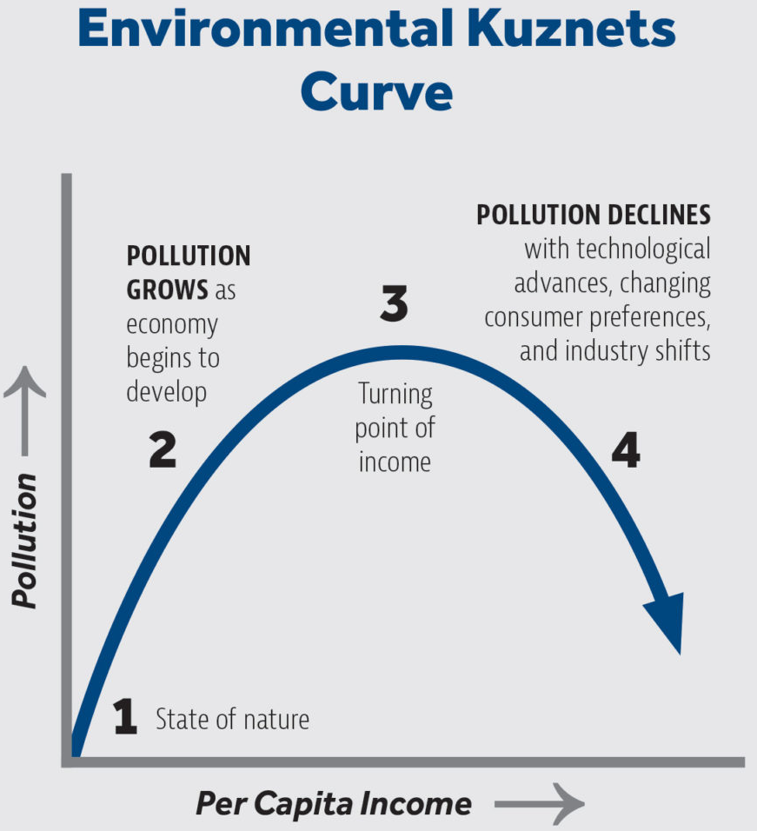
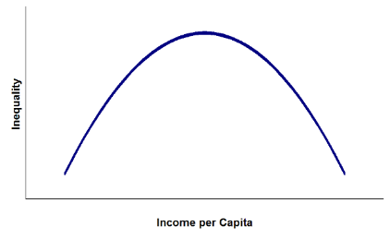
庫茲涅茨曲線
Kuznets Curve (倒U曲線)
分析人均收入水平與分配公平程度關係的一種學說。
研究表明，收入不均現象隨著經濟增長先升後降，
呈現倒U型曲線關係。
污染下降與GDP上升的關係尚
無法論證是因果關係。

Slide 7
檢定
e_{t}
commercial
Energy use per capita
單根檢定
VAR
ARDL
y_{t}
per capita
Real GDP
ε_{t}
Regression error term
C_{t}
CO2 emissions per capita
CUSUM
CUSUMSQ
y²_{t}
Square per capita
Real GDP
tr_{t}
Openness ratio used as proxy foreign trade
“The main focus of this paper is to examine the long-run relationship of environmental pollution and economic growth for China.”

Slide 8
The Original
Paper

Slide 9
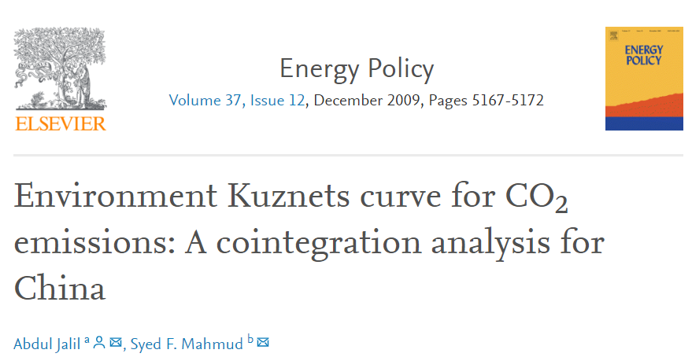
論文介紹

Slide 10
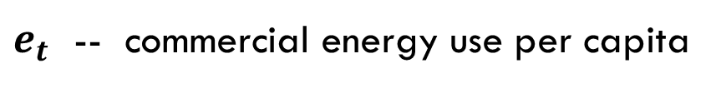
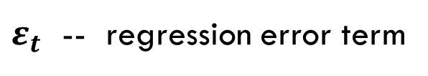
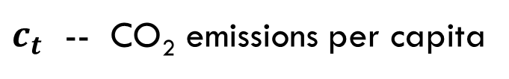
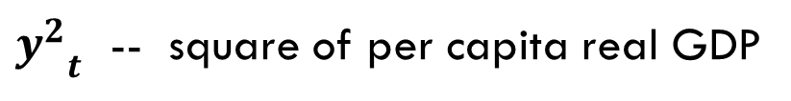
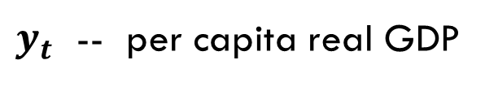
EQUATION :
CO₂ Emissions x Energy Consumption x Economic Growth x Foreign Trade
$$c_{t}=β_{0}+β_{1}e_{t}+β_{2}y_{t}+β_{3}{y^{2}}_{t}+β_{4}{tr}_{t}+ε_{t}$$
$$c_{t}=β_{0}+β_{1}e_{t}+β_{2}y_{t}+β_{3}{y^{2}}_{t}+β_{4}{tr}_{t}+ε_{t}$$
* Logarithmic form
$c_{t}$ -- CO₂ emissions per capita
$e_{t}$ -- commercial energy use per capita
$y_{t}$ -- per capita real GDP
${y^{2}}_{t}$ -- square of per capita real GDP
${tr}_{t}$ -- openness ratio used as proxy for foreign trade
$ε_{t}$ -- regression error term

Slide 11
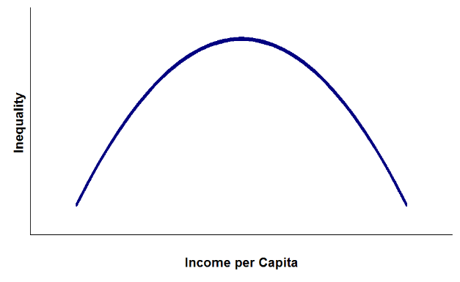
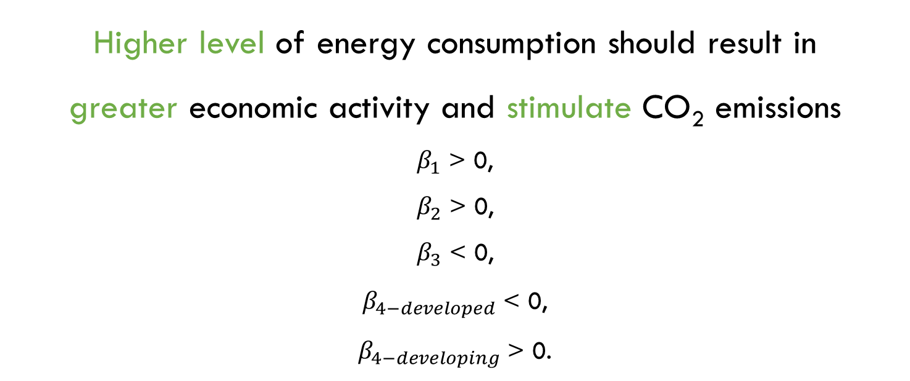
EXPECTATIONS :
$$c_{t}=β_{0}+β_{1}e_{t}+β_{2}y_{t}+β_{3}{y^{2}}_{t}+β_{4}{tr}_{t}+ε_{t}$$
$$c_{t}=β_{0}+β_{1}e_{t}+β_{2}y_{t}+β_{3}{y^{2}}_{t}+β_{4}{tr}_{t}+ε_{t}$$
Higher level of energy consumption should result in
greater economic activity and stimulate CO₂ emissions
$β_{1}$ > 0,
$β_{2}$ > 0,
$β_{3}$ < 0,
$β_{4−developed}$ < 0,
$β_{4−developing}$ > 0.
EKC assumption

Slide 12

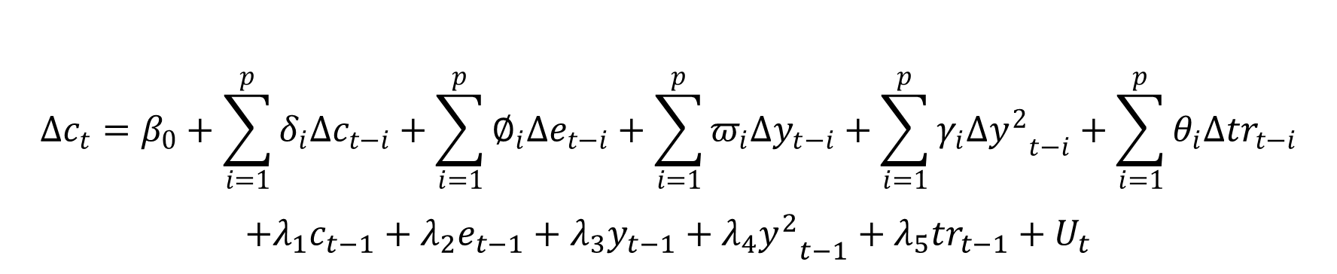
ARDL Model : explanation
* $β_{0}$ -- drift component / U_{t} -- white noise
$$∆c_{t}=β_{0}+\sum_{i=1}^{p}{δ_{i}∆c_{t−i}}+\sum_{i=1}^{p}{∅_{i}{∆e}_{t−i}}+\sum_{i=1}^{p}{π_{i}{∆y}_{t−i}}+\sum_{i=1}^{p}{γ_{i}{∆y^{2}}_{t−i}}+\sum_{i=1}^{p}{θ_{i}{∆tr}_{t−i}}$$
$$+λ_{1}c_{t−1}+λ_{2}e_{t−1}+λ_{3}y_{t−1}+λ_{4}{y^{2}}_{t−1}+λ_{5}{tr}_{t−1}+U_{t}$$
Represent the error correction dynamics
Corresponds to the long-run relationship

Slide 13

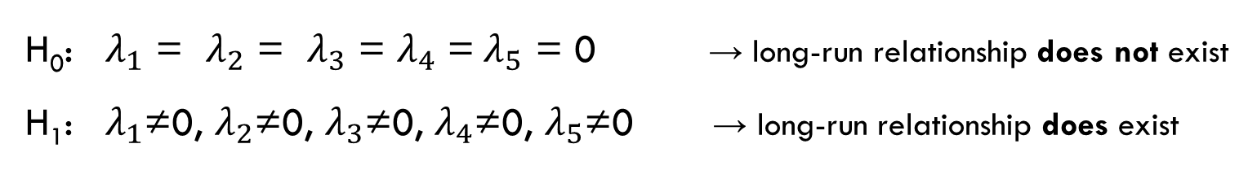
ARDL Model : F-test
* $β_{0}$ -- drift component / U_{t} -- white noise
$$∆c_{t}=β_{0}+\sum_{i=1}^{p}{δ_{i}∆c_{t−i}}+\sum_{i=1}^{p}{∅_{i}{∆e}_{t−i}}+\sum_{i=1}^{p}{π_{i}{∆y}_{t−i}}+\sum_{i=1}^{p}{γ_{i}{∆y^{2}}_{t−i}}+\sum_{i=1}^{p}{θ_{i}{∆tr}_{t−i}}$$
$$+λ_{1}c_{t−1}+λ_{2}e_{t−1}+λ_{3}y_{t−1}+λ_{4}{y^{2}}_{t−1}+λ_{5}{tr}_{t−1}+U_{t}$$
H₀: $λ_{1}$ = $λ_{2}$ = $λ_{3}$ = $λ_{4}$ =${ λ}_{5}$ = 0 → long-run relationship does not exist
H₁: $λ_{1}$≠0, $λ_{2}$≠0, $λ_{3}$≠0, $λ_{4}$≠0, $λ_{5}$≠0 → long-run relationship does exist
$$∆c_{i}=β_{0}+\sum_{i=1}^{p}{δ_{i}∆c_{t−i}}+\sum_{i=1}^{p}{∅_{i}{∆e}_{t−i}}+\sum_{i=1}^{p}{π_{i}{∆y}_{t−i}}+\sum_{i=1}^{p}{γ_{i}{∆y^{2}}_{t−i}}+\sum_{i=1}^{p}{θ_{i}{∆tr}_{t−i}}+α{ECM}_{t−1}+U_{t}$$
Error Correction Model

Slide 14
ECM Model :
# WHY ?
Very useful in short-term and long-term effects of one time series.
# WHAT ?
The error: the fact that last-period’s deviation from a long-run equilibrium influences its short-run dynamics.
# S0 …
The ECM directly estimates the speed at which a dependent variable returns to equilibrium after a change in other variables.
$$∆c_{i}=β_{0}+\sum_{i=1}^{p}{δ_{i}∆c_{t−i}}+\sum_{i=1}^{p}{∅_{i}{∆e}_{t−i}}+\sum_{i=1}^{p}{π_{i}{∆y}_{t−i}}+\sum_{i=1}^{p}{γ_{i}{∆y^{2}}_{t−i}}+\sum_{i=1}^{p}{θ_{i}{∆tr}_{t−i}}+α{ECM}_{t−1}+U_{t}$$
* Measure the speed of adjustment required to adjust to long-run values after a short-term shock.

Slide 15
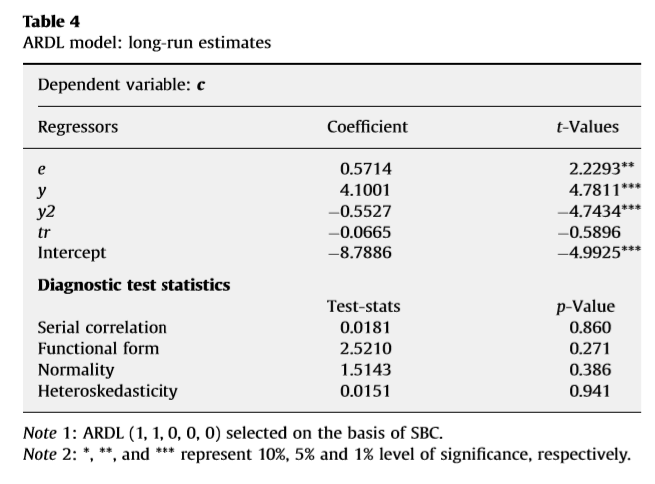
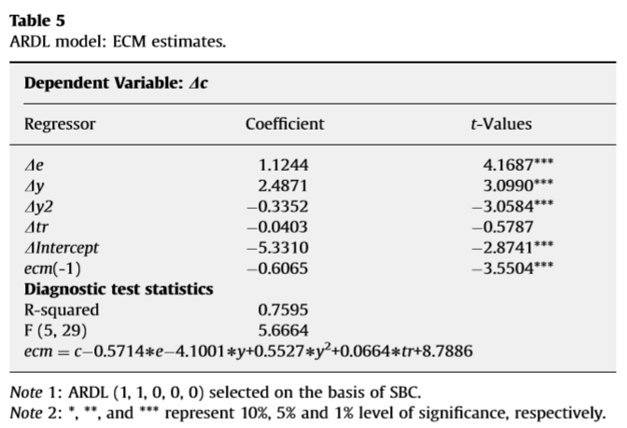

Slide 16
The results of this study indicates that the carbon emissions are mainly determined by real GDP and energy consumption in the long run. Trade has a positive but statistically insignificant impact on CO₂ emissions.

Slide 17
Our Own
Analysis

Slide 18
Datasets
C: Emission of CO₂
E: Energy Consumption
T: Trade Openness Ratio
Y: GDP per Capita
* We use the logarithm of all variables
Source: WorldBank, Selected Peroid: 1971-2014

Slide 19
ADF without difference
Variable | Lags’ | Lags | BIC | T-statistics | Significance
C | 0 | 1 | -6.239 | -2.26746 | -
E | 1 | 1 | -6.622 | -1.34997 | -
T | 2 | 0 | -4.131 | -1.69834 | -
Y | 2 | 0 | -7.114 | -3.88013 | **
Y² | 0 | 1 | -3.131 | -1.82999 | -
***99% **95% *90% level of significance
Notes:
有trend(為了把時間對變數的影響考慮進去)

Slide 20
ADF with difference
Variable | Lags’ | Lags | BIC | T-statistics | Significance
ΔC | 0 | 3 | -6.215 | -3.76668 | **
ΔE | 0 | 0 | -6.664 | -3.74190 | **
ΔT | 1 | 1 | -4.130 | -5.55061 | ***
ΔY | 1 | 4 | -7.205 | -4.08686 | **
ΔY² | 0 | 4 | -3.181 | -3.74651 | **
***99% **95% *90% level of significance

Slide 21
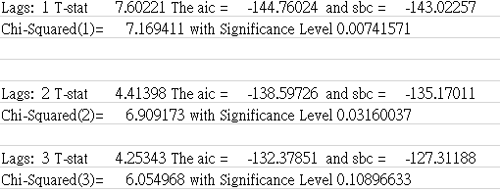
VAR
99% level of significance
Notes:
顯著水準99%之下

Slide 22
Granger Casual Test without ECM
 | F-Test | Prob.
C doesn't granger cause to Y | 0.01341 | 0.98668574
Y doesn't granger cause to C | 3.59207 | 0.05604423
C doesn't granger cause to Y² | 0.02376 | 0.97653033
Y² doesn't granger cause to C | 2.96144 | 0.06411909

Slide 23
ARDL without ECM -1
 | Coefficient | Standard Error | T-Test | P-Value
C{1} | 0.815206755 | 0.200951875 | 4.05673 | 0.00038084
C{2} | -0.0949257 | 0.195293522 | -0.48607 | 0.63084154
Y | 1.380585802 | 0.656810365 | 2.10195 | 0.0450232
Y{1} | -2.029387411 | 1.107209871 | -1.83288 | 0.07786944
Y{2} | 0.513584609 | 0.653849015 | 0.78548 | 0.4390117
Y² | -0.146448816 | 0.09952823 | -1.47143 | 0.15273522
Y²{1} | 0.234833724 | 0.170190062 | 1.37983 | 0.1789588
Y²{2} | -0.070900538 | 0.097422416 | -0.72776 | 0.47302241
T | 0.06040165 | 0.048545542 | 1.24423 | 0.22410964
T{1} | -0.021638552 | 0.052459296 | -0.41248 | 0.68324264
T{2} | 0.047436809 | 0.042555335 | 1.11471 | 0.27479952
E | 0.691002299 | 0.172383699 | 4.00851 | 0.00043271
E{1} | -0.227090767 | 0.241902514 | -0.93877 | 0.35617176
E{2} | -0.242189354 | 0.227423694 | -1.06493 | 0.29634076
Constant | -1.288599371 | 1.822180653 | -0.70717 | 0.48551752
***
**
*
***

Slide 24
ARDL without ECM -2
 | Coefficient | Standard Error | T-Test | P-Value | Significance
C{1} | 0.587103048 | 0.141444392 | 4.15077 | 0.00019371 | ***
Y | 0.182263699 | 0.14884772 | 1.2245 | 0.22871726
Y² | -0.02507876 | 0.017600699 | -1.42487 | 0.16280626
T | 0.026196119 | 0.030519224 | 0.85835 | 0.39637934
E | 1.053214463 | 0.115652161 | 9.10674 | 0 | ***
E{1} | -0.505581177 | 0.208476716 | -2.42512 | 0.02044741 | **
Constant | -3.703820293 | 1.401884523 | -2.64203 | 0.0121191 | **
***99% **95% *90% level of significance

Slide 25
ARDL without ECM -2(Cont.)
刪除依舊不顯著的Trade變數(T)
其它項的Significance大幅提升
 | Coefficient | Standard Error | T-Test | P-Value | Significance
C{1} | 0.538690853 | 0.129250419 | 4.16781 | 0.0001774 | ***
Y | 0.288005152 | 0.083245194 | 3.45972 | 0.00137833 | ***
Y² | -0.036976704 | 0.010807772 | -3.42131 | 0.00153438 | ***
E | 1.093470378 | 0.105339299 | 10.38046 | 0 | ***
E{1} | -0.463514383 | 0.201912177 | -2.29562 | 0.02746362 | **
Constant | -4.353077103 | 1.176105175 | -3.70127 | 0.00069501 | ***
***99% **95% *90% level of significance

Slide 26
Error Correction Model
 | Coefficient | Standard Error | T-Test | P-Value | Significance
C{1} | -0.459462022 | 0.1101506 | -4.17122 | 0.00023805 | ***
T{1} | -0.003359008 | 0.025988456 | -0.12925 | 0.8980225
Y{1} | 0.375555119 | 0.148416538 | 2.53041 | 0.0168757 | **
Y²{1} | -0.052282583 | 0.019317395 | -2.7065 | 0.0111091 | **
E{1} | 0.748747285 | 0.175515121 | 4.266 | 0.00018297 | ***
Constant | -5.249799467 | 1.29240616 | -4.06204 | 0.0003219 | ***
***99% **95% *90% level of significance

Slide 27
Residual Autocorrelation Test
Variable | Coefficient | Standard Error | T-Test | P-Value
ECM{1} | 0.1965810 | 0.1664382105 | 1.18111 | 0.24575520
Variable | Coefficient | Standard Error | T-Test | P-Value
ECM{1} | 0.1695363 | 0.1753268141 | 0.96697 | 0.34080910
ECM{2} | 0.1259921 | 0.1736135937 | 0.72570 | 0.47329462
第一個模型較有意義，但是兩者都不顯著有Autocorrelation關係

Slide 28
Granger Casual Test with ECM
 | F-Test | Prob.
C doesn't granger cause to Y | 0.69658 | 0.50616492
Y doesn't granger cause to C | 5.56994 | 0.00876743
C doesn't granger cause to Y² | 0.70386 | 0.50265830
Y² doesn't granger cause to C | 5.41510 | 0.00981962
加入ECM之後，Y為C的Granger cause的機率增加
C為Y的Granger cause的機率亦增加，但仍不顯著
Notes:
Granger Causality Test Null Hypothesis : The Following Coefficients Are Zero LY Lag(s) 1 to 2 F(2,30)= 5.56994 with Significance Level 0.00876743
Granger Causality Test Null Hypothesis : The Following Coefficients Are Zero LC Lag(s) 1 to 2 F(2,30)= 0.69658 with Significance Level 0.50616492
Granger Causality Test Null Hypothesis : The Following Coefficients Are Zero LY2 Lag(s) 1 to 2 F(2,30)= 5.41510 with Significance Level 0.00981962
Granger Causality Test Null Hypothesis : The Following Coefficients Are Zero LC Lag(s) 1 to 2 F(2,30)= 0.70386 with Significance Level 0.50265830

Slide 29
ARDL with ECM -1
 | Coefficient | Standard Error | T-Test | P-Value | Significance
ΔE | 1.017472528 | 0.078434414 | 12.97227 | 0 | ***
ΔE{1} | 0.241904606 | 0.094746489 | 2.55318 | 0.01688759 | **
ΔY | 1.073583522 | 0.166997923 | 6.42872 | 0.00000082 | ***
ΔY{1} | -0.107747591 | 0.116603433 | -0.92405 | 0.36395652
ΔY{2} | 0.224368817 | 0.085459641 | 2.62544 | 0.01430547 | **
ΔY² | -0.086740031 | 0.016833998 | -5.15267 | 0.00002247 | ***
ΔT | -0.001211834 | 0.019411831 | -0.06243 | 0.95069979
ΔC{1} | -0.110414111 | 0.092094366 | -1.19892 | 0.24137104
ΔC{2} | -0.196652479 | 0.057425265 | -3.42449 | 0.0020538 | ***
ECM | 0.938040326 | 0.102288616 | 9.17053 | 0 | ***
Constant | -0.02334018 | 0.008180868 | -2.85302 | 0.0083832 | ***
***99% **95% *90% level of significance

Slide 30
ARDL with ECM -2
 | Coefficient | Standard Error | T-Test | P-Value | Significance
ΔE | 1.015549461 | 0.070788907 | 14.34617 | 0 | ***
ΔE{1} | 0.241382233 | 0.092619008 | 2.60618 | 0.01472088 | **
ΔY | 1.068701407 | 0.144807207 | 7.38017 | 0.00000006 | ***
ΔY{1} | -0.107432465 | 0.114325033 | -0.93971 | 0.35569749
ΔY{2} | 0.225021452 | 0.083238514 | 2.70333 | 0.011729 | **
ΔY² | -0.086262736 | 0.014718367 | -5.86089 | 0.00000305 | ***
ΔC{1} | -0.108449996 | 0.08494183 | -1.27676 | 0.21256044
ΔC{2} | -0.196854314 | 0.056266634 | -3.4986 | 0.00163939 | ***
ECM | 0.936021616 | 0.095235818 | 9.82846 | 0 | ***
Constant | -0.023401023 | 0.007971364 | -2.93564 | 0.00672366 | ***
***99% **95% *90% level of significance

Slide 31
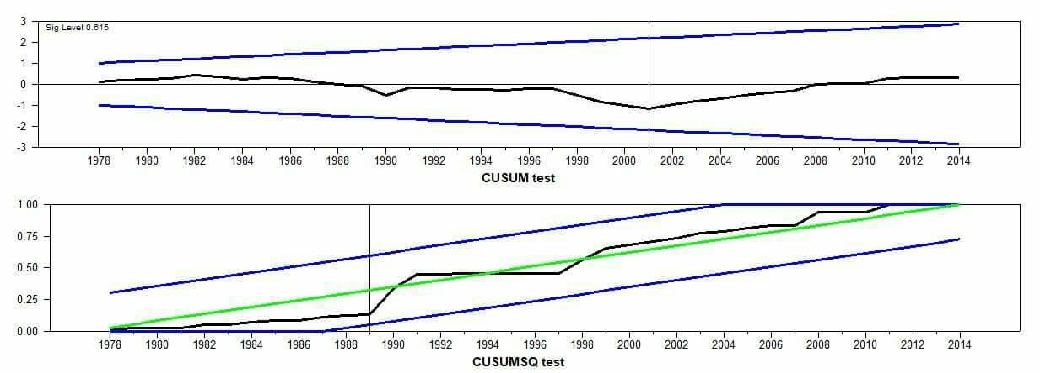
CUSUM & CUSUMSQ
OUR RESULTS

Slide 32
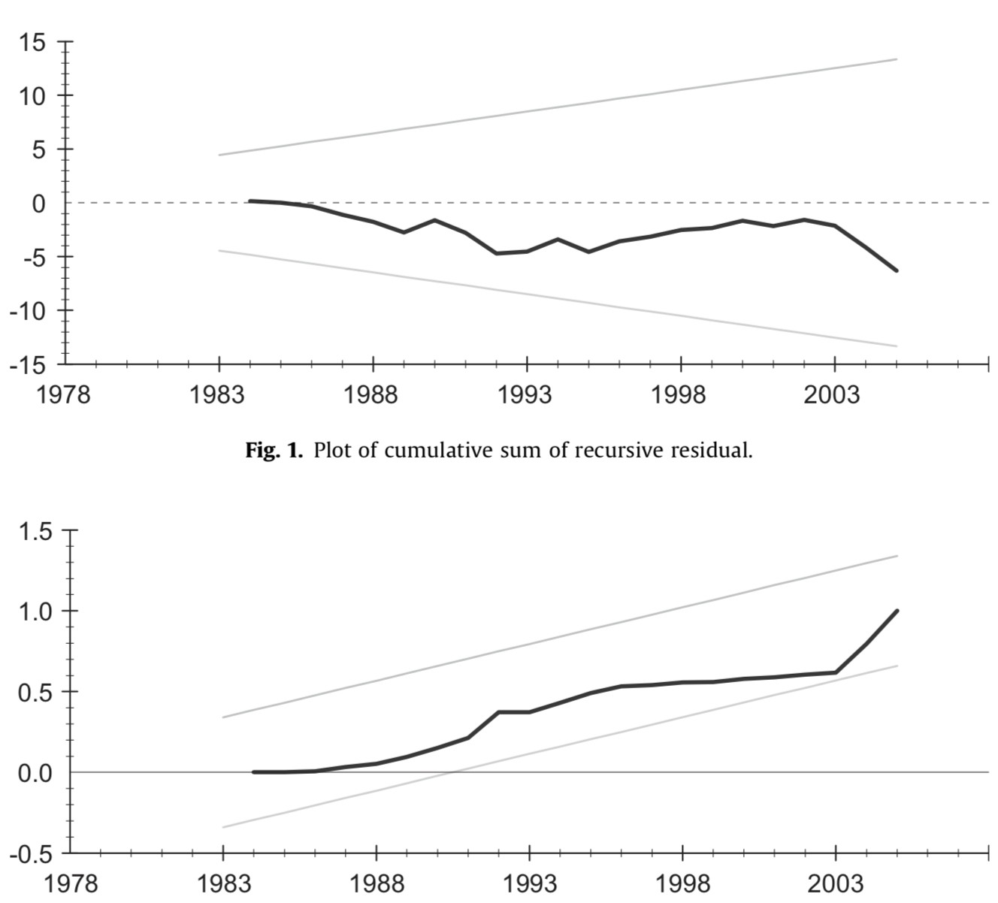
CUSUM & CUSUMSQ
ORIGINAL RESULTS

Slide 33
Conclusion
The results of our own analysis also indicates that the carbon emissions are mainly determined by real GDP and energy consumption in the long run.
However, we think that Trade has no significance in our study.

Slide 34


