Slide 1
Casa de Muebles
Products & Service Offered
Wood Furniture
Upholstery

Slide 2
Mission
  To showcase Filipino ingenuity and craftsmanship in the field of woodworking through world-class furniture design and production
  Contribute to the local furniture/woodworking industry by providing training and employment opportunities and pioneering design trends and production models
Vision
  To become the leading wholesale provider of furniture in the Philippines

Slide 3
Why Muebles?
Booming Real Estate = Booming furniture Sales
  Real estate development clients (i.e. condominium construction companies, hotels, restaurants)
Wood furniture:
  Durable
  High resale value
  Classic feel

Slide 4
Departments:
Management - MIKE
Finance - ARIANE
Design - NIKKI
Production - BEA
Supplies - TIN
Marketing/Sales - NINA
Equipment & Maintenance - GEORGE

Slide 5
Management
  Business Plan
  Design Approval
  Training
  Hiring of Employees

Slide 6
Finance
Generated Reports:
  Financial Statements
    Profit & Loss (Income Statement)
    Financial Position (Balance Sheet)
    Cash Flow Statement
    Statement of Changes in Owners’ Equity
  Tax Reporting
    Income Tax Return
    Expanded Withholding Tax
    Value-Added Tax
Budgeting and Planning

Slide 7
Design
  Prototyping
  Research Trends & Materials
  Documentation of Design
  Feasibility of Expenses

Slide 8
Production
  Assembly
  Cutting
  Production Flow
  Varnishing
  Quality Assurance
  Upholstery

Slide 9
Supplies
  Materials
  Procurement
  Purchasing
  Inventory
  Logistics

Slide 10
Marketing
  Sales
  Advertising/Events
  Client Relations
  Public Relations
  Marketing Strategy

Slide 11
Equipment & Marketing
  Equipment & Materials
  Field Maintenance
  Fumigation
  Machine Repairs

Slide 12
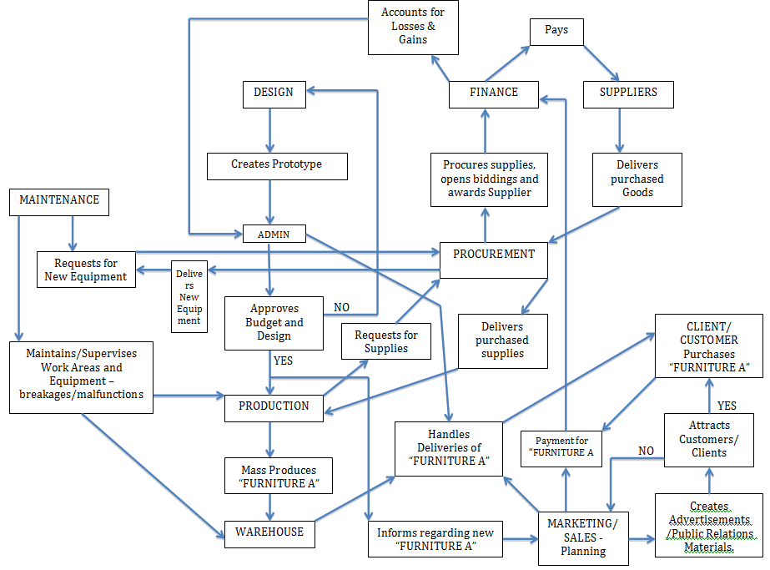

Slide 13
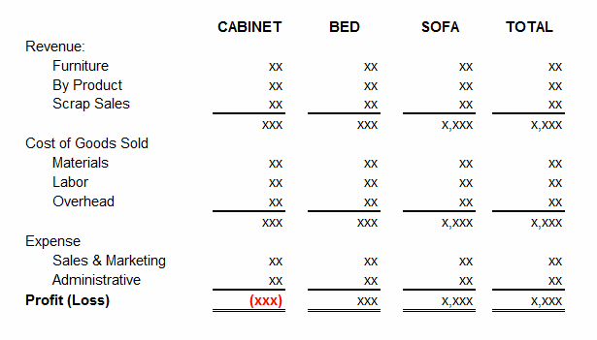
Primary Expense and Source of Revenue
Revenue
  Sales from Furniture
  Sales from By-Product / Scrap Sales
Expense
  Cost of Good Sold
    Materials (Wood, Fabric , etc…)
    Labor (Production Salary)
    Overhead (Plant/Warehouse Bldg expense)
  Marketing Expense
  Administrative Expense

Slide 14
Casa de Muebles Software Requirements:
Database of Clients, Suppliers, Supplies, Furniture Models and Inventory.
Tracking of deliveries.
Production Progress.
Financial Reports

Slide 15
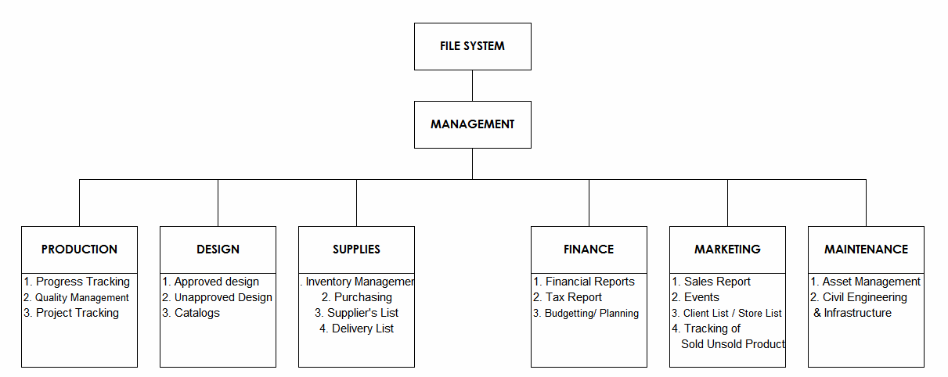
BREAKDOWN

Slide 16
Proposed GANTT Chart (Phased)
 | weeks
Task | 1 | 2 | 3 | 4 | 5 | 6 | 7 | 8 | 9 | 10 | 11 | 12 | 13 | 14 | 15 | 16 | 17
Requirements gathering
Specification
Planning
Admin
Finance
Production
Design
Supplies
Marketing
Modular Testing
Module Integration
Internal Testing (alpha)
Beta Test
End User Acceptance Test

Slide 17
GANTT (cont.)
Requirements Gathering will be three weeks of immersion with the client (start week 0)
Specification will start as soon as initial data is collected from the client (start week 1)
Planning will start on week 2
Phased development (per module) will start after planning nears completion and design is approved (estimated 2 months/8 weeks)
Modular testing will occur in between modular development after identification of milestones
Modular integration will start after phased development
Alpha, Beta and end-user testing will follow (1 week each)
Finally, the application will be presented to management and key users for user acceptance.

Slide 18
TASK ID | TASK NAME | DURATION | PREDECESSORS
W101 | Meeting with client | 3 | 0
W102 | Immersion with Client | 16 | W101
W103 | Finalization of Specs | 4 | W102
W104 | Finalization of Design | 8 | W103
W105 | Approval of Prototype Design and Specs | 3 | W104
W106 | Database Construction & Population | 24 | W105
W107 | Development of Base Platform | 40 | W106
W108 | Development of Modules | 80 | W107
W108A | Finance
W108B | Productiuon
W108C | Design
W108D | Supplies
W108E | Marketing
W108F | Maintenance
W108G | Admin
W109 | Modular Testing | 24 | W108
W110 | Module Integration | 24 | W109
W111 | Internal Testing(alpha) | 24 | W110
W112 | Beta Testing | 24 | W111
W113 | Client Testing | 40 | W112
W114 | **Revision | 40 | W113
W115 | Client Acceptance | 3 | W114

