Slide 1
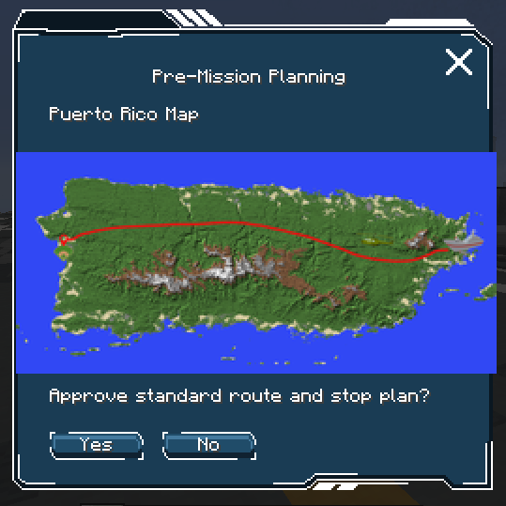
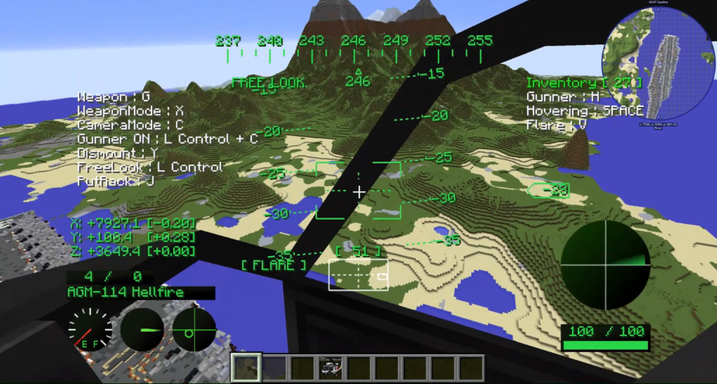
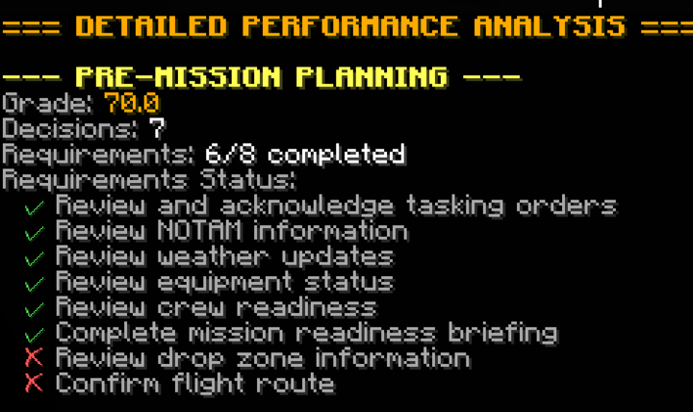
Exploration of Human-AI Teaming Concepts in Minecraft
CHIMERA - Creating Human-Centered AI/ML to Enhance Rational Advantage
TECHNICAL CHALLENGES
Operationally relevant simulation software may be under strict security protocols and/or expensive
  Overall process of ideation to simulation can be a slow, tedious process
Lack of free programs that can be used to recreate countries in 1-to-1 scale in Minecraft
  Insufficient computational power (e.g., only 32 GB of RAM)
Reinforcement Learning (RL) agent interaction with modified elements
INSERT
PHOTOS/GRAPHICS
AS NEEDED
TECHNICAL APPROACH
Previous research showcased the value of using video games for human-AI teaming research (e.g., Minecraft, StarCraft)
Utilized Minecraft to develop a gamified C3 contingency scenario designed by Professional Masters in Systems Engineering (PMASE) 2025 cohort
  Mission Crew Commander (MCC) player
  Contingency mission, 4-person rotary wing crew to provide post-hurricane humanitarian support to Puerto Rico
  Mission aligned with vetted cognitive workflows and Operational Risk Management (ORM) risk analysis
INSERT
PHOTOS/GRAPHICS
AS NEEDED
RESULTS/PROJECT OUTCOMES
Created a Minecraft server with three complex worlds
Enabled player actions through pre-made mods/plugins and custom scripts/mods throughout gameplay
  Total mission score calculated based on tracked user actions and decision time
  Player action is logged to a JSON file
CHIMERA Minecraft sandbox will be used in future research for human-AI teaming for C4ISR decision optimization
INSERT
PHOTOS/GRAPHICS
AS NEEDED
AUTHORS: Nina Bryan, Aaliyah McElrath, Tommy Tran, Vivian Zhou
COI: Command, Control, Communications, Computers, and Intelligence (C4I)
Contact: Dr. Courtney Crooks: Phone: (404) 407-8514;
Email: courtney.crooks@gtri.gatech.edu

