Slide 1
Memory Management Basics

Slide 2
Summary
Understanding how the processor architecture drives the memory management features of OS and system programs (compilers, linkers)
Understanding how different hardware designs lead to different memory management schemes by operating systems

Slide 3
Addresses issued by CPU
During the entire ‘on’ time of the CPU
  Addresses are “issued” by the CPU on address bus
  One address to fetch instruction from location specified by PC
  Zero or more addresses depending on instruction
    e.g. mov $0x300, r1 # move contents of address 0x300 to r1 --> one extra address issued on address bus

Slide 4
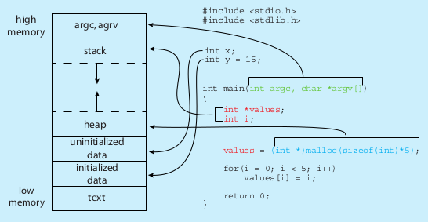
Memory layout of a C program
$ size /bin/ls
text data bss dec hex filename
128069 4688 4824 137581 2196d /bin/ls

Slide 5
Desired from a multi-tasking system
Multiple processes in RAM at the same time (multi-programming)
Processes should not be able to see/touch each other’s code, data (globals), stack, heap, etc.
Further advanced requirements
  Process could reside anywhere in RAM
  Process need not be continuous in RAM
  Parts of process could be moved anywhere in RAM

Slide 6
Different ‘times’
Different actions related to memory management for a program are taken at different times. So let’s know the different ‘times’
Compile time
  When compiler is compiling your C code
Load time
  When you execute “./myprogram” and it’s getting loaded in RAM by loader i.e. exec()
Run time
  When the process is alive, and getting scheduled by the OS

Slide 7
Different types of Address binding
Which binding is actually used, is mandated by processor features + OS
Compile time address binding
  Address of code/variables is fixed by compiler
  Very rigid scheme
  Location of process in RAM can not be changed ! Non-relocatable code.
Load time address binding
  Address of code/variables is fixed by loader
  Location of process in RAM is decided at load time, but can’t be changed later
  Flexible scheme, relocatable code
Run time address binding
  Address of code/variables is fixed at the time of executing the code
  Very flexible scheme , highly relocatable code
  Location of process in RAM is decided at load time, but CAN be changed later also

Slide 8
Simplest case
Suppose the address issued by CPU reaches the RAM controller directly
RAM
CPU
address

Slide 9
Simplest case
How does this impact the compiler and OS ?
When a process is running the addresses issued by it, will reach the RAM directly
So exact addresses of globals, addresses in “jmp” and “call” must be part the machine instructions generated by compiler
  How will the compiler know the addresses, at “compile time” ?
RAM
CPU
address
Example
address: instruction
1000: mov $0x300, r1
1004: add r1, -3
1008: jnz 1000
Sequence of addressed sent by CPU: 1000, 0x300, 1004, 1008, 1000, 0x300, ...

Slide 10
Simplest case
Solution: compiler assumes some fixed addresses for globals, code, etc.
OS loads the program exactly at the same addresses specified in the executable file. Non-relocatable code.
Now program can execute properly.
RAM
CPU
address
Example
1000: mov $0x300, r1
1004: add r1, -3
1008: jnz 1000

Slide 11
Simplest case
Problem with this solution
  Programs once loaded in RAM must stay there, can’t be moved
  What about 2 programs?
    Compilers being “programs”, will make same assumptions and are likely to generate same/overlapping addresses for two different programs
    Hence only one program can be in memory at a time !
    No need to check for any memory boundary violations – all memory belongs to one process
Example: DOS
RAM
CPU
address
Example
1000: mov $0x300, r1
1004: add r1, -3
1008: jnz 1000

Slide 12

Base/Relocation + Limit scheme
base/relocation address
Base and Limit are two registers inside CPU’s Memory Management Unit
‘base’ is added to the address generated by CPU
The result is compared with base+limit and if less passed to memory, else hardware interrupt is raised
Process
In
RAM

Slide 13
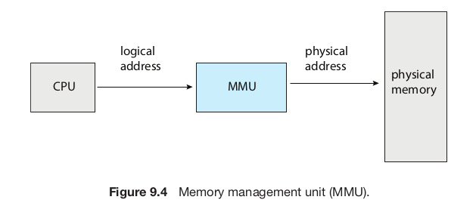
Memory Management Unit (MMU)
Is part of the CPU chip, acts on every memory address issue by execution unit of the CPU
In the scheme just discussed, the base, limit calculation parts are part of MMU

Slide 14
Base/Relocation + Limit scheme
Compiler’s work
  Assume that the process is one continous chunk in memory, with a size limit
  Assume that the process starts at address zero (!) and calculate addresses for globals, code, etc. And accordingly generate machine code
base
Compiler’s
view
Process
In
RAM
Base =0
Limit
Code
--
Data
--
Stack
--
heap
Limit
RAM

Slide 15
Base/Relocation + Limit scheme
base/relocation address
OS’s work
  While loading the process in memory – must load as one continous segment
  Fill in the ‘base’ register with the actual address of the process in RAM.
  Setup the limit to be the size of the process as set by compiler in the executable file. Remember the base+limit in OS’s own data structures.
Process
In
RAM

Slide 16
Base/Relocation + Limit scheme
base/relocation address
Combined effect
  “Relocatable code” – the process can go anywhere in RAM at the time of loading
  Some memory violations can be detected – a memory access beyond base+limit will raise interrupt, thus running OS in turn, which may take action against the process
Process
In
RAM

Slide 17
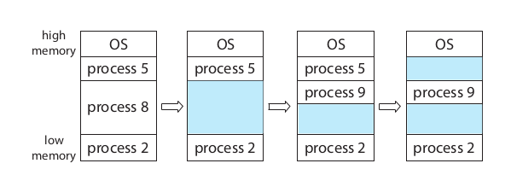
Example scenario of memory in base+limit scheme
Process 8 called exit()
Process 9 forked
Process 5 terminated

Slide 18
It should be possible to have relocatable code even with “simplest case”
By doing extra work during “loading”.
How?

Slide 19
Next scheme:
Multiple base +limit pairs
Limit:text
Base: text
Limit:data
Base: data
Limit: heap
Base: heap
P1: text
Limit: stack
Base: stack
Segment selector
P1: data
P1: heap
>
+
Logical address
Physical address
P1: stack
trap

Slide 20
Next scheme: Segmentation
Multiple base +limit pairs
Multiple sets of base + limit registers
Whenever an address is issued by execution unit of CPU, it will also include reference to some base register
  And hence limit register paired to that base register will be used for error checking
Compiler: can assume a separate chunk of memory for code, data, stack, heap, etc. And accordingly calculate addresses . Each “segment” starting at address 0.
OS: will load the different ‘sections’ in different memory regions and accordingly set different ‘base’ registers

Slide 21
Next scheme:
Multiple base +limit pairs, with further indirection
Base + limit pairs can also be stored in some memory location (not in registers). Question: how will the cpu know where it’s in memory?
  One CPU register to point to the location of table in memory
Segment registers still in use, they give an index in this table
This is x86 segmentation
  Flexibility to have lot more “base+limits” in the array/table in memory

Slide 22
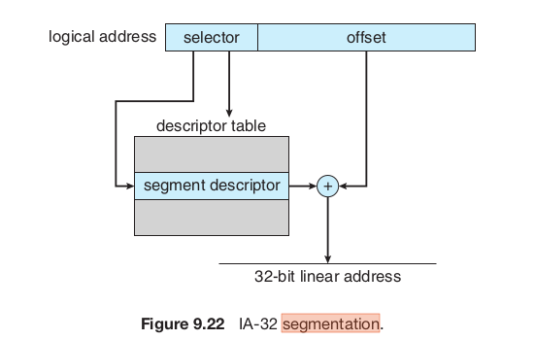
Next scheme:
Multiple base +limit pairs, with further indirection

Slide 23
Problems with segmentation schemes
OS needs to find a continuous free chunk of memory that fits the size of the “segment”
  If not available, your exec() can fail due to lack of memory
Suppose 50k is needed
  Possible that mong 3 free chunks total 100K may be available, but no single chunk of 50k!
  External fragmentation
Solution to external fragmentation: compaction – move the chunks around and make a continous big chunk available. Time consuming, tricky.

Slide 24
Solving external fragmentation problem
Process should not be continous in memory!
Divide the continuous process image in smaller chunks (let’s say 4k each) and locate the chunks anywhere in the physical memory
  Need a way to map the logical memory addresses into actual physical memory addresses

Slide 25


Slide 26


Slide 27

Paging scheme
PTBR

Slide 28
Paging
Process is assumed to be composed of equally sized “pages” (e.g. 4k page)
Actual memory is considered to be divided into page “frames”.
CPU generated logical address is split into a page number and offset
A page table base register inside CPU will give location of an in memory table called page table
Page number used as offset in a table called page table, which gives the physical page frame number
Frame number + offset are combined to get physical memory address

Slide 29
Paging
Compiler: assume the process to be one continous chunk of memory (!) . Generate addresses accordingly
OS: at exec() time – allocate different frames to process, allocate a page table(!), setup the page table to map page numbers with frame numbers, setup the page table base register, start the process
Now hardware will take care of all translations of logical addresses to physical addresses

Slide 30
X86 memory management

Slide 31
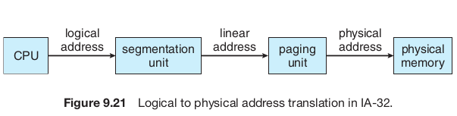

Slide 32
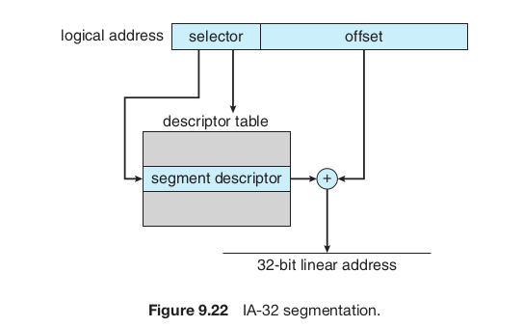
Segmentation in x86
The selector is automatically chosen using Code Segment (CS) register, or Data Segment (DS) register depending on which type of memory address is being fetched
Descriptor table is in memory
The location of Descriptor table (Global DT- GDT or Local DT – LDT) is given by a GDT-register i.e. GDTR or LDT-register i.e. LDTR

Slide 33
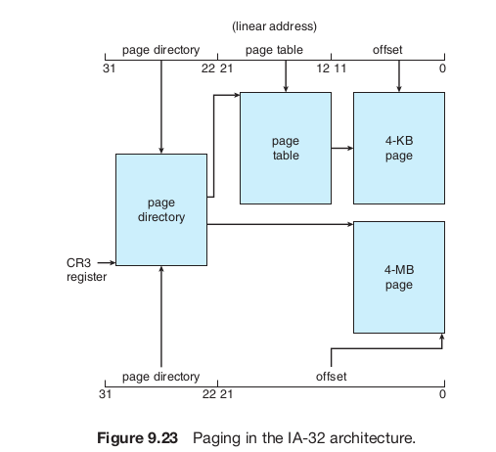
Paging in x86
Depending on a flag setup in CR3 register, either 4 MB or 4 KB pages can be enabled
Page directory, page table are both in memory

