Slide 1
Scheduling
Abhijit A.M.
abhijit.comp@coep.ac.in
Credits: Slides from os-book.com

Slide 2
Necessity of scheduling
Multiprogramming
  Ability to run multiple programs at a time
Increase use of CPU
  CPU utilisation

Slide 3
CPU Scheduling
The task of selecting ‘next’ process/thread to execute on CPU and doing a context switch
Scheduling algorithm
  Criteria for selecting the ‘next’ process/thread and it’s implementation
Why is it important?
  Affects performance !
  Affects end user experience !
  Involves money!

Slide 4
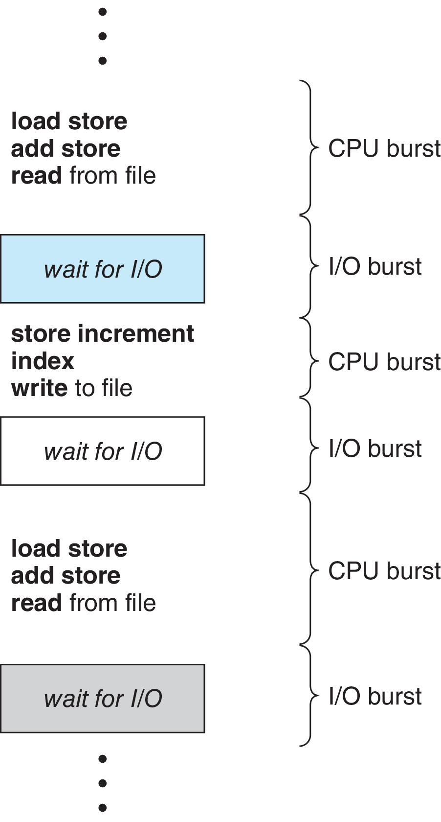
Observation: CPU, I/O Bursts
Process can ‘wait’ for an event (disk I/O, read from keyboard, etc. )
During this period another process can be scheduled
CPU–I/O Burst Cycle:
  Process execution consists of a cycle of CPU execution and I/O wait
  CPU burst followed by I/O burst
  CPU burst distribution is of main concern

Slide 5
Let’s understand the problem
Programs have alternate CPU and I’O bursts
  Some are CPU intensive
  Some are I/O intensive
  Some are mix of both
A C code example:
f(int i, int j, int k) {
j = k * i; // CPU burst
scanf("%d", &i); // I/O burst
k = i * j;// CPU burst
printf("%d\n", k):// I/O burst
return k;
}

Slide 6
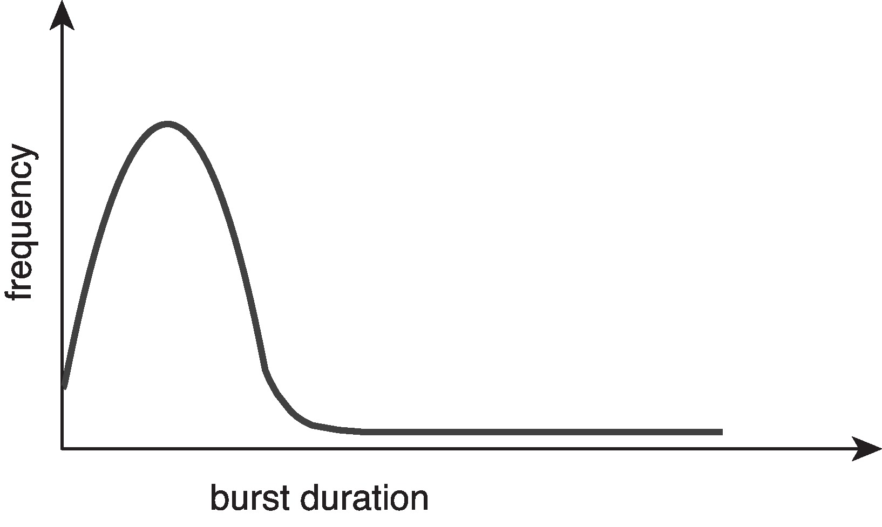
CPU bursts: observation
Large number of short bursts
Small number of longer bursts

Slide 7
Scheduler, what does it do?
From a list of processes, ready to run
  Selects a process for execution
  Allocates a CPU to the process for execution
  Does “context switch”

Slide 8
Context and Context Switch
Context
  Set of registers. Which ones?
  All or some ?
  Following registers on xv6 kernel: edi, esi, ebx, ebp, eip
    Related to calling convention!
  Linux kernel context: Much bigger!
  Also includes: MMU setup
Context switch
  Process context -> kernel context
    On interrupt, system call, or exception
  Kernel context -> process context
    Returning from system call, returning from interrupt handler, scheduling a process
  In every switch, need to change to the set of registers “last in use” by that context, and also the MMU setup

Slide 9
When is scheduler invoked?
Process Switches from running to waiting state
  Waiting for I/O, etc.
Switches from running to ready state
  E.g. on a timer interrupt
Switches from waiting to ready
  I/O wait completed, now ready to run
Terminates
Scheduling under 1 and 4 is nonpreemptive
All other scheduling is preemptive
  Consider access to shared data
  Consider preemption while in kernel mode
  Consider interrupts occurring during crucial OS activities

Slide 10
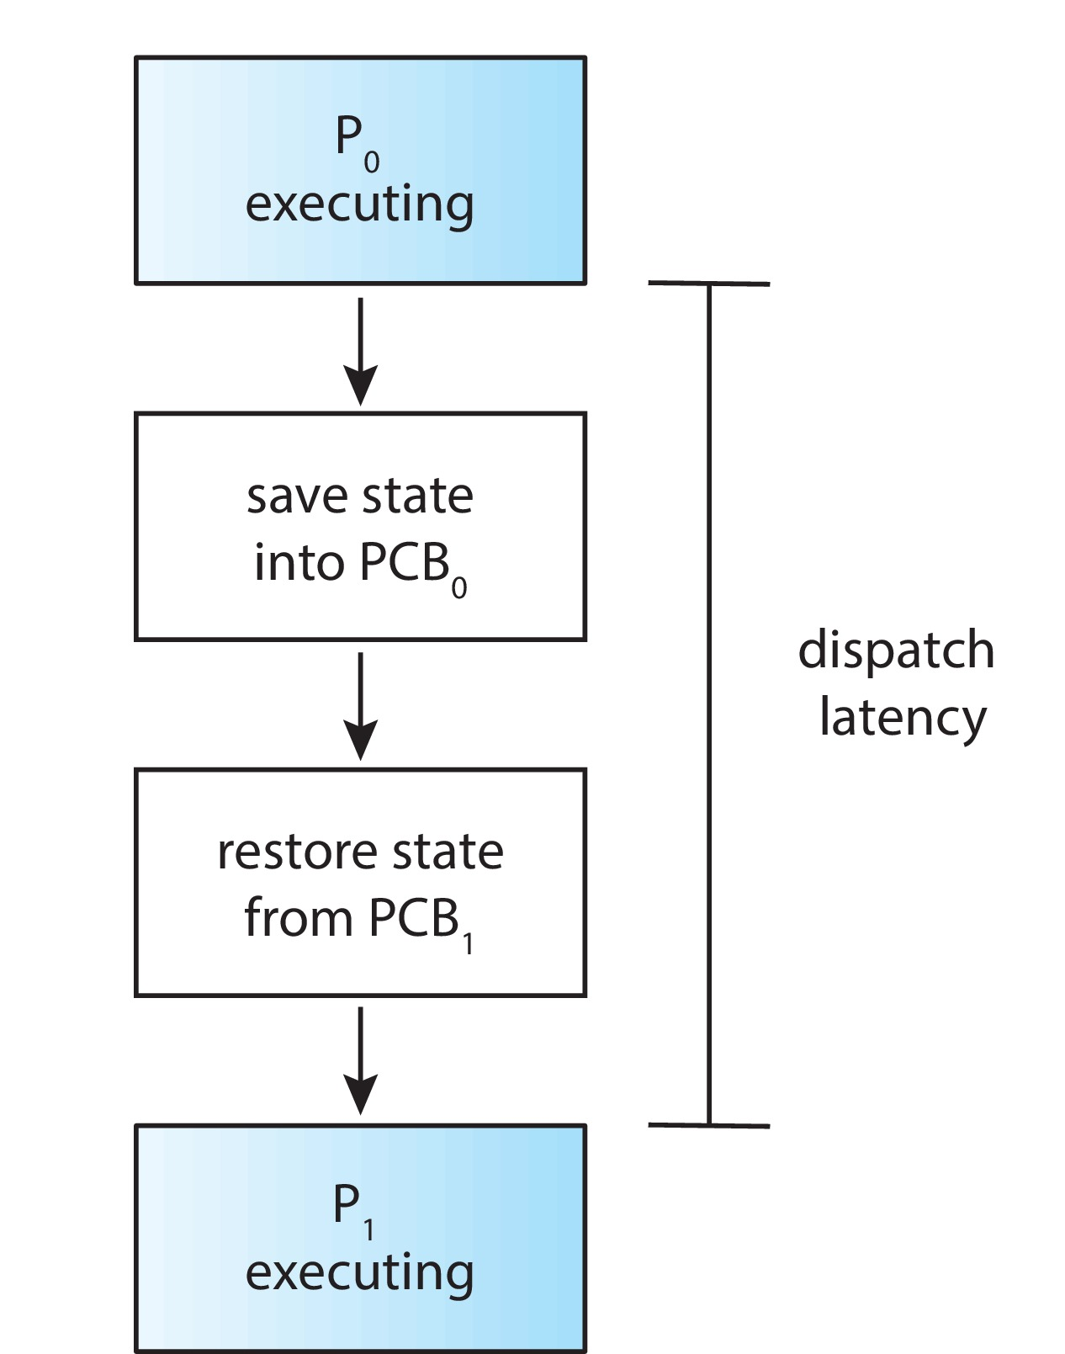
Dispatcher: A part of scheduler
Gives control of the CPU to the process selected by the short-term scheduler; this involves:
  switching context
  switching to user mode
  jumping to the proper location in the user program to restart that program
Dispatch latency
  time taken to stop one process and start another running
Xv6: swtch(), some tail end parts of sched(), trap(), trapret()

Slide 11
Dispatcher in action on Linux
Run “vmstat 1 3”
  Means run vmstat 3 times at 1 second delay
In output, look at CPU:cs
  Context switches every second
Also for a process with pid 3323
Run
“cat /proc/3323/status”
  See
  voluntary_ctxt_switches
  --> Process left CPU
  nonvoluntary_ctxt_switche
  --> Process was preempted

Slide 12
Scheduling criteria
CPU utilization: Maximise
  keep the CPU as busy as possible. Linux: idle task is scheduled when no process to be scheduled.
Throughput : Maximise
  # of processes that complete their execution per time unit
Turnaround time : Minimise
  amount of time to execute a particular process
Waiting time : Minimise
  amount of time a process has been waiting in the ready queue
Response time : Minimise
  amount of time it takes from when a request was submitted until the first response is produced, not output (for time-sharing environment)

Slide 13
To be studied later
Evaluation of scheduling criteria
Different scheduling algorithms, and their characteristics
  Round Robin, FIFO, Shortest Job First, Priority, Multi-level Queue, etc.
Thread scheduling

Slide 14
Multi Processor
Scheduling

Slide 15
Multiprocessor systems
Each processor has separate set of registers
  All: eip, esp, cr3, eax, ebx, etc.
Each processor runs independently of others
Main difference is in how do they access memory

Slide 16
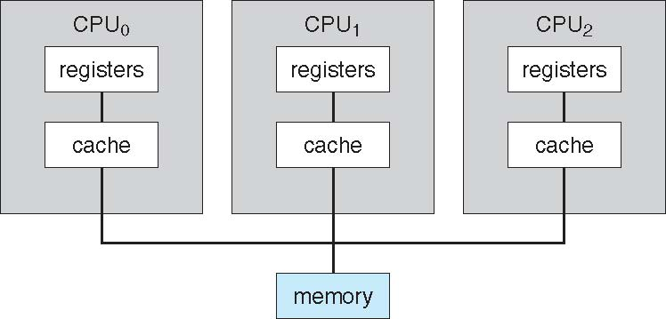
Symmetric multiprocessing (SMP)

Slide 17
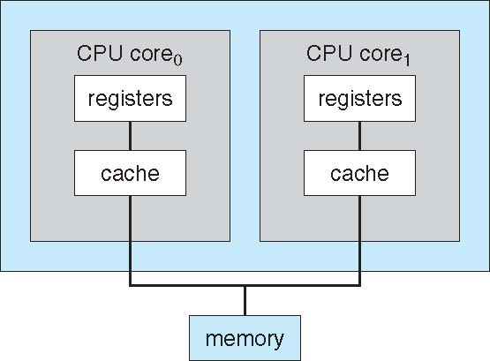
Multicore systems (also SMP)
No difference from the perspective of OS. The hardware ensures that OS sees multiple processors and not multiple cores.

Slide 18
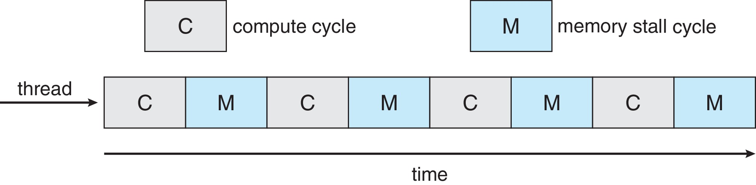
Multicore Processors
Recent trend to place multiple processor cores on same physical chip
Faster and consumes less power
Multiple threads per core also growing
  Takes advantage of memory stall to make progress on another thread while memory retrieve happens

Slide 19
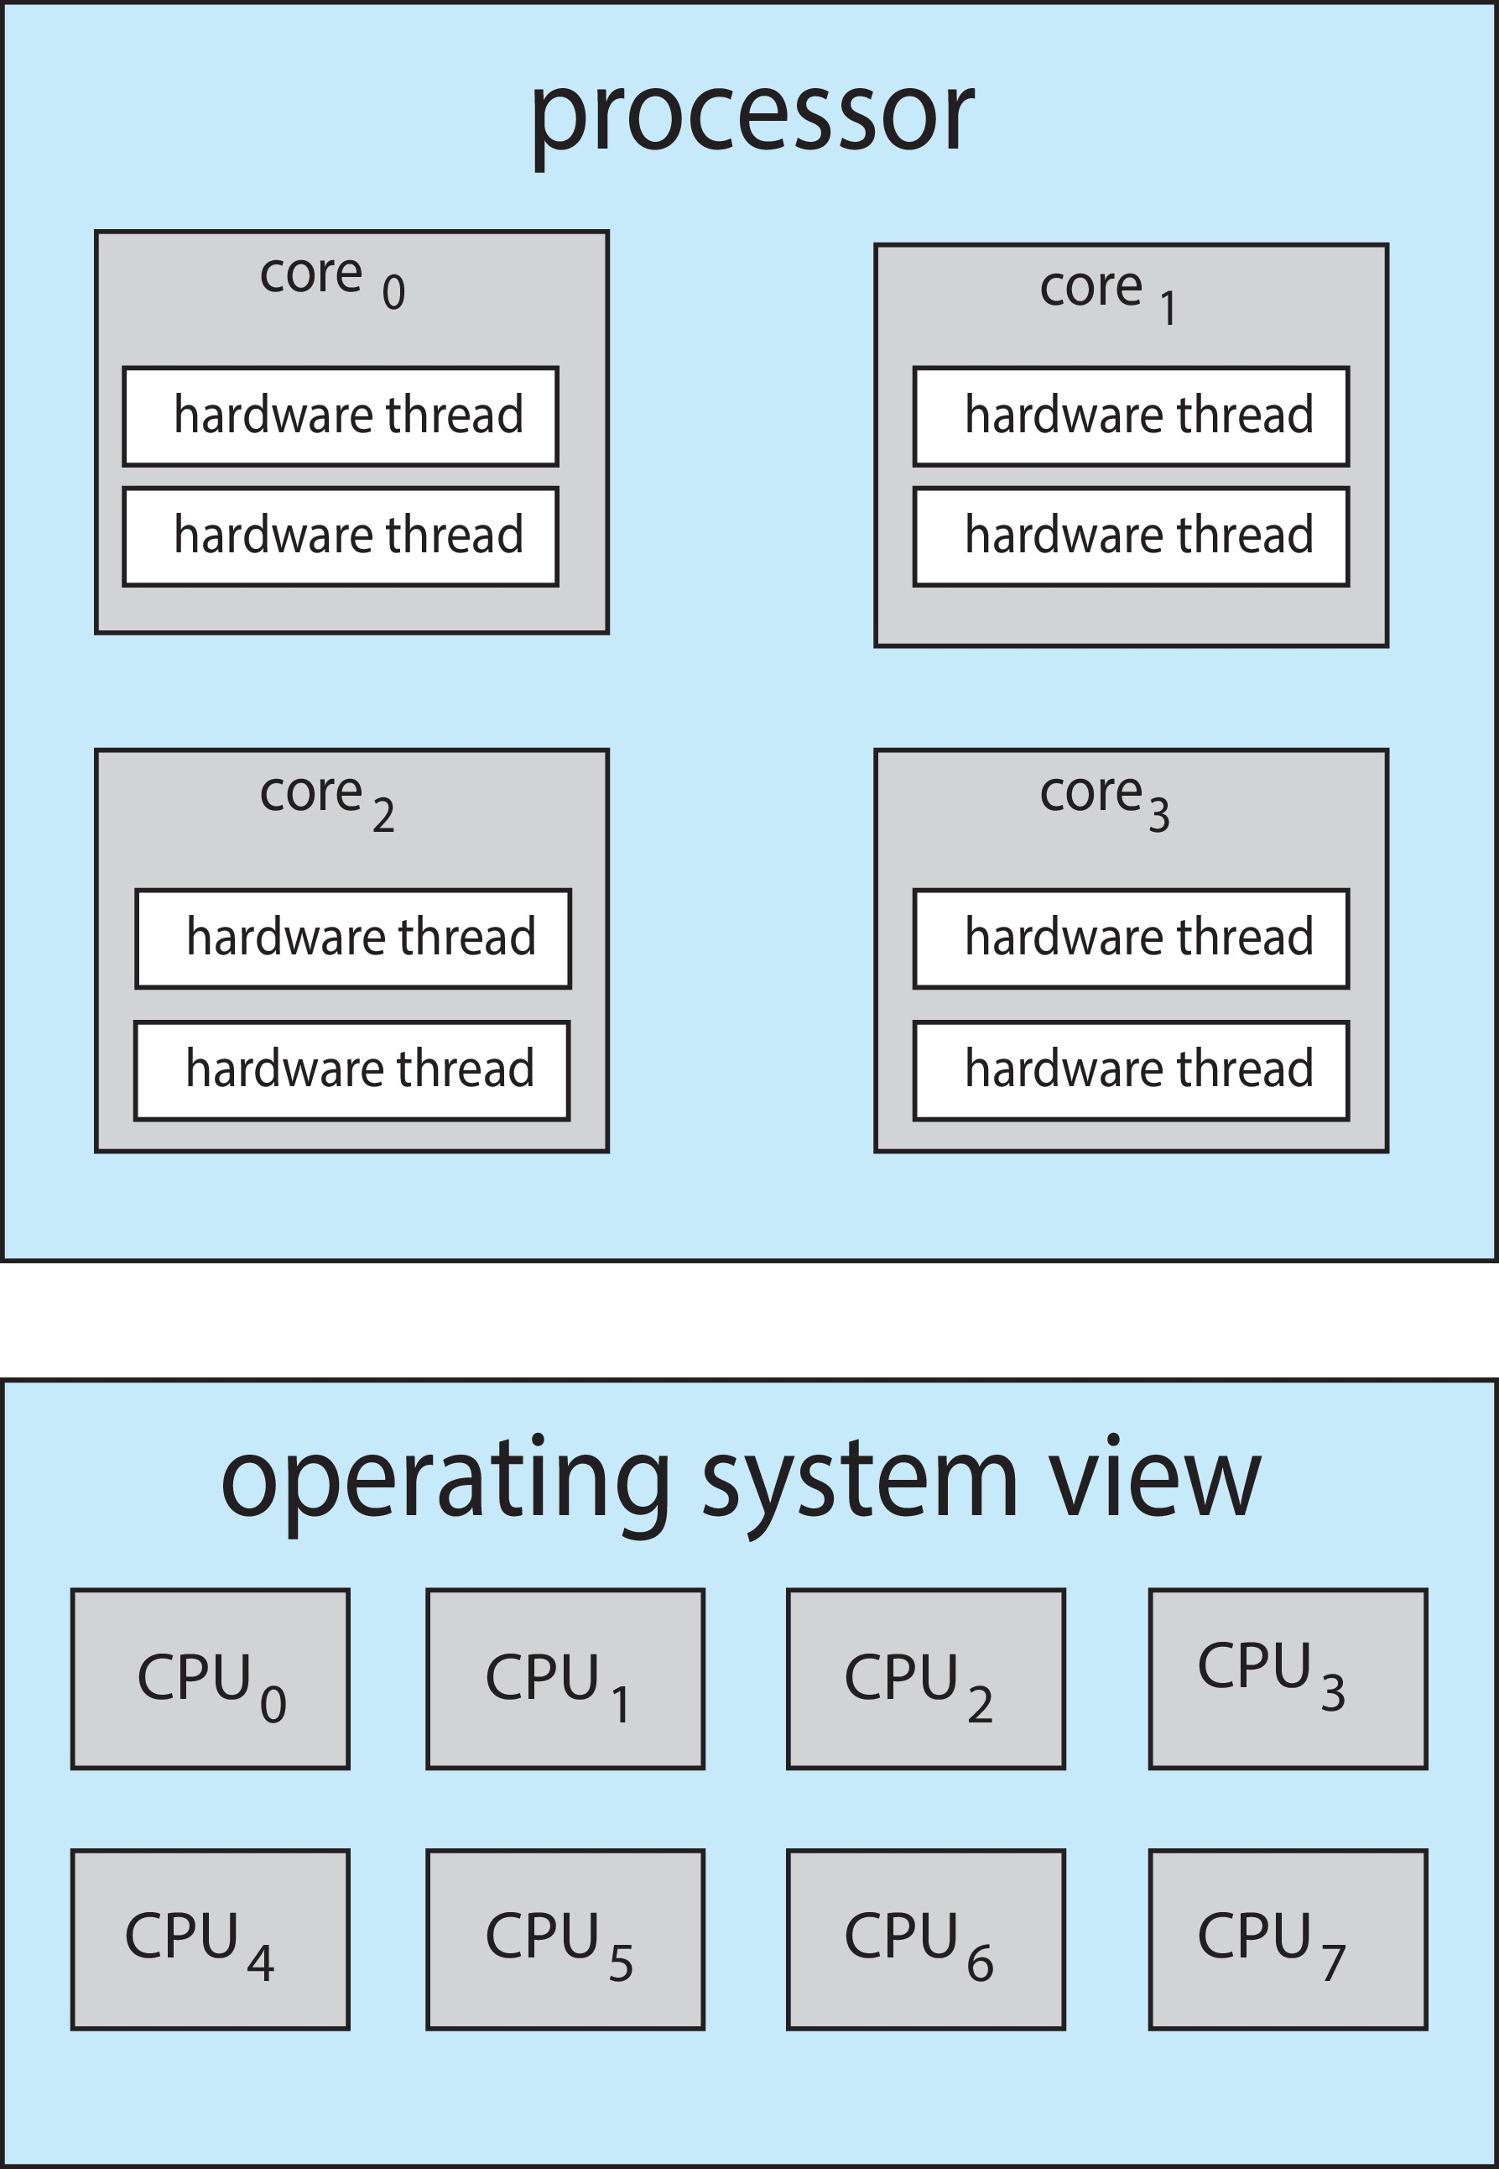
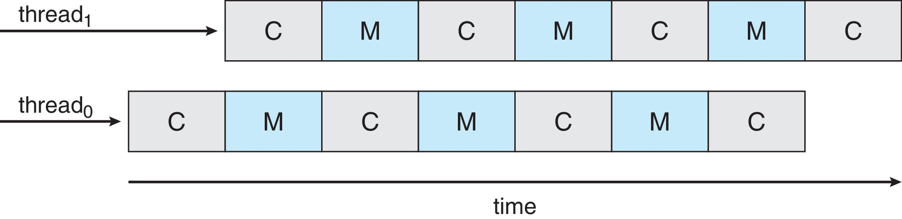
Multithreaded Multicore System
Each core has > 1 hardware threads.
Chip-multithreading (CMT) assigns each core multiple hardware threads. (Intel refers to this as hyperthreading.)
On a quad-core system with 2 hardware threads per core, the operating system sees 8 logical processors.
If one thread has a memory stall, switch to another thread!

Slide 20
More on SMP systems
During booting – each CPU needs to be turned on
  Special I/O instructions writing to particular ports
  See lapicstartap() in xv6
  Need to setup CR3 on each processor
  Segmentation, Page tables are shared (same memory for all CPUs)
All processors will keep running independently of each other
Different interrupts on each processor – each needs IDT setup
Each processor will be running processes, interrupt handlers, syscalls
Synchronization problems !
How to do scheduling ?

Slide 21
Multiple-Processor Scheduling
CPU scheduling more complex when multiple CPUs are available
Multiprocess may be any one of the following architectures:
  Multicore CPUs
  Multithreaded cores
  NUMA systems
  Heterogeneous multiprocessing

Slide 22
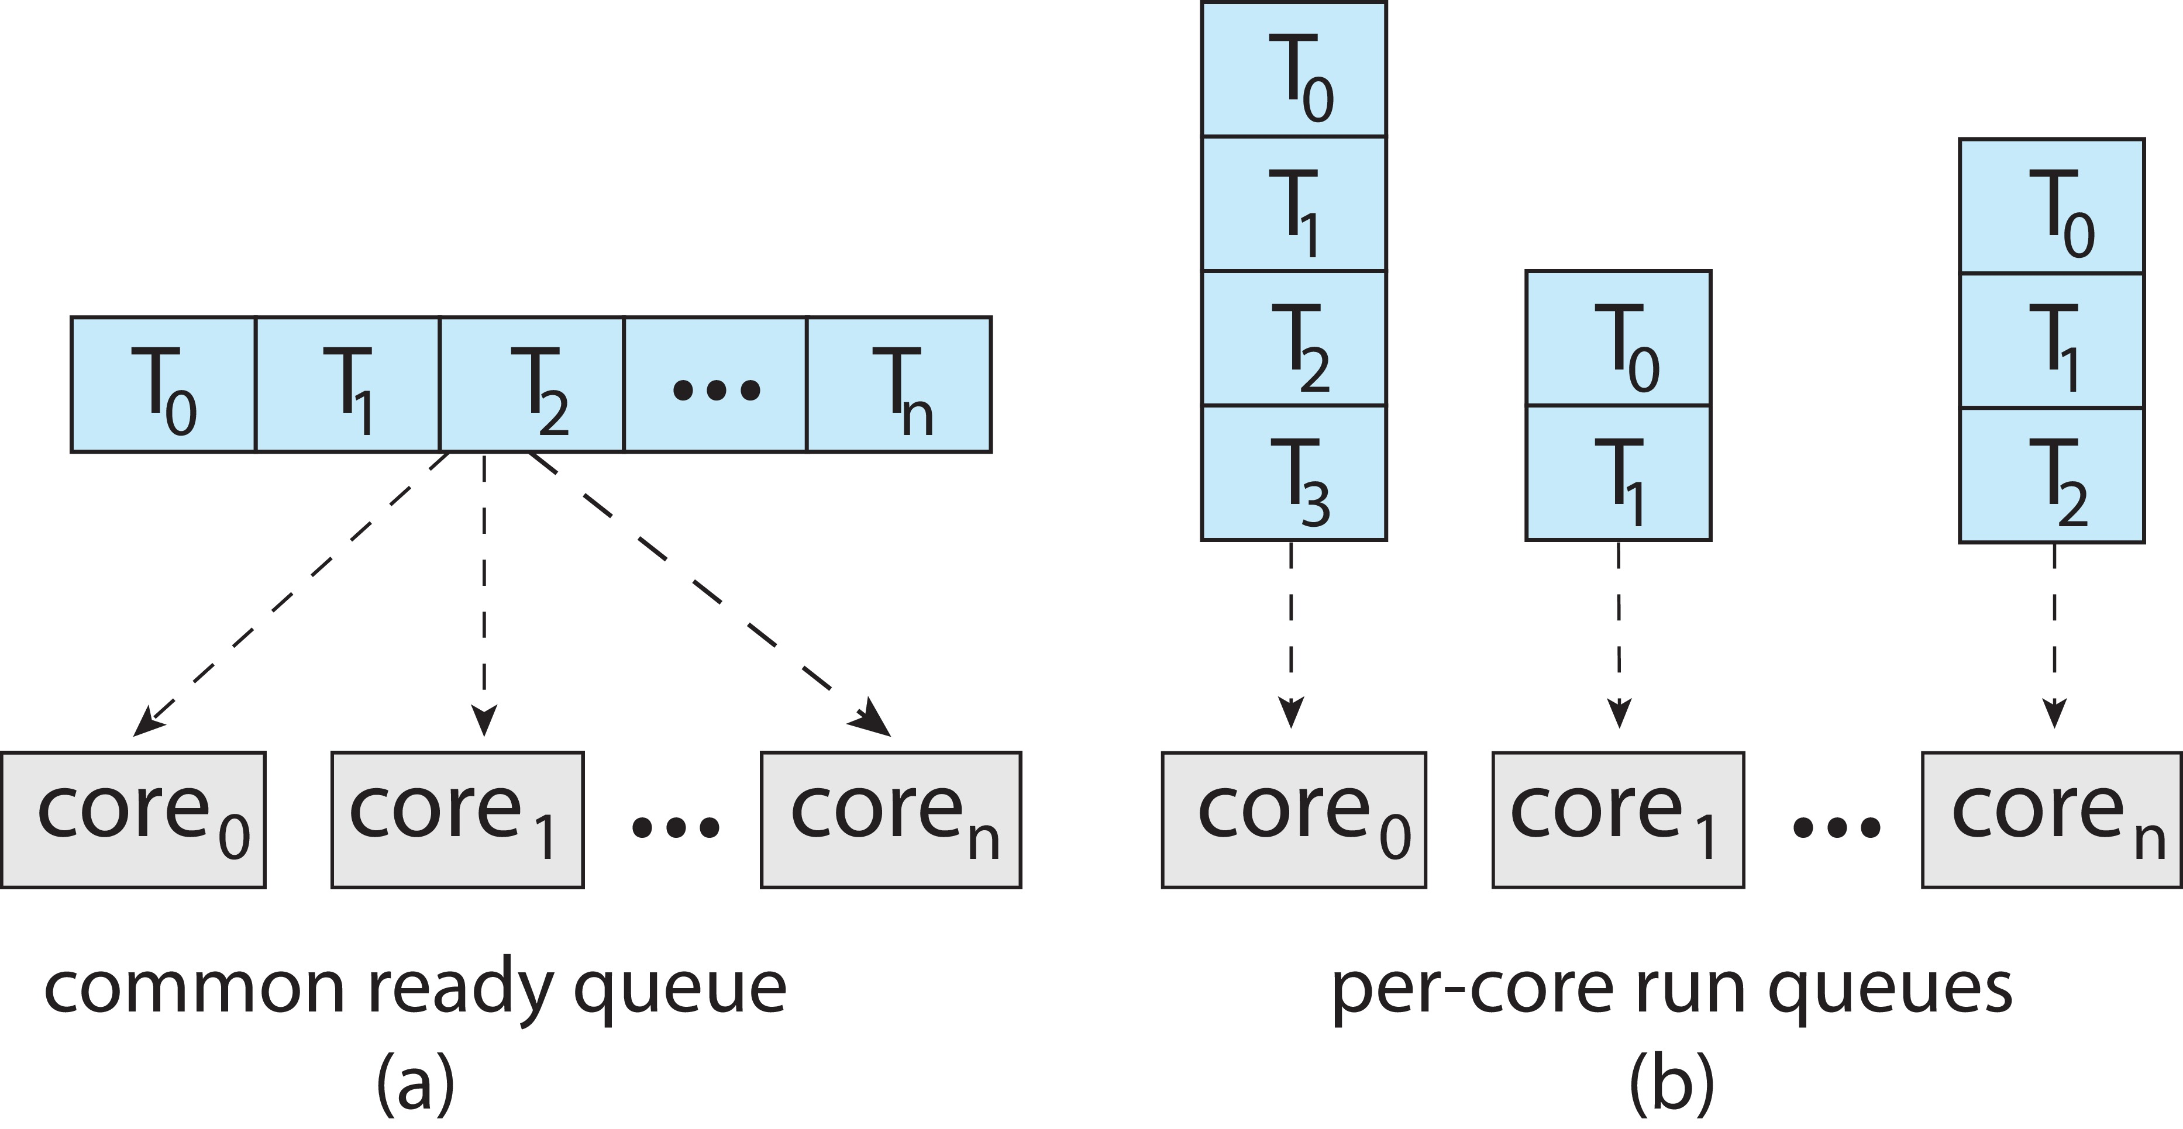
Multiple-Processor Scheduling
Symmetric multiprocessing (SMP) is where each processor is self scheduling.
All threads may be in a common ready queue (a)
Each processor may have its own private queue of threads (b)

Slide 23
SMP in xv6
Only one process queue
No load balancing, no affinity (more later)
A process may run any CPU-burst /alloted-time-quantum on any processor randomly

Slide 24
End

