Slide 1
File Systems
Abhijit A M
abhijit.comp@coep.ac.in

Slide 2
Introduction
Human end user’s view of file sytem on a modern desktop operating system
  Files, directories(folders), hierarchy – acyclic graph like structure
  Windows Vs Linux logical organization: multiple partitions (C:, D:,etc.), vs single logical namespace starting at “/”

Slide 3
Introduction
Secondary and Tertiary memory
  Hard disks, Pen drives, CD-ROMs, DVDs, Magnetic Tapes, Portable disks, etc. Used for storing files
  Each comes with a hardware “controller” that acts as an intermediary in the hardware/software boundary
  IDE, SATA, SCSI, SAS, etc. Protocols : Different types of cables, speeds, signaling mechanisms
  Controllers provide a block/sector based read/write access
    Block size is most typically 512 bytes
    Can’t read byte no. 33 directly. Must read sector 0 (byte 0 to 511) in memory and then access the byte no 33 in memory.

Slide 4
Introduction
OS and File system
  OS bridges the gap between end user and stoage hardware controller
  Provides data structure to map the logical view of end users onto disk storage
  Essentially an implementation of the acyclic graph on the sequential sector-based disk storage
    Both in memory and on-disk
  Provides system calls (open, read, write, ..., etc. ) to enable access to files, folders

Slide 5
What we are going to learn
The operating system interface (system calls, commands/utilities) for accessing files in a file-sysetm
Design aspects of OS to implement the file system
  On disk data structure
  In memory kernel data structures

Slide 6
What is a file?
A (dumb!) sequence of bytes (typically on a permanent storage:seconary, tertiary) , with
  A name
  Permissions
  Owner
  Timestamps,
  Etc.
Types: Text files, binary files (one classification)
  Text: All bytes are human readable
  Binary: Non-text
Types: ODT, MP4, TXT, DOCX, etc. (another classification)
  Most typically describing the organization of the data inside the file
  Each type serving the needs of a particular application (not kernel)

Slide 7
File types and kernel
For example, MP4 file
  vlc will do a open(...) on the file, and call read(...), interpret the contents of the file as movie and show movie
  Kernel will simply provide open(...) read(...), write(...) to access file data
  Meaning of the file contents is known to VLC and not to kernel!

Slide 8


Slide 9
What is a file?
The sequence of bytes can be interpreted (by an application) to be
  Just a sequence of bytes
    E.g. a text file
  Sequence of records/structures
    E.g. a file of student records , by database application, etc
  A complexly organized, collection of records and bytes
    E.g. a “ODT” or “DOCX” file
What’s the role of OS in above mentioned file type, and organization?
  Mostly NO role on Unixes, Linuxes!
  They are handled by applications !
  Types handled by OS: normal file, directory, block device file, character device file, FIFO file (named pipe), etc.
  Also types handled by OS: executable file, non-executable file

Slide 10
File attributes
Run
  $ ls -l
on Linux
To see file listing with different attributes
Different OSes and file-systems provide different sets of file attributes
  Some attributes are common to most, while some are different
  E.g. name, size, owner can be found on most systems
  “Executable” permission may not be found on all systems

Slide 11
File protection attributes
File owner/creator should be able to control:
  what can be done
  by whom
Types of access
  Read
  Write
  Execute
  Append
  Delete
  List
Linux: See commands: “chown”, “chgrp” and “chmod”
Linux file permissions
  For owner, group and others
  Read, write and execute
  Total 9 permissions

Slide 12

A Sample UNIX Directory Listing

Slide 13

Windows
XP
Access List

Slide 14
Access methods
OS system calls may provide two types of access to files
  Sequential Access
    read next
    write next
    reset
    no read after last write
    (rewrite)
  Linux provides sequential access using open(), read(), write(), ...
  Direct Access
    read n
    write n
    position to n
    read next
    write next
    rewrite n
  n = relative block number
  pread(), pwrite() on Linux
    ssize_t pread(int fd, void *buf, size_t count, off_t offset);
    ssize_t pwrite(int fd, const void *buf, size_t count, off_t offset);

Slide 15
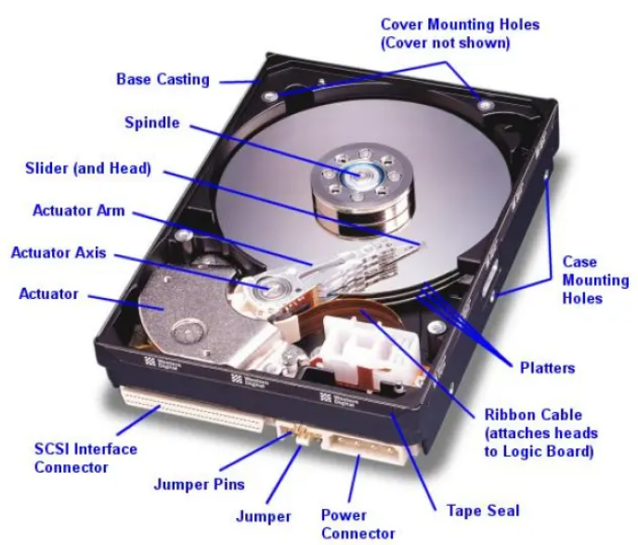
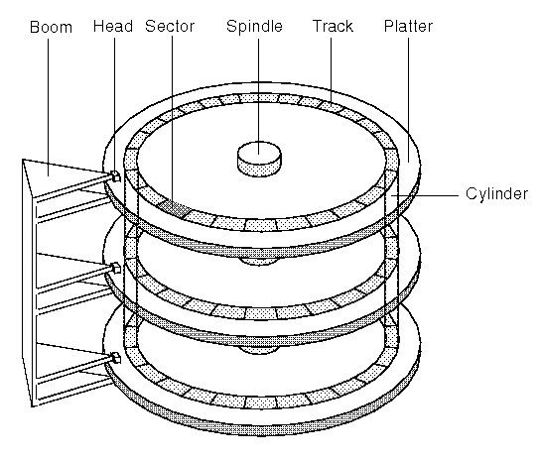
Disk

Slide 16
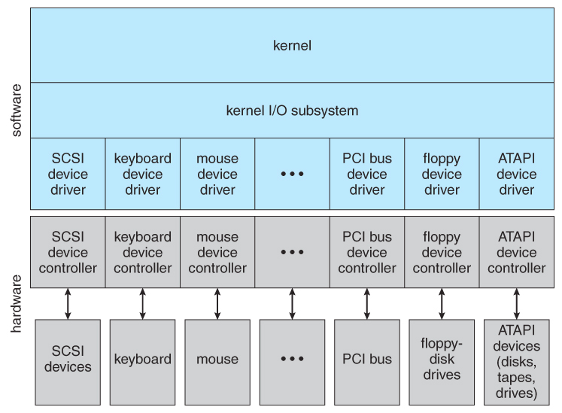
Device Driver

Slide 17

File system implementation: layering

Slide 18
Idea of Layering
Main() { // application
write(fd, "hello", 5);
}
C library
int write(int fd, char *str, int len) {
...
mov 5, eax; // 5 is syscall number
int 80;
}
--- application-kernel-boundary----
Kernel // logical file system
int sys_write(int fd, char *str, int len) {
file *fp = currproc->ofile[fd];
x = file_write(fp, str, len);
}
int file_write(file *fp, char *str, int len) { //file-organization module
// map current position in file to disk block, etc // basic file system
// prepare disc block to be writeen, say *buf
disk_device_driver_write(blockno, buf);
}
disk_device_driver_write(int blockno, char *buf) { // device-control
cyllinder, track, sector = convert(blockno)
//assembly code
//ask controller to write "buf" to cyllinder,track,sector
}
---hardware-software-boundary----
Controller (hw)
writes.

Slide 19
Application programs
int main() {
char buf[128]; int count;
fd = open(...):
read(fd, buf, count);
}
-----
OS
Logical file system:
sys_read(int fd, char *buf, int count) {
file *fp = currproc->fdarray[fd];
file_read(fp, ...);
}
File organization module:
file_read(file *fp, char *buf, int count) {
offset = fp->current-offset;
translate offset into blockno;
basic_read(blockno, buf, count);
}
Basic File system:
basic_read(int blockno, char *buf, ...) {
os_buffer *bp;
sectorno = calculation on blockno;
disk_driver_read(sectono, bp );
move-process-to-wait-queue;
copy-data-to-user-buffer(bp, buf);
}
IO Control, Device driver:
disk_driver_read(sectorno) {
issue instructions to disk controller (often assembly code)
to read sectorno into specific location;
}
XV6 does it slightely differently, but following the layering principle!

Slide 20
Device Drivers
Hardware manufacturers provide “hardware controllers” for their devices
Hardware controllers can operate the hardware, as instructed
Hardware controllers are instructed by writing to particular I/O ports using CPU’s machine instructions
  This bridges the hardware-software gap
OS programmers, typically, write one “device driver” code that interacts with one hardware controller
  This is pure C code
  Which calls I/O instructions for hardware controller
  This code is independent of most of the OS code
  Often this code is like an add-on Module , eg. Linux kernel

Slide 21
Disk device driver
OS views the disk as a logical sequence of blocks
  OS’s assumed block size may be > sector size
OS Talks to disk controller
Helps the OS Convert it’s view of “logical block” of the disk, into physical sector numbers
Acts as a translator between rest of OS and hardware controller
xv6: ide.c

Slide 22
OS’s job now
To implement the logical view of file system as seen by end user
Using the logical block-based view offerred by the device driver

Slide 23
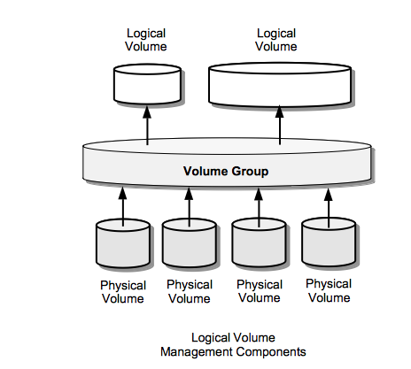
Volume Managers
Special type of kernel device drives, which reside on top of disk device drivers
Provide a more abstract view of the underlying hardware
E.g. Can combine two physical hard disks, and present them as one
Allow end users to
  “combine one more more physical disks to create physical volumes”
  “create volume groups out of a set of physical volumes”,
  “create logical volums within volume groups”

Slide 24
Formatting
Physical hard disk divided into partitions
  Partitions also known as minidisks, slices
A raw disk partition is accessible using device driver – but no block contains any data !
  Like an un-initialized array, or sectors/blocks
Formatting
  Creating an initialized data structure on the partition, so that it can start storing the acyclic graph tree structure on it
  Different formats depending on different implementations of the directory tree structure: ext4, NTFS, vfat, VxFS, ReiserFS, WafleFS, etc.
Formatting happens on “a physical partition” or “a logical volume made available by volume manager”

Slide 25

Different types of “layouts”
Single level directory
Naming problem
Grouping problem
Example: RT-11, from 1970s https://en.wikipedia.org/wiki/RT-11

Slide 26

Different types of “layouts”
Two level directory
Path name
Can have the same file name for different user
Efficient searching
No grouping capability

Slide 27

Tree Structured directories

Slide 28

Acyclic Graph Directories

Slide 29

General Graph directory

Slide 30
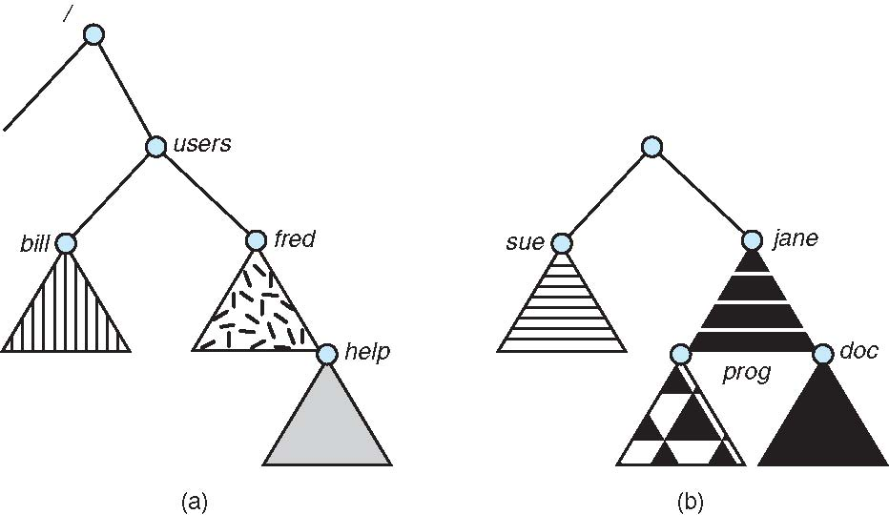
Mounting of a file system: before
/dev/sda3
/dev/sda5

Slide 31

Mounting of a file system: after
$sudo mount /dev/sda5 /users

Slide 32
Remote mounting: NFS
Network file system
$ sudo mount 10.2.1.2:/x/y /a/b
  The /x/y partition on 10.2.1.2 will be made available under the folde /a/b on this computer

Slide 33
File sharing semantics
Consistency semantics specify how multiple users are to access a shared file simultaneously
Unix file system (UFS) implements:
  Writes to an open file visible immediately to other users of the same open file
  One mode of sharing file pointer to allow multiple users to read and write concurrently
AFS has session semantics
  Writes only visible to sessions starting after the file is closed

Slide 34
Implementing file systems

Slide 35
File system on disk
What we know
  Disk I/O in terms of sectors (512 bytes)
  File system: implementation of acyclic graph using the linear sequence of sectors
    Store a acyclic graph into array of “blocks”/“sectors”
  Device driver available: gives sector/block wise access to the disk

Slide 36
File system implementation: layering

Slide 37
File system: Layering
Device drivers manage I/O devices at the I/O control layer
  Given commands like “read drive1, cylinder 72, track 2, sector 10, into memory location 1060” outputs low-level hardware specific commands to hardware controller
Basic file system given command like “retrieve block 123” translates to device driver
  Also manages memory buffers and caches (allocation, freeing, replacement)
  Buffers hold data in transit
  Caches hold frequently used data
File organization module understands files, logical address, and physical blocks
  Translates logical block # to physical block #
  Manages free space, disk allocation
Logical file system manages metadata information
  Translates file name into file number, file handle, location by maintaining file control blocks (inodes in Unix)
  Directory management
  Protection

Slide 38
Application programs
int main() {
char buf[128]; int count;
fd = open(...):
read(fd, buf, count);
}
-----
OS
Logical file system:
sys_read(int fd, char *buf, int count) {
file *fp = currproc->fdarray[fd];
file_read(fp, ...);
}
File organization module:
file_read(file *fp, char *buf, int count) {
offset = fp->current-offset;
translate offset into blockno;
basic_read(blockno, buf, count);
}
Basic File system:
basic_read(int blockno, char *buf, ...) {
os_buffer *bp;
sectorno = calculation on blockno;
disk_driver_read(sectono, bp );
move-process-to-wait-queue;
copy-data-to-user-buffer(bp, buf);
}
IO Control, Device driver:
disk_driver_read(sectorno) {
issue instructions to disk controller (often assembly code)
to read sectorno into specific location;
}
XV6 does it slightely differently, but following the layering principle!

Slide 39
Layering advantages
Layering useful for reducing complexity and redundancy, but adds overhead and can decrease performance
  Logical layers can be implemented by any coding method according to OS designer
Many file systems, sometimes many within an operating system
  Each with its own format (CD-ROM is ISO 9660; Unix has UFS, FFS; Windows has FAT, FAT32, NTFS as well as floppy, CD, DVD Blu-ray, Linux has more than 40 types, with extended file system ext2 and ext3 leading; plus distributed file systems, etc)
  New ones still arriving – ZFS, GoogleFS, Oracle ASM, FUSE
  The Virtual File System (to be discussed later) helps us combine multiple physically different file systems into one logical layer at the top

Slide 40
File system implementation: Different problems to be solved
What to do at boot time, how to locate kernel ?
How to store directories and files on the partition ?
  Complex problem. Hiearchy + storage allocation + efficiency + limits on file/directory sizes + links (hard, soft)
How to manage list of free sectors/blocks?
How to store the summary information about the complete file system : #files, #free-blocks, ...
How to mount a file system , how to unmount?

Slide 41
File system implementation: Different problems to be solved
About storing a file, how to store
  Data
  Attributes
  Name
  Link count

Slide 42
The hard link problem
Need to separate name from data !
  /x/y and /a/b should be same file. How?
  Both names should refer to same data !
  Data is separated separately from name, and the name gives a “reference” to data
What about attributes ?
  They go with data! (not with name!)
So solution was: indirection !

Slide 43
The hard link problem
Name1
Data of file
Name2
We are not considering other problems here , just focussing on hard link problem

Slide 44
File system implementation
We have system calls at the API level, but how do we implement their functions?
  On-disk and in-memory structures. Let’s see some of the important ones.
  Boot control block contains info needed by system to boot OS from that volume
    Not always needed. Needed if volume contains OS, usually first block of volume
  Volume control block (superblock, master file table) contains volume details
    Total # of blocks, # of free blocks, block size, free block pointers or array
  Per-file File Control Block (FCB) contains many details about the file
    Inode(FCB) number, permissions, size, dates
  Directory structure organizes the files
    Names and inode numbers, master file table

Slide 45

A typical file control block (inode)
Name is stored separately
Where?
IN data block of directory

Slide 46
In memory data structures
Mount table
  storing file system mounts, mount points, file system types
See next slide for “file” related data structures
Buffers
  hold data blocks from secondary storage

Slide 47

In memory data structures: for open,read,write, ...
Open returns a file handle for subsequent use
Data from read eventually copied to specified user process memory address

Slide 48
At boot time
Root partition
  Contains the file system hosting OS
  “mounted” at boot time – contains “/”
    Normally can’t be unmounted!
Check all other partitions
  Specified in /etc/fstab on Linux
  Check if the data structure on them is consistent
    Consistent != perfect/accurate/complete

Slide 49
Directory Implementation
Problem
  Directory contains files and/or subdirectories
  Operations required – create files/directories, access files/directories, search for a file (during lookup), etc.
  Directory needs to give location of each file on disk

Slide 50
Directory Implementation
Linear list of file names with pointer to the data blocks
  Simple to program
  Time-consuming to execute
    Linear search time
    Could keep ordered alphabetically via linked list or use B+ tree
  Ext2 improves upon this approach.
Hash Table – linear list with hash data structure
  Decreases directory search time
  Collisions – situations where two file names hash to the same location
  Only good if entries are fixed size, or use chained-overflow method

Slide 51
Disk space allocation for files
File contain data and need disk blocks/sectors for storing it
File system layer does the allocation of blocks on disk to files
Files need to
  Be created, expanded, deleted, shrunk, etc.
  How to accommodate these requirements?

Slide 52

Contiguous Allocation of Disk Space

Slide 53
Contiguous allocation
Each file occupies set of contiguous blocks
Best performance in most cases
Simple – only starting location (block #) and length (number of blocks) are required
Problems include finding space for file, knowing file size, external fragmentation, need for compaction off-line (downtime) or on-line

Slide 54

Linked allocation of blocks to a file

Slide 55
Linked allocation of blocks to a file
Linked allocation
  Each file a linked list of blocks
  File ends at nil pointer
  No external fragmentation
  Each block contains pointer to next block (i.e. data + pointer to next block)
  No compaction, external fragmentation
  Free space management system called when new block needed
  Improve efficiency by clustering blocks into groups but increases internal fragmentation
  Reliability can be a problem
  Locating a block can take many I/Os and disk seeks

Slide 56

FAT: File Allocation Table
FAT (File Allocation Table), a variation
  Beginning of volume has table, indexed by block number
  Much like a linked list, but faster on disk and cacheable
  New block allocation simple

Slide 57

FAT: File Allocation Table
Variants: FAT8, FAT12, FAT16, FAT32, VFAT, ...

Slide 58

Indexed allocation

Slide 59
Indexed allocation
Need index table
Random access
Dynamic access without external fragmentation, but have overhead of index block
Mapping from logical to physical in a file of maximum size of 256K bytes and block size of 512 bytes. We need only 1 block for index table

Slide 60
Multi level indexing
outer-index
index table
file

Slide 61

Unix UFS: combined scheme for block allocation

Slide 62
Free Space Management
File system maintains free-space list to track available blocks/clusters
  Bit vector or bit map (n blocks)
  Or Linked list

Slide 63
Free Space Management: bit vector
Each block is represented by 1 bit.
If the block is free, the bit is 1; if the block is allocated, the bit is 0.
  For example, consider a disk where blocks 2, 3, 4, 5, 8, 9, 10, 11, 12, 13, 17 18, 25, 26, and 27 are free and the rest of the blocks are allocated. The free-space bitmap would be
  001111001111110001100000011100000 ...
A 1- TB disk with 4- KB blocks would require 32 MB (2⁴⁰ / 2¹² = 2²⁸ bits = 2²⁵ bytes = 2⁵ MB) to store its bitmap

Slide 64

Free Space Management: Linked list (not in memory, on disk!)

Slide 65
Further improvements on link list method of free-blocks
Grouping
Counting
Space Maps (ZFS)
Read as homework

Slide 66
Ext2 FS layout

Slide 67
struct ext2_inode {
__le16 i_mode; /* File mode */
__le16 i_uid; /* Low 16 bits of Owner Uid */
__le32 i_size; /* Size in bytes */
__le32 i_atime; /* Access time */
__le32 i_ctime; /* Creation time */
__le32 i_mtime; /* Modification time */
__le32 i_dtime; /* Deletion Time */
__le16 i_gid; /* Low 16 bits of Group Id */
__le16 i_links_count; /* Links count */
__le32 i_blocks; /* Blocks count */
__le32 i_flags; /* File flags */

Slide 68

Inode in ext2

Slide 69
struct ext2_inode {
...
union {
struct {
__le32 l_i_reserved1;
} linux1;
struct {
__le32 h_i_translator;
} hurd1;
struct {
__le32 m_i_reserved1;
} masix1;
} osd1; /* OS dependent 1 */
__le32 i_block[EXT2_N_BLOCKS];/* Pointers to blocks */
__le32 i_generation; /* File version (for NFS) */
__le32 i_file_acl; /* File ACL */
__le32 i_dir_acl; /* Directory ACL */
__le32 i_faddr; /* Fragment address */

Slide 70
struct ext2_inode {
...
union {
struct {
__u8 l_i_frag; /* Fragment number */ __u8 l_i_fsize; /* Fragment size */
__u16 i_pad1; __le16 l_i_uid_high; /* these 2 fields */
__le16 l_i_gid_high; /* were reserved2[0] */
__u32 l_i_reserved2;
} linux2;
struct {
__u8 h_i_frag; /* Fragment number */ __u8 h_i_fsize; /* Fragment size */
__le16 h_i_mode_high; __le16 h_i_uid_high;
__le16 h_i_gid_high;
__le32 h_i_author;
} hurd2;
struct {
__u8 m_i_frag; /* Fragment number */ __u8 m_i_fsize; /* Fragment size */
__u16 m_pad1; __u32 m_i_reserved2[2];
} masix2;
} osd2; /* OS dependent 2 */

Slide 71

Ext2 FS Layout: Entries in directory’s data blocks

Slide 72

Ext2 FS Layout
Size of block
4k,1k, etc
Determined at time of mkfs (formatting)

Slide 73
Calculations done by “mkfs” like this
Block size = 4KB (specified to mkfs)
Number of total blocks = size of partition / 4KB
  How to get size of partition ?
4KB = 4 * 1024 * 8 = 32768 bits
Data Block Bitmap, Inode Bitmap are always one block
So
  size of a group is 32,768 Blocks
  #groups = #blocks-in-partition / 32,768

Slide 74
struct ext2_super_block {
__le32 s_inodes_count; /* Inodes count */
__le32 s_blocks_count; /* Blocks count */
__le32 s_r_blocks_count; /* Reserved blocks count */
__le32 s_free_blocks_count; /* Free blocks count */
__le32 s_free_inodes_count; /* Free inodes count */
__le32 s_first_data_block; /* First Data Block */
__le32 s_log_block_size; /* Block size */
__le32 s_log_frag_size; /* Fragment size */
__le32 s_blocks_per_group; /* # Blocks per group */
__le32 s_frags_per_group; /* # Fragments per group */
__le32 s_inodes_per_group; /* # Inodes per group */
__le32 s_mtime; /* Mount time */
__le32 s_wtime; /* Write time */
__le16 s_mnt_count; /* Mount count */
__le16 s_max_mnt_count; /* Maximal mount count */
__le16 s_magic; /* Magic signature */
__le16 s_state; /* File system state */
__le16 s_errors; /* Behaviour when detecting errors */

Slide 75
struct ext2_super_block {
...
__le16 s_minor_rev_level; /* minor revision level */
__le32 s_lastcheck; /* time of last check */
__le32 s_checkinterval; /* max. time between checks */
__le32 s_creator_os; /* OS */
__le32 s_rev_level; /* Revision level */
__le16 s_def_resuid; /* Default uid for reserved blocks */
__le16 s_def_resgid; /* Default gid for reserved blocks */
__le32 s_first_ino; /* First non-reserved inode */
__le16 s_inode_size; /* size of inode structure */
__le16 s_block_group_nr; /* block group # of this superblock */
__le32 s_feature_compat; /* compatible feature set */
__le32 s_feature_incompat; /* incompatible feature set */
__le32 s_feature_ro_compat; /* readonly-compatible feature set */
__u8 s_uuid[16]; /* 128-bit uuid for volume */
char s_volume_name[16]; /* volume name */
char s_last_mounted[64]; /* directory where last mounted */
__le32 s_algorithm_usage_bitmap; /* For compression */

Slide 76
struct ext2_super_block {
...
__u8 s_prealloc_blocks; /* Nr of blocks to try to preallocate*/
__u8 s_prealloc_dir_blocks; /* Nr to preallocate for dirs */
__u16 s_padding1;
/*
* Journaling support valid if EXT3_FEATURE_COMPAT_HAS_JOURNAL set.
*/
__u8 s_journal_uuid[16]; /* uuid of journal superblock */
__u32 s_journal_inum; /* inode number of journal file */
__u32 s_journal_dev; /* device number of journal file */
__u32 s_last_orphan; /* start of list of inodes to delete */
__u32 s_hash_seed[4]; /* HTREE hash seed */
__u8 s_def_hash_version; /* Default hash version to use */
__u8 s_reserved_char_pad;
__u16 s_reserved_word_pad;
__le32 s_default_mount_opts;
__le32 s_first_meta_bg; /* First metablock block group */
__u32 s_reserved[190]; /* Padding to the end of the block */

Slide 77
struct ext2_group_desc
{
__le32 bg_block_bitmap; /* Blocks bitmap block */
__le32 bg_inode_bitmap; /* Inodes bitmap block */
__le32 bg_inode_table; /* Inodes table block */
__le16 bg_free_blocks_count; /* Free blocks count */
__le16 bg_free_inodes_count; /* Free inodes count */
__le16 bg_used_dirs_count; /* Directories count */
__le16 bg_pad;
__le32 bg_reserved[3];
};

Slide 78
Traversal / path-name resolution
//resolving /a/b
s = read_superblock(); // struct
g = read_bg_descriptors(); // array
inode getinode(int n) {
calculate the block number for n'th inode
(using info from superblock, bg descriptors, block-size etc)
read that block
extract inode from block
return inode
}
ino = 2
i = getinode(ino) ; //root
while (path not complete) {
if (i is directory and path not complete)
x = get-pathname-component(path); // give "a" from "/a/b", then "b" , etc
read-data blocks of i'th inode
search for x in the data-blocks
if found
ino = inode for found entry
else
return not-found
else
return not-found
}

Slide 79
Let’s see a program to read superblock of an ext2 file system.

