Slide 1


Black-Box and Grey-Box Modeling of Buildings
Ninad Gaikwad, Dr. Anamika Dubey and Dr. Anjan Bose
Energy Systems Innovation Center,
Electrical Engineering and Computer Science,
Washington State University
CPS Meeting
06/19/2023

Slide 2
Motivation

Slide 3
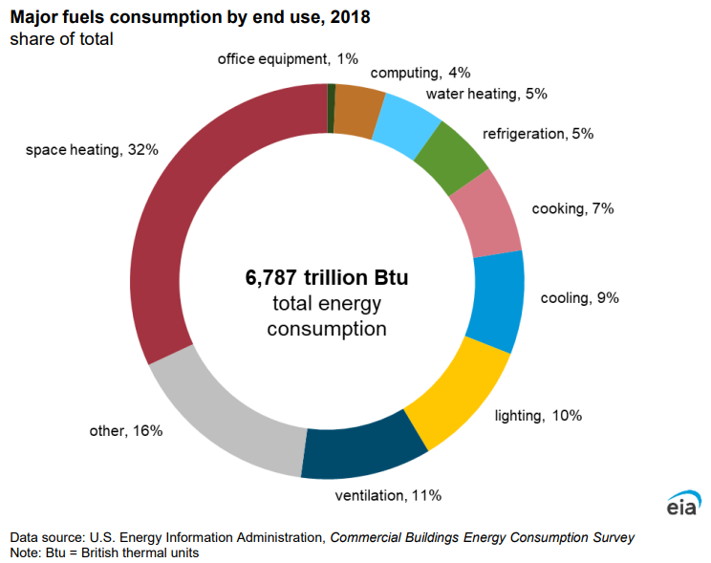
Motivation – Building Energy Consumption
From EIA
Residential Buildings: 22% of Energy Usage (2022)
Residential Buildings: 51% Energy for HVAC (2015)
Commercial Buildings: 18% of Energy Usage (2022)
Commercial Buildings: 41% Energy for HVAC

Slide 4
Motivation – Building as a Flexible Grid Edge Asset
Ambient Weather
Occupant Behavior
Aggregator
Ancillary Services to Grid
Weather Forecast
Building 1
Building 2
Load Forecast
Energy Cost Reduction
Actions
Occupant Model
Building i
Building n
Thermal Model
Maintaining Occupant Comfort
Controller
Feedback

Slide 5
Models

Slide 6
Building Model Schematic
Solar PV
Battery Storage
Ancillary Services to Grid
Ambient Weather
Electric Vehicles
Energy Cost Reduction
HVAC Load
Occupant Behavior
Other Electric Load
Maintaining Occupant Comfort
Building Thermal Model

Slide 7
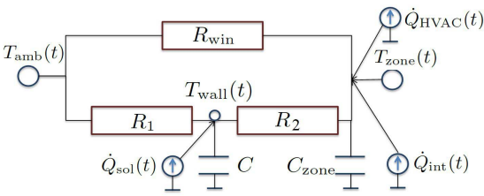

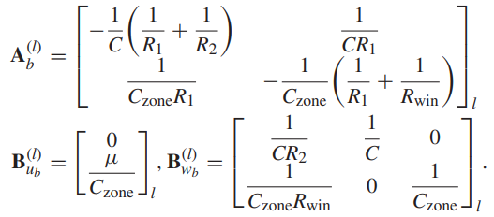
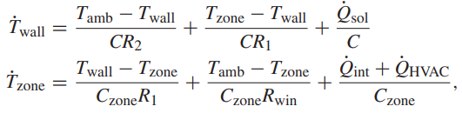

Building Thermal Model – Continuous Time
RC Network Model for Building
Matrix-Vector Representation for 1 Building
RC Network Model ODE
Matrix-Vector Representation for all Buildings

Slide 8
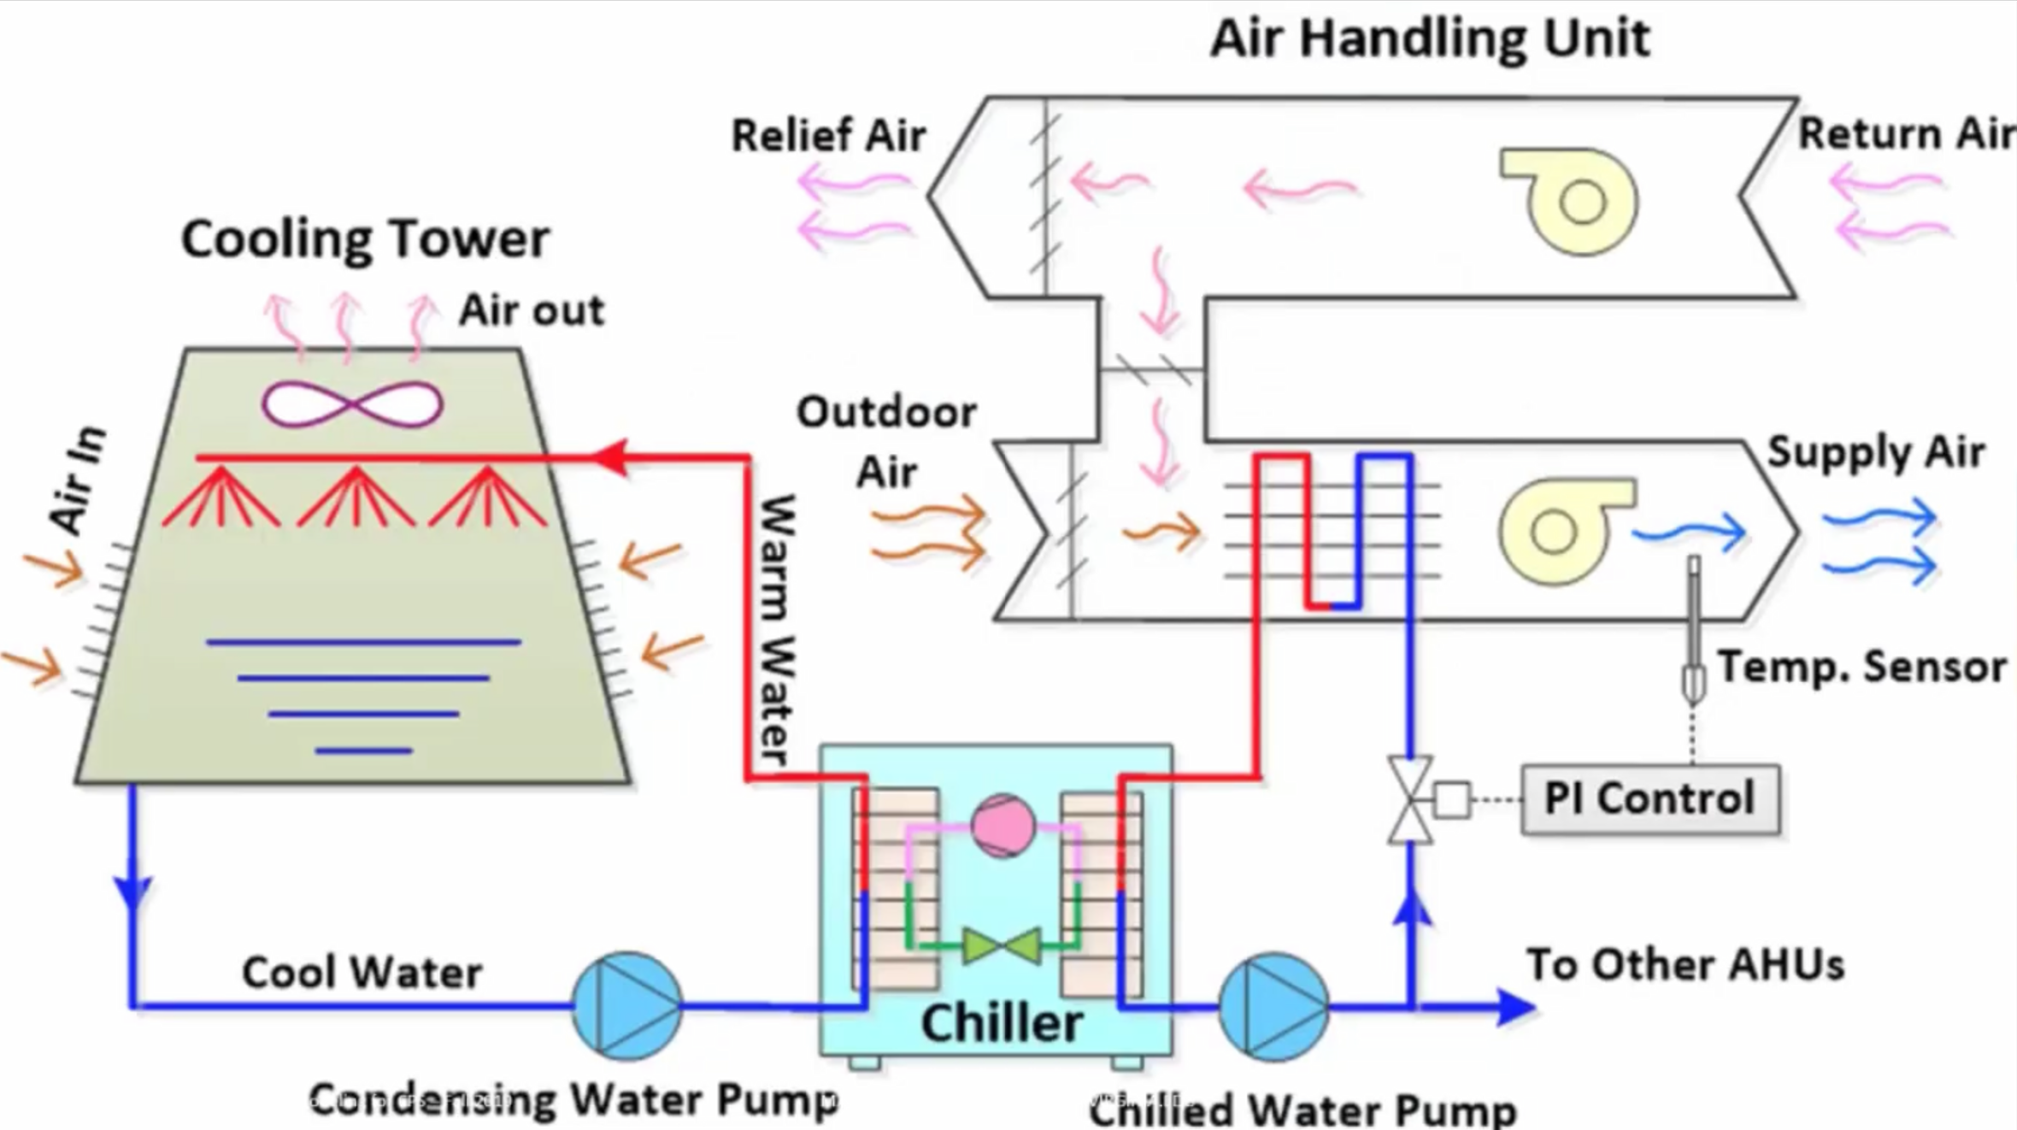
HVAC System – Detailed Schematic

Slide 9
Modelling Landscape
CFD Approach – 3D
Zonal Approach – 2D
Nodal Approach – 1D
ANSYS
SPARK
Energy Plus
BSim
Fluent
WUFI Plus
TrnSys
BUILDOPT-VIE
COMSOL
IDA-ICE
Modellica – IBPSA
BOPTEST
CDIM
BIM
DESTEST
Multiphysics
ESP-r
OpenFoam
Clim2000
Spawn of Energy Plus

Slide 10
Modelling Landscape
EnergyPlusAPI.py
Energy Plus
OpyPlus.py
OpenDSSDirect.py
OpenDss
Spawn of Energy Plus
HELICS
GridLab-D
Modellica – IBPSA
BOPTEST
CDIM
BIM
DESTEST
PYHelics.py
PowerDistribution.jl

Slide 11
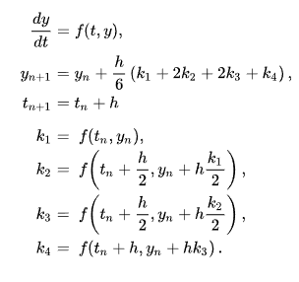
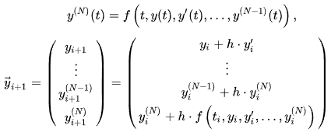

Model Discretization
Euler Method
Runge-Kutta Method
Zero-Order Hold

Slide 12
Black Box Modeling

Slide 13
Building Modeling - Workflow
PNNL Buildings
Database
Input Data
Processed Input Data
Model Estimation – Gray-box
Building Gray-box Model
Building IDF File
Occupant Equipment Schedules
Weather EPW File
Model Estimation – Black-box
Building Black-box Model
Outside Temperature Humidity Irradiance
Average Building Geometry
Output Data
AHU Data
HVAC Loads
AHU Inputs
Model Estimation – Gray-box
AHU Gray-box Model
Zone Temperatures
AHU Outputs
Zone Humidity
13

Slide 14
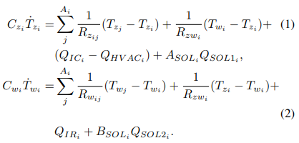

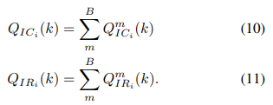
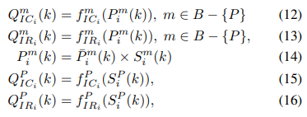


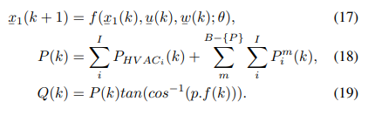
Modeling
Thermal Dynamics
Solar Heat Gain Models
Internal Heat Gain Models
HVAC Power Consumption
Complete ANN Building Model

Slide 15


Zone Aggregation Model
Aggregation
Aggregated Thermal Discrete ANN Model
Aggregated Thermal Discrete Model

Slide 16
Building Thermal Modeling – ANN Approach I
Input
Output
Current Time-Step Zone Temperature
Current Ambient Temperature
ANN Model
Next Time-Step Zone Temperature
Zone Internal Radiant/Convective Heat Gains
Zone Solar Radiation Het Gain
Zone HVAC Heating/Cooling Heat Gain

Slide 17
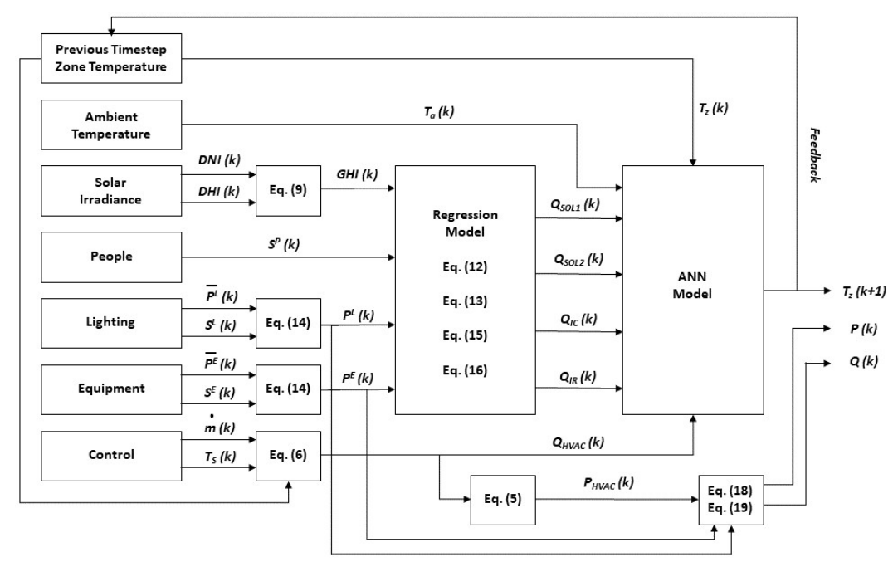
Building Thermal Modeling – ANN Approach II

Slide 18
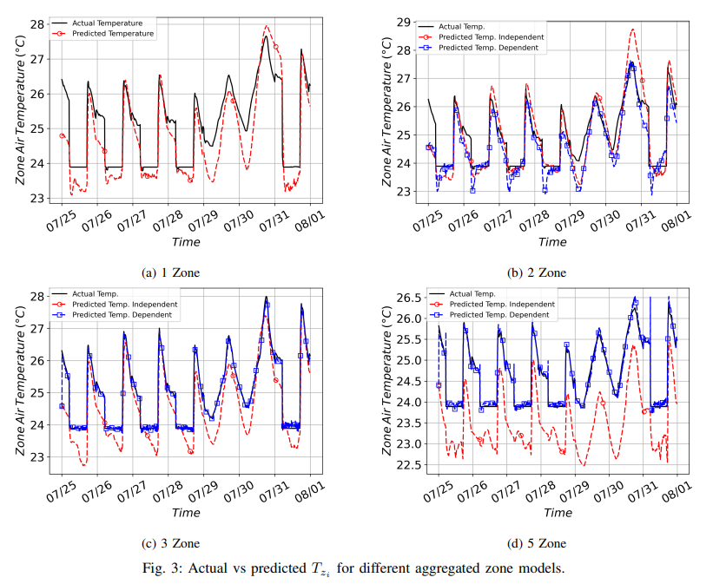
Results – Zone Temperatures

Slide 19
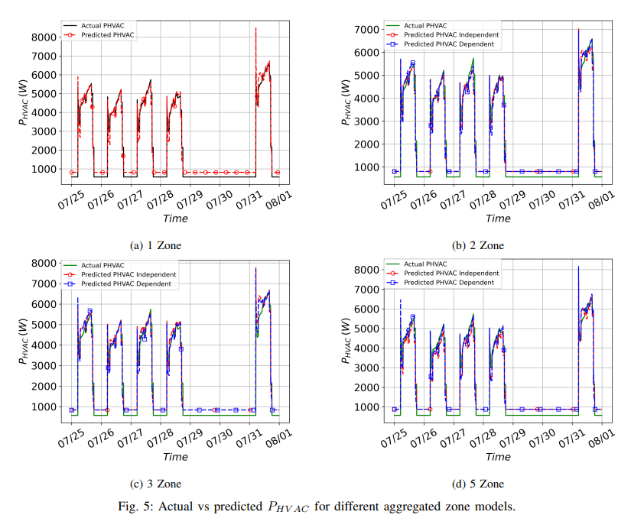
Results – Zone HVAC Power Consumption

Slide 20
Key Takeaways for Black-Box Modeling
1. Easy to setup
2. Opensource tools like Pytorch and Tensorflow do the heavy lifting
3. Most effort is required in data collection and processing
4. Models are not interpretable
5. Models are not Convex – Less useful for control purposes

Slide 21
Grey-Box Modeling

Slide 22
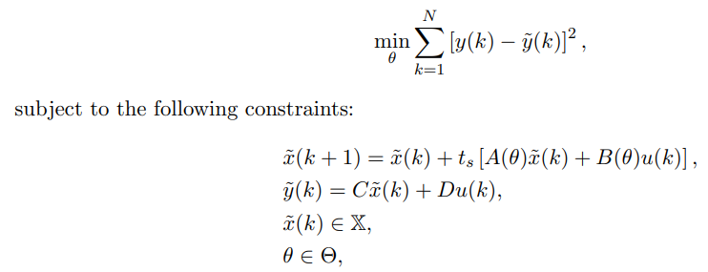
Naïve Problem Solution – Noise Processes not considered

Slide 23





Bayesian Problem Setup
Discrete Stochastic ODEs - Models
Full Posterior
Data
Unknown
Known

Slide 24


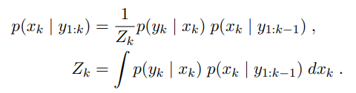

Bayesian – Filtering and Smoothing
Filtering
Smoothing
Prediction Step:
Prediction Step:
Update Step:
Update Step:

Slide 25


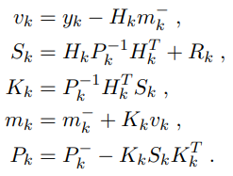
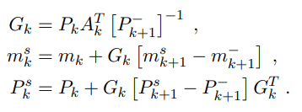
Bayesian – Filtering and Smoothing – Kalman Filter
Filtering
Smoothing
Prediction Step:
Prediction Step:
Update Step:
Update Step:

Slide 26
A Zoo of Bayesian Filters and Smoothers
Filters Smoothers
Exact Gaussian
Gaussian Approximation
Non-Gaussian Approximation
Kalman Filter/Smoother
Extended Kalman Filter/Smoother
Unscented Kalman Filter/Smoother
Gaussian Filter/Smoother
Particle Filter Smoother
Linear System
Nonlinear System

Slide 27
Grey-Box Modeling Landscape
Bayesian Framework
Filtering/Smoothing Algorithms Algorithms
Maximum Likelihood Estimation (MLE)
Full Posterior
Batch Estimation
Maximum A Posteriori (MAP)
Expectation Maximization (EM)
Bayesian Filter – State Augmentation

Slide 28



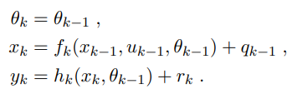
Bayesian Filter - State Augmentation
Model
Model – With Parameter Dynamics and Noise
Model – With Parameter Dynamics

Slide 29
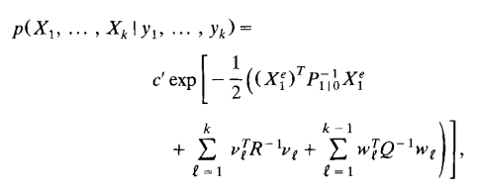
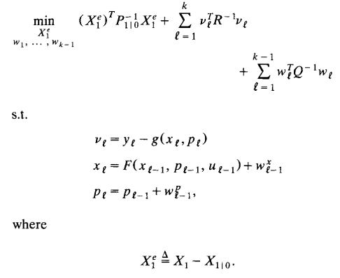
Batch Estimation
Full Posterior
Batch Estimation -NLP

Slide 30
Model for RL Training

Slide 31
Possible RL Training Architectures
Environment
RC-Network Based Model
Local Controller
RL Agent
ANN-Based Model
Action
Local Controller
EnergyPlus Model
Local Operation Sequences
State/Reward

Slide 32
Questions?

