Slide 1
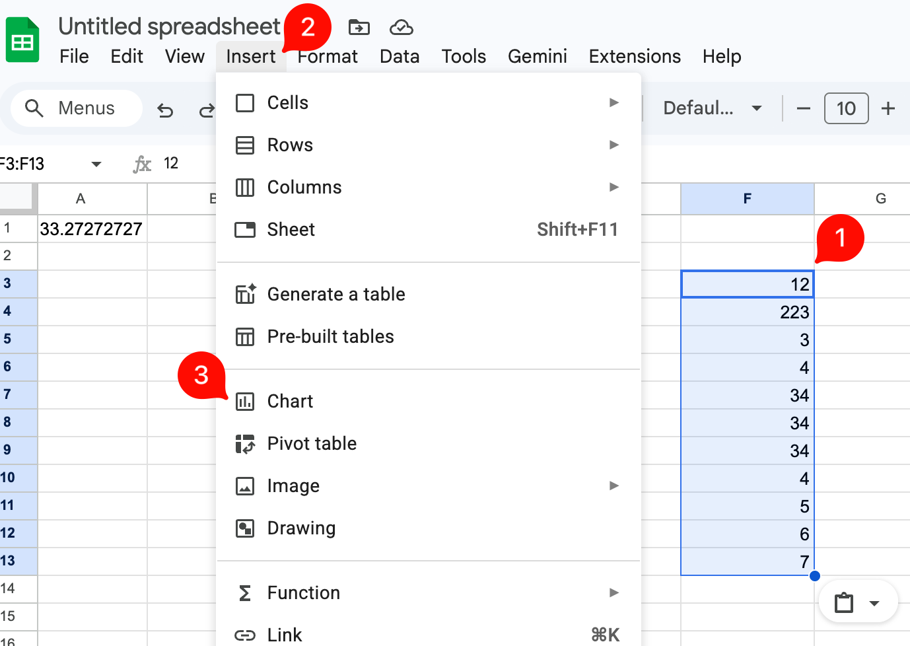
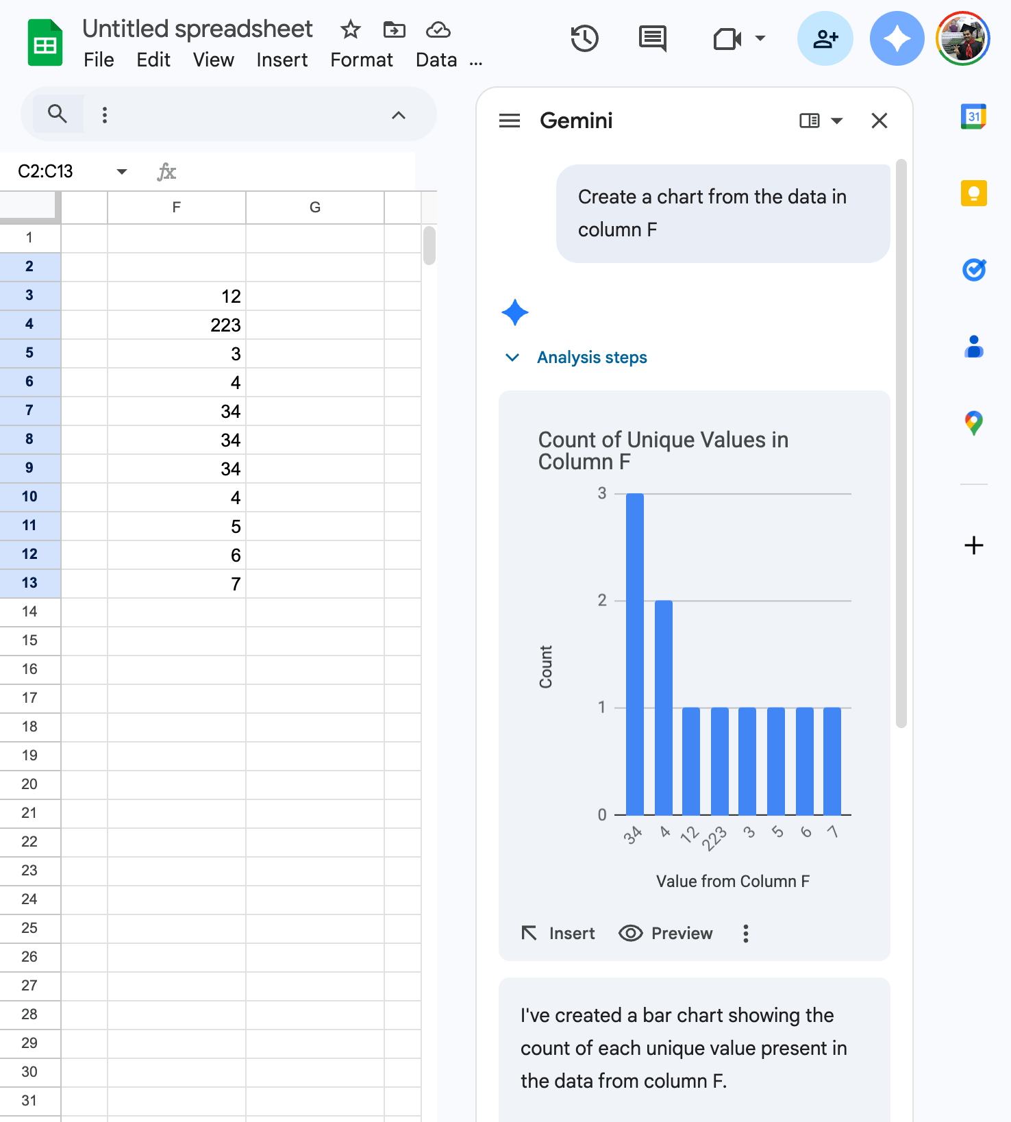
Testing Language Mediated GUIs
April 2026 \ Chaudhari, Ninad & Kuri, Sharmista
Creating a Chart – Traditional (left) vs Language Assisted (Right)

Slide 2
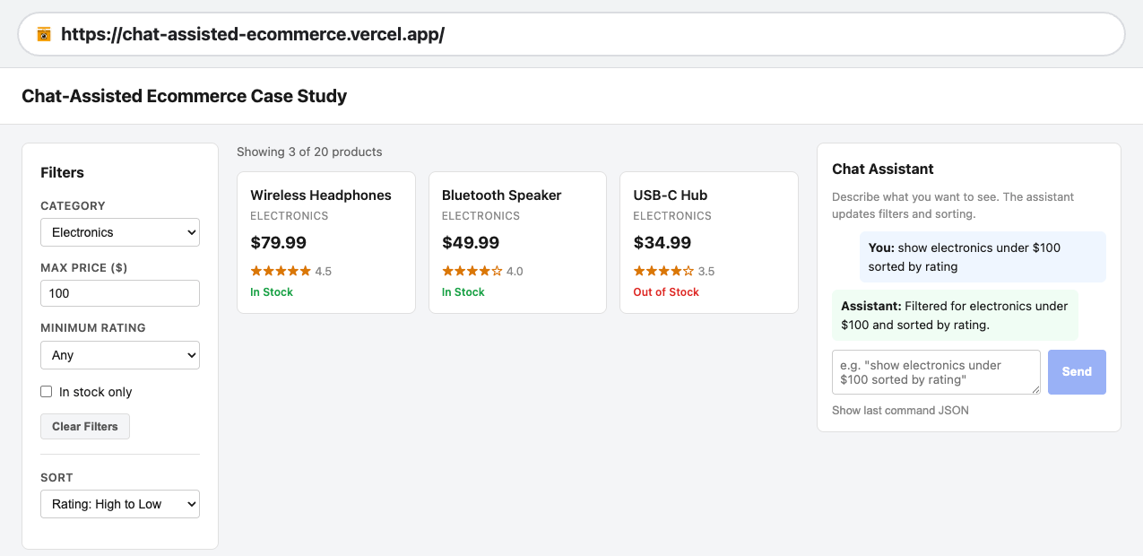
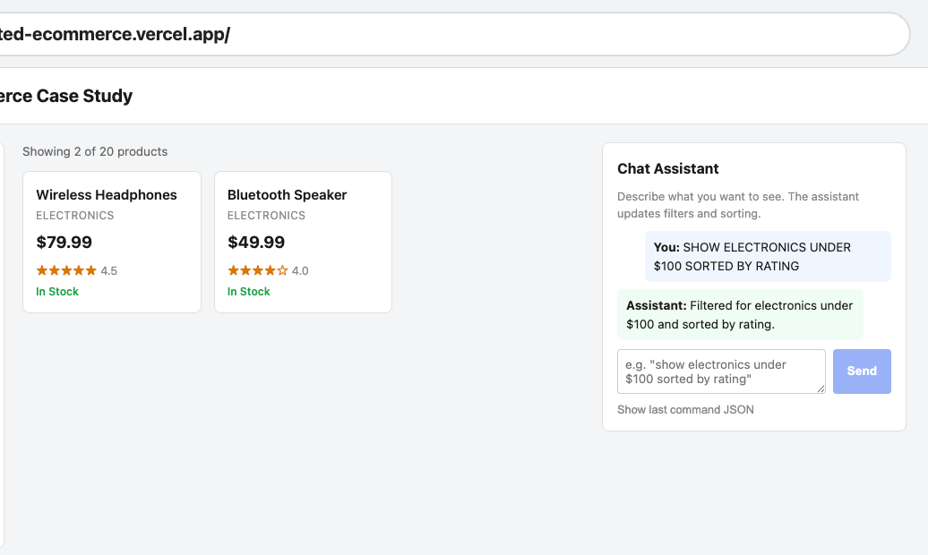
“In Stock Only” filter Automatically applied when utterance is in uppercase (right)

Slide 3
Progress Directions
Writing
  Formalizing & Defining new UI
  Problem Definition
Experiments
  Test Harness
    LLMs : Observability, Router & Visualizations
  Defining Objectives
  Comparative Analysis

Slide 5
Testing Harness

Slide 6
Feb 2026

Slide 7
Testing Language Mediated GUIs
Chaudhari, Ninad & Kuri, Sharmista
Creating a Chart – Traditional (left) vs Language Assisted (Right)

Slide 9
What is an E2E Test
Consider this problem,
  You are tasked with building a feature for a web app.
Let’s look at an app that you just built, - E-Commerce or Robo Coasters
  You are confident that the code is correct to the best of your knowledge
  Do you take it for it’s face value? – Most don’t.
  The first thing we do is test out a few scenarios
    Say buying a ticket, from a user’s perspective.
    You try out specific “user flows”
This Methodology that validates the entire software application's workflow
  from start to the finish
    Does not matter if you only worked on frontend or the backend.
    Does not matter how small / big the change…
  E2E implies evaluating a complete “flow”,
  considering the application is a black box!

Slide 10
Testing Flow
Select a Test Input from the input domain.
You feed that input into the SUT.
The SUT produces an Actual Output.
The Test Oracle compares that Actual Output to the Expected Output.
The Oracle issues a verdict: Pass or Fail.

Slide 11
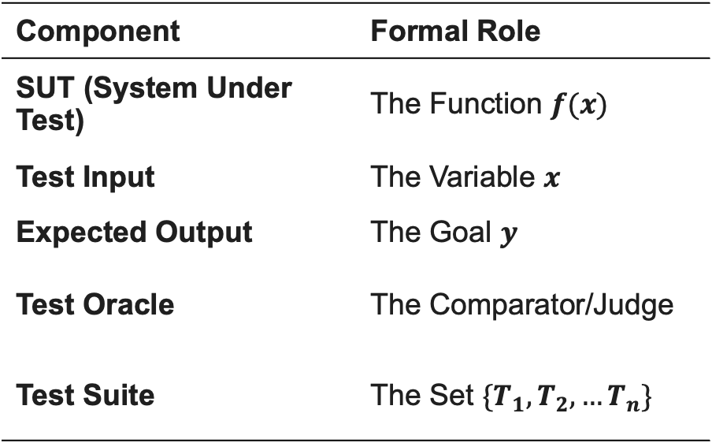
Testing Components
Component | Formal Role
SUT (System Under Test) | The Function $f(x)$
Test Input | The Variable $x$
Expected Output | The Goal $y$
Test Oracle | The Comparator/Judge
Test Suite | The Set $\{T_{1},T_{2},…T_{n}\}$

Slide 12
End-to-End Tests
for Direct Manipulation GUIs (DM-GUI) [1]
[1] C. Görner, P. Vossen, and J. Ziegler, "Direct Manipulation User Interface," in Human Factors in Information Technology, vol. 9, M. Galer, S. Harker, and J. Ziegler, Eds. Amsterdam, Netherlands: North-Holland, 1992, ch. 8, pp. 237–279. doi: 10.1016/B978-0-444-89301-7.50014-9.

Slide 13
End to End Tests
Scope: System-wide
Perspective: User-centric
Validation: Workflow integrity
Environment: Production-like
Dependency: Integrated components
Goal: Functional correctness

Slide 14
Automated E2E Testing
Automated End-to-End (E2E) Testing refers to a verification methodology that validates the complete functional flow of a system from the user's perspective by simulating real-world transactions via automated scrips.
It evaluates the interoperability of all integrated components, the frontend, backend services, and external dependencies, without manual intervention to ensure the software satisfies high-level business requirements as a unified whole [1,2,3].
[1] Alian et al., "A Feature-Based Approach to Generating Comprehensive End-to-End Tests," ICSE 2025.
[2] B. García et al., "Test automation with Selenium: A survey," Information and Software Technology, vol. 182, 2026.
[3] ISO/IEC/IEEE. (2022). Software and systems engineering — Software testing — Part 1: General concepts
(ISO/IEC/IEEE 29119-1:2022). International Organization for Standardization.
A niche in Software Testing Academic Community

Slide 15
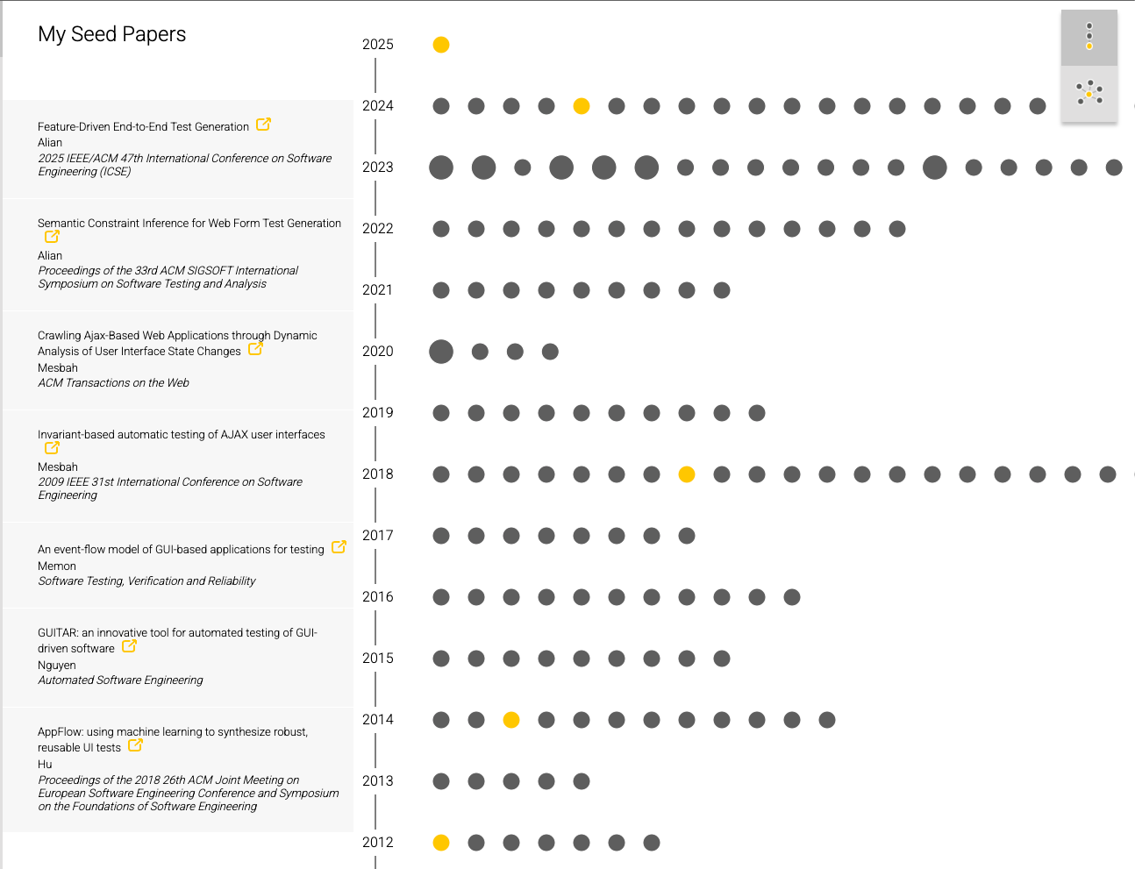
E2E Testing,
Cornerstone papers
-- Over the years! (Citation Gecko)
https://github.com/CitationGecko/gecko-react

Slide 16
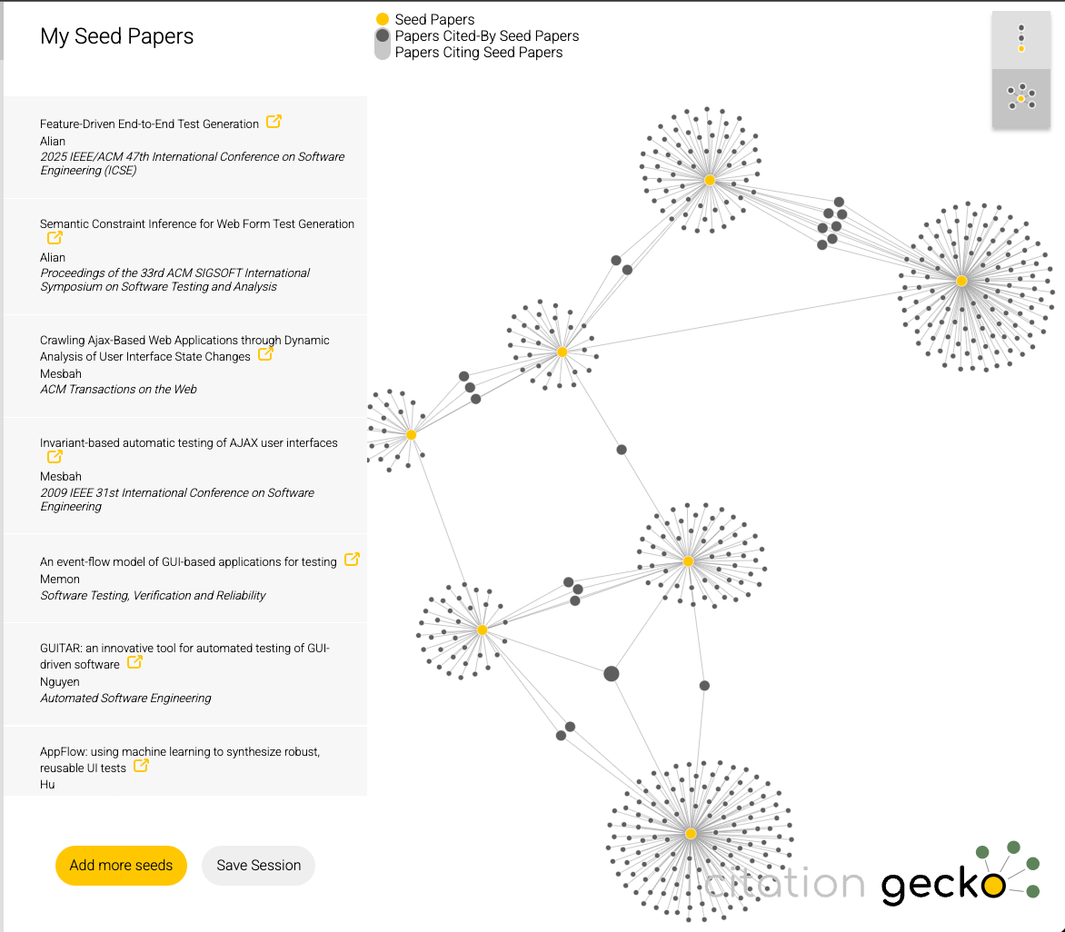
Seminal E2E Papers and their connections
Form Entity Relation Graph
ISSTA ‘24
CrawlJax
Tweb ‘12
Invariants
ICSE ’09
Features - AutoE2E
ICSE ’25
GUITAR
ASE ’13
EFG
STVR ’07
AppFlow
FSE ’18

Slide 17
Some approaches also use LLMs!
Form Entity Relation Graph
ISSTA ‘24
Features - AutoE2E
ICSE ’25

Slide 18
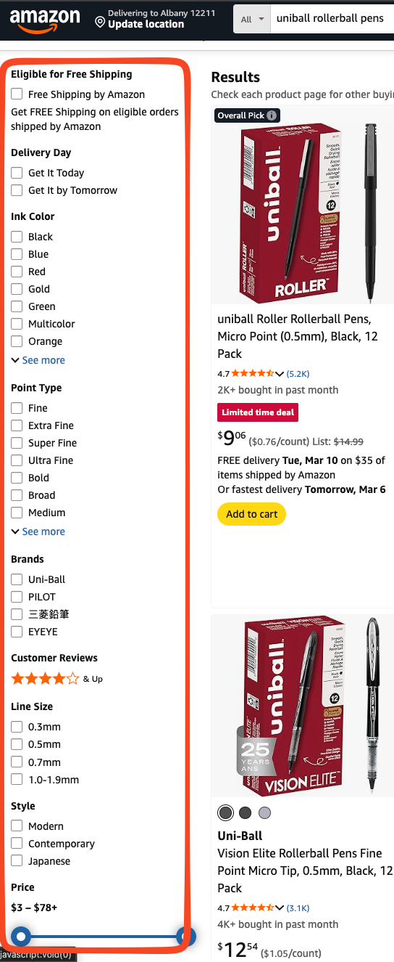
Bottlenecks - Direct Manipulation
Hidden Menus-Steps to create a chart.
High Friction filtering operations

Slide 19
Bottlenecks - Direct Manipulation
(Formally)
Discoverability Debt:
  Elements, like the sub-menus in the Google Sheets
  are hidden behind "hover" or "click" walls.
Cognitive Locality:
  Users must remember where a filter lives.
The "N-Click" Burden:
  To achieve a complex state a user must perform
  N discrete visual searches and N physical clicks.
  e.g., "Find blue, fine-tip pens under $10 with Prime "
High Friction filtering operations
Hidden Menus-Steps to create a chart.

Slide 20
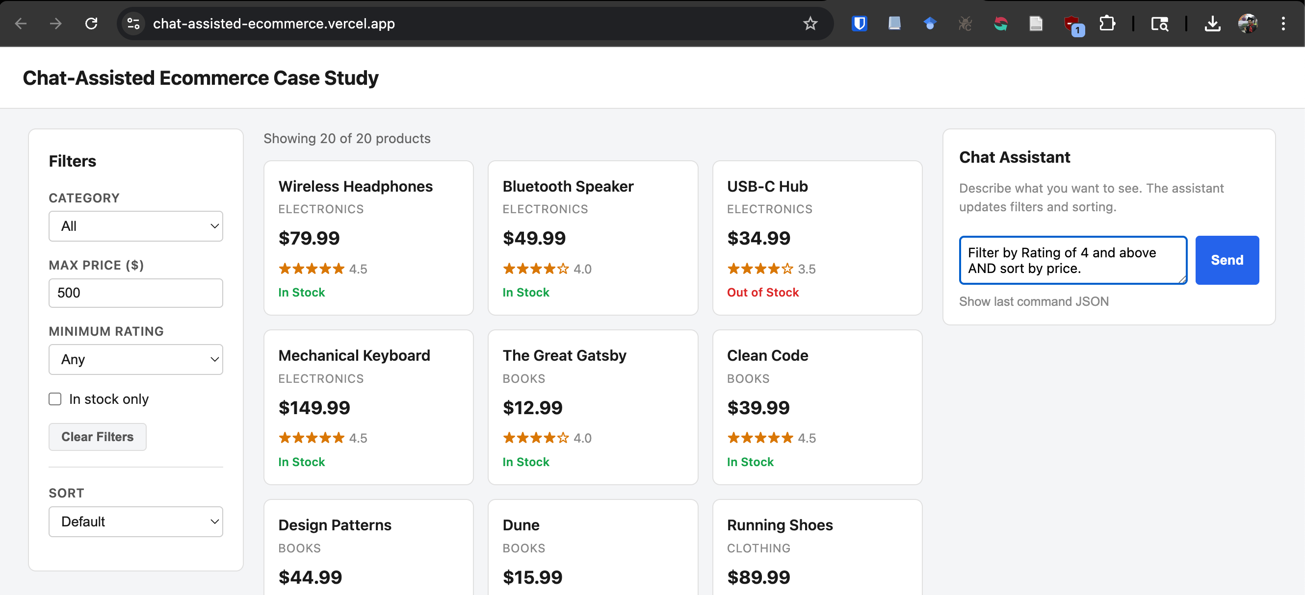
LAGUI Paradigm
Orchestration layer between user intent and software functions.
spatial navigation (clicking) replaced by
semantic navigation (utterances).

Slide 21
Transition Semantics
NL Utterance
LLM Mediator
Control Activation
Application Logic
Display State

Slide 22
Project Motivation
How do we formalize
and test this new paradigm to ensure
it's as reliable as the menus it replaces?

Slide 23

Challenges in Testing LNGUIs
Component | Formal Role
SUT (System Under Test) | The Function $f(x)$
Test Input | The Variable $x$
Expected Output | The Goal $y$
Test Oracle | The Comparator/Judge
Test Suite | The Set $\{T_{1},T_{2},…T_{n}\}$
English Language - Huge!
Not always a single answer

Slide 24
Challenges in Testing LNGUIs
The Oracle Problem
  "Show me some shoes" could return different but equally valid sets of results
Input Domain
  We cannot possibly test every permutation of a command.
Non-Determinism
  LLMs can produce different outputs for exactly same inputs
Context Sensitivity
  “Delete that” needs prior context

Slide 25
Modalities of Failure
What unique Fault patterns can LNGUIs have?

Slide 26
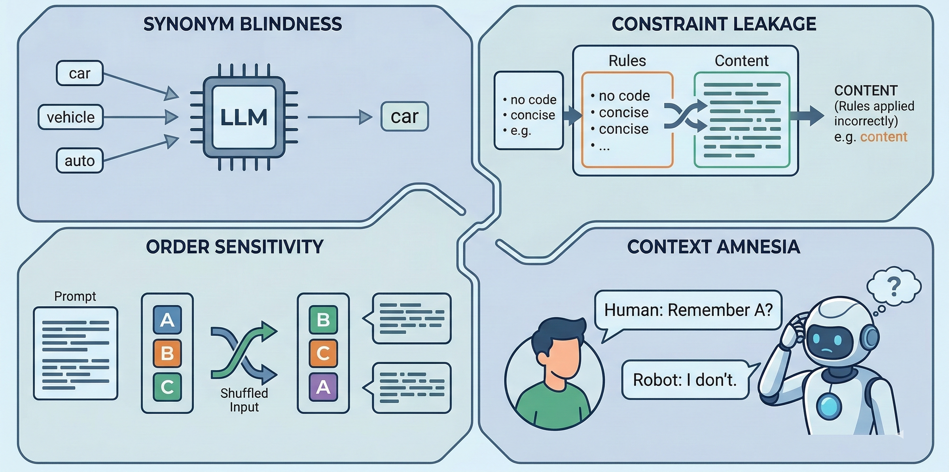
Fault Model

Slide 27
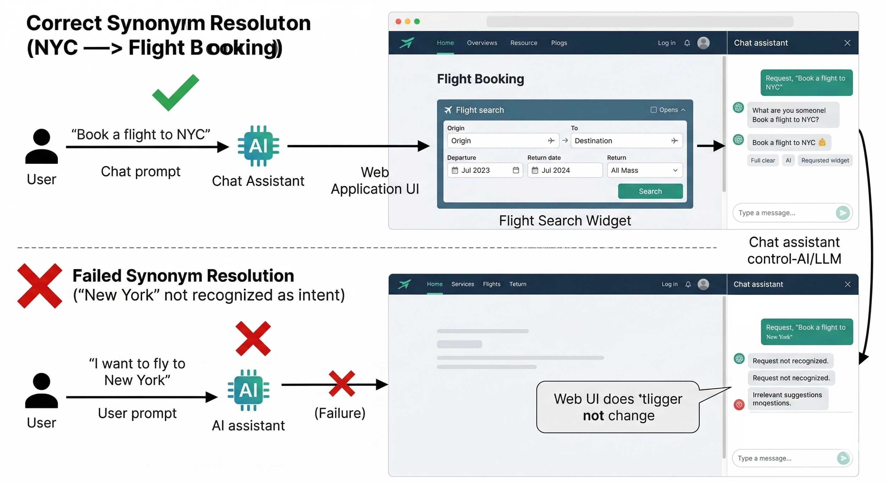
Synonym Blindness

Slide 28
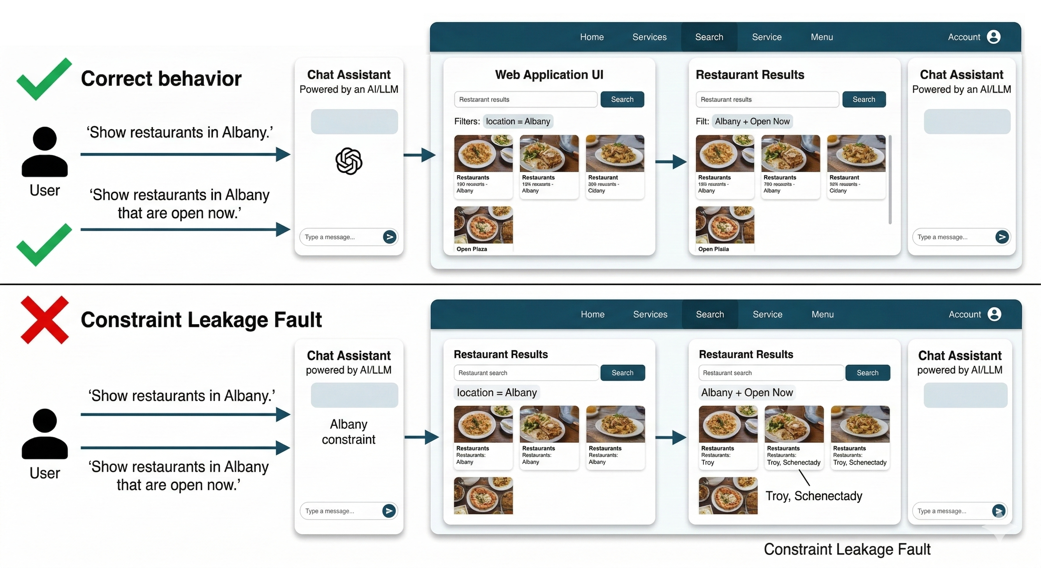
Constraint Leakage

Slide 29
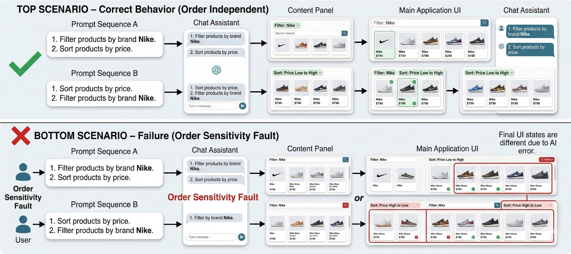
Order Sensitivity

Slide 30
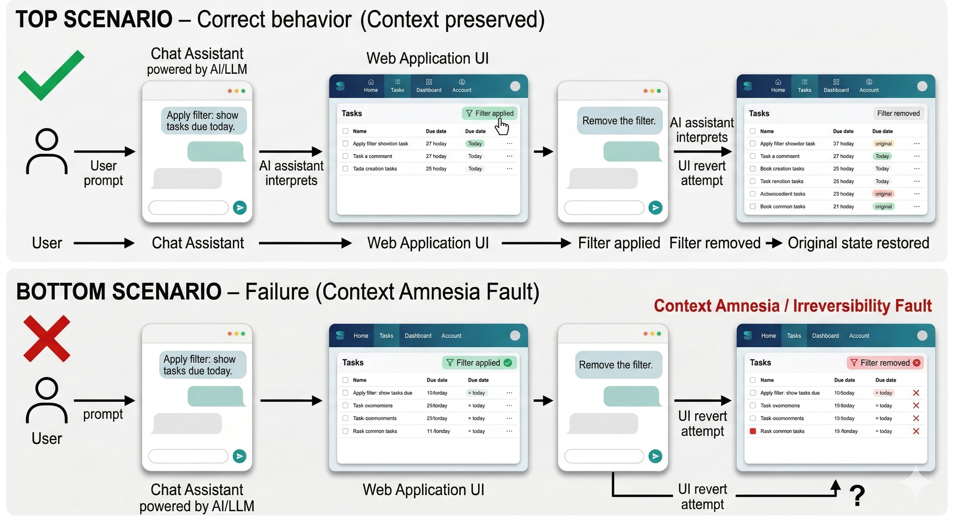
Context Amnesia

Slide 31
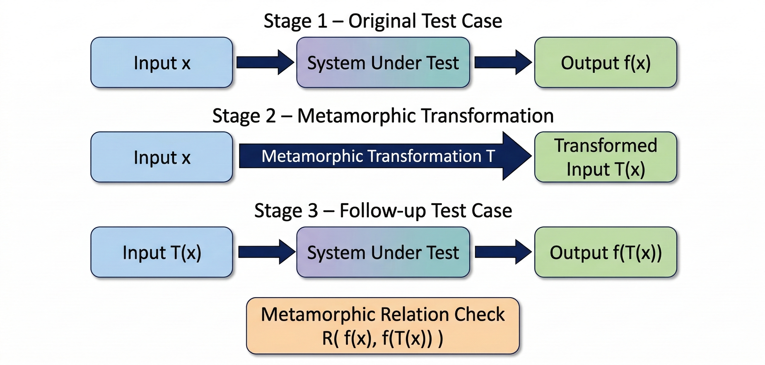
Metamorphic Testing[5]
[5] T.Y. Chen; S.C. Cheung; S.M. Yiu (1998), "Metamorphic testing: A new approach for generating next test cases", Technical Report HKUST-CS98-01 (PDF), Department of Computer Science, The Hong Kong University of Science and Technology, Hong Kong, arXiv:2002.12543
Notes:
Metamorphic testing is useful when the correct output is unknown.
We first run the system with an input x and observe output f(x).
Then we transform the input using a metamorphic relation to create a follow-up input T(x).
After running the system again, we check whether the outputs satisfy the expected relation.

Slide 32
Metamorphic Relation
Metamorphic Relations(MR) are the rules that define how outputs should behave when inputs are transformed.
Instead of checking one correct output,
we check whether the outputs follow the expected relation.
Notes:
A metamorphic relation specifies how outputs should change when we transform the input. Instead of checking one correct output, we check whether the outputs follow the expected relation.

Slide 33
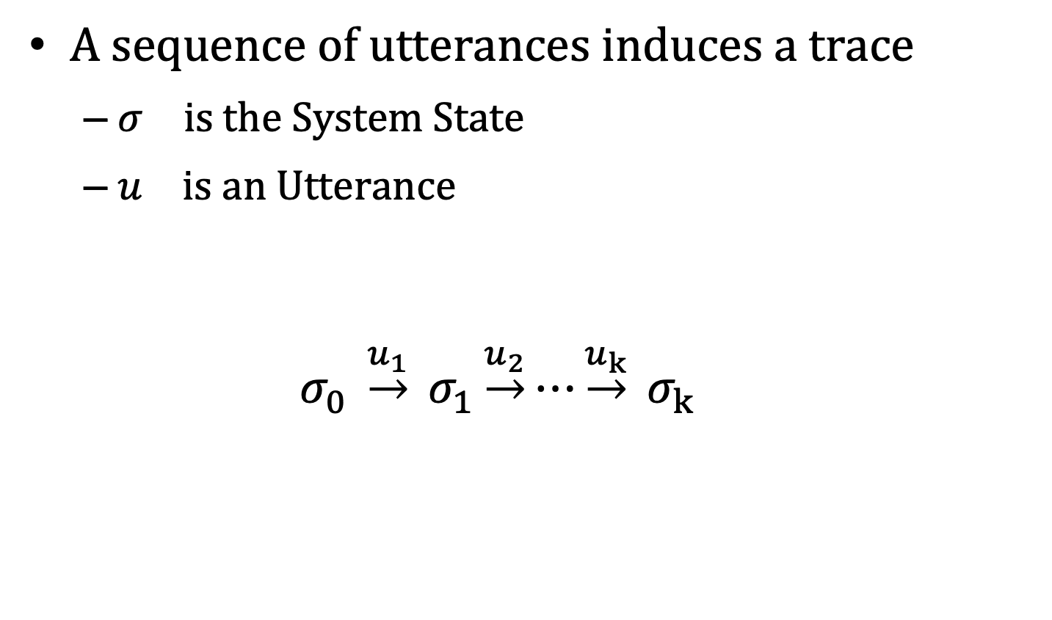
Intuitively
A sequence of utterances induces a trace
  $σ_{}$ is the System State
  $u_{}$is an Utterance
    $σ_{0} \underset{→}{u_{1}} σ_{1}\underset{→}{u_{2}}⋯\underset{→}{u_{k}} σ_{k}$

Slide 34
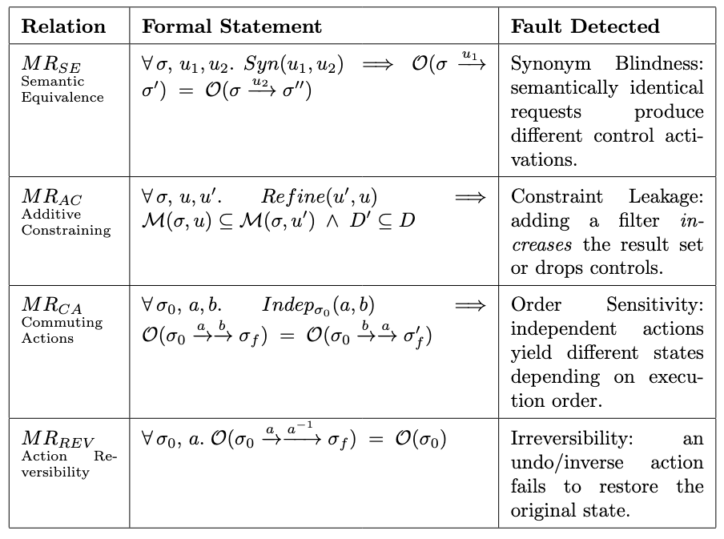
Some Relations

Slide 35
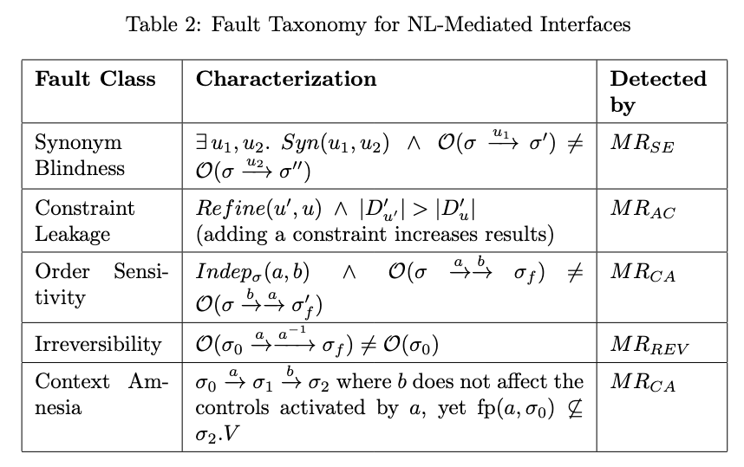
Fault Taxonomy

Slide 36
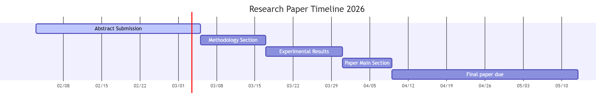
Timeline - Gantt Chart

Slide 37
Expected Outcome
Formalize LNGUIs
  Map to some Model (graphs or FSM)
Define the Fault Model
Design a Coverage criteria
  Based on Metamorphic testing
A tool to automatically create a test suite for LNGUIs

Slide 38

Expected Outcome
Bridge this gap!

Slide 39
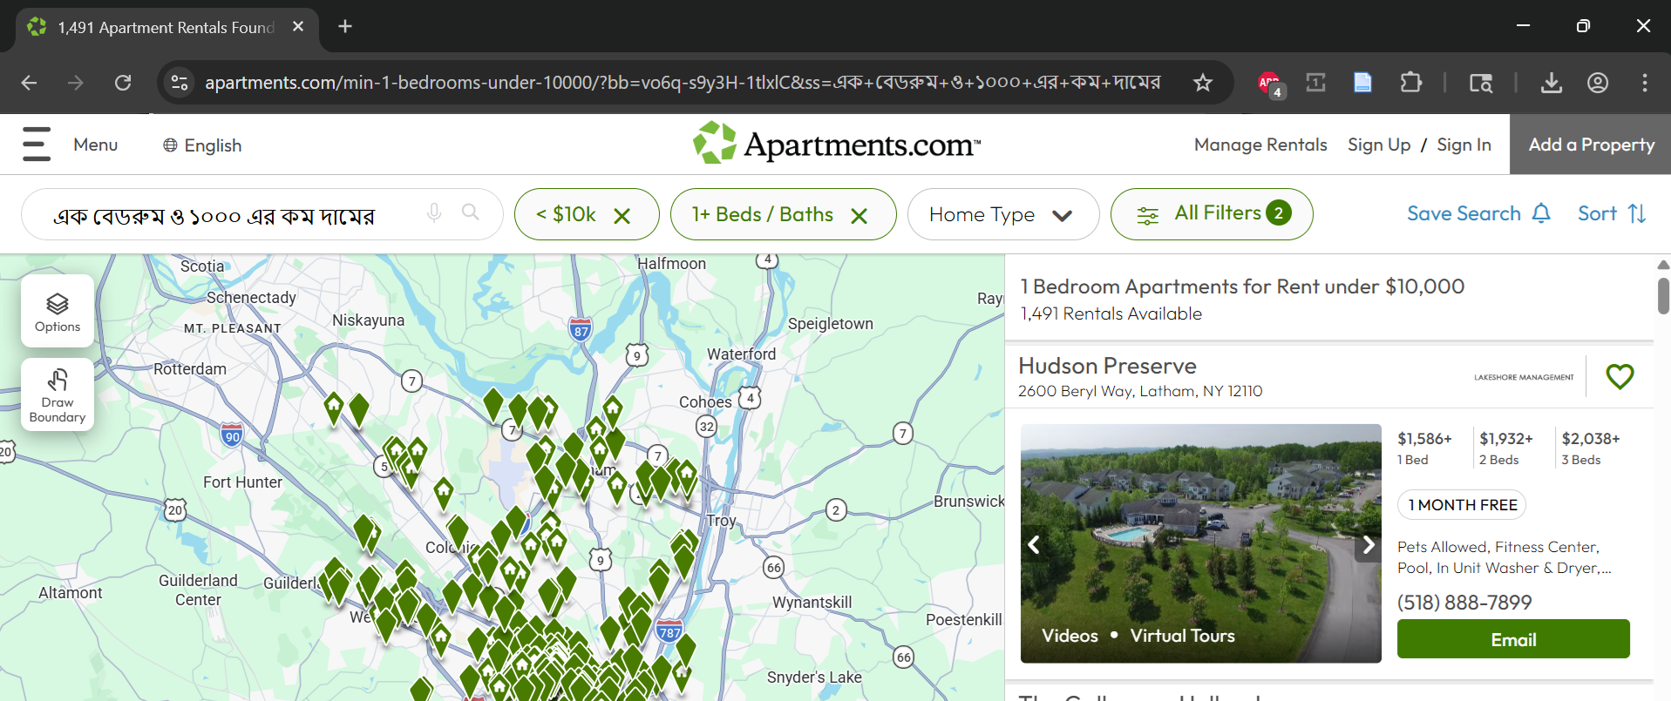
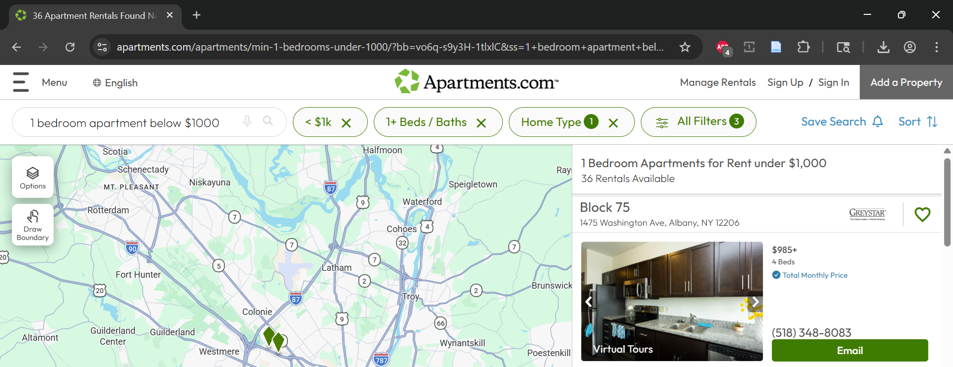
Apartment.com
এক বেডরুম ও
১০০০ এর কম দামের
1,491 Rentals Available
1 bedroom apartment below $1000
36 Rentals Available

Slide 40
Metamorphic Relation (MR1)
  If two queries express similar apartment requirements, the results should follow a logical relationship based on the filter constraints.
Expected relation:
Results(price ≤ $1000) ⊆ Results(price ≤ $10,000)

Slide 41
Thank you
Criticisms welcome!

