Slide 1
CSYE 7245 Big-Data Systems and Intelligence Analytics
Nik Bear Brown
nikbearbrown@gmail.com
Graph Search

Slide 2
Topics
Uninformed Search
Breadth-First Search
Depth-First Search
Iterative Deepening
Heuristic Search
- Greedy Search
- A*-Search
- IDA*-Search

Slide 3
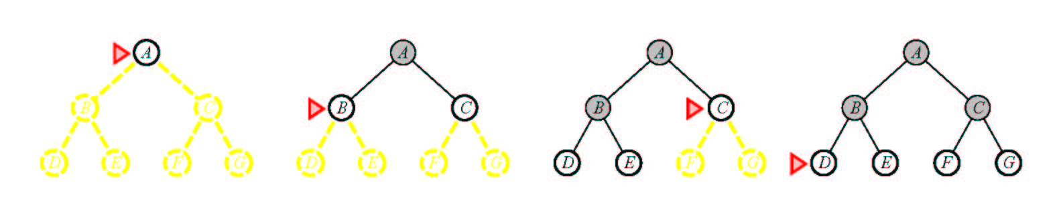
Breadth-First Search
Notes:
Suppose the solution is at depth 4 at the right. Then we must explore almost all paths of length 5 before we find it.
Suppose all paths of length 10 are solutions?
Note how much memory this approach takes.

Slide 4
Pseudocode for Breadth-First Search
Initialize: Let Q = {S}
While Q is not empty
pull Q1, the first element in Q
if Q1 is a goal
report(success) and quit
else
child_nodes = expand(Q1)
eliminate child_nodes which represent loops
put remaining child_nodes at the back of Q
end
Continue

Slide 5
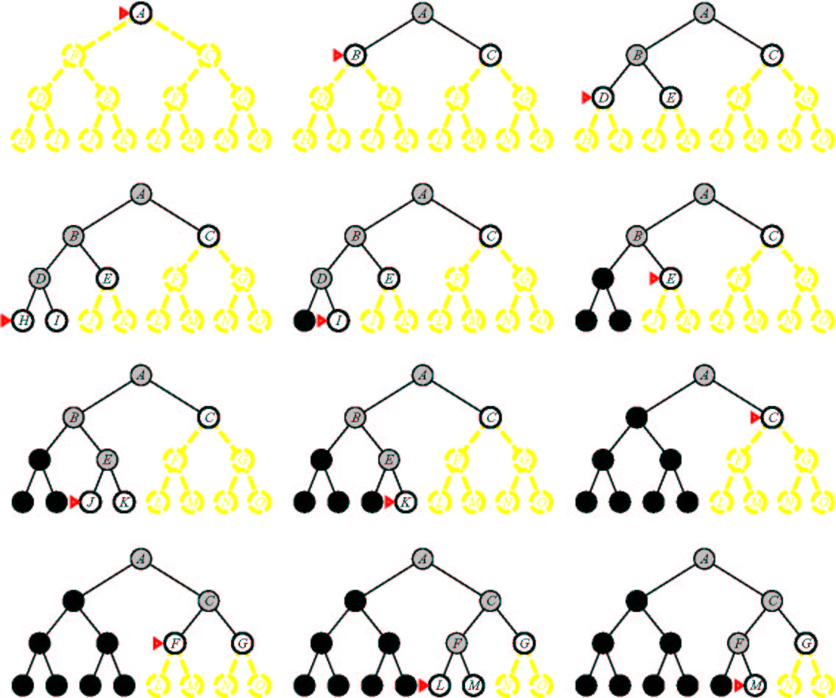
Depth-First Search
Notes:
Notice how much less memory this takes.
Note that we could have generated the answer but not noticed it.
Is depth-first search optimal? (I.e., if it finds the solution, it’s the best one) no. Can miss a better one somewhere else in the tree.
What’s the worst problem? Can go on forever. Can implement a cut off.

Slide 6
Depth First Search (DFS)
S
A
D
B
D
C
E
Here, to avoid repeated states assume we don’t expand any child node which appears already in the path from the root S to the parent. (Other strategies are also possible)
D
F
G

Slide 7
Pseudocode for Depth-First Search
Initialize: Let Q = {S}
While Q is not empty
pull Q1, the first element in Q
if Q1 is a goal
report(success) and quit
else
child_nodes = expand(Q1)
eliminate child_nodes which represent loops
put remaining child_nodes at the front of Q
end
Continue

Slide 8
Breadth First Search
S
A
D
B
A
D
E
C
E
E
S
B
S
B
F
(Use the simple heuristic of not generating a child node if that node is a parent to avoid “obvious” loops: this clearly does not avoid all loops and there are other ways to do this)

Slide 9
Comparing DFS and BFS
Same Time Complexity, unless...
say we have a search problem with
goals at some depth d
but paths without goals and which have infinite depth (i.e., loops in the search space)
in this case DFS never may never find a goal!
(it stays on an infinite (non-goal) path forever)
BFS does not have this problem
it will find the finite depth goals in time O(b^{d})
Practical considerations
if there are no infinite paths, and many possible goals in the search tree, DFS will work best
For large branching factors b, BFS may run out of memory
BFS is “safer” if we know there can be loops

Slide 10
Depth-Limited Search
This is Depth-first Search with a cutoff on the maximum depth of any path
i.e., implement the usual DFS algorithm
when any path gets to be of length m, then do not expand this path any further and backup
this will systematically explore a search tree of depth m
Properties of DLS
Time complexity = O(b^m), Space complexity = O(bm)
If goal state is within m steps from S:
DLS is complete
e.g., with N cities, we know that if there is a path to goal state G it can be of length N-1 at most
But usually we don’t know where the goal is!
if goal state is more than m steps from S, DLS is incomplete!
=> the big problem is how to choose the value of m

Slide 11
Iterative Deepening Search
Basic Idea:
we can run DFS with a maximum depth constraint, m
i.e., DFS algorithm but it backs-up at depth m
this avoids the problem of infinite paths
But how do we choose m in practice? say m < d (!!)
We can run DFS multiple times, gradually increasing m
this is known as Iterative Deepening Search
Procedure
for m = 1 to infinity
if (depth-first search with max-depth = m ) returns success
then report (success) and quit
else
continue
end

Slide 12
Iterative Deepening Search
Complexity
Space complexity = O(bd)
(since its like depth first search run different times)
Time Complexity
1 + (1+b) + (1 +b+b²) + .......(1 +b+....b^{d}) = O(b^{d}) (i.e., the same as BFS or DFS in the the worst case)
The overhead in repeated searching of the same subtrees is small relative to the overall time
e.g., for b=10, only takes about 11% more time than DFS
A useful practical method
combines
guarantee of finding a solution if one exists (as in BFS)
space efficiency, O(bd) of DFS

Slide 13
Bidirectional Search
Idea
simultaneously search forward from S and backwards from G
stop when both “meet in the middle”
need to keep track of the intersection of 2 open sets of nodes
What does searching backwards from G mean
need a way to specify the predecessors of G
this can be difficult,
e.g., predecessors of checkmate in chess?
what if there are multiple goal states?
what if there is only a goal test, no explicit list?
Complexity
time complexity is O(2 b^{(d/2)}) = O(b ^{(d/2)}) steps
memory complexity is the same

Slide 14
Repeated States
S
B
S
B
C
C
C
S
B
S
State Space
Example of a Search Tree
For many problems we can have repeated states in the search tree
i.e., the same state can be gotten to by different paths
=> same state appears in multiple places in the tree
this is inefficient, we want to avoid it
How inefficient can this be?
a problem with a finite number of states can have an infinite search tree!

Slide 15
Techniques for Avoiding Repeated States
Method 1
when expanding, do not allow return to parent state
(but this will not avoid “triangle loops” for example)
Method 2
do not create paths containing cycles (loops)
i.e., do not keep any child-node which is also an ancestor in the tree
Method 3
never generate a state generated before
only method which is guaranteed to always avoid repeated states
must keep track of all possible states (uses a lot of memory)
e.g., 8-puzzle problem, we have 9! = 362,880 states
Methods 1 and 2 are most practical, work well on most problems

Slide 16
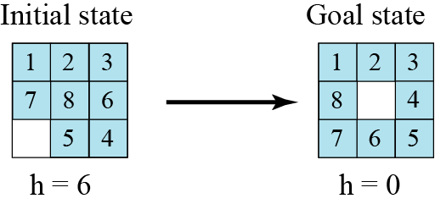
Heuristic search
Using heuristic search, we assign a quantitative value called a heuristic value (h value) to each node. This quantitative value shows the relative closeness of the node to the goal state. For example, consider solving the 8-puzzle.

Slide 17
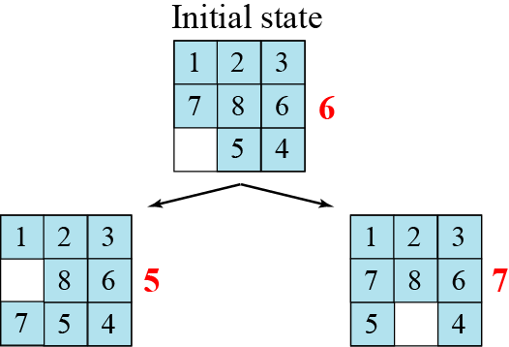

Slide 18
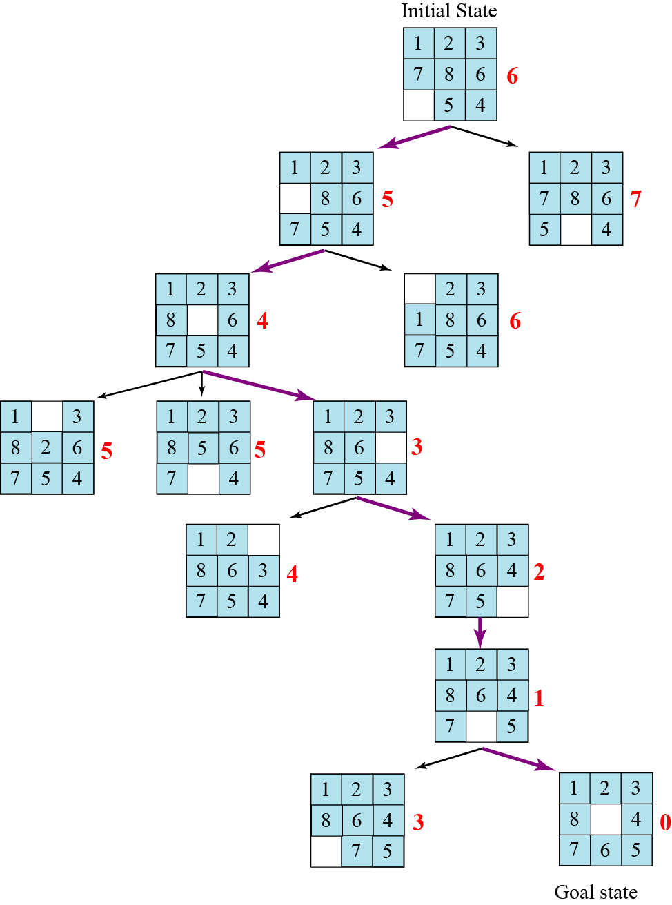

Slide 19
Uniform Cost Search
Uniform Cost Search
orders the nodes on the Q according to path cost from S
always expands the node with minimum path cost from S
Initialize: Let Q = {S}
While Q is not empty
pull Q1, the first element in Q
if Q1 is a goal report(success) and quit
else
child_nodes = expand(Q1)
<eliminate child_nodes which represent loops>
put remaining child_nodes in Q
sort Q according to path-cost to each node
end
Continue

Slide 20
Heuristics and Search
in general
a heuristic is a “rule-of-thumb” based on domain-dependent knowledge to help you solve a problem
in search
one uses a heuristic function of a state where h(node) = estimated cost of cheapest path from the state for that node to a goal state G
h(G) = 0
h(other nodes) ≥ 0
(note: we will assume all individual node-to-node costs are > 0)

Slide 21
A(*) Algorithm
Goal: Find shortest path
Prerequisites
Graph
Method to estimate distance between points (heuristic)
Basic Method
Try all paths?
Takes time
Orient search towards target
Minimizes areas of the map to be examined
Uses heuristics that indicate the estimated cost of getting to the destination
Main advantage

Slide 22
A(*) Algorithm
Algorithm
Open list
Nodes that need to be considered as possible starts for further extensions of the path
Closed list
Nodes that have had all their neighbors added to the open list
G score
Contains the length or weight of the path from the current node to the start node
Low lengths are better
Every node has a G score
H score
Heuristic
Resembles G score except it represents an estimate of the distance from the current node to the endpoint
To find shortest path, this score must underestimate the distance

Slide 23
The A* Algorithm
A heuristic h is admissible if
it for any node n it does NOT overestimate the true path cost from n to the nearest goal.
The A* search is a search algorithm orders the nodes on the Q according to f(n)=g(n)+h(n), where h(n) is an admissible heuristic
i.e., it sorts nodes on Q according to an admissible heuristic h*
It is like uniform-cost,
but uses fcost(node) = path-cost(S to node) + h(node)
rather than just path cost(S to node)
note that uniform cost search can be viewed as A* search where h(n) equals 0 for all n (the latter heuristic equal to 0 for every node is clearly admissible! Why?)

Slide 24
Pseudo-code for the A* Search Algorithm
Initialize: Let Q = {S}
While Q is not empty
pull Q1, the first element in Q
if Q1 is a goal report(success) and quit
else
child_nodes = expand(Q1)
<eliminate child_nodes which represent loops>
put remaining child_nodes in Q
sort Q according to ucost = pathcost(S to node) + h*(node)
end
Continue

Slide 25
Example of A* Algorithm in action
S
5 + 8.9 = 13.9
2 +10.4 = 12..4
A
D
3 + 6.7 = 9.7
B
D
4 + 8.9 = 12.9
7 + 4 = 11
8 + 6.9 = 14.9
C
E
E
6 + 6.9 = 12.9
Dead End
B
F
10 + 3.0 = 13
11 + 6.7 = 17.7
G
13 + 0 = 13

Slide 26
Comments on heuristic estimation
The estimate of the distance is called a heuristic
typically it comes from domain knowledge
e.g., the straight-line distance between 2 points
If the heuristic never overestimates, then the search procedure using this heuristic is “admissible”, i.e.,
h*(N) is less than or equal to realcost(N to G)
A* is a search with admissible heuristic is optimal
i.e., if one uses an admissible heuristic to order the search one is guaranteed to find the optimal solution
The closer the heuristic is to the real (unknown) path cost, the more effective it will be, ie if h1(n) and h2(n) are two admissible heuristics and h1(n)≤h2(n) for any node n then A* search with h2(n) will in general expand fewer nodes than A* search with h1(n)

Slide 27
Properties of A*
A* generates an optimal solution if h(n) is an admissible heuristic and the search space is a tree:
h(n) is admissible if it never overestimates the cost to reach the destination node
A* generates an optimal solution if h(n) is a consistent heuristic and the search space is a graph:
h(n) is consistent if for every node n and for every successor node n’ of n:
h(n) ≤ c(n,n’) + h(n’)
If h(n) is consistent then h(n) is admissible
Frequently when h(n) is admissible, it is also consistent

Slide 28
Admissible Heuristics
A heuristic is admissible if it is too optimistic, estimating the cost to be smaller than it actually is.
Example:
In the road map domain,
h(n) = “Euclidean distance to destination”
is admissible as normally cities are not connected by roads that make straight lines

Slide 29
Metric Space
A set of points X
Distance function d(x,y) d : X →[0… ∞)
d(x,y) = 0 iff x=y
d(x,y) = d(y,x) Symmetric
d(x,z) ≤ d(x,y) + d(y,z) Triangle inequality
Metric space M(X,d)
x
z
y

Slide 30
Dominance
If h2(n) ≥ h1(n) for all n (both admissible)
then h2 dominates h1
h2 is better for search: it is guaranteed to expand
less or equal nr of nodes.

Slide 31
Examples of Heuristic Functions for A*
the 8-puzzle problem
the number of tiles in the wrong position
is this admissible?
the sum of distances of the tiles from their goal positions, where distance is counted as the sum of vertical and horizontal tile displacements (“Manhattan distance”)
is this admissible?
How can we invent admissible heuristics in general?
look at “relaxed” problem where constraints are removed
e.g., we can move in straight lines between cities
e.g., we can move tiles independently of each other

Slide 32
IDA(*) Algorithm
A*, like depth-first search, except based on increasing values of total cost rather than increasing depths
IDA* sets bounds on the heuristic cost of a path, instead of depth
A* always finds a cheapest solution if the heuristic is admissible
IDA* is optimal in terms of solution cost, time, and space for admissible best-first searches on a tree

Slide 33
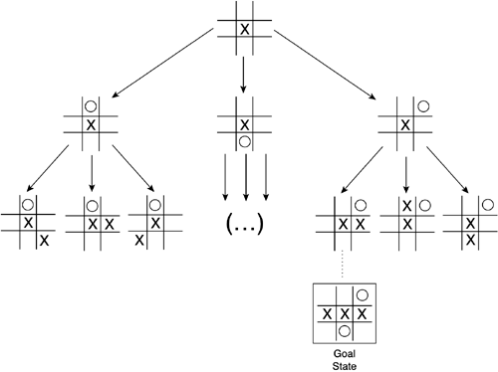
State Space
Model of a system as a set of input, output and state variables

Slide 34
Setting Up a State Space Model
State-space Model is a Model for The Search Problem
usually a set of discrete states X
e.g., in driving, the states in the model could be towns/cities
Start State - a state from X where the search starts
Goal State(s)
a goal is defined as a target state
For now: all goal states have utility 1, and all non-goals have utility 0
there may be many states which satisfy the goal
e.g., drive to a town with an airport
or just one state which satisfies the goal
e.g., drive to Las Vegas
Operators
operators are mappings from X to X
e.g. moves from one city to another that are legal (connected with a road)

Slide 35
A State Space and a Search Tree are different
S
B
D
S
B
C
C
B
State Space
Example of a Search Tree
A State Space represents all states and operators for the problem
A Search Tree is what an algorithm constructs as it solves a search problem:
so we can have different search trees for the same problem
search trees grow in a dynamic fashion until the goal is found

Slide 36
Puzzle-Solving as Search
You have a 3-gallon and a 4-gallon
You have a faucet with an unlimited amount of water
You need to get exactly 2 gallons in 4-gallon jug
State representation: (x, y)
x: Contents of four gallon
y: Contents of three gallon
Start state: (0, 0)
Goal state(s) G = {(2, 0), (2, 1), (2, 2)}
Operators
Fill 3-gallon (0,0)->(0,3), fill 4-gallon (0,0)->(0,4)
Fill 3-gallon from 4-gallon (4,0)->(1,3), fill 4-gallon from 3-gallon (0,3)->(3,0) or (1,3)->(4,0) or (2,3)->(4,0)….
Empty 3-gallon into 4-gallon, empty 4-gallon into 3-gallon
Dump 3-gallon down drain (0,3)->(0,0), dump 4-gallon down drain (4,0)->(0,0)

