Slide 1
CSYE 7245 Big-Data Systems and Intelligence Analytics
Nik Bear Brown
nikbearbrown@gmail.com
Proofs

Slide 2
Topics
Counterexamples
Proof by contradiction
Proof by induction

Slide 3
Counter Examples
You can disprove often with counter examples. For example, if you could show an instance of Gale-Shapley that terminated but had an unstable pairing then you could prove that Gale-Shapley doesn’t always generate stable pairings.

Slide 4
Proof by Contradiction
Let r be a proposition.
A proof of r by contradiction consists of
proving that not(r) implies a contradiction,
thus concluding that not(r) is false,
which implies that r is true.

Slide 5
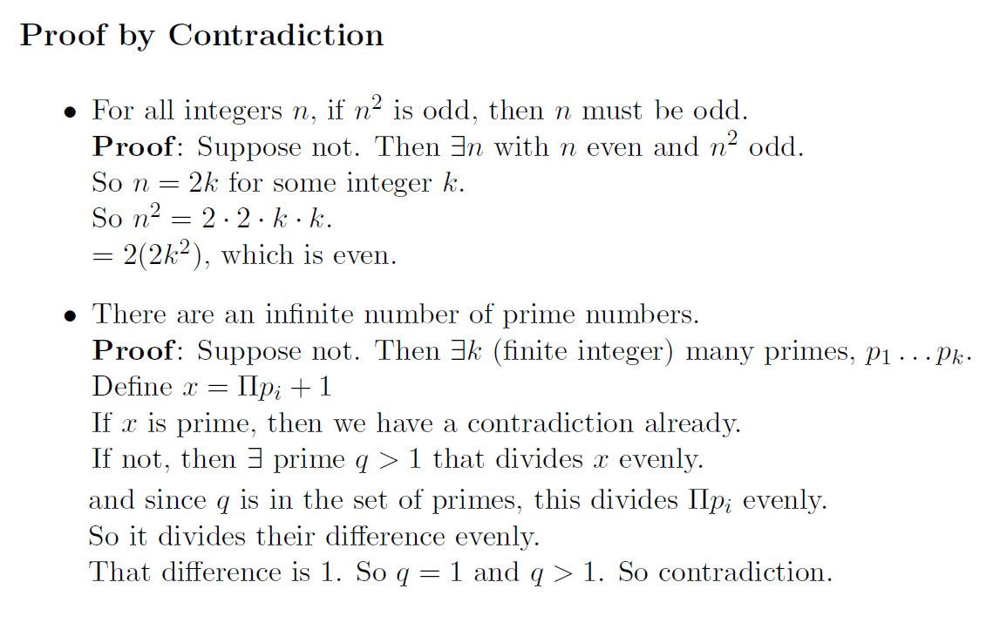

Slide 6
Proof by Contradiction
Prove that the sum of an even integer
and a non-even integer is non-even.
(Note: a non-even integer is an integer
that is not even.)

Slide 7
Proof by Contradiction
We have to prove that for every even integer
a and every non-even integer b, a+b
is non-even.
This is the same as proving that
For all integers a,b, if [a is even and
b is non-even] then [a+b is non-even].

Slide 8
Proof by Contradiction
We prove that by contradiction.
Assume that
[a is even and b is non-even],
and that [a+b is even]. So for some
integers m,n, a=2m and a+b=2n.
Since b=(a+b)-a, b=2n-2m=2(n-m).
We conclude that b is even. This leads
to a contradiction, since we assumed that
b is non-even.

Slide 9
What is induction?
Three parts:
Base case(s): show it is true for one element
Inductive hypothesis: assume it is true for any given element
Show that if it true for the next highest element

Slide 10
Induction
Suppose
S(k) is true for fixed constant k
Often k = 0
S(n) → S(n+1) for all n >= k
Then S(n) is true for all n >= k

Slide 11
Induction
The Principle of Mathematical Induction
Let P_{n} be a statement involving the positive
integer n. If
P₁ is true, and
the truth of P_{k} implies the truth of P_{k+1} , for
every positive integer k,
then P_{n} must be true for all integers n

Slide 12
Principle of Mathematical Induction
Hypothesis: P(n) is true for all integers n≥b
To prove that P(n) is true for all integers n≥b (*), where P(n) is a propositional function, follow the steps:
Basic Step or Base Case: Verify that P(b) is true;
Inductive Hypothesis: assume P(k) is true for some k ≥ b;
Inductive Step: Show that the conditional statement P(k) →P(k+1) is true for all integers k ≥ b. This can be done by showing that under the inductive hypothesis that P(k) is true, P(k+1) must also be true.

Slide 13
Proof by Induction
Claim:S(n) is true for all n >= k
Basis:
Show formula is true when n = k
Inductive hypothesis:
Assume formula is true for an arbitrary n
Step:
Show that formula is then true for n+1

Slide 14
Induction
Show that n < 2^{n} for all positive integers n.
Let P(n) be the proposition “n < 2^{n}.”
1. Show that P(1) is true. (basis step)
P(1) is true, because 1 < 2¹ = 2.

Slide 15
Induction
2. Show that if P(n) is true, then P(n + 1) is true. (inductive step)
Assume that n < 2^{n} is true.
We need to show that P(n + 1) is true, i.e.
n + 1 < 2^{n+1}
We start from n < 2^{n}:
n + 1 < 2^{n} + 1 ≤ 2^{n} + 2^{n} = 2^{n+1}
Therefore, if n < 2^{n} then n + 1 < 2^{n+1}

Slide 16
Induction
Then P(n) must be true for any positive integer. (conclusion)
n < 2^{n} is true for any positive integer.
End of proof.

Slide 17
Induction Example: Gaussian Closed Form
Prove 1 + 2 + 3 + … + n = n(n+1) / 2
Basis:
If n = 0, then 0 = 0(0+1) / 2
Inductive hypothesis:
Assume 1 + 2 + 3 + … + n = n(n+1) / 2
Step (show true for n+1):
1 + 2 + … + n + n+1 = (1 + 2 + …+ n) + (n+1)
= n(n+1)/2 + n+1 = [n(n+1) + 2(n+1)]/2
= (n+1)(n+2)/2 = (n+1)(n+1 + 1) / 2

