Slide 1



E-Waste Image Classification Using EfficientNetV2B0 (Transfer Learning)
Ninad Thorat

Slide 2

Learning Objectives
Understand the fundamentals of image classification using CNNs.
Apply transfer learning using pre-trained models like EfficientNetV2B0.
Load and preprocess image datasets using TensorFlow’s image_dataset_from_directory().
Train and evaluate deep learning models using Keras APIs.
Analyze model performance using confusion matrix and classification reports.
Create an interactive UI using Gradio for live predictions.
GOAL
Source :
www.freepik.com/

Slide 3
Tools and Technology used
TensorFlow & Keras – For building, training, and evaluating deep learning models.
EfficientNetV2B0 – Pre-trained CNN model used for transfer learning.
Matplotlib & Seaborn – For visualizing model performance and confusion matrix.
TensorFlow Datasets API – To load and preprocess image data from directories.
Gradio – To create a real-time webcam-based UI for model inference.
NumPy & PIL – For image manipulation and array processing.
Scikit-learn (sklearn) – For generating classification reports and confusion matrices.
Jupyter Notebook – For interactive coding, experimentation, and visualization.

Slide 4
Methodology
The project starts by organizing image data into training and testing folders. Using TensorFlow's utility functions, the images are loaded, resized, and batched. A pre-trained EfficientNetV2B0 model is used for transfer learning, with a custom classification layer added on top. The model is compiled, trained, and evaluated using metrics like accuracy and confusion matrix to validate performance.
For real-time deployment, the trained model is integrated with Gradio, allowing webcam input for live image classification. Captured images are preprocessed and passed to the model, which instantly displays predictions. This setup demonstrates the practical use of deep learning in interactive applications.

Slide 5
Problem Statement:
E-waste (electronic waste) is rapidly becoming a serious environmental and health issue around the world. Proper sorting and categorization of e-waste is essential for efficient recycling and disposal, but manual classification is error-prone and labor-intensive.
This project aims to build an automated e-waste classification system using artificial intelligence and machine learning. By training a deep learning model on images of different types of e-waste, we can identify and categorize them accurately

Slide 6
Solution:
Used a pre-trained EfficientNetV2B0 model with transfer learning for image classification.
Loaded and preprocessed image data using TensorFlow’s dataset utilities.
Trained the model and evaluated performance using accuracy and confusion matrix.
Integrated the trained model with Gradio to enable real-time webcam-based predictions.
Captured live images via webcam, resized and normalized them before inference.
Displayed instant classification results in a browser-based interactive.

Slide 7
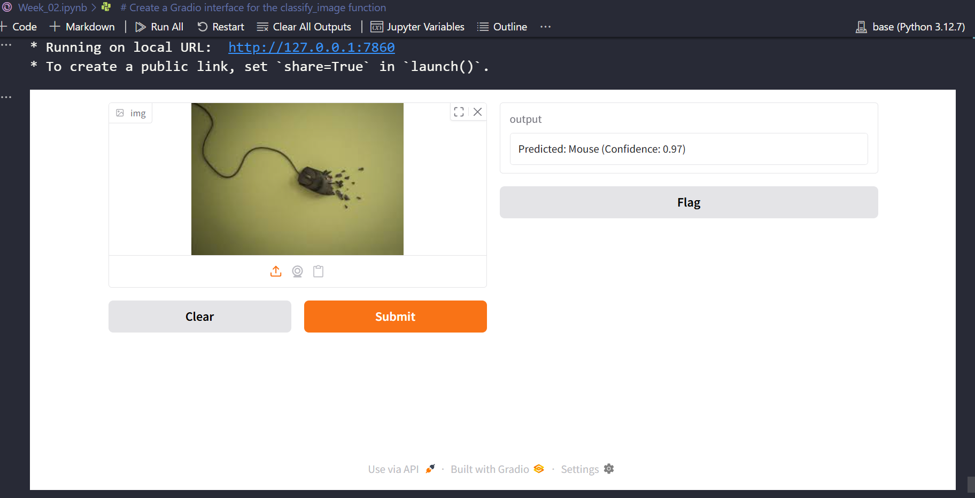
Screenshot of Output:

Slide 8
Conclusion:
Successfully implemented an end-to-end image classification system using deep learning.
Demonstrated the power of transfer learning with EfficientNet for high accuracy with limited data.
Showcased a real-time, user-friendly deployment using Gradio and webcam integration.
Proved the model's ability to classify live images accurately in a practical environment.
This project bridges the gap between theoretical machine learning and real-world application..\
Github_link.

