Slide 2
Notes:
Put all logger temp data with different shapes same color

Slide 3
Notes:
Percent change in bouyant weight. Does skeletal mass and standardizing lose resolution
Final-Day 1/ Day 1 * 100

Slide 4
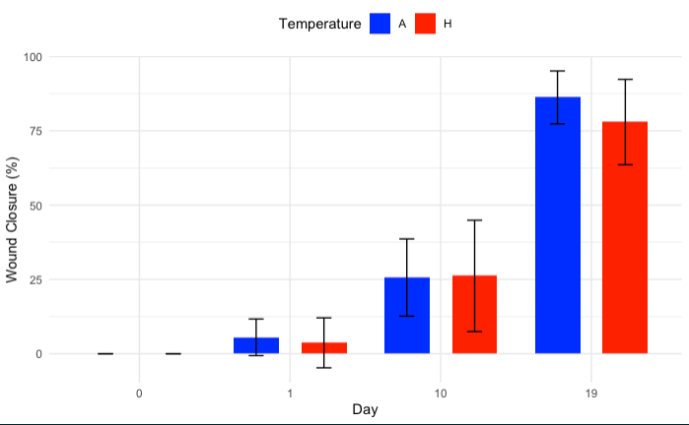
Fragment wound closure

Slide 5
Survival analysis based on signs of healing
Notes:
Kaplin meyer on abrasion with temperature
Rate of survival by calculating proportions is different?
Covariate of surface area in the model
Wound*temp*surface area

Slide 7
Is there a trade off between growth and regeneration? → no☺

Slide 8
Is there a trade off between growth and regeneration? → no☺
Notes:
Day to signs of regeneration instead on x.
Try doing one of the signs of healing metrics instead of all three

Slide 9
Does wound type exacerbate a tradeoff? → no☺
But fragmented corals heal faster according to survival analysis.

Slide 10
Does elevated temperature exacerbate a tradeoff? → no☺
Notes:
Relationship between size and regeneration
Time to regeneration and size
Size of wound
Plot of growth and wound diameter/SA (size)
At ten days mean growth rate of individuals that show 1, 2, and 3 signs of healing
Use boxplots for data as is with mean growth

Slide 12
No Injury
Fragmentation
Abrasion
Gross Photosynthesis
Net Photosynthesis
Respiration
Notes:
skeletal mass - bouyant weight to get tissue biomass
Log transform unocrected resp rate and size and fit relationship to that and that’s how you scale. Linearizing relationship between mass and resp rate. Slope of the line is the exponent in metabolic theory
Change timepoint to continuous
Quantifying tissue mass to mass correct metabolic rates
Growth x net photosynthesis

Slide 13
Notes:
#ancova, continuous variables anova

