Slide 1



GROUP ACTIVITY #2:
CREATE A PROGRAM FOR THE GIVEN OUTPUT
Group 5

Slide 2
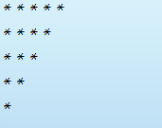

ITEM 1:

Slide 3
Code:
1 #include <iostream>
2 //*****
3 //****
4 //***
5 //**
6 //*
7 int main() {
8 int i;
9
10 for(i = 1; i <= 5; i++)
11
12 std::cout << "*";
13 std::cout << std::endl;
14
15 for(i = 1; i <= 4; i++)
16
17 std::cout << "*";
18 std::cout << std::endl;
19
20 for(i = 1; i <= 3; i++)
21
22 std::cout << "*";
23 std::cout << std::endl;
24
26 for(i = 1; i <= 2; i++)
27
28 std::cout << "*";
29 std::cout << std::endl;
30
31 for(i = 1; i <= 1; i++)
32
33 std::cout << "*";
34 std::cout << std::endl;
35 return 0;
36 }

Slide 4
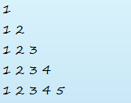
ITEM 2:

Slide 5
1
2
3
4
5
6
7
8
9
10
11
12
13
14
15
16
17
18
19
20
21
22
23
24
25
26
27
28
29
30
31
32
33
34
35
36
for(i = 1; i <= 3; i++) std::cout << i << " "; std::cout << std::endl;
for(i = 1; i <= 4; i++) std::cout << i << " "; std::cout << std::endl;
for(i = 1; i <= 5; i++) std::cout << i << " "; std::cout << std::endl; return 0;
}
Code:
#include <iostream>
//1
//1 2
//1 2 3
//1 2 3 4
//1 2 3 4 5
{ int main()
int i=1;
while (i <= 1)
{
std::cout << i << " ";
++i;
}
std::cout << std::endl;
for(i = 1; i <= 2; i++)
std::cout << i << " ";
std::cout << std::endl;

Slide 6
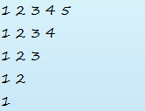
ITEM 3:

Slide 7
Code:
19
20
21
22
23
24
25
26
27
28
29
30
31
32
33
34
35
36
for(i = 1; i <= 3; i++)
std::cout << i << " ";
std::cout << std::endl;
for(i = 1; i <= 2; i++)
std::cout << i << " ";
std::cout << std::endl;
for(i = 1; i <= 1; i++)
std::cout << i << " ";
std::cout << std::endl;
return 0;
}
1
2
3
4
5
6
7
8
9
10
11
12
13
14
15
16
17
18
#include <iostream>
//1 2 3 4 5
//1 2 3 4
//1 2 3
//1 2
//1
int main() {
int i=1;
while (i <= 5){
std::cout << i << " ";
++i;
}
std::cout <<std::endl;
for(i = 1; i <= 4; i++)
std::cout << i << " ";
std::cout << std::endl;

Slide 8
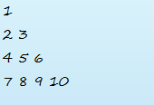
ITEM 4:

Slide 9
Code:
1 //1
2 //2 3
3 //4 5 6
4 //7 8 9 10
5 #include <iostream>
6
7 using namespace std;
8
9 int main() {
10 int i=1;
11
12
13 while (i <= 1){
14 cout << i << " ";
15 ++i;
16 }
17 cout << endl;
18
19 while (i <= 3){
20 cout << i << " ";
21 ++i;
22 }
23 cout << endl;
24
25
26 while (i <= 6){
27 cout << i << " ";
28 ++i;
29 }
30 cout << endl;
31
32 while (i <= 10){
33 cout << i << " ";
34 ++i;
35 }
36 cout << endl;
37
38 return 0;
39 }

Slide 10


Slide 11

Create a program to find a square root of a input number

Slide 12
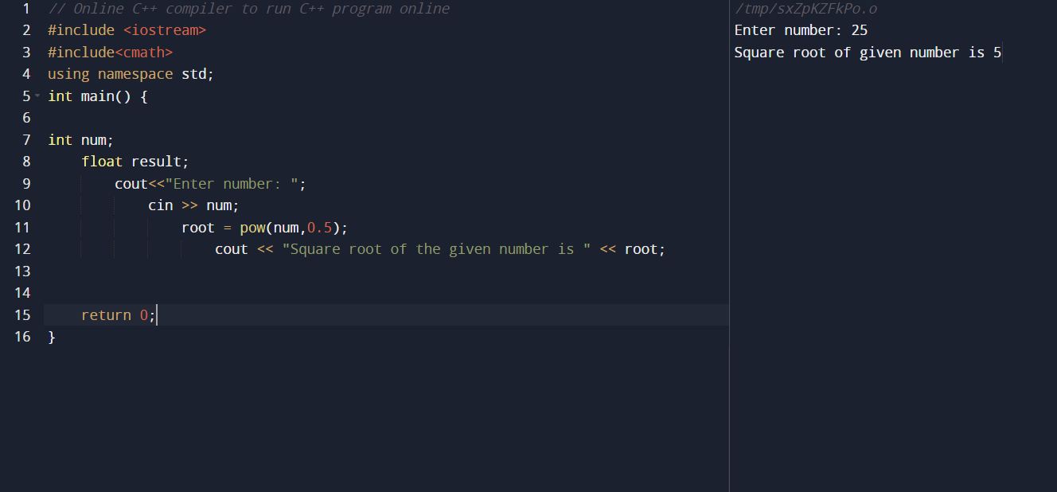
Code:

Slide 13
2. Create a program to
compute a quaotient
and remainder

Slide 14
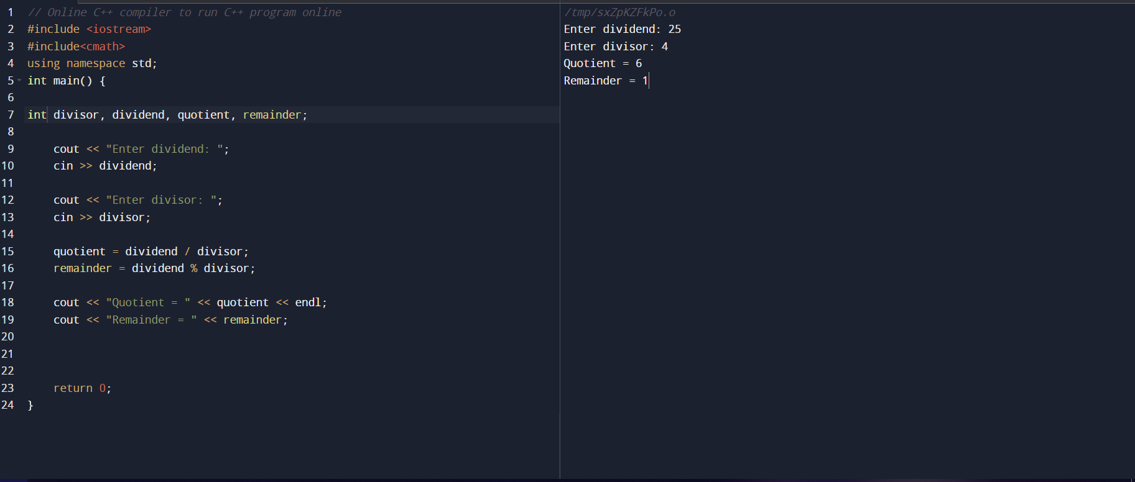
Code:

Slide 15

Thank you!

