Slide 1
1.HEDA_Tidy
2.ReversalCount
3.clean_position
4. clean_Spt
5. clean_conectD
6.HPK_metrics
7.HPK_plot
HEDA Package
Notes:
Figure 3. Schematic diagram showing the sequential steps of the HEDA.

Slide 2
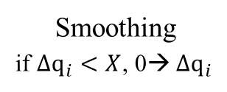
Function 1:HEDA_Tidy
Input 1_sm.csv
Data Preparation
Input 2_sm.csv
Input 1.csv
Split by seasons
Input n_sm.csv
Input 2.csv
Interpolation
Input 1_wt.csv
Input n.csv
Input 2_wt.csv
Smoothing
if $∆q_{i}<X$, 0→ $∆q_{i}$
Input n_wt.csv
Inputs processed in loop. Apply function doesn’t work well, still slow in this case.

Slide 3
location_id | datetime | parameter_value
text | 2020-12-02 1:00:00 | (number)
Input 1.csv
One sample of the data frame of input data.
3 columns.
location id stores the gauge id information, 1 gauge 1 ID
datetime is time format. Year-month-day Hour:00:00
Parameter_value is discharge. Float format

Slide 4
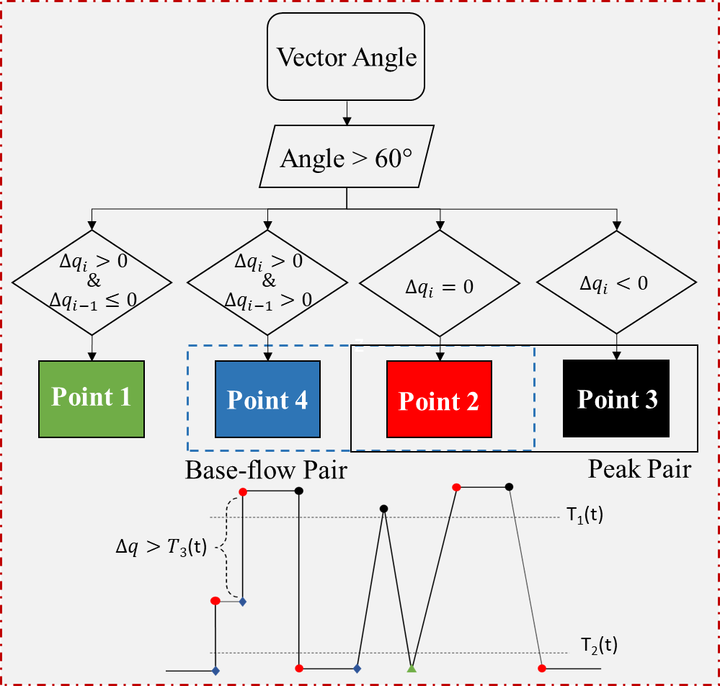
2.ReversalCount
Input 1_sm.csv
Input 2_sm.csv
Input n_sm.csv

Slide 5
3.clean_position
4. clean_Spt
5. clean_conectD
Input 1_ct.csv
Clean Noise
Input 2_ct.csv
Position
(Dynamic T1 & T2)
Input n_ct.csv
Repetition
(Dynamic T3)
location_id | datetime | parameter_value
text | 2020-12-02 1:00:00 | (number)
Difference
(Dynamic T3)
It has similar structure as input but with more columns

Slide 6
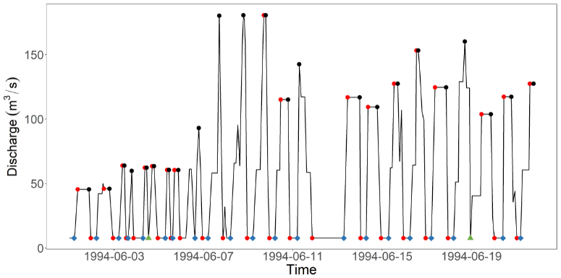
7.HPK_plot
Input 1_ct.csv
Visualization of reversal count. A sample plot

Slide 7
6.HPK_metrics
Input 1_metric.csv
Input 2_metric.csv
Input 1_ct.csv
Input 2_ct.csv
Input n_metric.csv
Input n_ct.csv
location_id | metric1 | metric2 | …
text
For each file, output file has 16 columns and one row.

