Slide 1
Energy Efficient IoT-Based Smart Home
Nina Nguyen

Slide 2
Summary
What is a smart home?
Possibility of IoT devices and sensors in a home being connected to control heating/cooling, lighting and any utilities.
Tricky thing is to get all the different IoT to share information with each other to create a chain of events.
Model of a kitchen was analyzed
Future: Extended to other parts of a home and commercial buildings
Notes:
What is a smart home? Smart home is a home that is equipped with lighting, heating, electronics devices that can be controlled remotely by phone or computer
Article covered some important features such as communication between devices and coupling/RF interferences between antennas integrated in the devices.
IoT devices connected to the Home Control Unit

Slide 3
Methodology
Different Multiphysics simulations were done using a model of a kitchen – electromagnetic, thermal, structural
Approach
ANSYS products
ANSYS HFSS FEM Solver – Designed and simulated antenna signals
ANSYS EMIT – Built-in library and behavioral models for the sensors (900 MHz, 2.45 GHz, 5.8 GHz)
ANSYS Icepak – Thermal analysis on smart LED
ANSYS Mechanical – Additional thermal stress and deformation analysis
ANSYS FLUENT – Built a computational fluid dynamics model, HVAC
Notes:
* Approach – Occupant approaches the kitchen. Motion sensor detects this and relays the information to the HOME ENERGY CONTROL unit, which then turns on the LED light bulbs. The motion sensor also has information on the temperature and the HOME ENERGY CONTROL unit can remotely turn on or off the HVAC system.

Slide 4
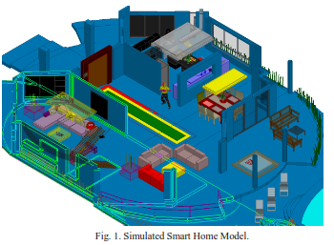
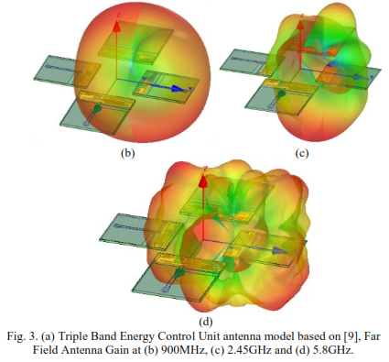
ANSYS

Slide 5
Comparison
Strengths
Weaknesses
ANSYS software
Authors considered different failure points
Applied Multiphysics analysis approach
Did not have a practical experiment
Can be more relatable if there were some monetary calculations as the title suggests
Notes:
A lot of different ANSYS software were used to build models, simulations, or perform analysis. They look impressive
Authors looked into different parts of the Smart-Home proposal to identify potential weak points. Such as, the antenna signals between the IoT devices, thermal distress on the antennas, inferences from other RF sources
They discussed scenarios where the antennas might be exposed to extremities such as heat.

Slide 6
Conclusion
Connected IoT devices to design a smart home
Electromagnetic simulation was coupled to thermal and structural simulations
Overall, need a practical approach with monetary assessment
Notes:
* Electromagnetic simulation was coupled to thermal and structural simulations to demonstrate the design and tuning of the smart home.

Slide 7
Questions?

