Slide 1
პრეზენტაცია
საბა აბუთიძე

Slide 2
AI Overview
AI, or artificial intelligence, is the simulation of human intelligence in machines that are programmed to think and learn like humans. It involves systems that can perform tasks like problem-solving, decision-making, understanding language, and recognizing patterns.
AI systems learn from data to perform tasks, adapt to new information, and improve their performance over time without explicit programming for every scenario.

Slide 3
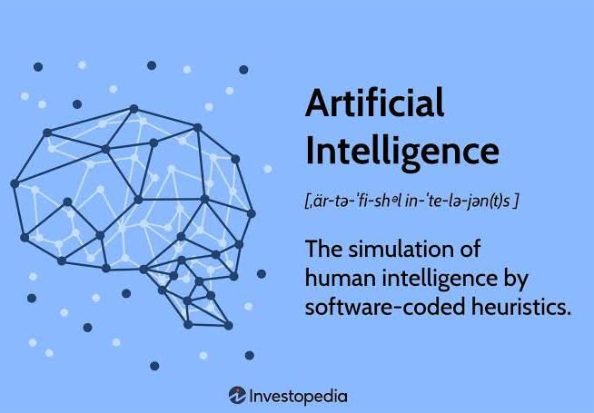
Key aspects of AI
Learning: AI systems can learn from data, a process often called machine learning, allowing them to improve their performance without being explicitly programmed for each task.
Reasoning and problem-solving: AI can analyze complex problems and find solutions, which can include tasks like optimizing energy solutions or predicting financial outlooks.

Slide 4
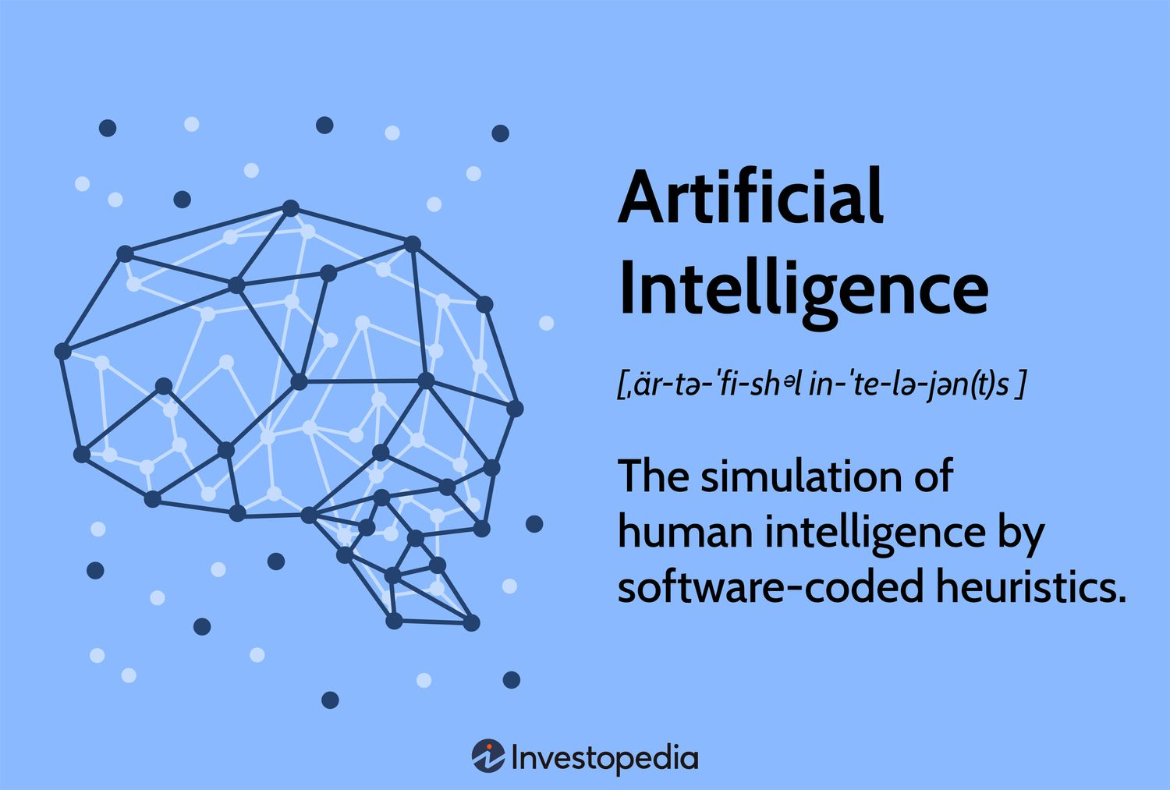
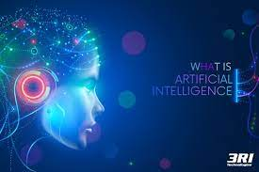
Key aspects of AI
Perception
Decision-making

Slide 5
AI Table
Type | Description | Examples
Narrow AI | Designed for a specific task | Siri, ChatGPT, Google Translate
General AI | Can perform any intellectual task like a human | Still theoretical
Superintelligent AI | Exceeds human intelligence | Only hypothetical

Slide 6
AI SmartArt
Data Collecting
Data Processing
Machine Learning
Decision Making
Continuous Improvement

Slide 7
AI Chart

Slide 8
სქემა
Shape
Deep Learning (DL)
Artificial Intelligence (AI)
Machine Learning (ML)
Natural Language Processing (NLP)
Computer Vision
Robotics

Slide 9

სქემა
13
123
123
.
1231
1231
1231

