Slide 1
Classifying by Rhythm - 10/13
Nina Wang

Slide 2
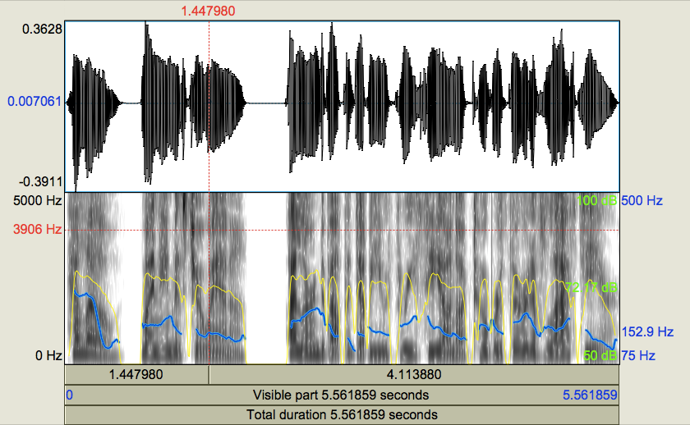
Data Analysis
Polly -> Praat pipeline
Spectrum, pitch, intensity, pulses
Scripting in Python?

Slide 3
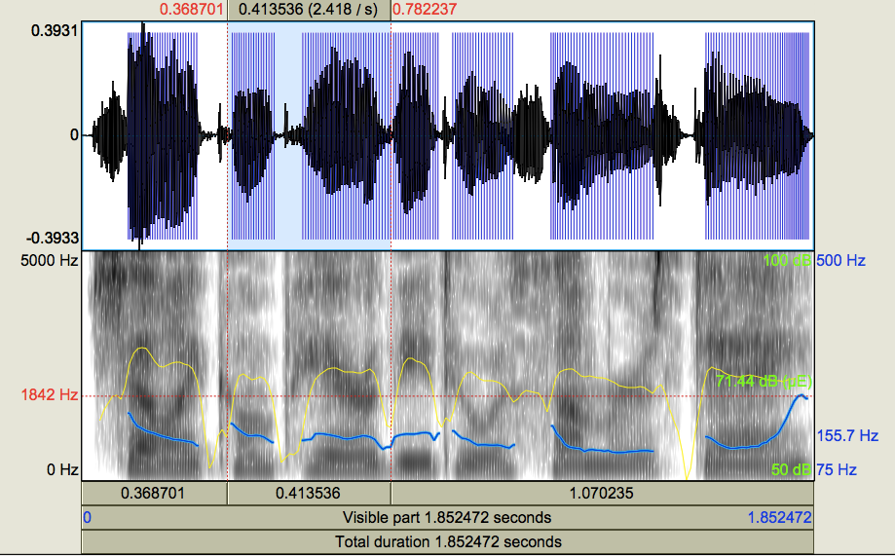
shall I / com PARE / thee TO/a SUM mer’s DAY?

Slide 4
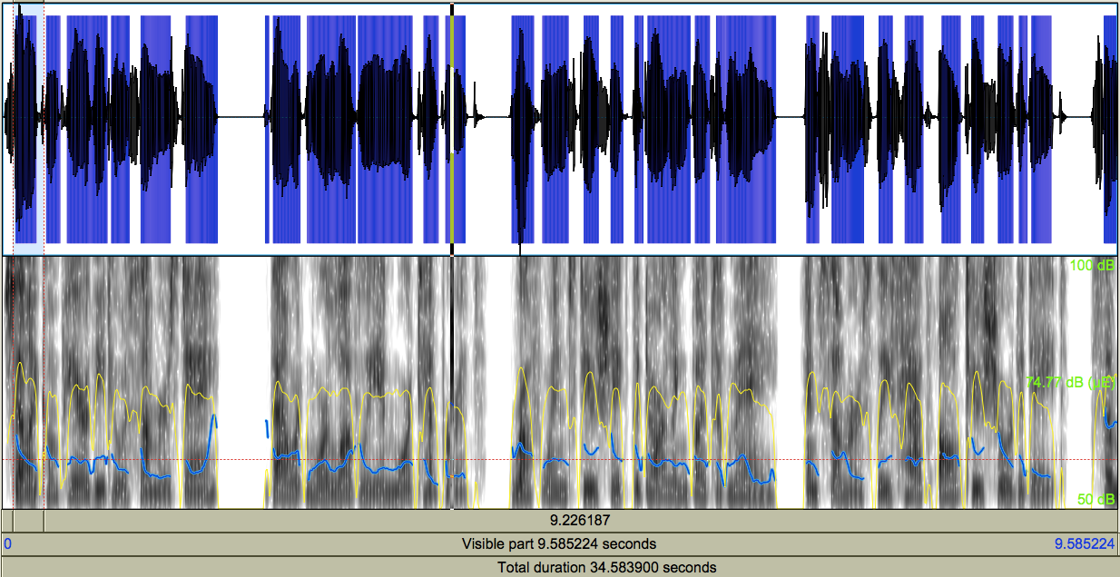

Slide 5
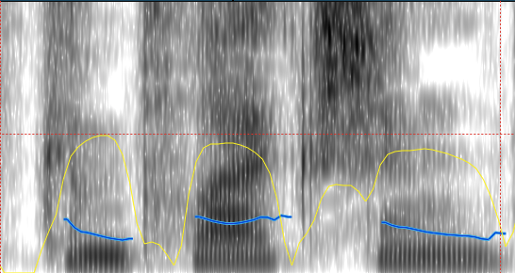
Analyzing words & sentences
To determine if a syllable is stressed, look at intensity and pitch
Montreal Forced Aligner
com PLEX ion

Slide 6
Next Steps
Figure out dataset
Continue working with Shakespeare works to finalize an algorithm for measuring rhythm
Making sure not to force everything to match this definition

