Slide 1
CLASSIFYING TEXT BY RHYTHM AND SOUND
Nina Wang

Slide 2

MOTIVATION
Some literary works have a defined rhythmic pattern:
Shakespeare’s iambic pentameter
Homer’s use of hexameter
Do other types of writing also have rhythm and melody?
Poetry
News articles
Academic writing

Slide 3
MELODY IN WRITING
“This sentence has five words. Here are five more words. Five-word sentences are fine. But several together become monotonous…
Now listen. I vary the sentence length, and I create music. Music.The writing sings. It has a pleasant rhythm, a lilt, a harmony. I use short sentences. And I use sentences of medium length. And sometimes when I am certain the reader is rested, I will engage him with a sentence of considerable length, a sentence that burns with energy and builds with all the impetus of a crescendo, the roll of the drums, the crash of the cymbals—sounds that say listen to this, it is important.
… Don’t just write words.Write Music.”
-Gary Provost

Slide 4
RESEARCH QUESTIONS
Do different genres of writing “sound” different? Can we quantify that?
Can we use the “sound” of a text to identify its genre?
Notes:
- Creative vs Academic writing
Intuitively, creative works are purposefully more rhythmic and lyrical, while academic papers may pay no attention to the melody of their writing
PREVIOUS WORK
Authorship identification:
Frequencies of key words
Word complexity
(structural) Length of words, sentences, paragraphs, how many there are

Slide 5
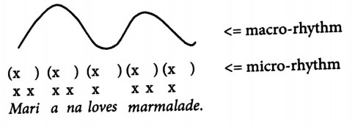
QUANTIFYING “SOUND”
Micro-rhythm: Regular alternation of strong & weak beats
Split sentences by stresses →evenly spaced feet
Macro-rhythm: Regular alternation of high & low tones (pitch)
Proposed by Sun-Ah Jun
Split by H/L peaks →evenly-spaced hills
Melody: Variation in the structure
Notes:
MICRO:
- Alignment of stressed syllables in time – dictionary information, mere pronunciation, fixed, static
Traditional measure of rhythm
process
MACRO:
Intonation depends on context
Repetition of H/L tonal sequences
ToBI (for tones: H,L,H-L,…) annotations – simplifying, pitch accent

Slide 6
PROCESS
Transform texts into audio streams using Amazon Polly, a text-to-speech conversion software
Dataset: novels, poetry, and academic papers
Process audio files with Praat, to view information about features like pitch and intensity
Analyze the three “sound” metrics in the audio files.
Use established machine learning techniques (SVM) to classify writing based on its rhythmic/melodic features.
Notes:
Gutenberg
CMU Pronouncing Dictionary
AuToBI
evaluation

Slide 7
RESULTS
N/A
Notes:
Preliminary results
Perception of speech – diana deutch
- text-to-speech illusion (speech to song, text to song)
-it has a melody, wired to hear melody in speech

Slide 8
CONCLUSIONS
N/A

