Slide 1
RHYTHM AND Melody in written language
NINA WANG

Slide 2

MOTIVATION
Some texts have a defined rhythmic pattern:
Shakespeare’s iambic pentameter
Homer’s dactylic hexameter
Do other genres also have rhythm and melody?
Novels
News articles
Academic writing

Slide 3
A LITTLE BIT OF INTUITION
"In this paper, the problem of pedestrian egress under different geometries is studied by means of two numerical models.”
“There was a Young Lady whose chin
Resembled the point of a pin...”
"I took a deep breath and listened to the old brag of my heart; I am, I am, I am.”

Slide 4
“This sentence has five words. Here are five more words. Five-word sentences are fine. But several together become monotonous…
Now listen. I vary the sentence length, and I create music. Music. The writing sings. It has a pleasant rhythm, a lilt, a harmony. I use short sentences. And I use sentences of medium length. And sometimes when I am certain the reader is rested, I will engage him with a sentence of considerable length, a sentence that burns with energy and builds with all the impetus of a crescendo, the roll of the drums, the crash of the cymbals—sounds that say listen to this, it is important.
… Don’t just write words. Write Music.”
-Gary Provost

Slide 5
questions
Do different genres of writing “sound” different? Can we quantify that?
Creative vs. Academic writing
Can we use the “sound” of a text to identify its genre?

Slide 6
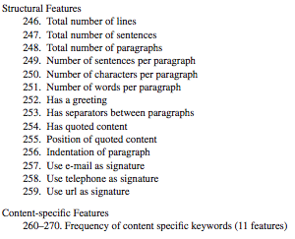
Previous work
A Framework for Authorship Identification of Online Messages: Writing-Style Features and Classification Techniques – Zheng et al.
Measures four types of features:
Lexical
Syntactic
Structural
Content-Specific
Total of 270 features!
Can we simplify this?

Slide 7
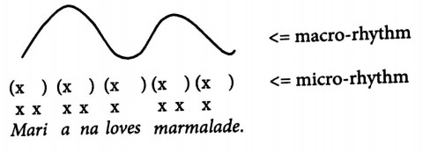
Quantifying ”sound”
Micro-rhythm: Regular alternation of strong & weak beats
Split sentences by stresses →evenly spaced feet
Macro-rhythm: Regular alternation of high & low tones (pitch)
Proposed by Sun-Ah Jun
Split by H/L tonal sequences →evenly-spaced hills
Melody: Variation throughout the text

Slide 8
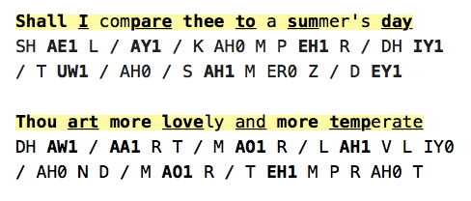

Micro-rhythm: process
Goal: Split text by syllable prominence (pitch, duration, intensity)
Step 1: Use CMU Pronunciation Dictionary for baseline
Lots of false positives! – CMU based on word pronounced in isolation
In reality, intonation based on context.

Slide 9
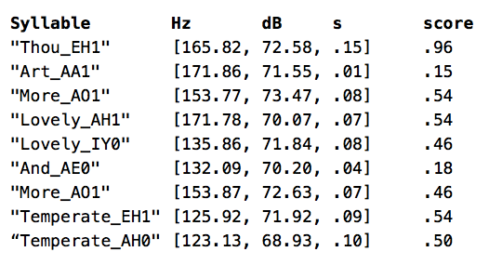
Micro-rhythm: process
Goal: Split text by syllable prominence (pitch, duration, intensity)
Step 2: Look at audio waveform to refine
Amazon Text-To-Speech
Gentle Aligner
Praat

Slide 10
Macro-rhythm: process
Goal: Split text by pitch contour patterns (high/low slopes)
Definition: ”perceived rhythm based on regular pitch movement”
Text is more macro-rhythmic if:
It has more sequences of rise-fall hills
HHHH < HLHLL
The rise-fall hills are shaped similarly to each other
The rise-fall hills occur at regular time intervals

Slide 11
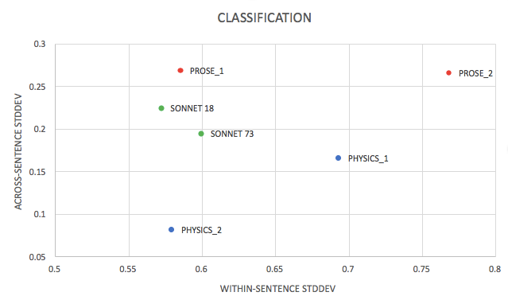
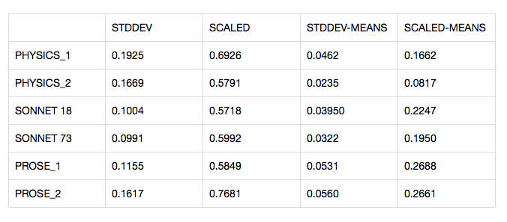
RESULTS
Per-sentence rhythmicity vs across-sentence rhythmicity

Slide 12
Work remaining
Complete analysis of macro-rhythm
Run algorithms on bigger datasets
Set up classification mechanism - SVM

Slide 13
acknowledgements
My advisor, Professor Christiane Fellbaum, for guidance throughout the semester
Professor Byron Ahn, for insights into intonation theory

