Slide 1

Beijing House Pricing Analysis
Group 2: Yilin Luo, Jiawen Xie, Boyue Huang, Yi Yang
Instructor: Daya Rudhramoorthi
Class: ALY6110 Big Data and Data Management
Date: 02/27/2021

Slide 2
Introduction
EDA
CONTENT
Analysis
Conclusion

Slide 3

01
Introduction

Slide 4


Background
Zhang (2019) stated that Beijing has the ninth highest house price in the world.
The growth of price can be huge from 17,854 RMB in 2013 to 27,497 RMB in 2016.

Slide 5




Business Questions
What factors are important in Beijing house price?
What types of houses are favored in market and When is the best time to sell?
Which model is the best fit to represent the market?

Slide 6


Tools
Rstudio:
Mainly focusing on
EDA & Modeling
Tableau:
Exploring
pattern of the housing market

Slide 7

02
Exploratory Data Analysis

Slide 8
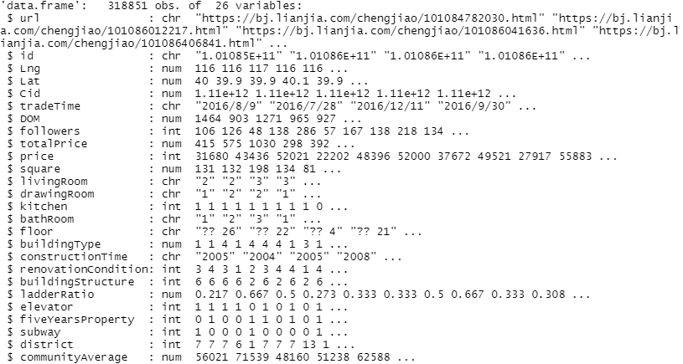
Data Collection
Obtained from https://bj.lianjia.com/ershoufang/
Total 318,851 observations
8 Character attributes
9 Numeric and 9 Integer attributes
Outcome variable: totalPrice

Slide 9
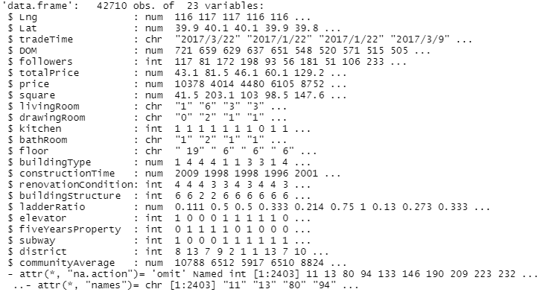
Data Cleansing
drop url, id, cid columns
49.54% of DOM data is missing-replace with mean
select only 2017 data
changed currency unit of CNY to USD
outlier detection
dummy variable creation

Slide 10
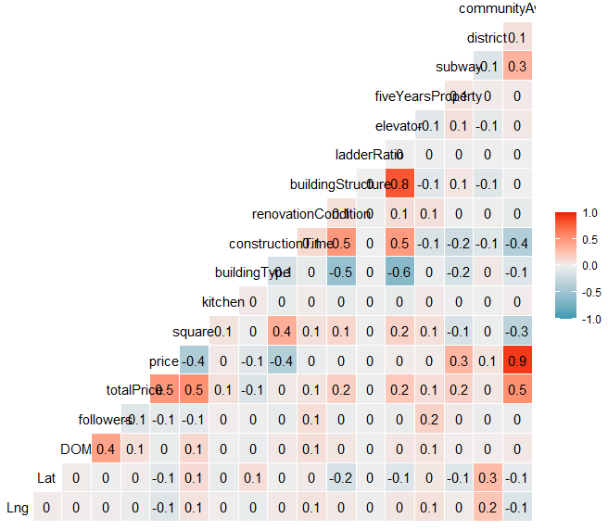
Correlation Matrix
Top 3 attributes that are highly related to Total Price
Top 3
P
Price
S
C
Community Average
Square

Slide 11
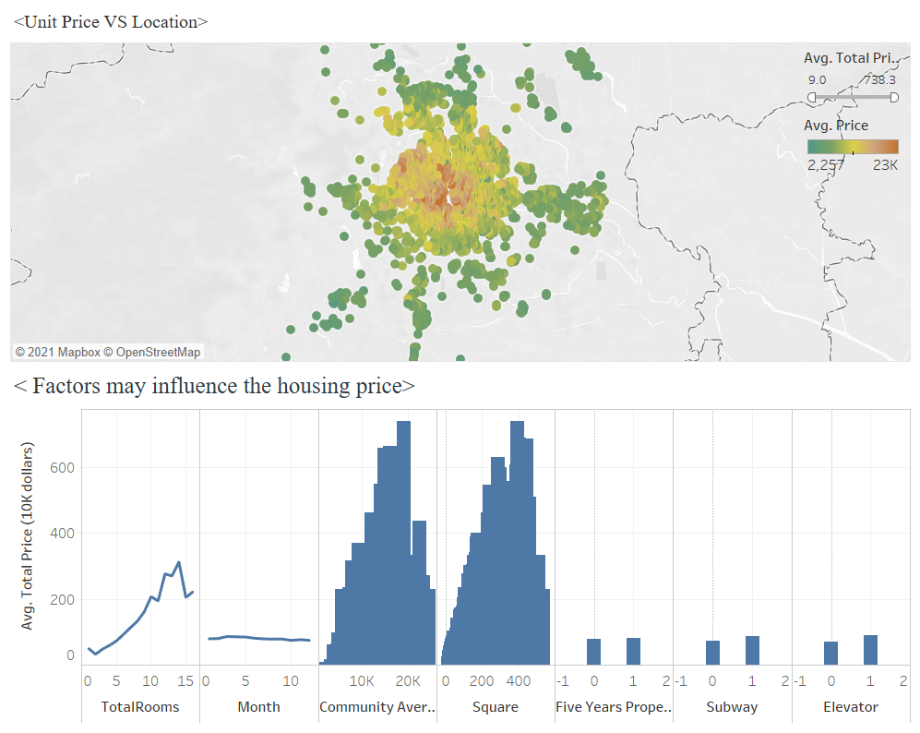
As the location becomes closer to the center part of the city, the unit price climbs.
The average total prices will increases as the total number of rooms increases.
Dashboard with Visualizations
Squares
Location
F
A
C
T
O
R
S
House Prices in Beijing
Community Averages
Room
Types

Slide 12
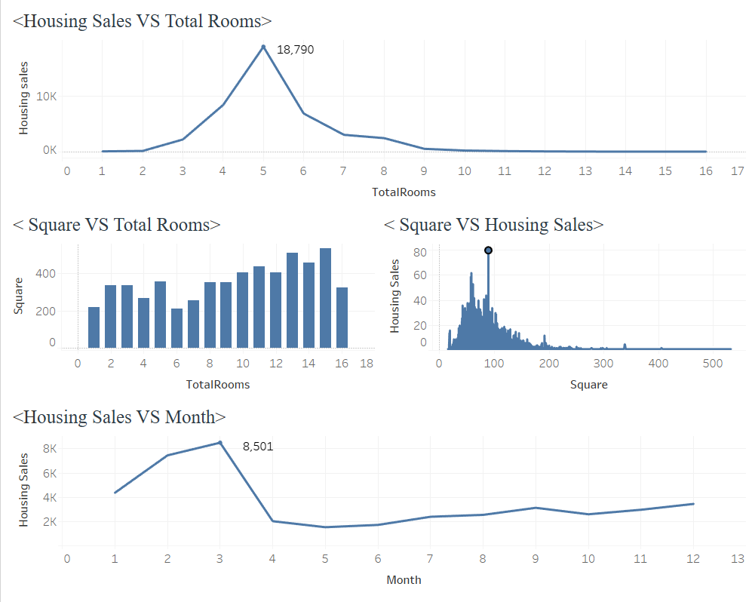
Dashboard with Visualizations
Five Room Houses have the most transaction sales.
The highest count of trades happened in March.
Squares of houses does have a slight influence on housing sales, and 89 m² can be favored by most house buyers in Beijing.

Slide 13

03
Analysis

Slide 14
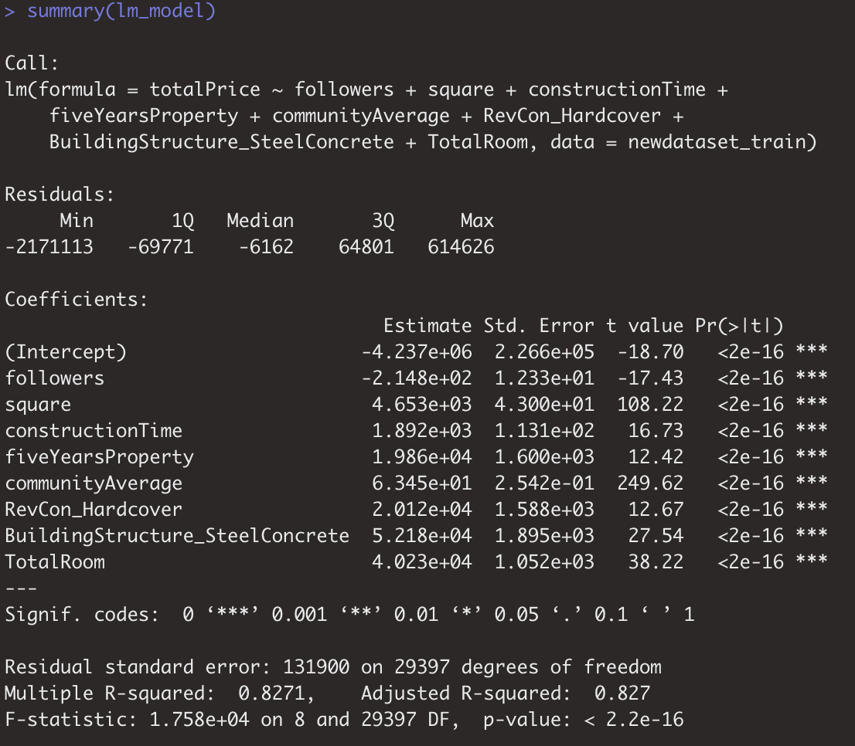
Model selection -- Linear Regression Modeling
total price is continuous
simple and fast
identify important variables
MSE

Slide 15
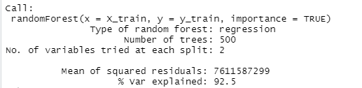
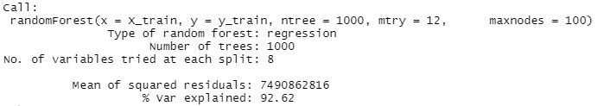
Model selection -- Random Forest Modeling
Default parameters:
tree based model
high accuracy
time-consuming
MAE | MSE | R2
63251.51 | 7394079110.68 | 0.9325
After tuning:
MAE | MSE | R2
61656.15 | 7365654519.98 | 0.9268
The model’s accuracy did not improve a lot after tuning.

Slide 16
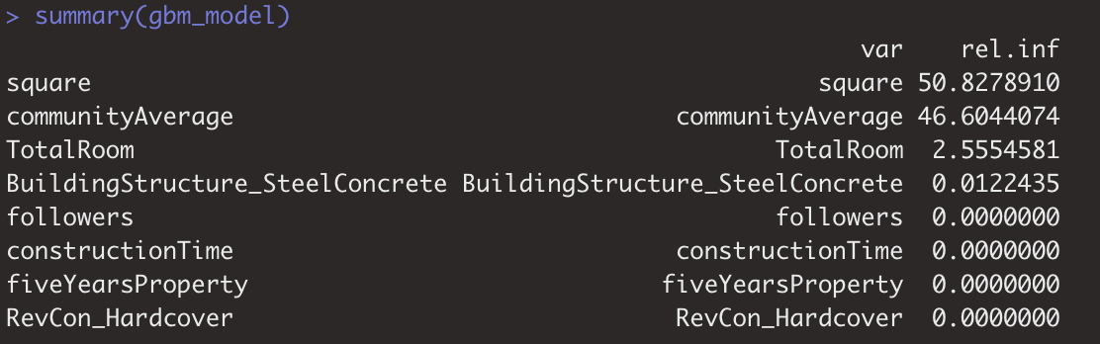

Model selection -- Gradient Boosting Modeling
tree based model
high accuracy
time-consuming
effected on white noise
MSE
square and communityAverage are the most important variables

Slide 17
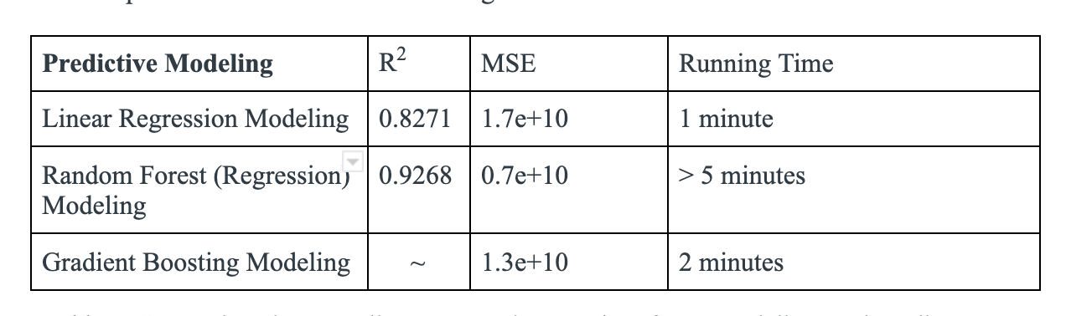



Modeling Comparison
输入标题
标题文本
This is a sample letter that has been placed to demonstrate the typing format on the letterhead design. the typing formproperly.
输入标题

Slide 18

0
4
Conclusion

Slide 19
Conclusion
Variable Selection
Model Selection
Most relevant houses’ attributes
Give companies the view on the factors of houses needed to be aware to get quick sales.
Random Forest Model
Has the advantage of high R squared value and low MSE value.
Accuracy is more important in the housing market.

Slide 20



Recommendations
Important Factors:
Location, Room Types, Squares, and Community Average
Ideal House Type: Five Rooms and 89 m²
Highest Demand Month: March

Slide 21
Thanks for watching!

