Slide 1


Landscape Connectivity Modelling with ConScape
Bram Van Moorter Raf Schouten

Slide 2
Motivation & Origin

Slide 3
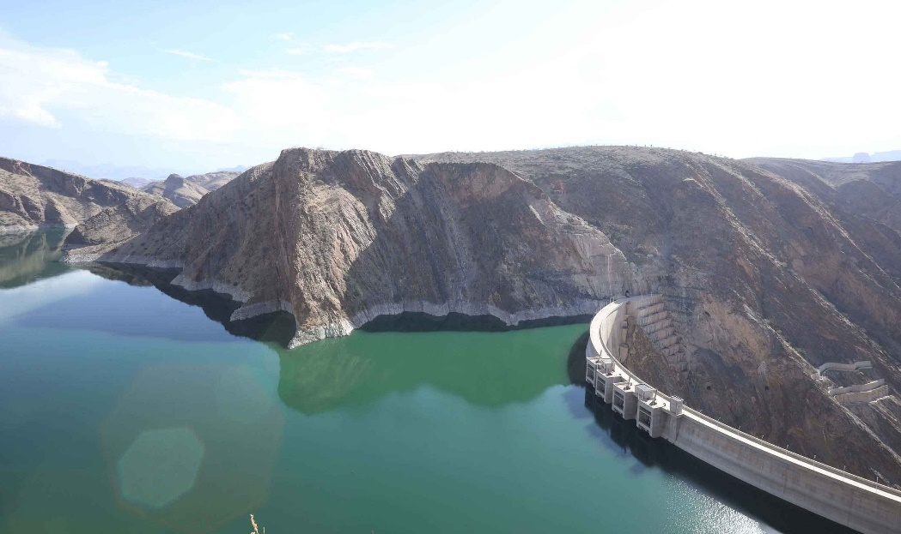
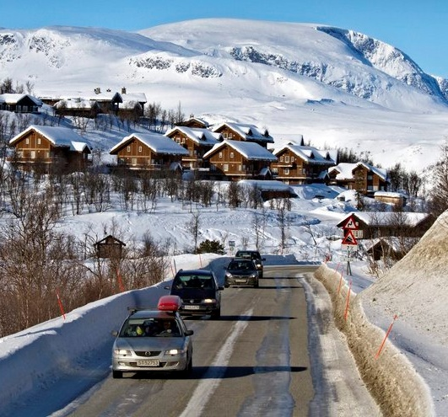
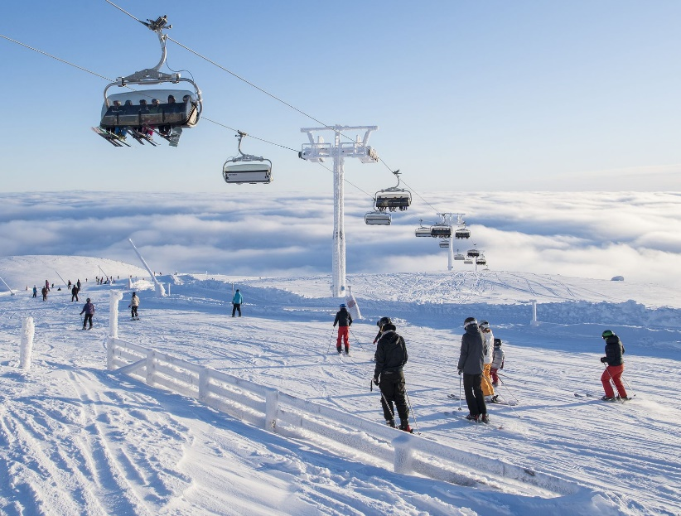
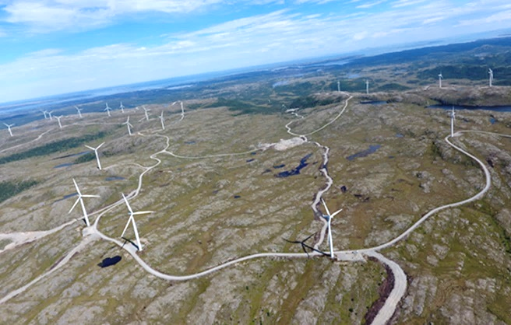
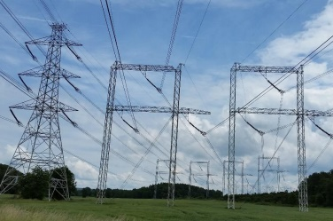


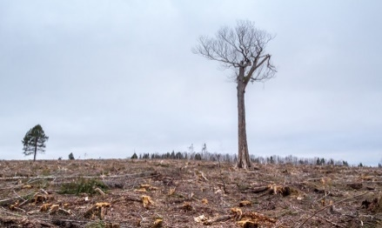
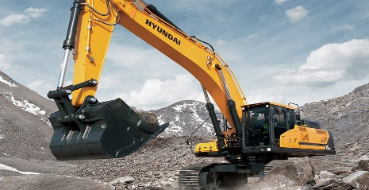
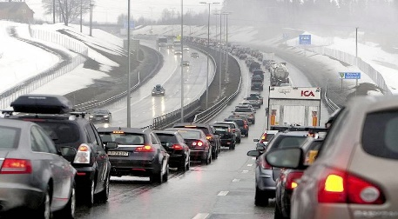
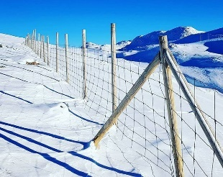
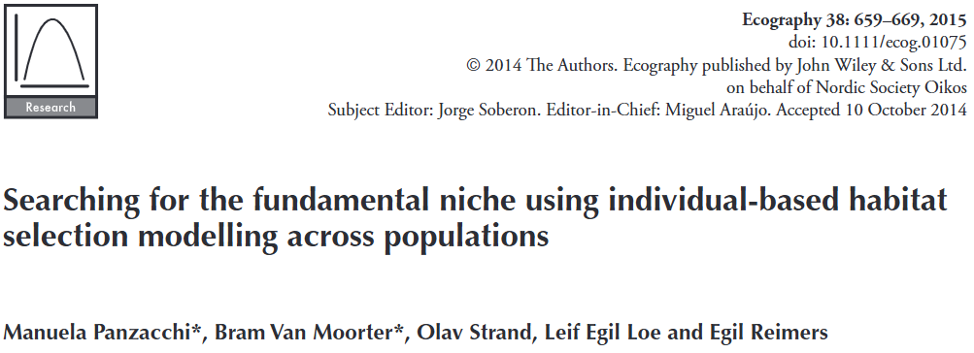
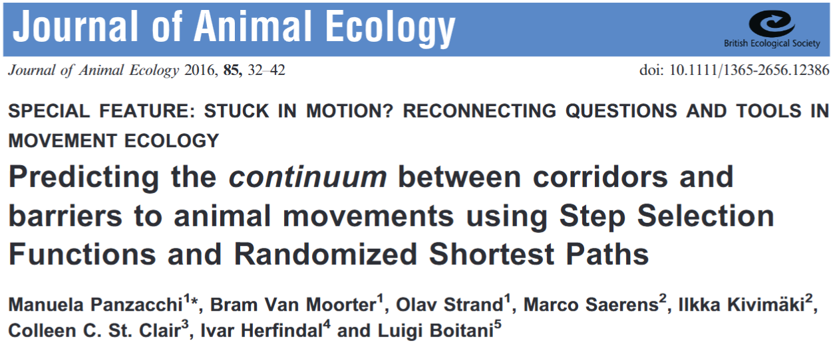
Each source of disturbance
Based on its type, amount and location
HABITAT LOSS/DEGRADATION
HABITAT FRAGMENTATION

Slide 4
Each source of disturbance
Based on its type, amount and location
HABITAT LOSS/DEGRADATION
HABITAT FRAGMENTATION
Cumulative impact
↓
guide sustainable land planning
quantitatively & spatially

Slide 5
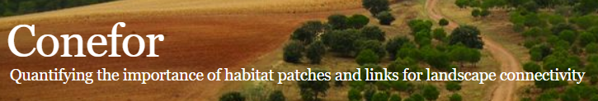

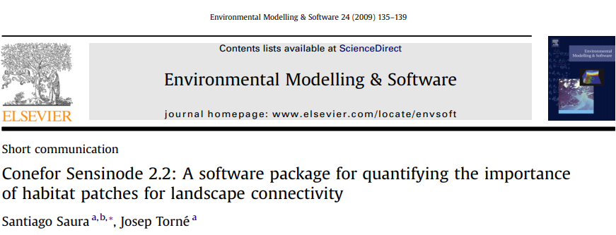
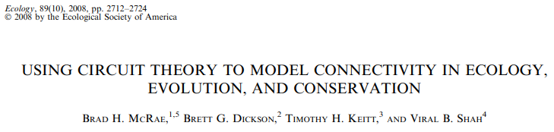

Slide 6
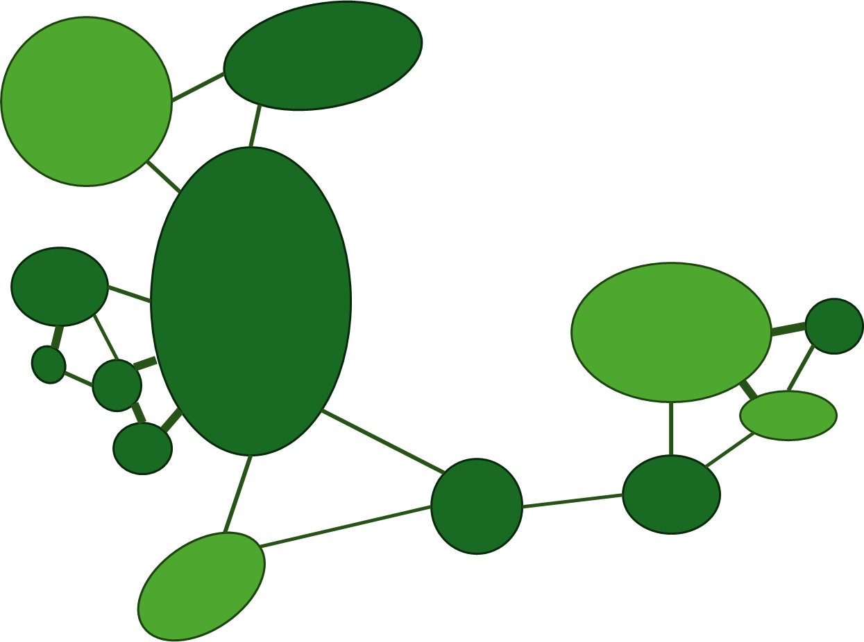
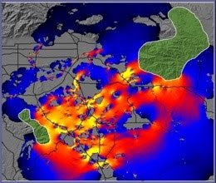
landscape perspective
multiple paths

Slide 7
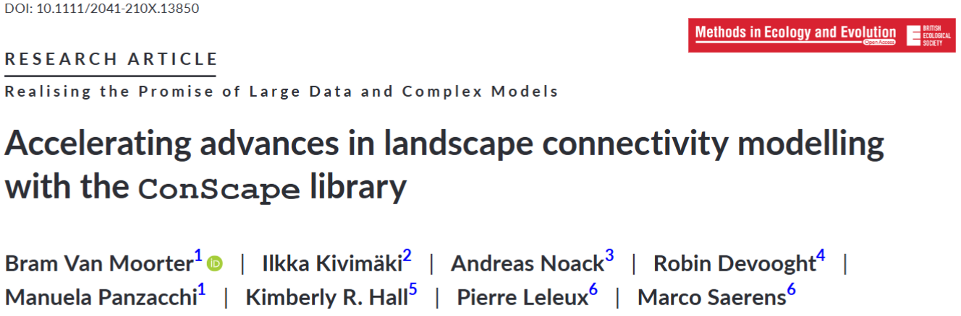


Slide 8
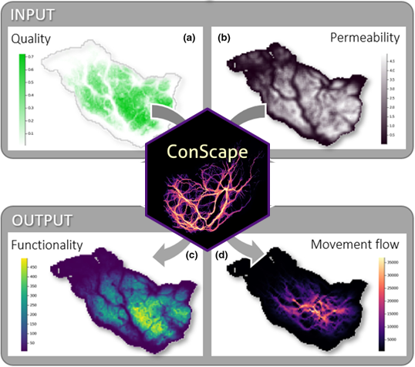
Why ConScape?
Habitat models
Network
models

Slide 9
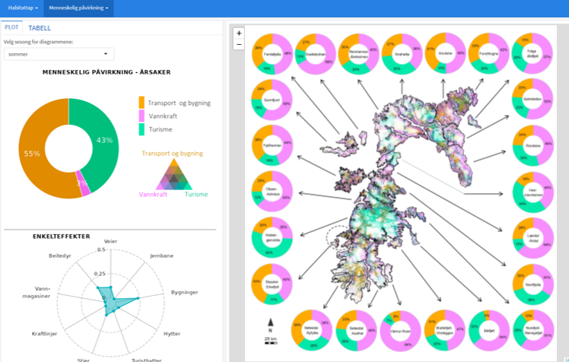

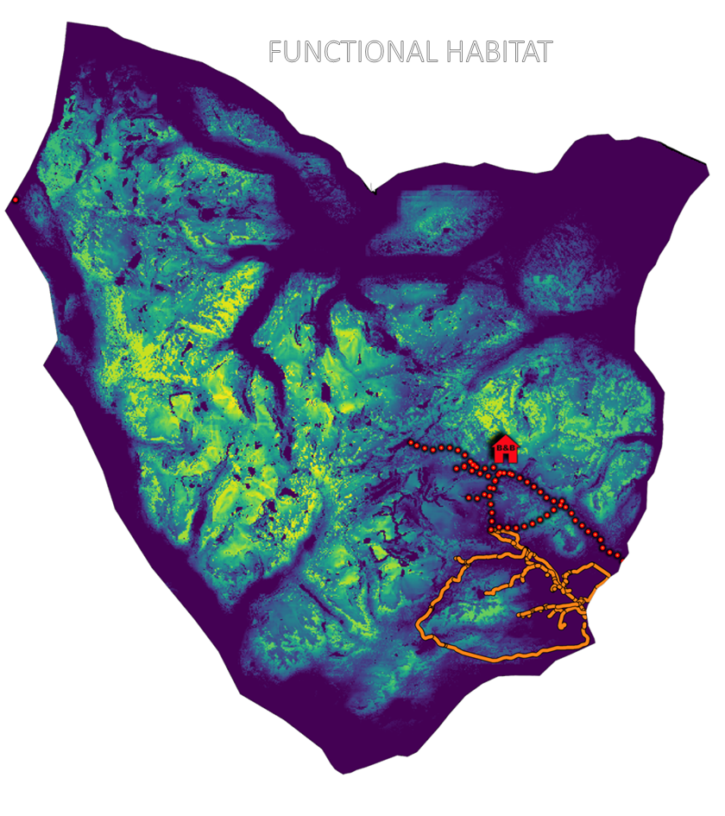
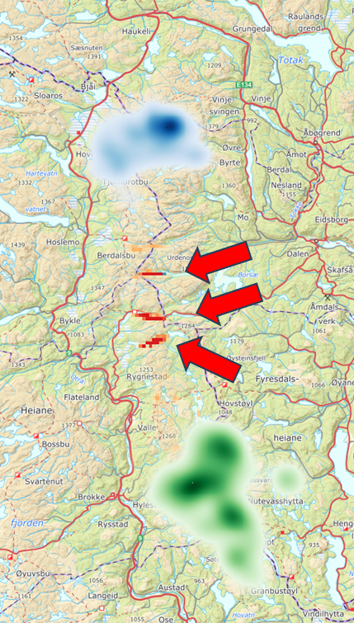
Why ConScape?
Dashboards of cumulative impacts
Scenario analysis
Spatial prioritization of
conservation and restoration
through sensitivity analysis

Slide 10
Why Julia?
Relatively easy to write (unlike C, similar to R)
Fast (unlike R or Python) – C like performance
Overcome the «two language problem»
Just as the new Circuitscape library

Slide 11
Key concepts

Slide 12

The landscape as a network
habitat patches with a size and/or quality
connections between patches

Slide 13
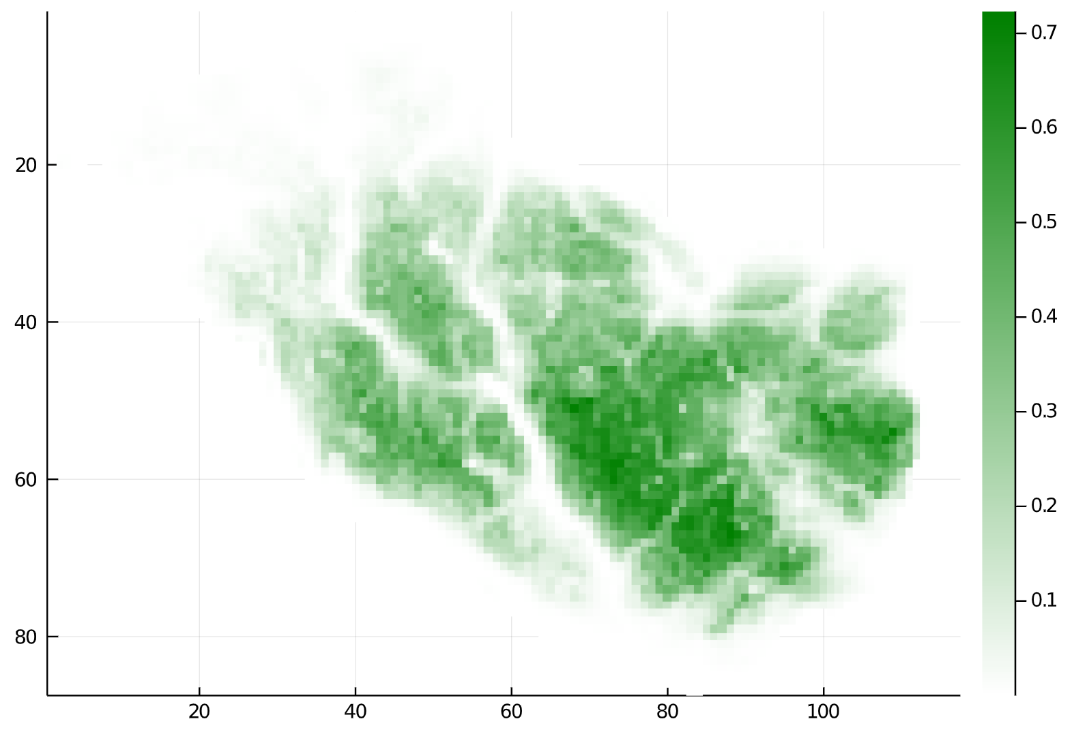
Continous landscapes
Continuous habitat quality
continuous landscapes without clear patches
pixels are patches

Slide 14
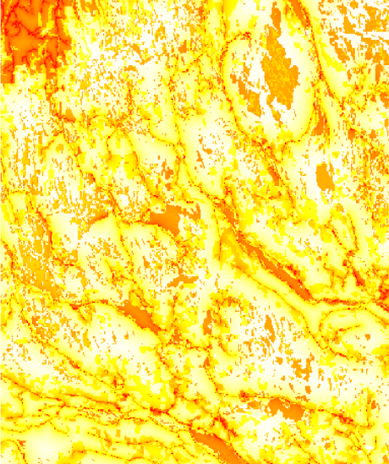
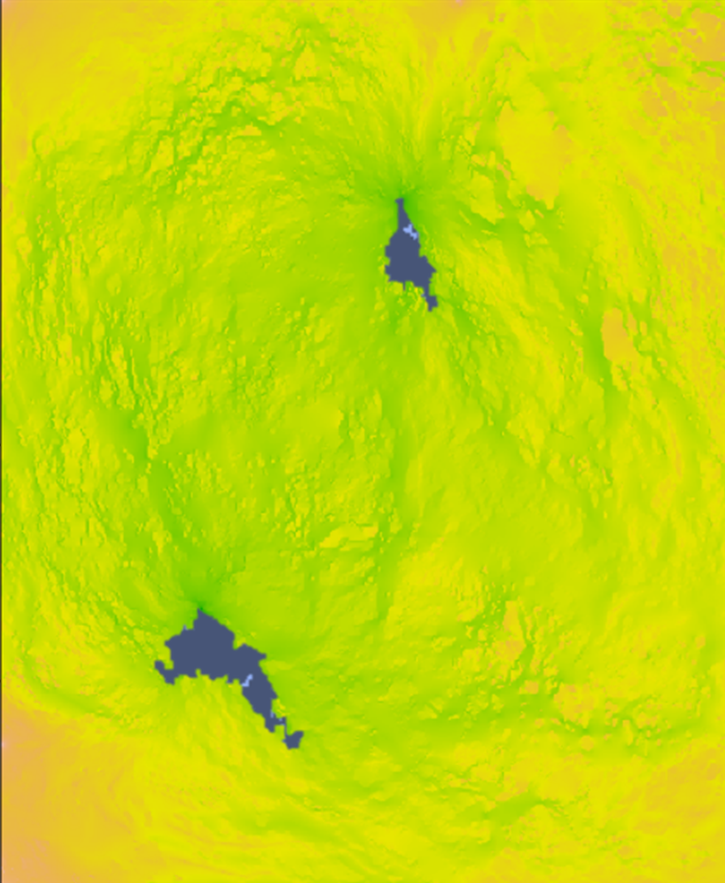
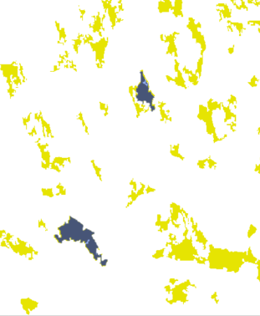
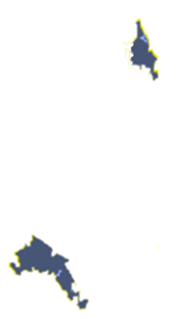
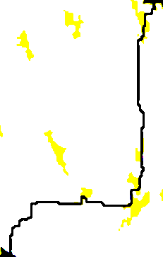
Connectivity: movement on the network
Euclidean Distance
«as the craw flies»
Least Cost Path
«as the fox runs»
Random Walk
«drunkard’s walk»
B
B
B
A
A
A
Pros: simple
Cons: ignores landscape matrix
(e.g.: Hanski 2000)
Pros: considers landscape permeability
Cons: ignores multiple connections
(e.g.: Saura et al 2007 - CONEFOR)
Pros: considers multiple connections
Cons: walker gets “lost in space”
(e.g.: McRae et al – CIRCUITSCAPE)

Slide 15
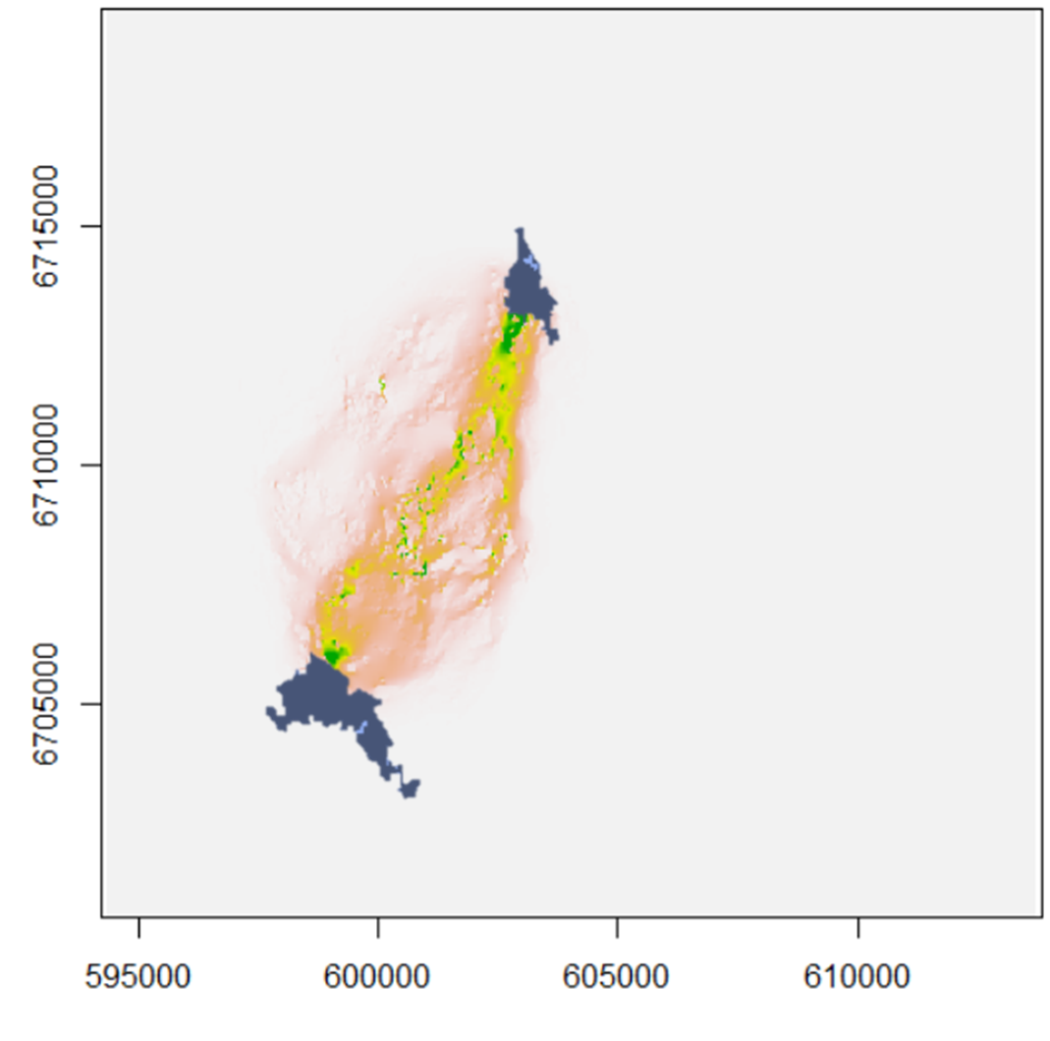
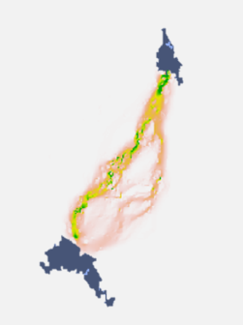
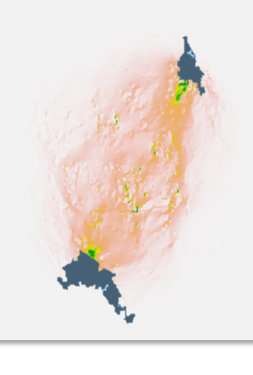
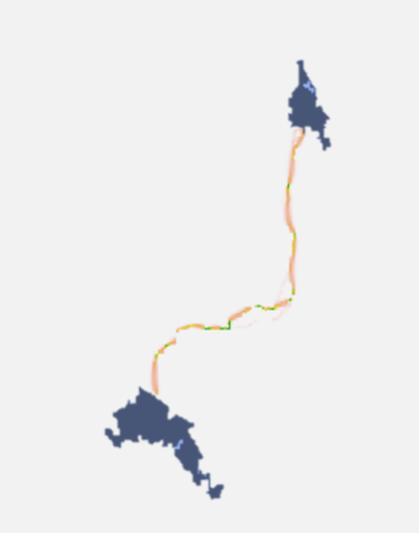
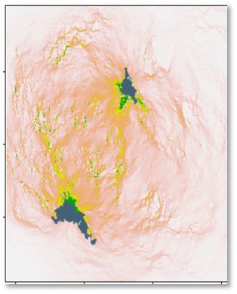
θ = 0.0001
θ = 0.00001
LEAST- COST PATH
θ = 0.001
RANDOM WALK
θ = 0.1
θ = 0.00000001
θ controls degree of randomness in movements
movement paths more realistic for the focal species / ecological process (e.g. migration vs. feeding)
fast computation over large, high-resolution landscapes
allows to scale-up from pixel-based permeability to landscape-scale connectivity

Slide 16
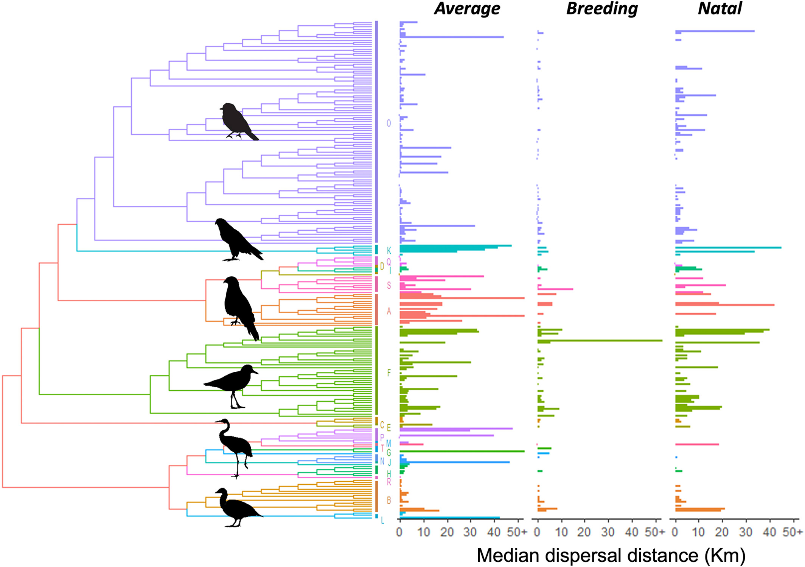
Fandos et al. (2023) Standardised empirical dispersal kernels emphasise the pervasiveness of long‐distance dispersal in European birds. J. Animal Ecology 92(1): 158-170.

Slide 17
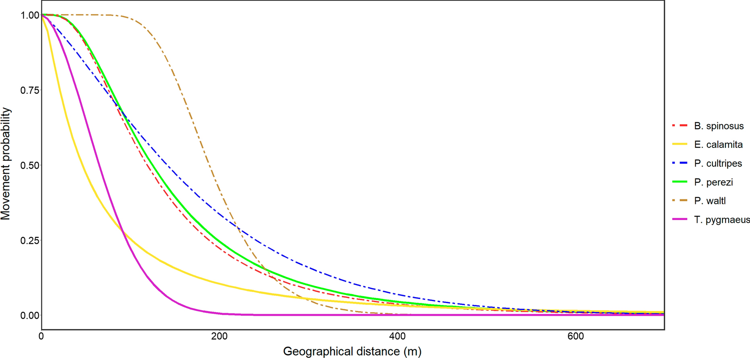
Movement probability
Reyes-Moya et al. (2022) Integrating dispersal, breeding and abundance data with graph theory for the characterization and management of functional connectivity in amphibian pondscapes.
Landscape Ecology 37(12): 3159-3177.
Geographic distance (m)

Slide 18
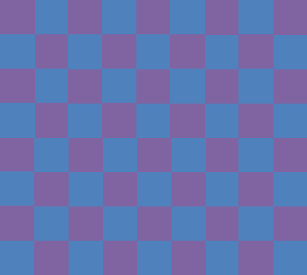
In summary
Network parameters
Quality of each pixel
Permeability between pixels
Likelihood
Cost

Slide 19
In summary
Network parameters
Quality of each pixel
Permeability between pixels
Likelihood
Cost
Movement paths
Optimal
Random

Slide 20
In summary
Network parameters
Quality of each pixel
Permeability between pixels
Likelihood
Cost
Movement paths
Optimal
Random
Distance-proximity relationship
1
0
Proximity
Distance

Slide 21
Demonstration

Slide 22
We install the ConScape library from the “demo” branch:
] add ConScape#demo
Now we load the relevant libraries:
using ConScape, SparseArrays, LinearAlgebra using Rasters, ArchGDAL using ConScape.LinearSolve using CairoMakie

Slide 23
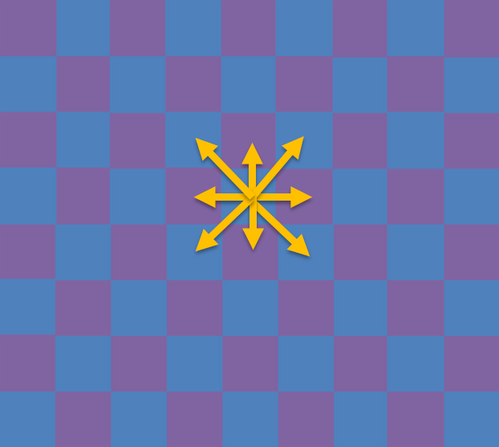
First: habitat quality and permeability
The first step is to load the raster data specifying the graph structure in terms of habitat quality and permeability.
Quality of each pixel
Permeability between pixels
Likelihood
Cost

Slide 24
We set the data directory to the ConScape directory with the test data:
datadir = joinpath(dirname(pathof(ConScape)), "..", "data") readdir(datadir) _tempdir = mkdir(tempname());

Slide 25
We load the habitat suitabilty data, note that the way the ascii is read in GDAL is reversed and rotated:
qualities = reverse(rotr90(replace_missing(
Raster(joinpath(datadir, "hab_qual_200.asc")),
NaN)); dims=X) Makie.plot(qualities,
colormap=cgrad([:lightgrey, :green]))

Slide 26
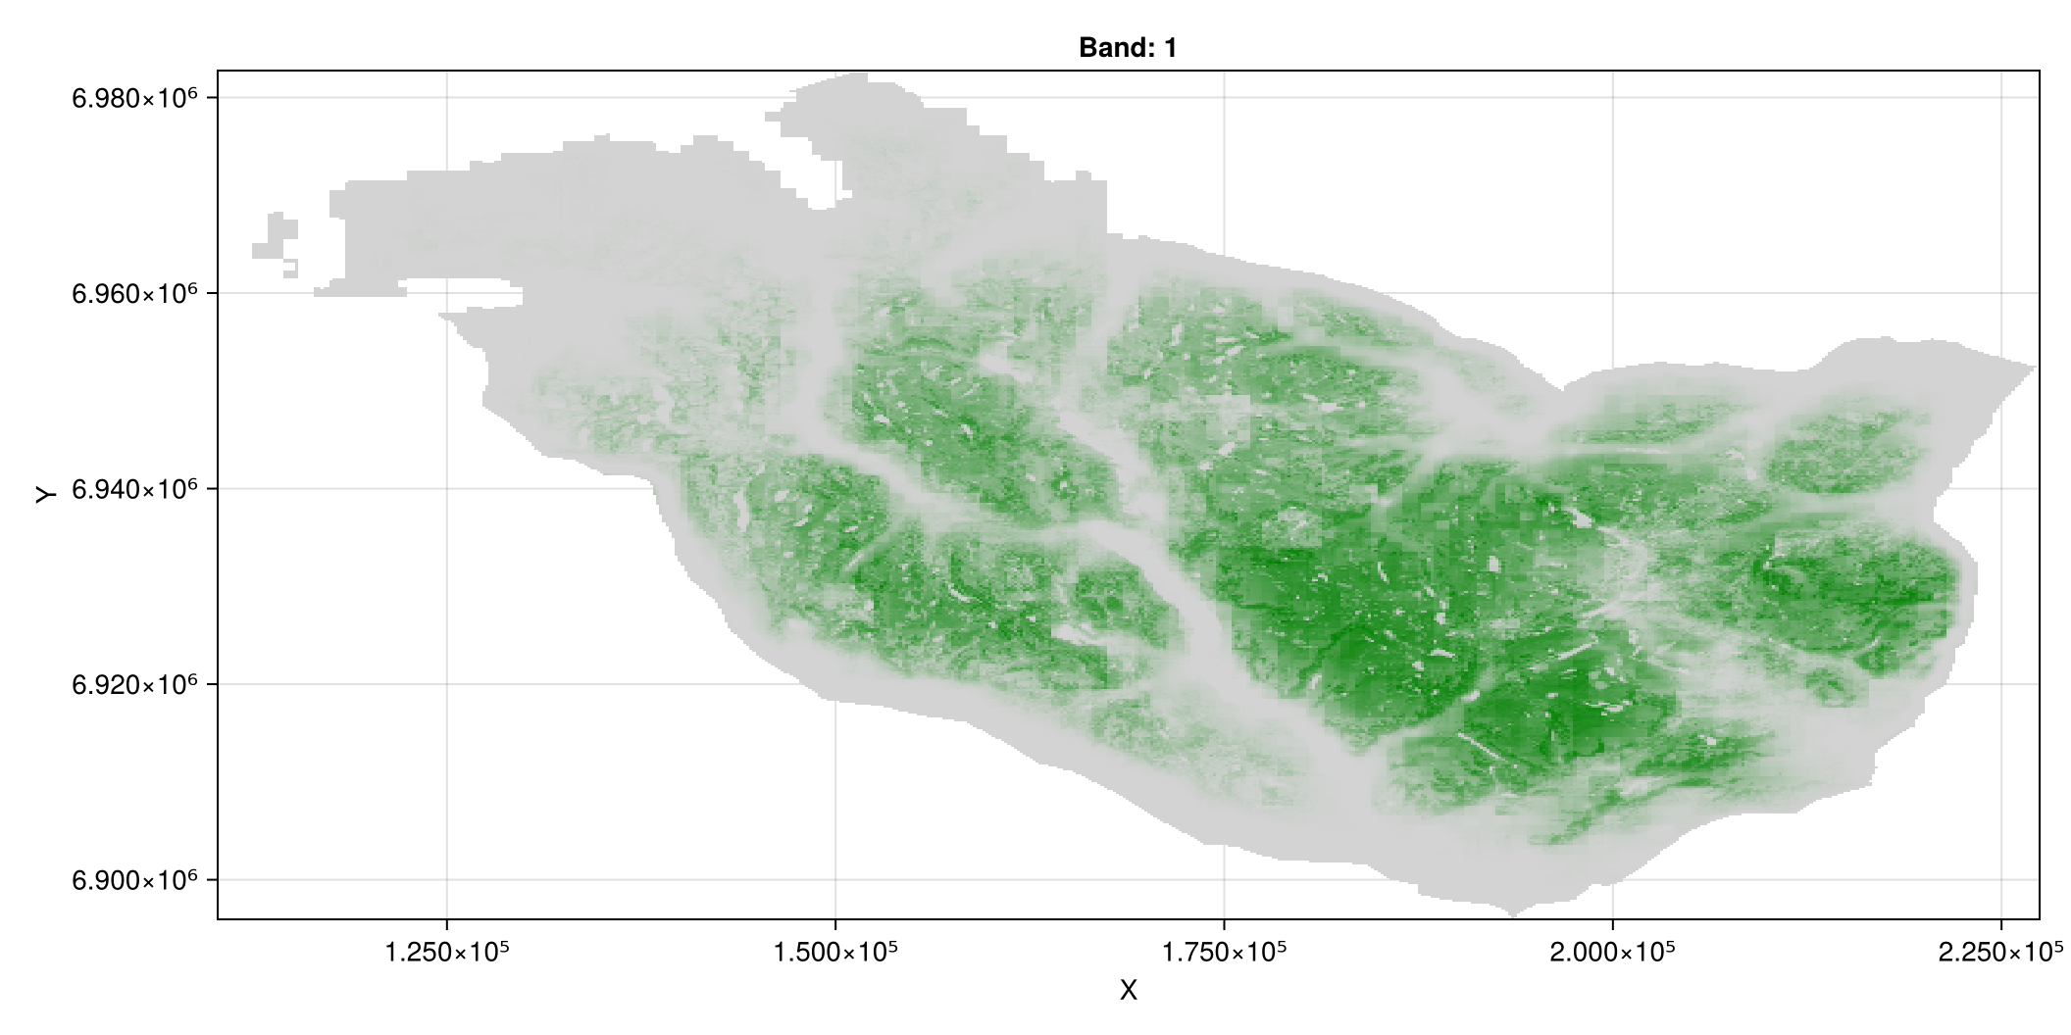

Slide 27
Next we read the habitat permeability:
affinities = reverse(rotr90(replace_missing(
Raster(joinpath(datadir, "mov_prob_200.asc"))
, NaN)); dims=X) Makie.plot(qualities, colormap=cgrad(:acton))

Slide 28
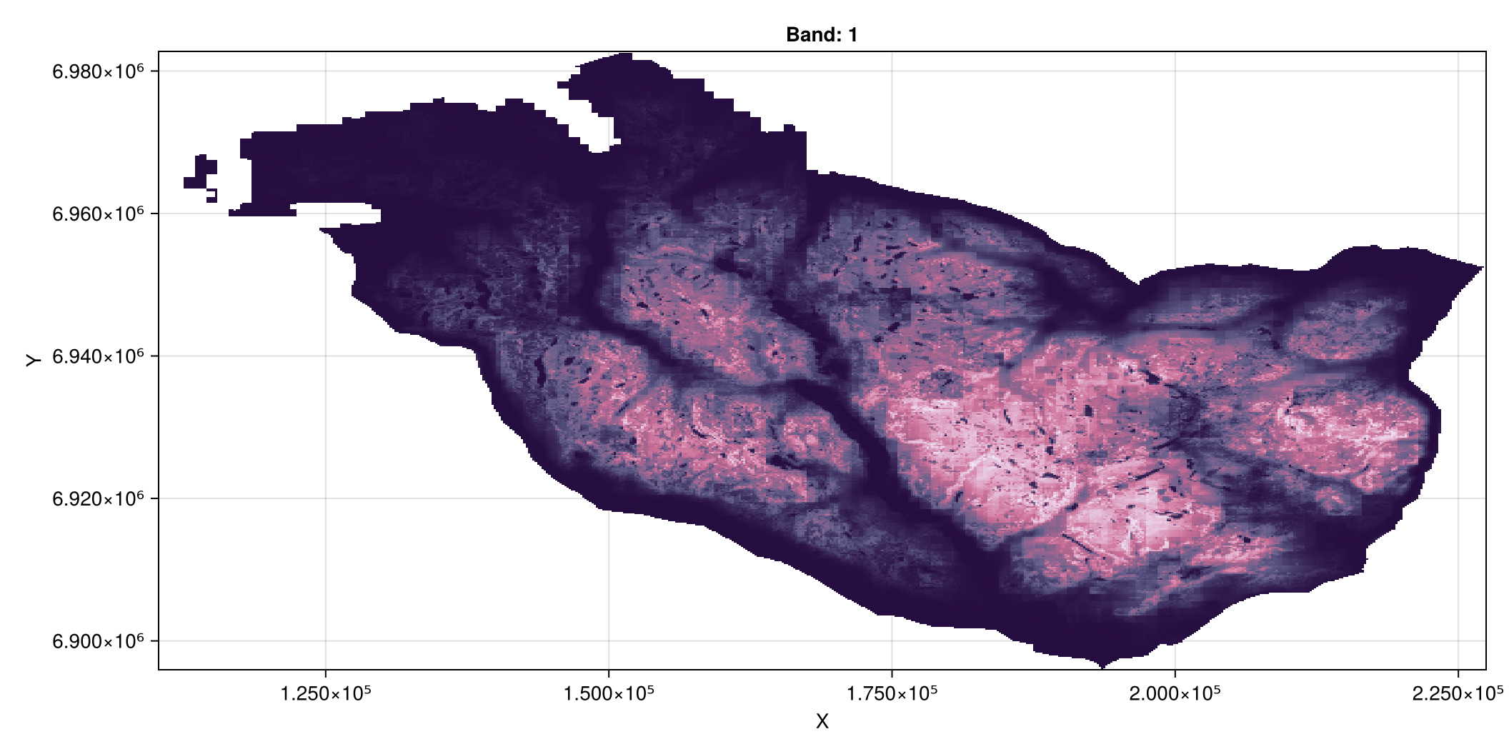

Slide 29
Very important
Ensure that all the connected nodes have a value for the quality of the habitat.
qualities[(affinities .> 0) .& isnan.(qualities)] .= 1e-20;

Slide 30
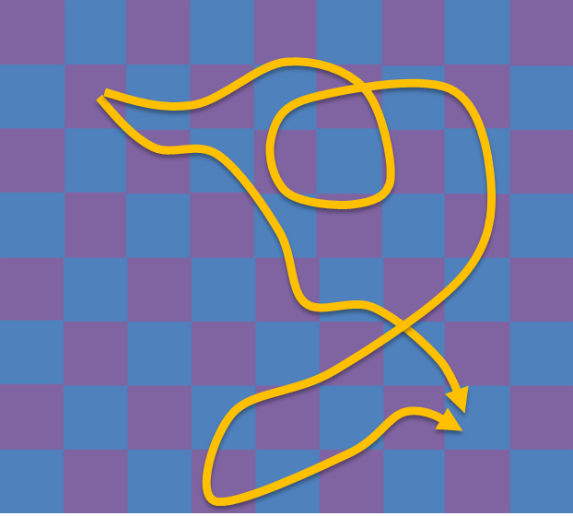
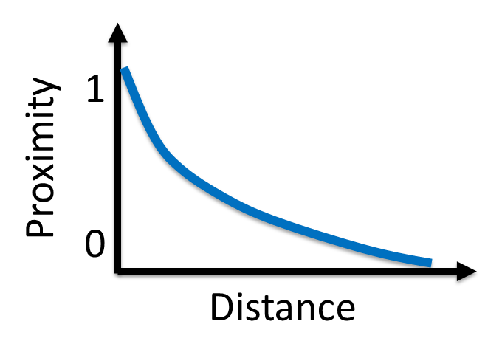
Second: determine path parameters
The second step after parameterizing the graph nodes and edges is to determine the parameters of the paths. We first investigate the effect of path randomness, then we study how distance should be converted into proximity.
Network parameters
Movement paths: optimal-random
Distance-proximity relationship

Slide 31
The effect of path randomness – theta
To investigate the effect of theta, we will investigate the path distribution between a single pixel as source and one as a target:
source_qualities = copy(qualities) source_qualities[:,:] .= 0 source_qualities[250, 500] = 1 target_qualities = copy(qualities) target_qualities[:,:] .= 0 target_qualities[350, 400] = 1

Slide 32
The effect of path randomness – theta
Make the RasterStack:
rast = RasterStack((; affinities, qualities=source_qualities, target_qualities=modify(sparse, target_qualities)))
┌ 434×586 RasterStack ┐ ├─────────────────────┴────────────────────────────────────────────────── dims ┐ ↓ Y Projected{Float64} 6.98255e6:-200.0:6.89595e6 ReverseOrdered Regular Intervals{Start}, → X Projected{Float64} 110250.0:200.0:227250.0 ForwardOrdered Regular Intervals{Start} ├────────────────────────────────────────────────────────────────────── layers ┤ :affinities eltype: Float64 dims: Y, X size: 434×586 :qualities eltype: Float64 dims: Y, X size: 434×586 :target_qualities eltype: Float64 dims: Y, X size: 434×586 ├────────────────────────────────────────────────────────────────────── raster ┤ extent: Extent(Y = (6.89595e6, 6.98275e6), X = (110250.0, 227450.0)) missingval: NaN crs: └──────────────────────────────────────────────────────────────────────────────┘

Slide 33
The effect of path randomness – theta
We setup a problem to solve it – we loop over different optimality values:
graph_measures = (; betw=ConScape.BetweennessQweighted()) distance_transformation = (nodist=nothing) solver = ConScape.MatrixSolver()

Slide 34
The effect of path randomness – theta
θs = [1, 0.1, 0.01, 0.001, 0.0001, 0.00001] betw = map(θs) do θ connectivity_measure = ConScape.ExpectedCost(; θ, distance_transformation) problem = ConScape.Problem(;graph_measures, connectivity_measure, solver) ConScape.solve(problem, rast).betw end betw = cat(betw...; dims=Dim{:theta}(θs))

Slide 35
The effect of path randomness – theta
Plot:
Rasters.rplot(betw[Y(6.90e6 .. 6.94e6), X(175000 .. 220000)], colormap=cgrad(:magma), width=1500, height=500)

Slide 36
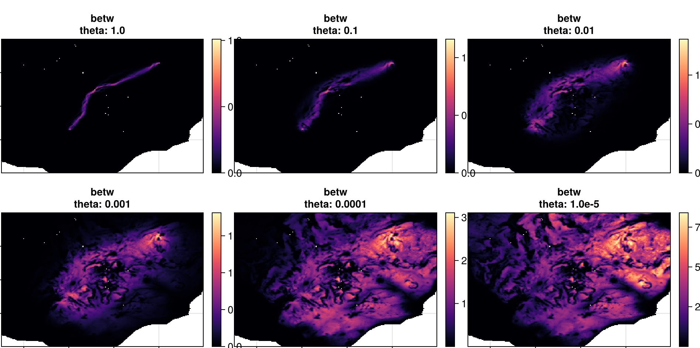
The effect of path randomness – theta

Slide 37
The effect of distance decay – alpha
We setup a problem and initialize it to look at the effect of the distance decay:
θ = 0.1 graph_measures = (; betq=ConScape.BetweennessQweighted()) distance_transformation = nothing connectivity_measure = ConScape.ExpectedCost(; θ, distance_transformation) problem = ConScape.Problem(;graph_measures, connectivity_measure, solver) workspace = init(problem, rast);

Slide 38
The effect of distance decay – alpha
The distance towards a target pixel:
dists = ConScape.Raster(
workspace.expected_costs[:,1], workspace.grid) Makie.plot(dists)

Slide 39
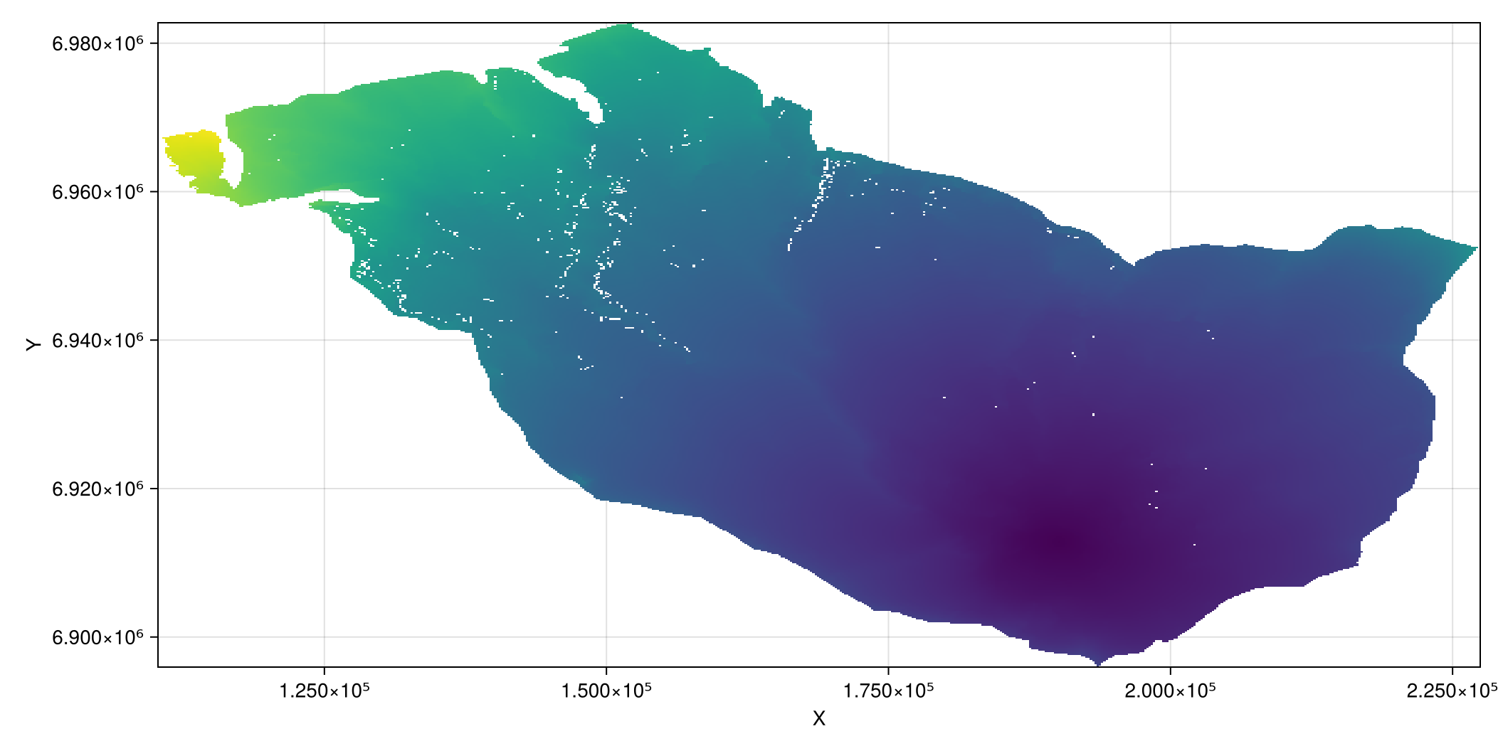

Slide 40
The effect of distance decay – alpha
We loop over different distance decay values – alpha:
αs = 1 ./ [1, 100, 250, 500] proxs = map(αs) do α ConScape.Raster(map(x -> exp(-α*x), workspace.expected_costs[:,1]), workspace.grid) end
proxs = cat(proxs...; dims=Dim{:alpha}(αs))

Slide 41
The effect of distance decay – alpha
Plot:
Rasters.rplot(proxs[Y(6.90e6 .. 6.94e6),
X(175000 .. 220000)], colormap=cgrad(:magma))

Slide 42
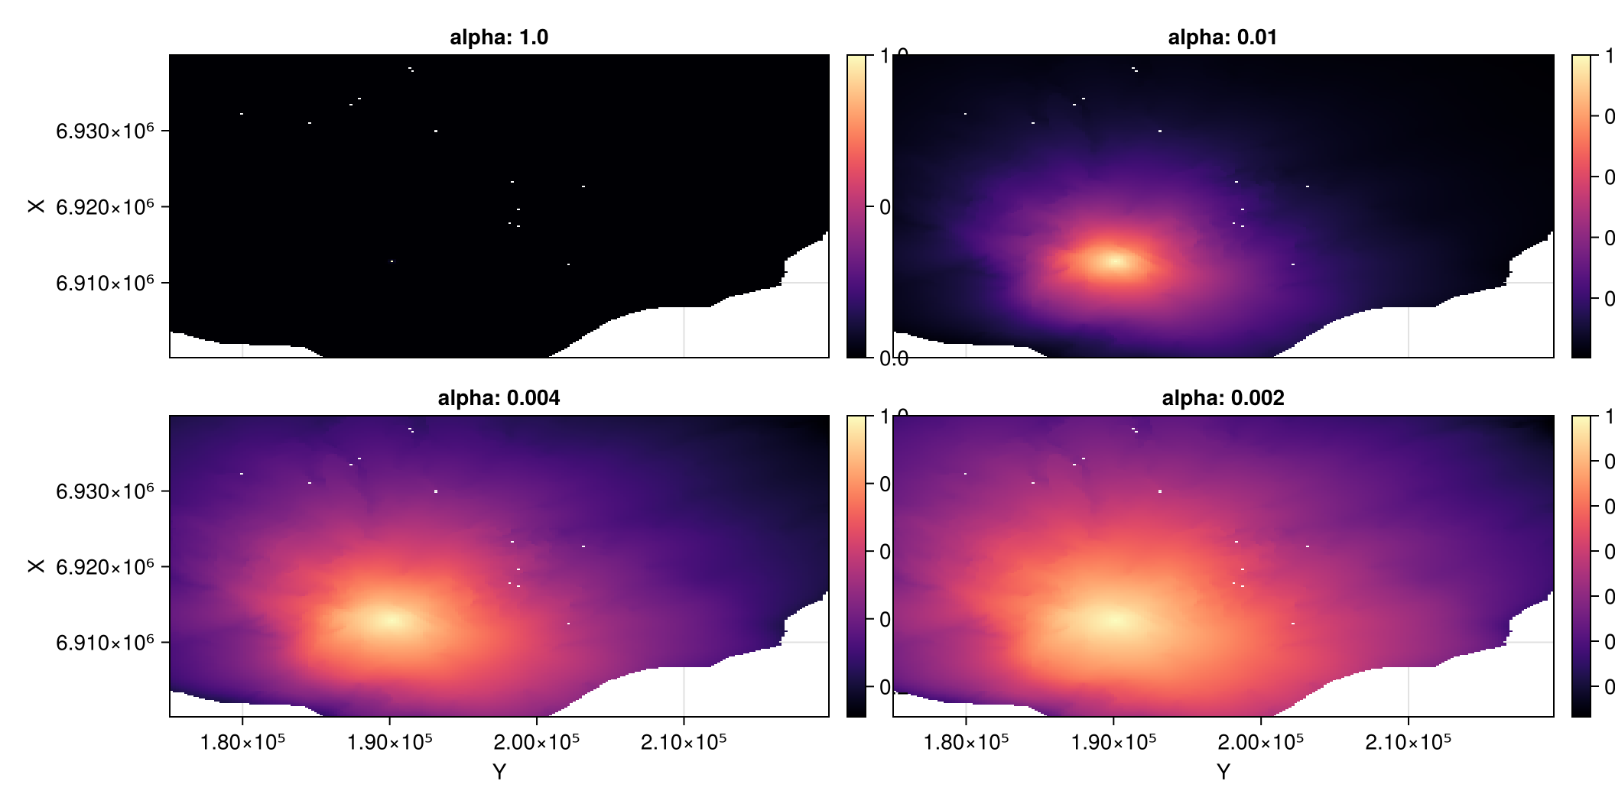

Slide 43
Third: compute graph measures
Setup landscape network
We reduce computational load by merging pixels into a coarser pixel
{100%}

Slide 44
Third: compute graph measures
Setup landscape network
We reduce computational load by merging pixels into a coarser pixel:

Slide 45
Third: compute graph measures
Parameterize the graph:
rast = RasterStack((; affinities, qualities, target_qualities=ConScape.coarse_graining(qualities, 10)))
┌ 434×586 RasterStack ┐ ├─────────────────────┴────────────────────────────────────────────────── dims ┐ ↓ Y Projected{Float64} 6.98255e6:-200.0:6.89595e6 ReverseOrdered Regular Intervals{Start}, → X Projected{Float64} 110250.0:200.0:227250.0 ForwardOrdered Regular Intervals{Start} ├────────────────────────────────────────────────────────────────────── layers ┤ :affinities eltype: Float64 dims: Y, X size: 434×586 :qualities eltype: Float64 dims: Y, X size: 434×586 :target_qualities eltype: Float64 dims: Y, X size: 434×586 ├────────────────────────────────────────────────────────────────────── raster ┤ extent: Extent(Y = (6.89595e6, 6.98275e6), X = (110250.0, 227450.0)) missingval: NaN crs: └──────────────────────────────────────────────────────────────────────────────┘

Slide 46
Third: compute graph measures
Parameterize the paths:
θ = 0.1 α = 1/500
0.002

Slide 47
Compute functional habitat
Setup the problem:
graph_measures = (; ch=ConScape.ConnectedHabitat()) distance_transformation = (expx=t -> exp(-α*t)) connectivity_measure = ConScape.ExpectedCost(; θ, distance_transformation) problem = ConScape.Problem(;graph_measures, connectivity_measure, solver)
ConScape.Problem{@NamedTuple{ch::ConScape.ConnectedHabitat}, ConScape.ExpectedCost{Float64, var"#17#18"}, ConScape.MatrixSolver, Nothing, ConScape.MinusLog}((ch = ConScape.ConnectedHabitat(),), ConScape.ExpectedCost{Float64, var"#17#18"}(0.1, var"#17#18"(), false), ConScape.MatrixSolver(true), nothing, ConScape.MinusLog(), true)

Slide 48
Compute functional habitat
Solve the problem:
workspace = init(problem, rast); func = ConScape.solve!(workspace, problem).ch
Initialising for ConScape.MatrixSolver(true) Defining grid for RasterStack size (434, 586)... Retreiving measures... Defining sparse arrays of size (128166, 128166)... Initialising factorizations... Allocating workspaces... Solving Z matrix... Calculating inverses... Calculating expected cost... Finished workspace...
┌ 434×586 Raster{Float64, 2} ch ┐ ├───────────────────────────────┴──────────────────────────────────────── dims ┐ ↓ Y Projected{Float64} 6.98255e6:-200.0:6.89595e6 ReverseOrdered Regular Intervals{Start}, → X Projected{Float64} 110250.0:200.0:227250.0 ForwardOrdered Regular Intervals{Start} ├────────────────────────────────────────────────────────────────────── raster ┤ extent: Extent(Y = (6.89595e6, 6.98275e6), X = (110250.0, 227450.0)) crs: └──────────────────────────────────────────────────────────────────────────────┘ ↓ → 110250.0 110450.0 110650.0 … 226850.0 227050.0 227250.0 6.98255e6 NaN NaN NaN NaN NaN NaN 6.98235e6 NaN NaN NaN NaN NaN NaN 6.98215e6 NaN NaN NaN NaN NaN NaN 6.98195e6 NaN NaN NaN NaN NaN NaN 6.98175e6 NaN NaN NaN … NaN NaN NaN 6.98155e6 NaN NaN NaN NaN NaN NaN 6.98135e6 NaN NaN NaN NaN NaN NaN ⋮ ⋱ ⋮ 6.89735e6 NaN NaN NaN NaN NaN NaN 6.89715e6 NaN NaN NaN NaN NaN NaN 6.89695e6 NaN NaN NaN NaN NaN NaN 6.89675e6 NaN NaN NaN … NaN NaN NaN 6.89655e6 NaN NaN NaN NaN NaN NaN 6.89635e6 NaN NaN NaN NaN NaN NaN 6.89615e6 NaN NaN NaN NaN NaN NaN 6.89595e6 NaN NaN NaN NaN NaN NaN

Slide 49
Compute functional habitat
Plot functional habitat – suitable and well-connected habitat:
Makie.plot(func, colormap=cgrad(:viridis))

Slide 50
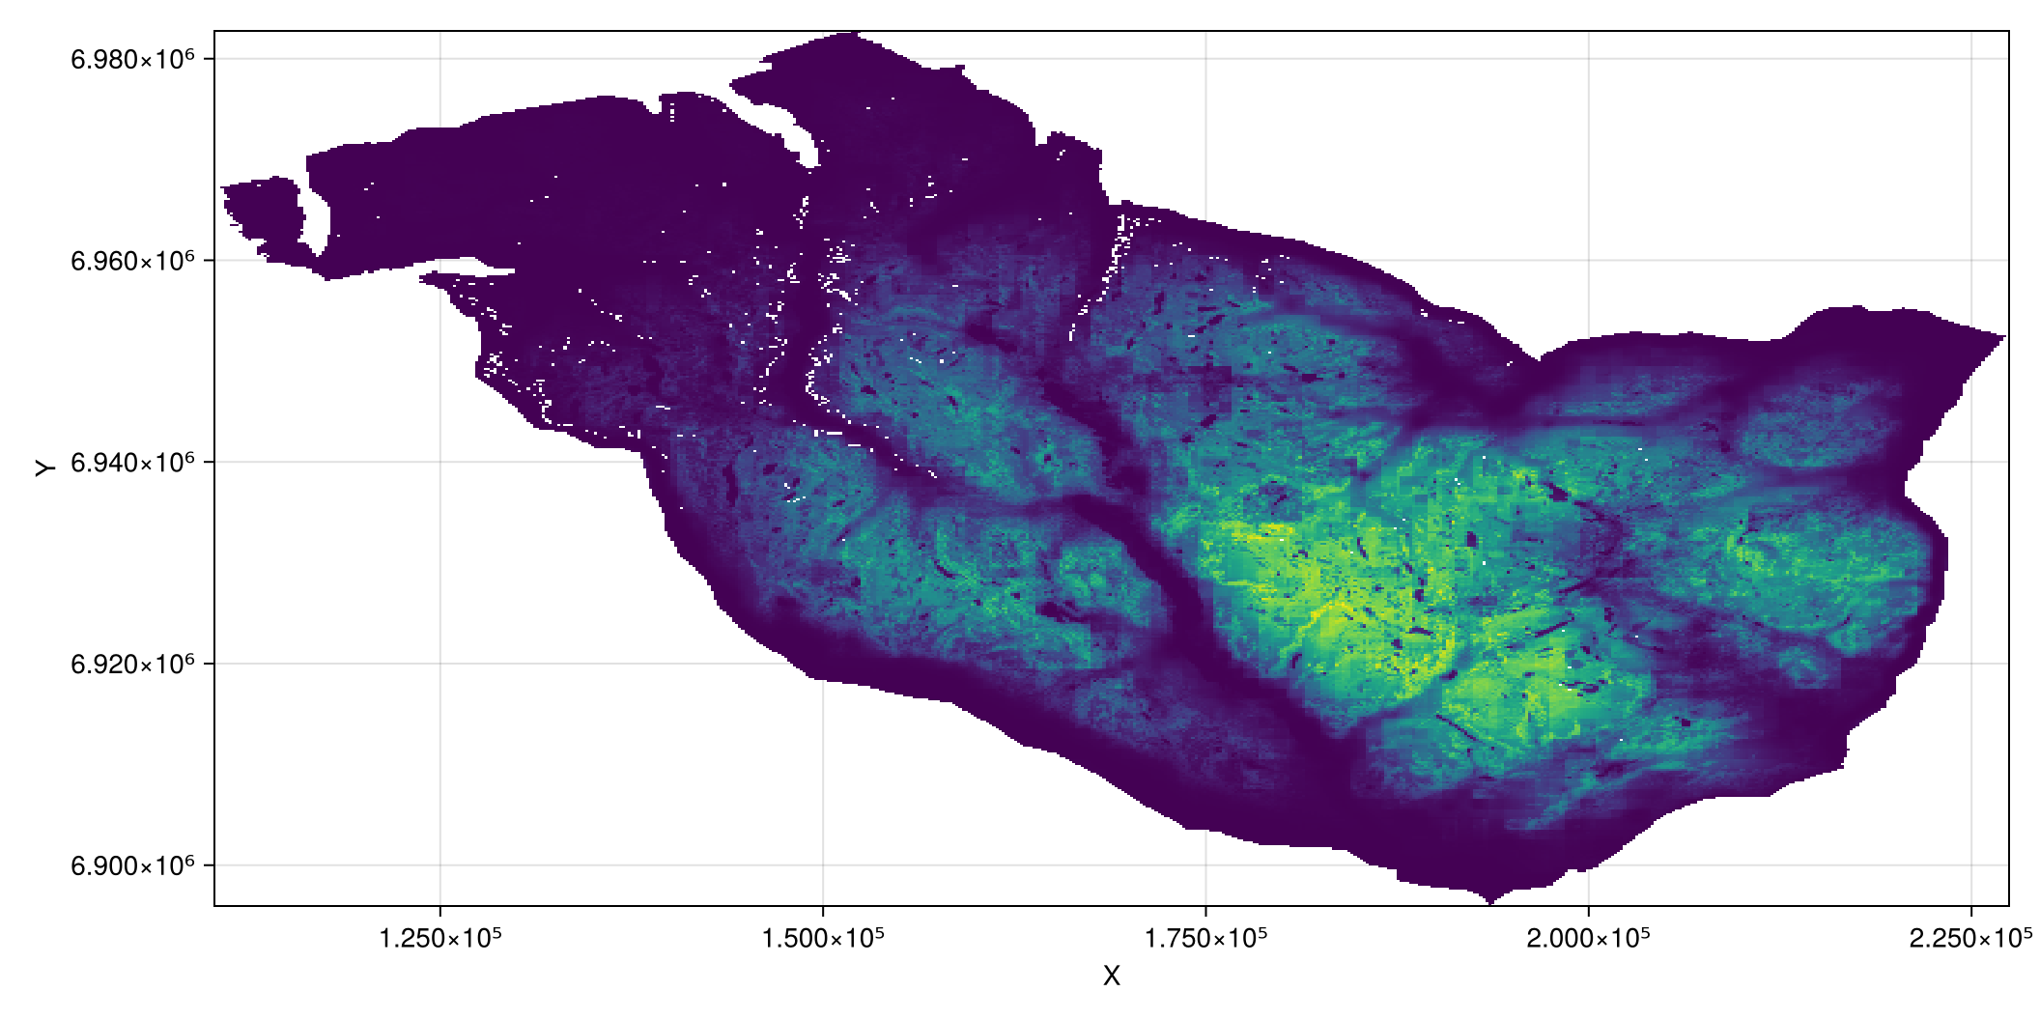

Slide 51
Compute movement flow or corridors
Setup the problem:
graph_measures = (; flow=ConScape.BetweennessKweighted()) distance_transformation = (expx=t -> exp(-α*t)) connectivity_measure = ConScape.ExpectedCost(; θ, distance_transformation) problem = ConScape.Problem(;graph_measures, connectivity_measure, solver)
ConScape.Problem{@NamedTuple{flow::ConScape.BetweennessKweighted}, ConScape.ExpectedCost{Float64, var"#19#20"}, ConScape.MatrixSolver, Nothing, ConScape.MinusLog}((flow = ConScape.BetweennessKweighted(),), ConScape.ExpectedCost{Float64, var"#19#20"}(0.1, var"#19#20"(), false), ConScape.MatrixSolver(true), nothing, ConScape.MinusLog(), true)

Slide 52
Compute movement flow or corridors
Solve the problem:
flow = ConScape.solve(problem, rast).flow
Initialising for ConScape.MatrixSolver(true) Defining grid for RasterStack size (434, 586)... Retreiving measures... Defining sparse arrays of size (128166, 128166)... Initialising factorizations... Allocating workspaces... Solving Z matrix... Calculating inverses... Calculating expected cost... Calculating proximities... Finished workspace...
┌ 434×586 Raster{Float64, 2} flow ┐ ├─────────────────────────────────┴────────────────────────────────────── dims ┐ ↓ Y Projected{Float64} 6.98255e6:-200.0:6.89595e6 ReverseOrdered Regular Intervals{Start}, → X Projected{Float64} 110250.0:200.0:227250.0 ForwardOrdered Regular Intervals{Start} ├────────────────────────────────────────────────────────────────────── raster ┤ extent: Extent(Y = (6.89595e6, 6.98275e6), X = (110250.0, 227450.0)) crs: └──────────────────────────────────────────────────────────────────────────────┘ ↓ → 110250.0 110450.0 110650.0 … 226850.0 227050.0 227250.0 6.98255e6 NaN NaN NaN NaN NaN NaN 6.98235e6 NaN NaN NaN NaN NaN NaN 6.98215e6 NaN NaN NaN NaN NaN NaN 6.98195e6 NaN NaN NaN NaN NaN NaN 6.98175e6 NaN NaN NaN … NaN NaN NaN 6.98155e6 NaN NaN NaN NaN NaN NaN 6.98135e6 NaN NaN NaN NaN NaN NaN ⋮ ⋱ ⋮ 6.89735e6 NaN NaN NaN NaN NaN NaN 6.89715e6 NaN NaN NaN NaN NaN NaN 6.89695e6 NaN NaN NaN NaN NaN NaN 6.89675e6 NaN NaN NaN … NaN NaN NaN 6.89655e6 NaN NaN NaN NaN NaN NaN 6.89635e6 NaN NaN NaN NaN NaN NaN 6.89615e6 NaN NaN NaN NaN NaN NaN 6.89595e6 NaN NaN NaN NaN NaN NaN

Slide 53
Compute movement flow or corridors
Plot movement flows – corridors:
Makie.plot(flow, colormap=cgrad(:magma))

Slide 54
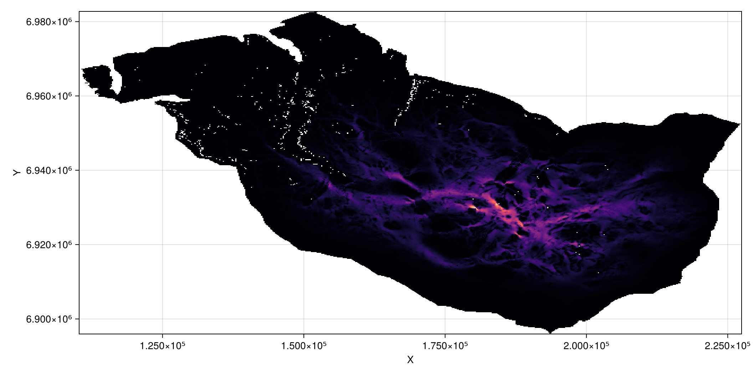

Slide 55
Compute movement flow or corridors
Plot movement flows – corridors:
Makie.plot((flow).^(1/1.75),
colormap=cgrad(:magma))

Slide 56
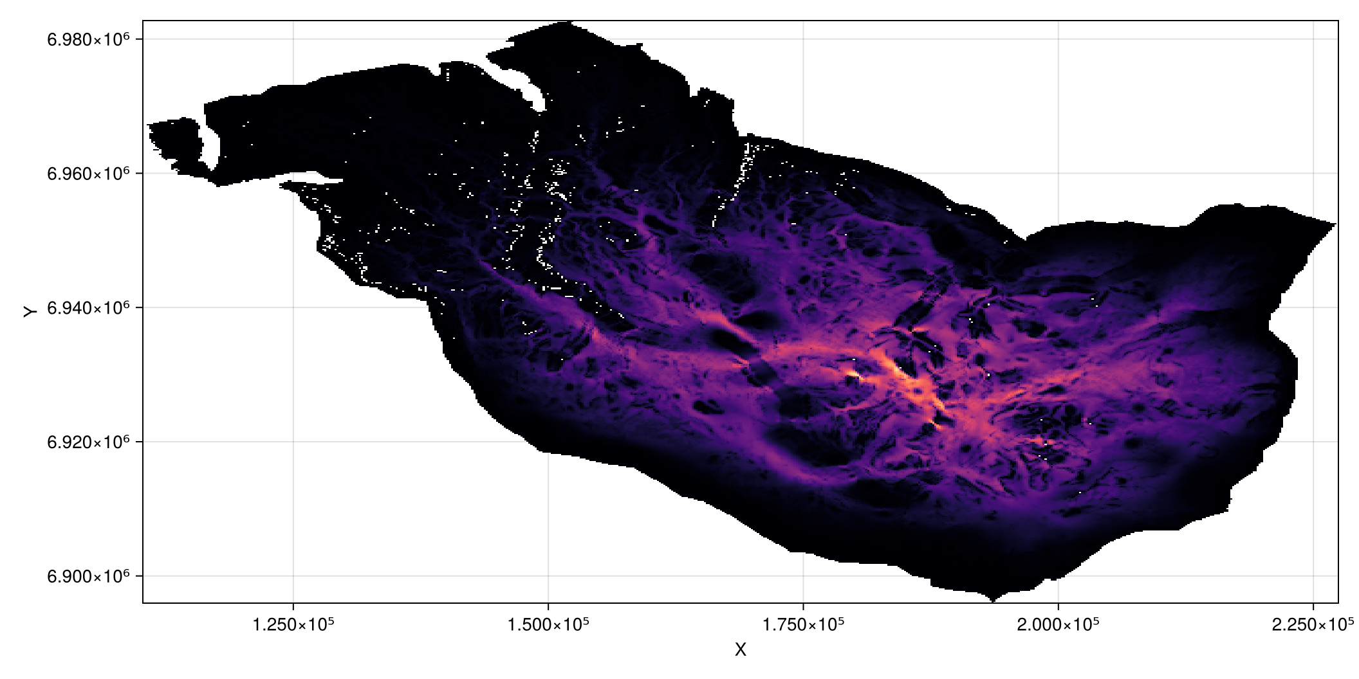

Slide 57
Compute landscape functional habitat
Sum all values of the landscape into a single metric:
sum(x -> isnan(x) ? 0.0 : x, func)
2.739192366546321e8

Slide 58
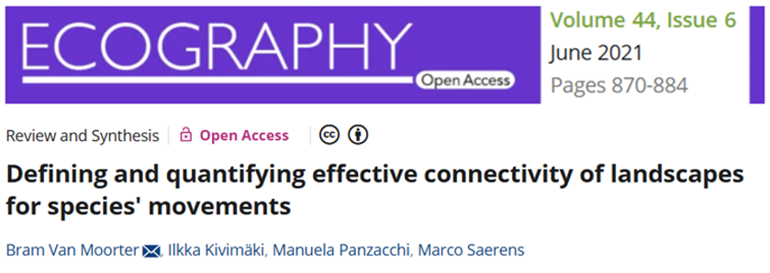
Further information
Network parametrization

Slide 59
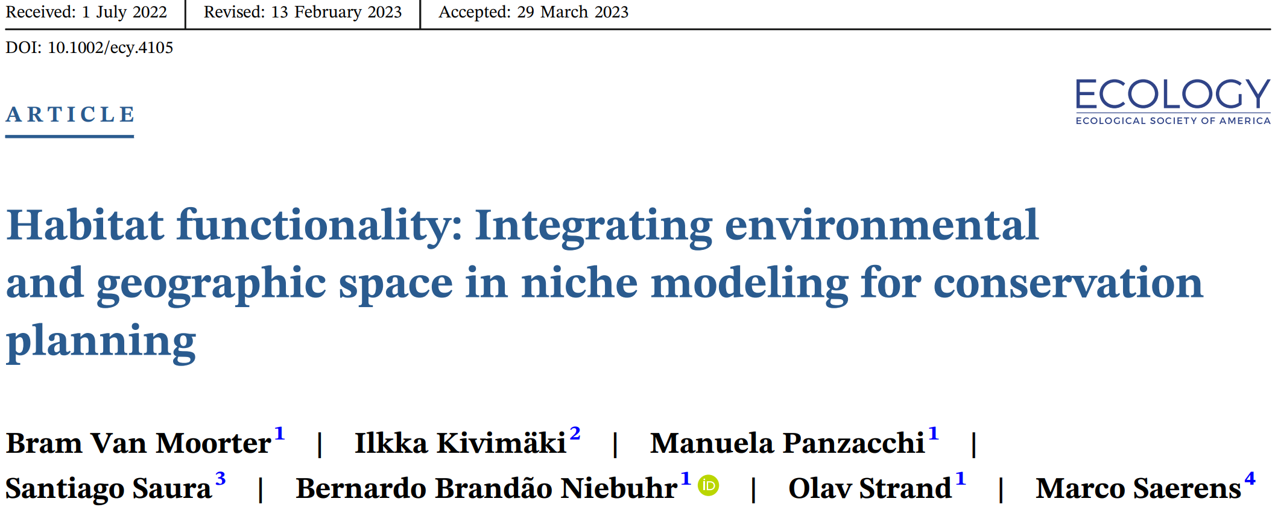
Further information
Concepts: functional habitat

Slide 60
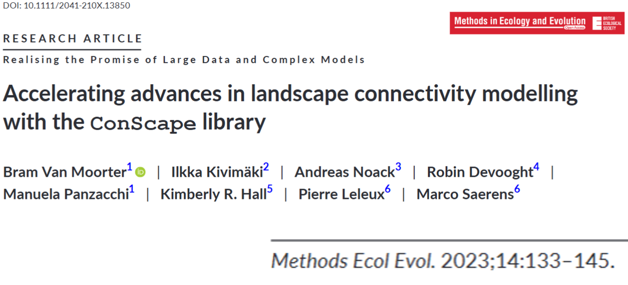
Further information
Computation

Slide 61
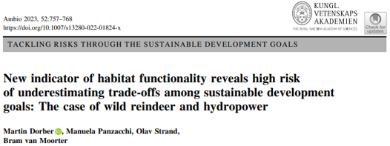
Further information
Scenario analysis

Slide 62

Further information
Sensitivity analysis

Slide 63

https://conscape.org/
Thanks to:
I. Kivimäki, M. Saerens,
R. Schouten, A. Noack,
V. Boussange, M. Panzacchi

