Slide 1

Artificial intelligence Lecture 6. Introduction to Keras
prof. Krzysztof Rybinski

Slide 2


Keras library
Keras is an open-source high-level software library that provides a Python interface for artificial neural networks.
Keras acts as an interface for the TensorFlow library.
Up until version 2.3, Keras supported multiple backends, including TensorFlow, Microsoft Cognitive Toolkit, Theano, and PlaidML. As of version 2.4, only TensorFlow is supported.

Slide 3
Why use Keras?
Useful for fast prototyping, ignoring the details of implementing backprop or writing optimization procedure
Supports all major types of layers
Runs on CPU and GPU
Almost any architecture can be designed using this framework
Open Source code – Large community support

Slide 4
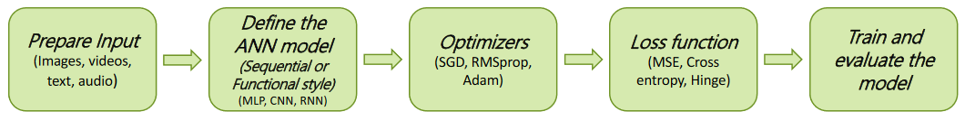
Implementing a NN in Keras
Five major steps
Preparing the input and specify the input dimension (size)
Define the model architecture and build the computational graph
Specify the optimizer and configure the learning process
Specify the Inputs, Outputs of the computational graph (model) and the Loss function
Train and test the model on the dataset

Slide 5
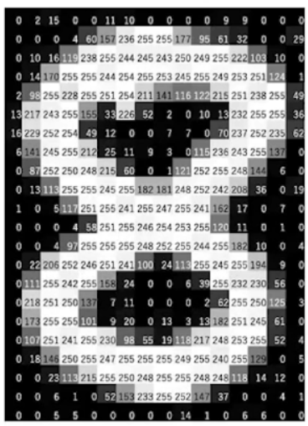
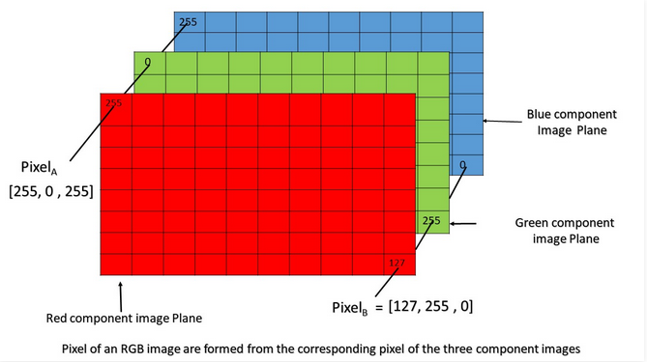
How images are stored on a computer
Grey scale (batch_size, p_height, p_width, 1), channel-last convention
Color (batch_size, p_height, p_width, 3)

Slide 6
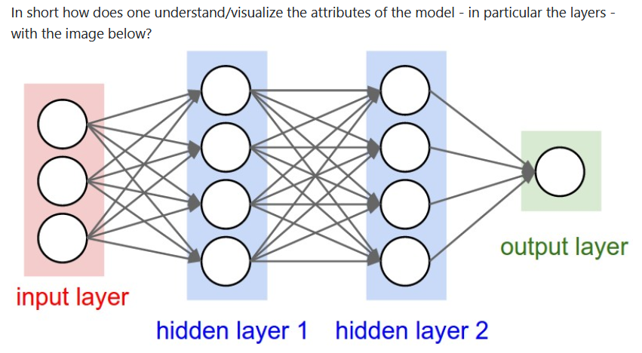
Understanding dimensions in Keras (1)
A dense layer has an output shape of (batch_size, units). So, units, the property of the layer, also defines the output shape.
Hidden layer 1: 4 units, output shape: (batch_size,4).
Hidden layer 2: 4 units, output shape: (batch_size,4).
Last layer: 1 unit, output shape: (batch_size,1).
Example for layer 1
X_batch(32x3), W(3x4), b(4), z=(X_batch.dot(W) + b), z(32,4), sigmoid(z) (32,4)

Slide 7
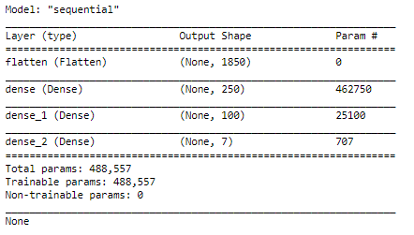
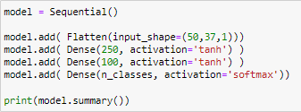
Understanding dimensions in Keras (2)
You have to specify the data input shape, other shapes are calculated automatically based on the stated numer of nodes in each layer
First entry (None, ….) refers to the batch size (number of samples used for the single pass through the computation graph)
Number of parameters of r layer dense_1:
Weights: Input dimension 250, output dimension 100 (250x100) = 25,000
Biases: one per output (100)
Total 25,000 + 100 = 25,100

Slide 8
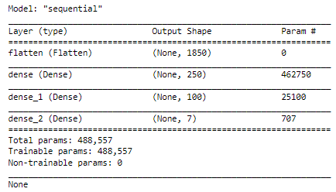
Building MLP model in Keras (1)
from keras.models import Sequential
from keras.layers import Dense, Flatten
model = Sequential()
model.add( Flatten(input_shape=(50,37,1))) #grey scale image 50x37, channel last
model.add( Dense(250, activation='tanh') )
model.add( Dense(100, activation='tanh') )
model.add( Dense(n_classes, activation='softmax'))
print(model.summary())

Slide 9
Running MLP model in Keras (2)
# compile the model
model.compile(
loss = 'categorical_crossentropy',
optimizer = 'adam',
metrics = ['acc’] )
# train
model.fit(
x = X_train, # training_data
y = y_train, # training_labels
batch_size = 32, epochs = 100, verbose = 1 )
# evaluate
model.evaluate(
x = X_test,
y = y_test,
batch_size = 8 , verbose = 1)

Slide 10
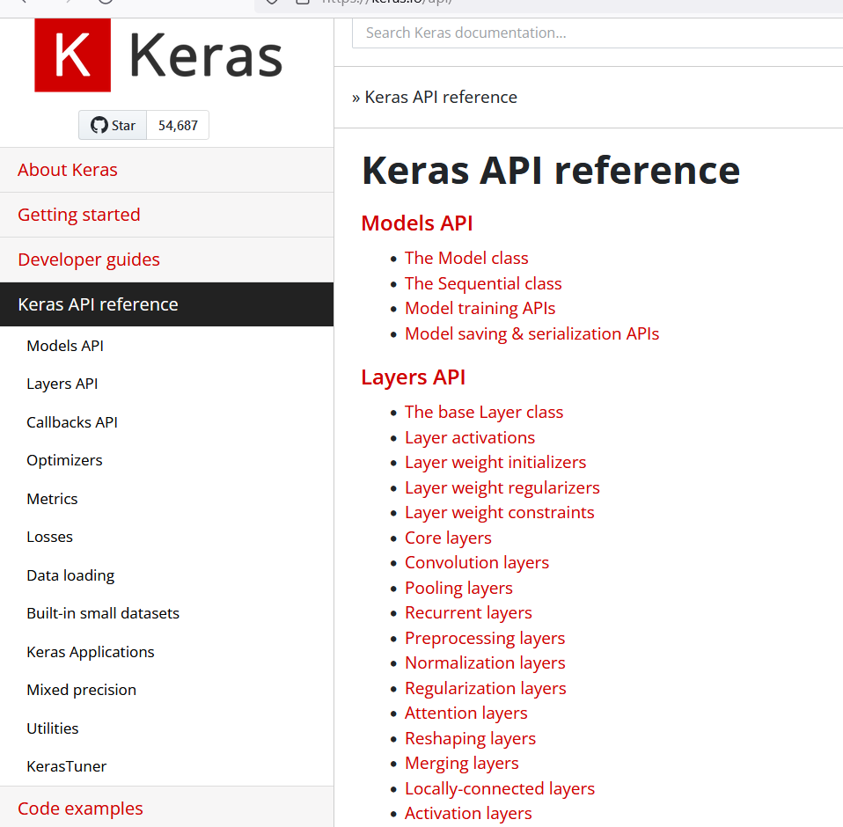
https://keras.io/api/

Slide 11
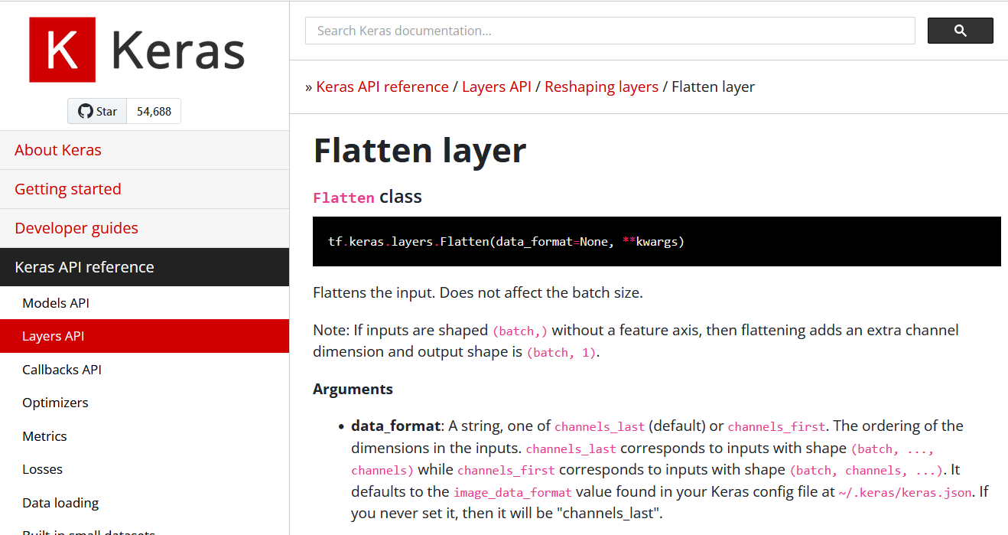
Reading documentation in Keras (1)
https://keras.io/api/layers/reshaping_layers/flatten/

Slide 12
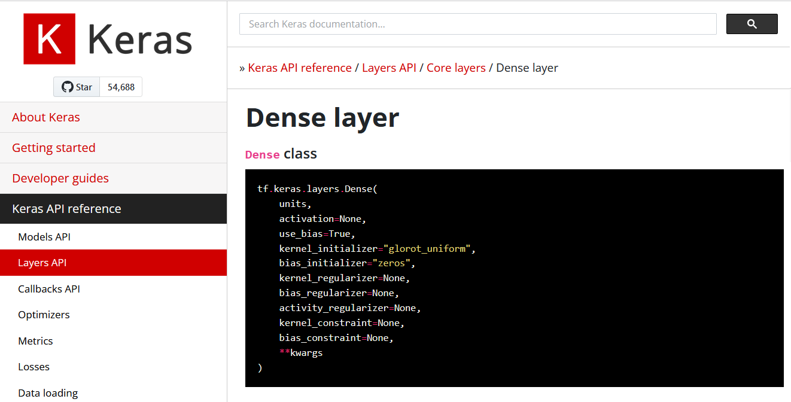
Reading documentation in Keras (2)
https://keras.io/api/layers/core_layers/dense/

Slide 13
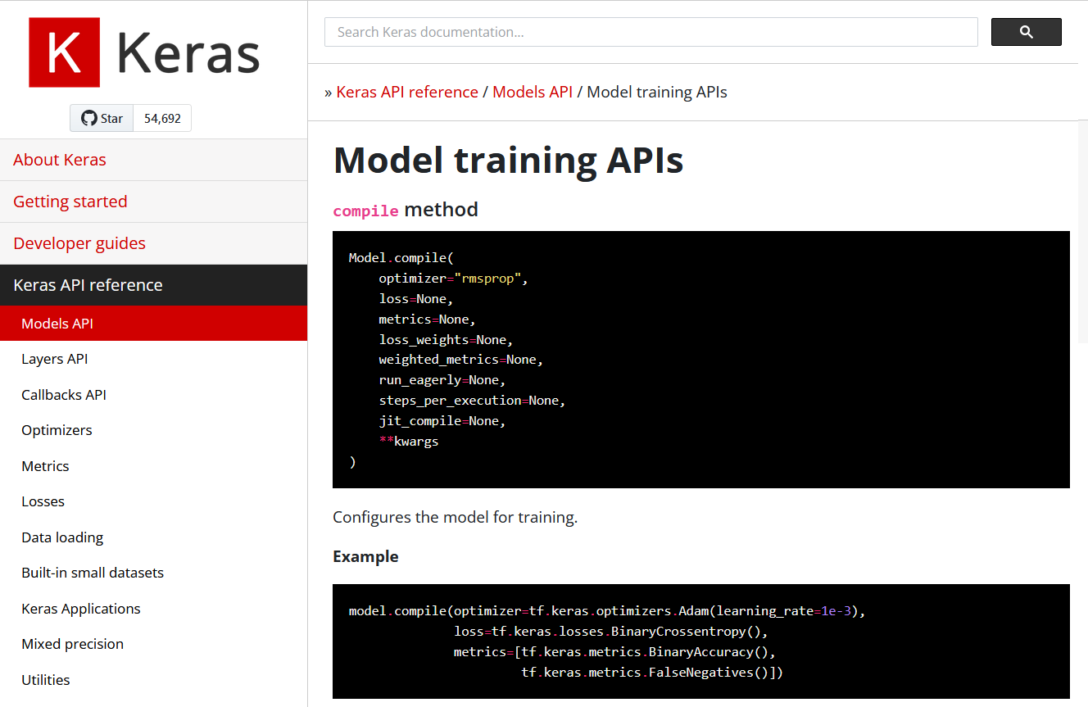
Reading documentation in Keras (3)
https://keras.io/api/models/model_training_apis/

Slide 14
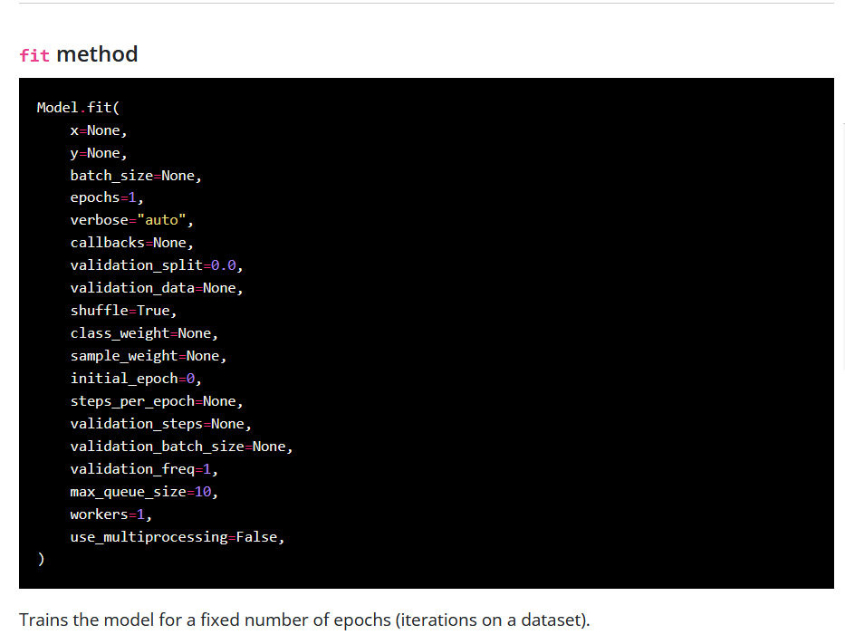
Reading documentation in Keras (4)
https://keras.io/api/models/model_training_apis/

Slide 15
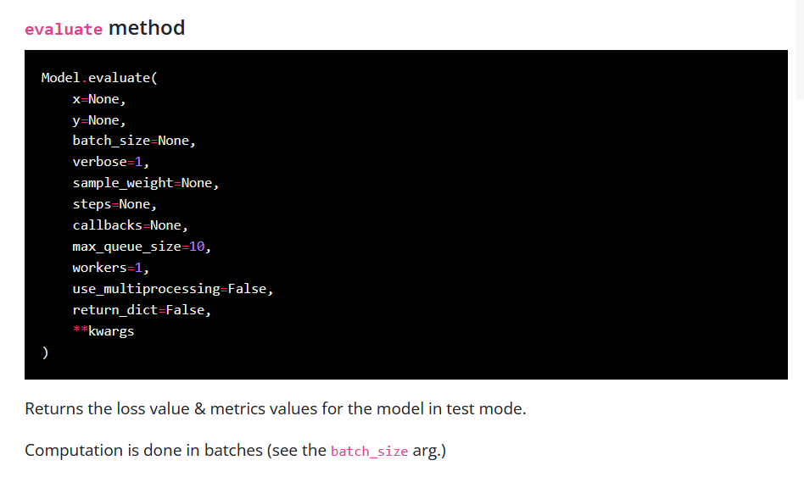
Reading documentation in Keras (5)
https://keras.io/api/models/model_training_apis/

Slide 16
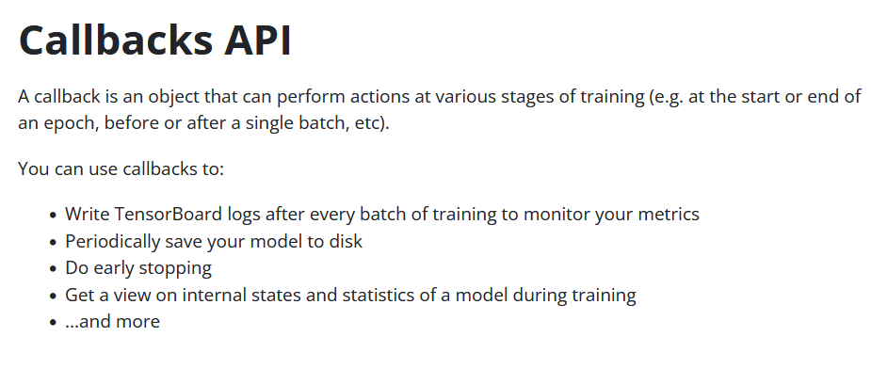
Callbacks API in Keras
https://keras.io/api/callbacks/

Slide 17
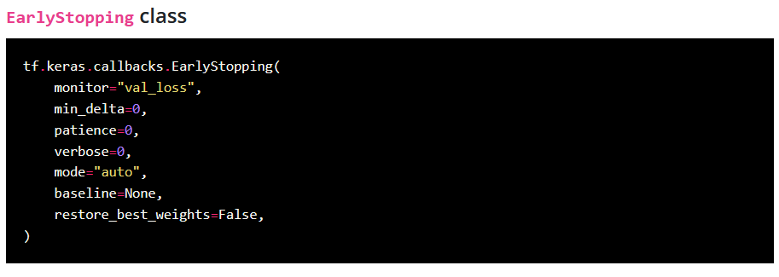
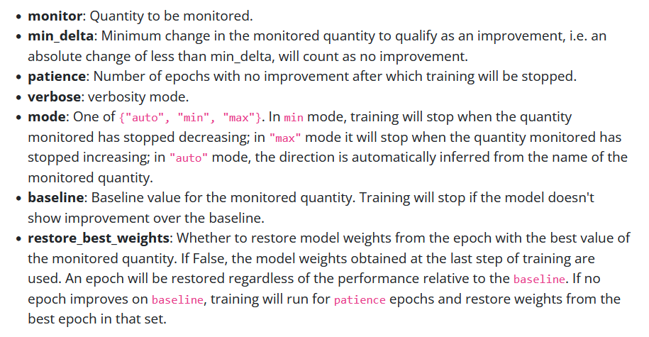
Callbacks – early stopping
https://keras.io/api/callbacks/early_stopping/

Slide 18
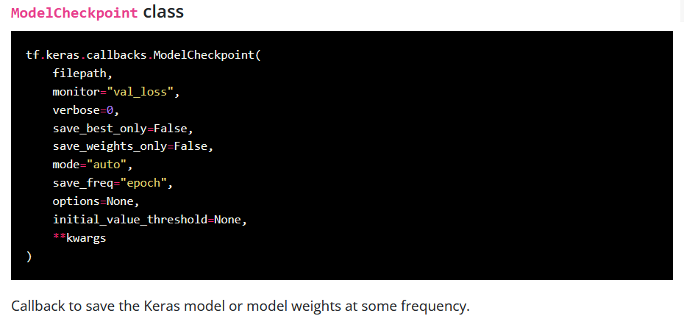
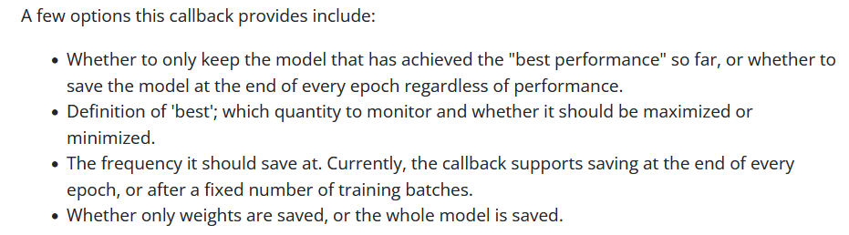
Callbacks – model checkpoint
https://keras.io/api/callbacks/model_checkpoint/

Slide 19

Questions
If you have questions about the lecture please send me me an email at rybinski@rybinski.eu

Slide 20
Next: Lab 6

Slide 21
prof. Krzysztof Rybinski
rybinski@rybinski.eu
Narxoz: all for the student

