Slide 1

Artificial intelligence Lecture 4. Introduction to neural networks
prof. Krzysztof Rybinski

Slide 2
Topics already covered
So far we covered
Linear regression: economist approach and ML approach with gradient descent implementation for univariate linear model
Logistic regression
Train set, test set (Lab 3)
ROC and threshold choice
Confusion matrix
Accuracy and other model quality metrics
In this lecture
Logistic regression as a simple NN
Forward and backward pass
Gradient descent in shallow NN

Slide 3
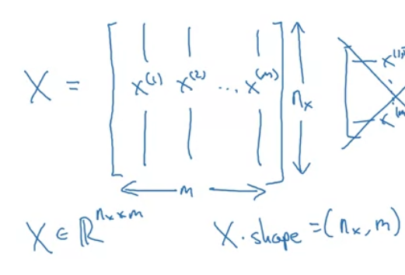
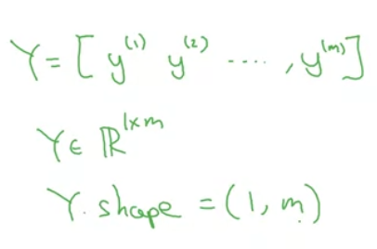
Notation for NN binary classification
Data: (x,y): x ϵ R^{nx} , y ϵ {0,1}
m training samples: {(x⁽¹⁾,y⁽¹⁾), (x⁽²⁾,y⁽²⁾), …, (x^{(m)},y^{(m)})}
Inspired by Andrew Ng course

Slide 4
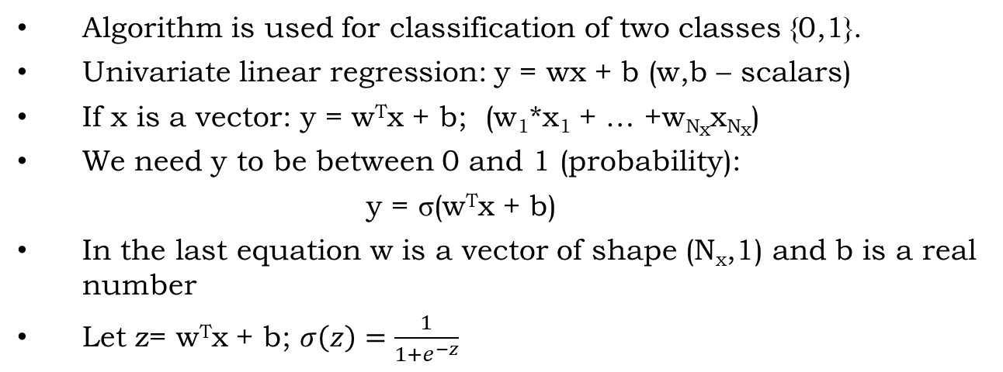
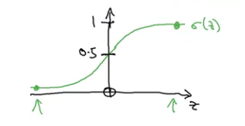
Logistic regression - notation

Slide 5
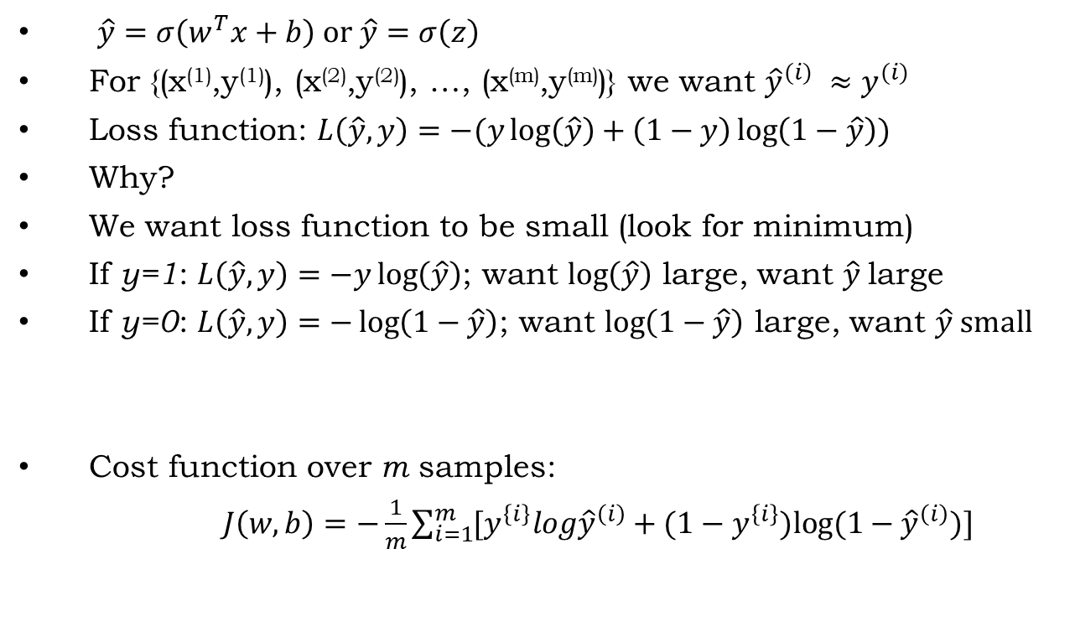
Logistic regression – loss function
y

Slide 6
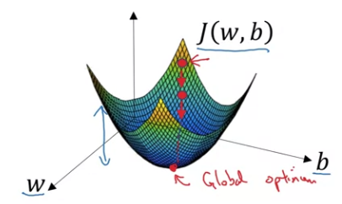
Minimizing loss function
We want to predict w and b that minimize the cost function.
Our cost function J(w,b) is convex
First we initialize (w,b) to (0,0) or to random values and then try to improve the values the reach minimum of the cost function J(w,b).

Slide 7
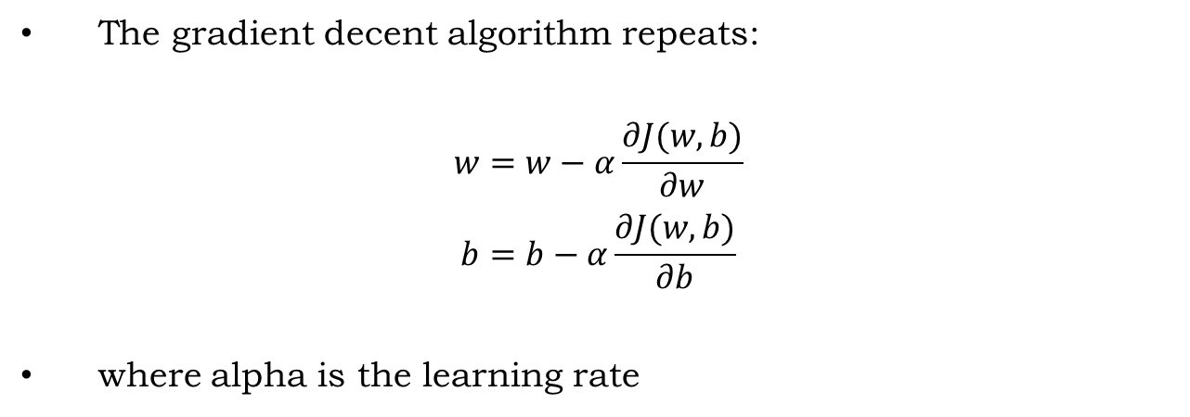
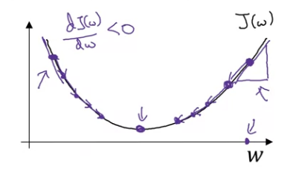
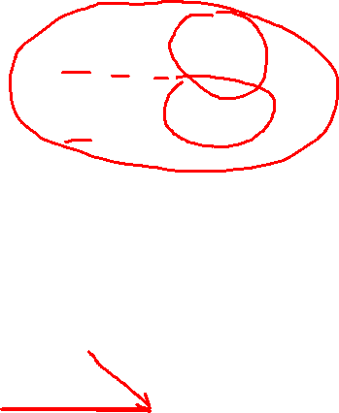
Gradient descent

Slide 8
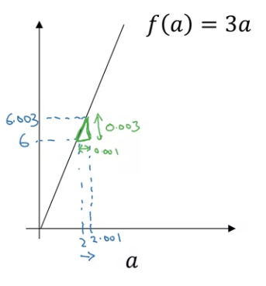
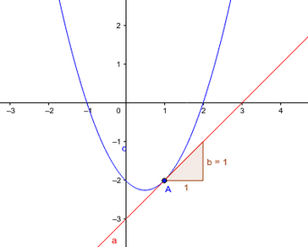

How derivatives help find minimum
y
a=2, f(a)=6
a=2.001, f(a)=6.003
Slope of f(a) at a=2 equals height divided by width of the triangle
df(a=2) = 0.003/0.001 = 3
df(a=10) = 0.0003/0.001 = 3
df/da = 3
It was simple for a linear function, it works the same way for all convex functions, locally approximated by a straight (tangent) line
Derivative in point x of a f(x) function is a slope of the tangent line at point x
Example: tangent line equation is y=1*x-3

Slide 9
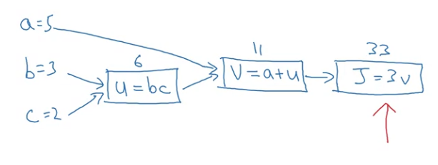

Computation graph – forward pass
J(a,b,c) = 3(a+bc)
u=bc
v=a+u
J(5,3,2) = 3(5+3*2) = 33

Slide 10

Computing derivatives – backward pass
Using calculus
dJ/da = dJ/dv * dv/da = 3*1 = 3
dJ/db = dJ/dv * dv/du * du/db = 3*1*c = 3*2 = 6
dJ/dc = try yourselves
Using small increments
a (5->5.001) => J(33->33.003); dJ/da = 0.003/0.001 = 3
Try other derivatives yourselves

Slide 11
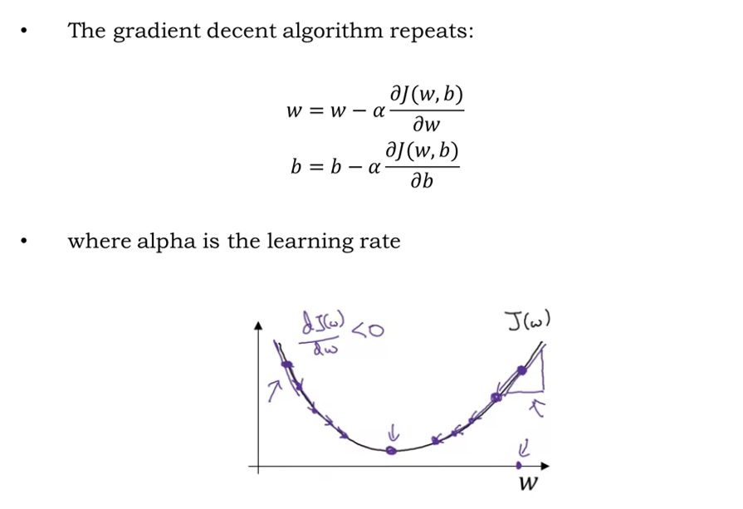

Why we compute derivatives?

Slide 12
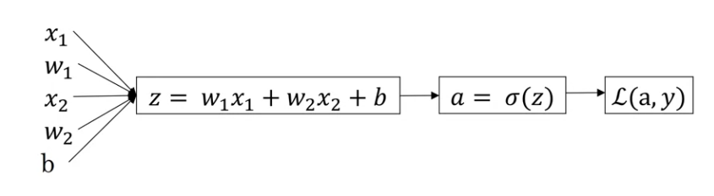
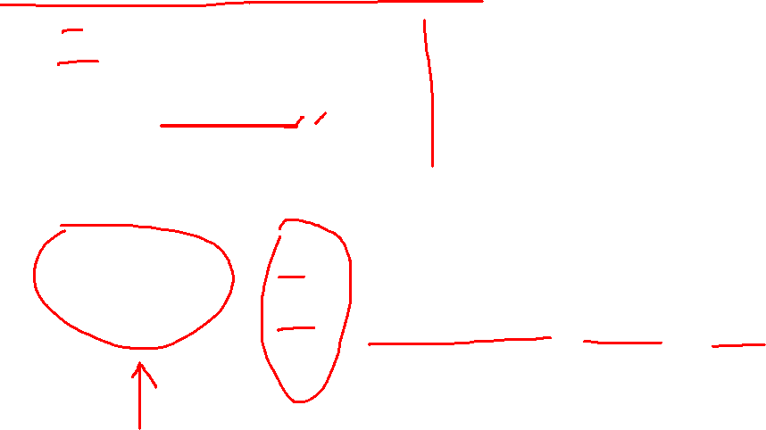
Gradient descent for logistic regression
L(a,y) = -(ylog(a)+(1-y)log(1-a)); σ(z)=1/(1+e^{-z})
da = dL/da = -(y/a) + (1-y)/(1-a)
dz = dL/dz = a - y
dw1 = dL/dw1 = x1 * dz
dw2 = dL/dw2 = x2 * d(z)
db = dL/db = dz
Parameters update
w₁ = w₁ – αdw₁
w₂ = w₂ – αdw₂
b = b – αdb

Slide 13

Gradient descent on m samples
J = 0; dw₁ = 0; dw₂ =0; db = 0;
w₁ = 0; w₂ = 0; b=0; #model weights to be learned
for i = 1 to m
# Forward pass
z[i] = w₁*x₁[i] + w₂*x₂[i] + b
a[i] = σ(z[i])
J += (y[i]*log(a[i]) + (1-y[i])*log(1-a[i]))
# Backward pass
dz[i] = a[i] – y[i]
dw₁ += dz[i] * x₁[i]
dw₂ += dz[i] * x₂[i]
db += dz[i]
J /= m; dw₁/= m; dw₂/= m; db/= m
Parameters update This is just one step of
w₁ = w₁ – αdw₁ of gradient descent calculation
w₂ = w₂ – αdw₂
b = b – αdb

Slide 14

Gradient descent vectorized
We will implement Logistic Regression without any „for” loop.
As an input we have a matrix X, X.shape=(N_{x}, m) and a matrix Y, Y.shape=(N_{y}, m) .
We will then compute at instance [z₁,z₂...z_{m}] = W^{T} * X + [b,b,...b] .
This single iteration of gradient descent can be written in Python as:
Z = np.dot(W.T,X) + b #Z shape is (m,1)
A = 1 / (1 + np.exp(-Z)) #A shape is (m,1)
#Vectorizing Logistic Regression's Gradient Output:
dz = A - Y #dz shape is (m,1)
dw = np.dot(X, dz.T) /m #dw shape is (N_{x}, 1)
db = dz.sum()/m # Vectorization, dz shape is (1, 1)
But you still need many steps of gradient descent, for step in range(1000)
or similar. You have seen this in linear regression example.

Slide 15
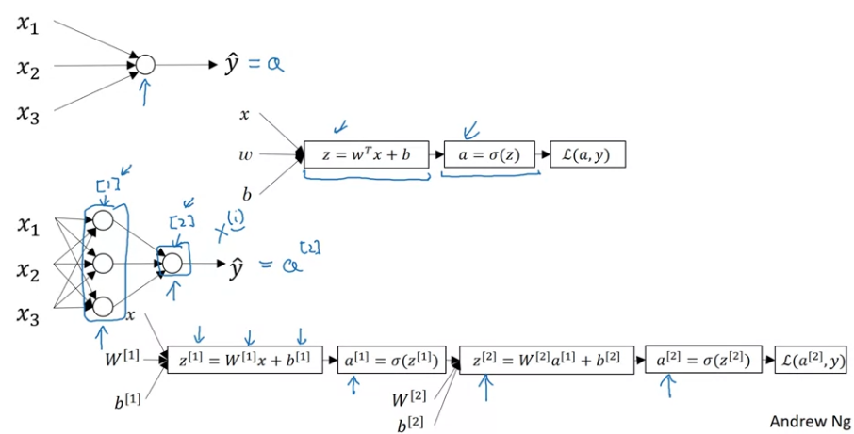
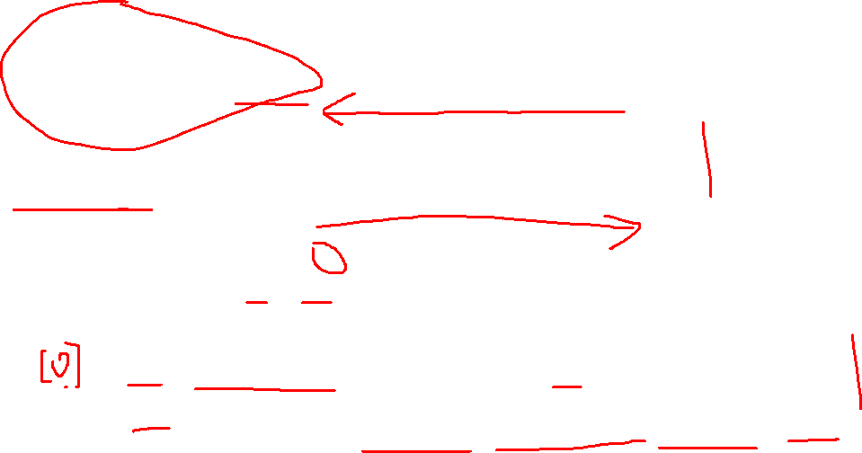
Shallow neural network

Slide 16
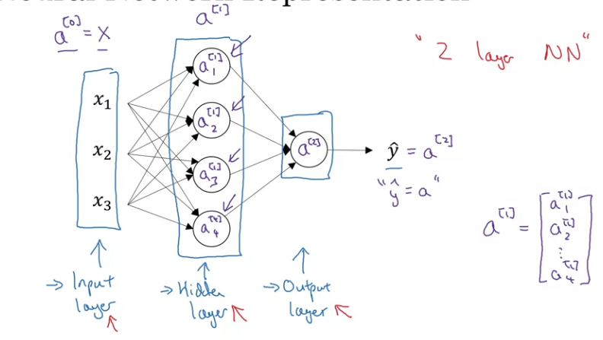
Shallow neural network notation

Slide 17
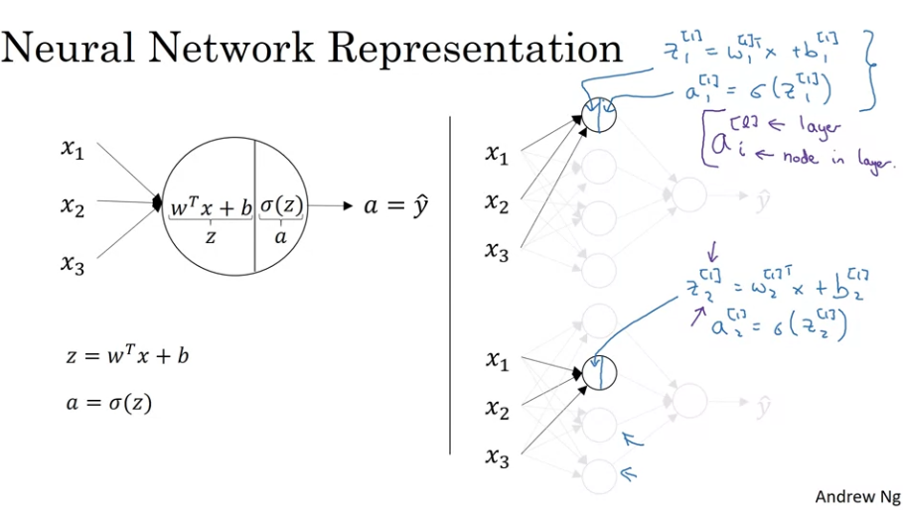
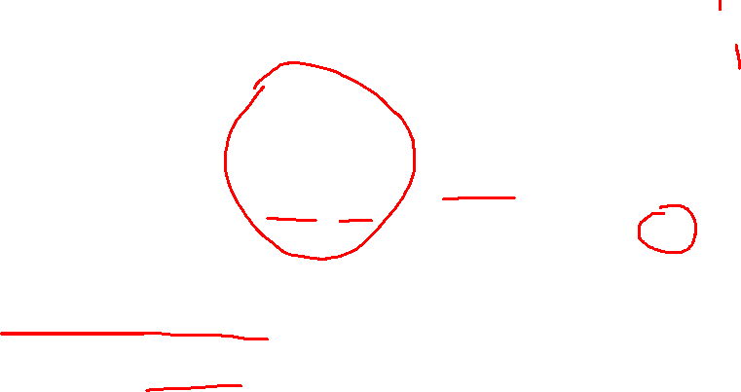
Shallow neural network representation

Slide 18
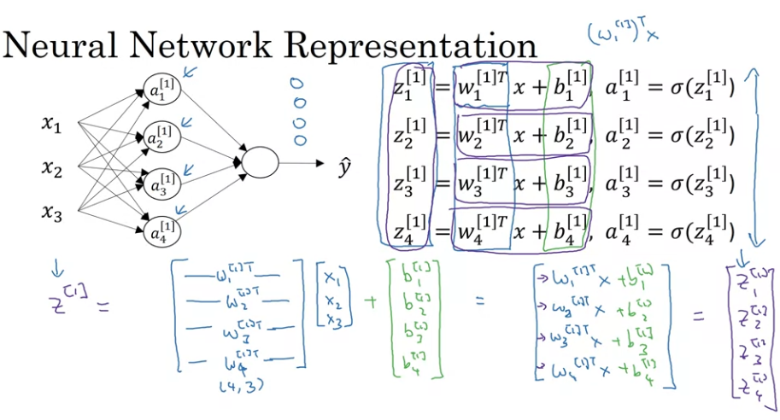

Fully connected layer representation

Slide 19
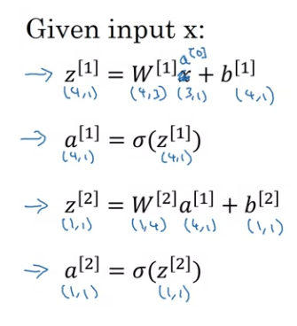
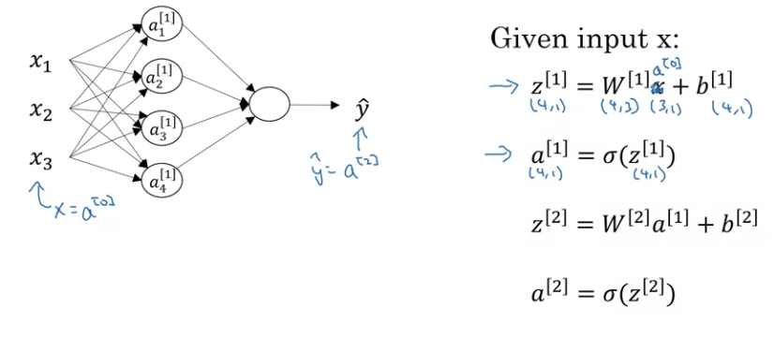

Forward pass in fully connected NN

Slide 20
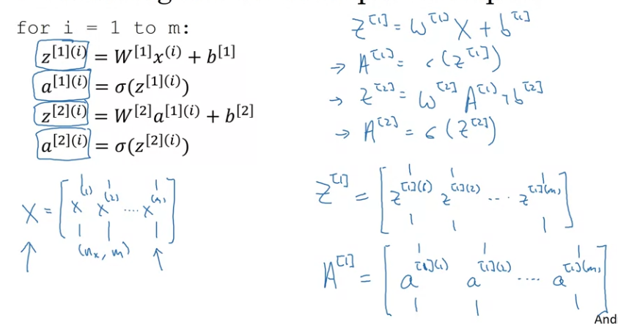

Vectorizing forward pass

Slide 21
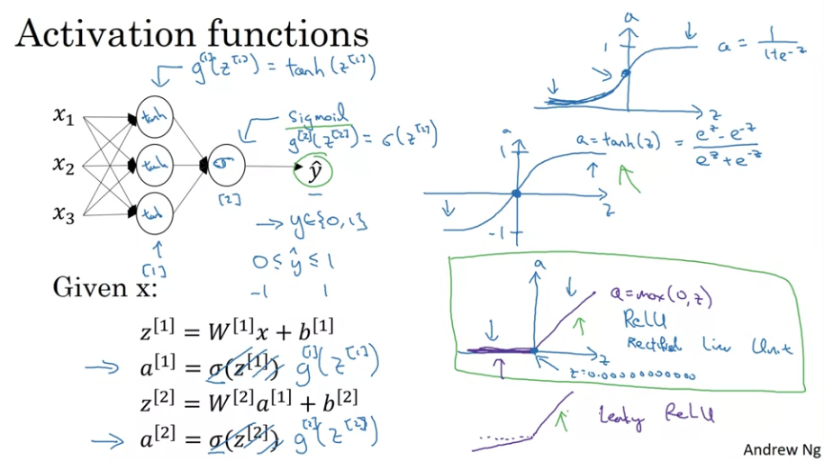
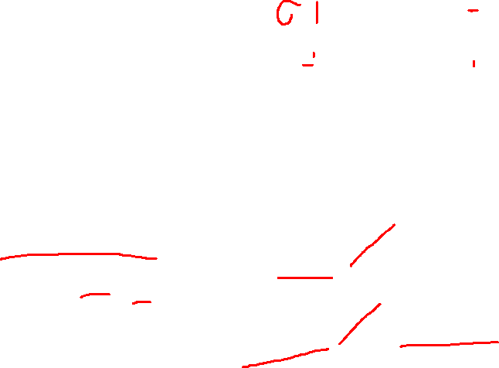
Activation functions

Slide 22
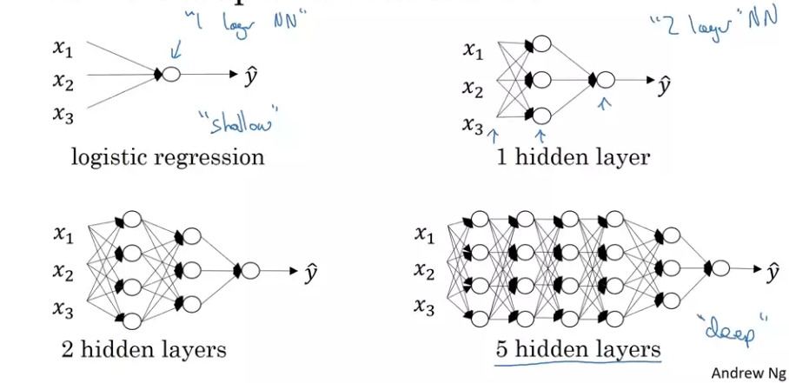
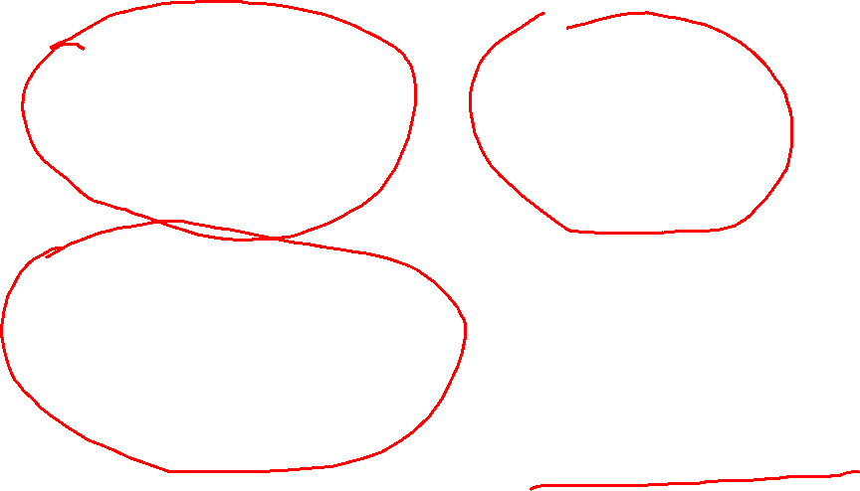
Deep neural networks

Slide 23
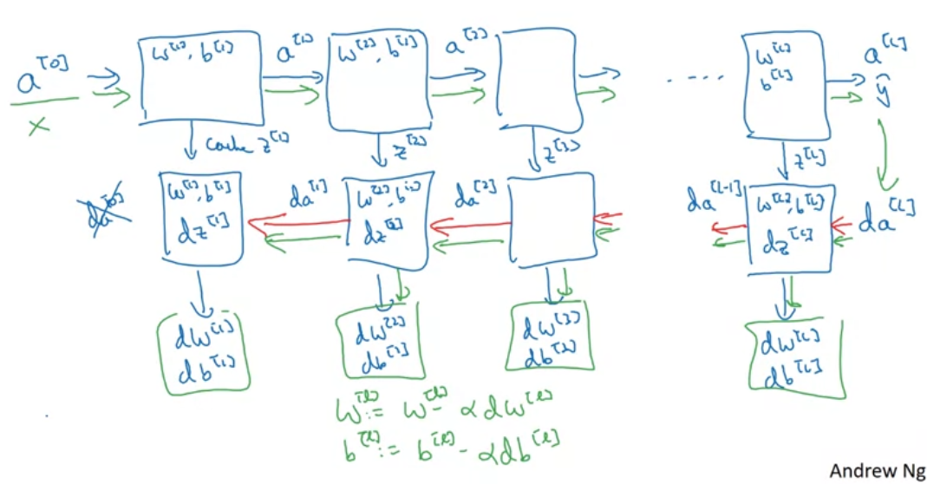

Forward and backward pass

Slide 24

Hyperparameters
Main parameters of the NN is W and b
Hyperparameters (parameters that control the algorithm) are like:
Learning rate
Number of iterations
Number of hidden layers L
Number of hidden units n in each layer
Choice of activation functions
And many more, depends on the type of the NN.
You have to try different values of hyperparameters yourself.

Slide 25

Questions
If you have questions about the lecture please send me me an email at rybinski@rybinski.eu

Slide 26
Next: Lab 4

Slide 27
prof. Krzysztof Rybinski
rybinski@rybinski.eu
Narxoz: all for the student

