Slide 1

Artificial intelligence Lecture 6.1. Gradient decent optimizers
prof. Krzysztof Rybinski

Slide 2


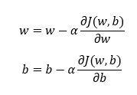

Problems with (batch) gradient descent
Recall equations from previous lectures
Binary cross-entropy loss function:
Cost function:
Learning:
Gradient descent means that is computed for all m data samples. If m is large, the cost in terms of memory and compute time will be high.

Slide 3

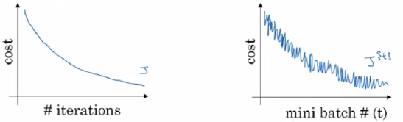
Stochastic and minibatch GD
Stochastic gradient descent means that is computed for each data point i separately, chosen randomly, no repetitions.
Slow as it cannot be vectorized, very noisy, may not converge to a minimum
Solution, use minibatch gradient descent
1 < minibatch size < m
Gradient descent
Minibatch GD

Slide 4
Pros and cons
BGD
Simple, fixed learning rate, quick convergence to global minimum if loss function is convex (rare), can be stuck in local minimum
Slow for large datasets,
Use for small datasets that fit into computer memory, for problems with convex loss functions (linear and logistic regression)
SGD
Faster than BGD for large data sets, can escape from local minima
Noisy steps, can bounce around the global minimum, not vectorized
Rarely used as such, is a basis for optimized algorithms
Minibatch GD
A good balance between BGD and SGD, fits into RAM, can escape from local minima
Can bounce around the global minimum, one more hyperparameter to optimize (batch size)
Very frequently used, with optimizers, batch size is a power of 2 (32, 64, 128,…), make sure it fits in CPU/GPU memory. For small training set (<2000 examples) use Batch Gradient Descent

Slide 5

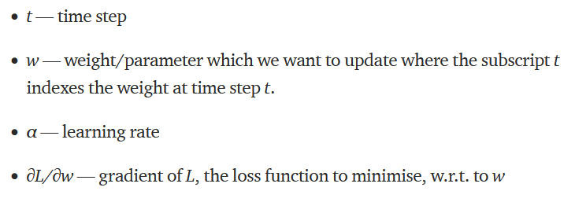
Notation for optimizers’ discussion
https://towardsdatascience.com/10-gradient-descent-optimisation-algorithms-86989510b5e9

Slide 6

SGD optimization
Adapt the gradient component , such as taking an aggregate of multiple gradients
Adapt the learning rate component , change the learning rate according to the magnitude of the gradient
Adapt both

Slide 7

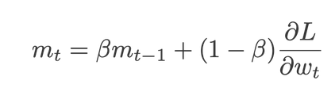
Momentum
In weights update equation current gradient is replaced with momentum m.
Momentum is a geometric moving average of current and past gradients.
m is intialized to 0, and the common value for β is 0.9.
Less noisy, more weight given to recent gradients
Momentum is used by most optimizers

Slide 8
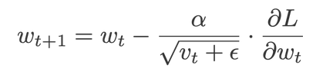
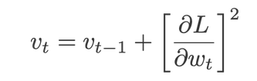
Adaptive gradient (AdaGrad)
Learning rate is didived by a sqrt of cummulative sum of squared past gradients
ϵ is a small number (fuzz factor) to avoid division by zero
Default values from Keras α = 0.01, ϵ = 10⁻⁷
is sum of squares, so it increases over time, and the learning rate falls over time, so no manual adjustment to learning rate is needed
When there are many interations, can become large and convergence can be very slow

Slide 9
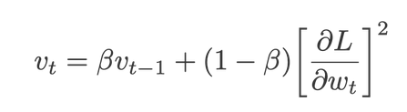
Root mean square prop (RMSprop)
Learning rate is didived by a sqrt of exponential moving average of squared past gradients
ϵ is a small number (fuzz factor) to avoid division by zero
Default/recommended values α = 0.001, ϵ = 10⁻⁶, β = 0.9
Avoids the problem of learning rate becoming very small
RMSprop is a standard update for learning rate for many optimizers

Slide 10

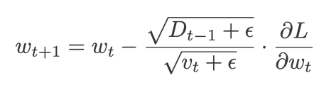
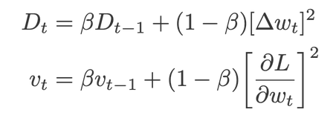

Adaptive delta (Adadelta)
It removes the use of learning rate parameter completely, replacing with D, exponential moving average of squared
ϵ is a small number (fuzz factor) to avoid division by zero
Default values in Keras: ϵ = 10⁻⁶, β = 0.95

Slide 11
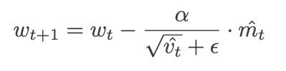
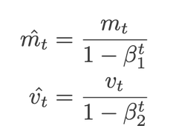
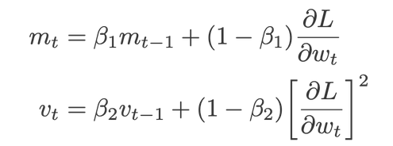
Adaptive moment estimation (Adam)
Adam optimizer works well in a large number of scenarios. It takes the best of RMS-Prop and momentum.
Recommended values : ϵ = 10⁻⁸, β₁ = 0.9, β₂ = 0.999, α = 0.001

Slide 12
Strategies for optimising SGD
Shuffling
Avoid providing the training samples in a meaningful order, good idea is to shuffle training data after every epoch
Curriculum Learning
In some scenarios we aim to solve progressively harder problems, supplying samples in a meaningful order may lead to improved performance. For example it is applied when the algorithm performance differs across classes.
Batch normalization
Training process updates parameters to a different extent, which slows training and amplifies changes as the network becomes deeper. Normalization reestablishes the typical range of values, we do not have to pay attention to the initialization parameters.
Early stopping
You should monitor the error on a validation set and stop training if this error does not improve. This helps avoid overfitting.

Slide 13
Visualisation of optimizers
https://editor.analyticsvidhya.com/uploads/56201contours_evaluation_optimizers.gif

Slide 14

Questions
If you have questions about the lecture please send me me an email at rybinski@rybinski.eu

Slide 15
Next: Lecture 5.2

Slide 16
prof. Krzysztof Rybinski
rybinski@rybinski.eu
Narxoz: all for the student

