Slide 1
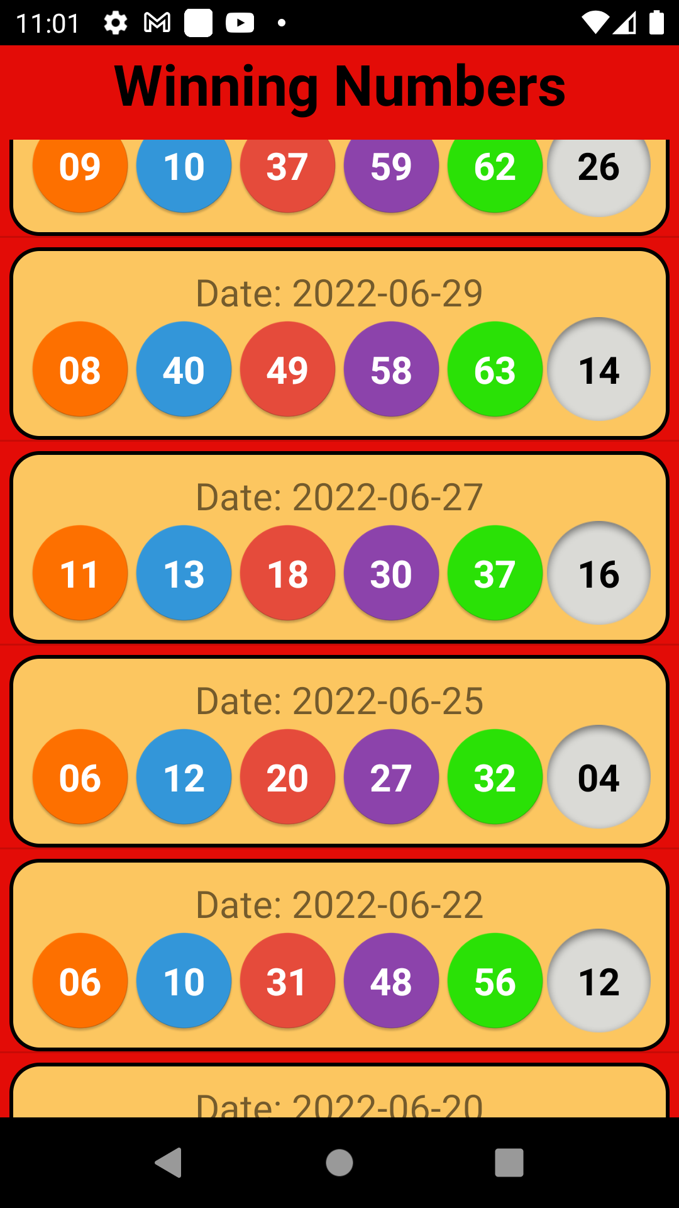
Power Ball
Predict numbers

Slide 2
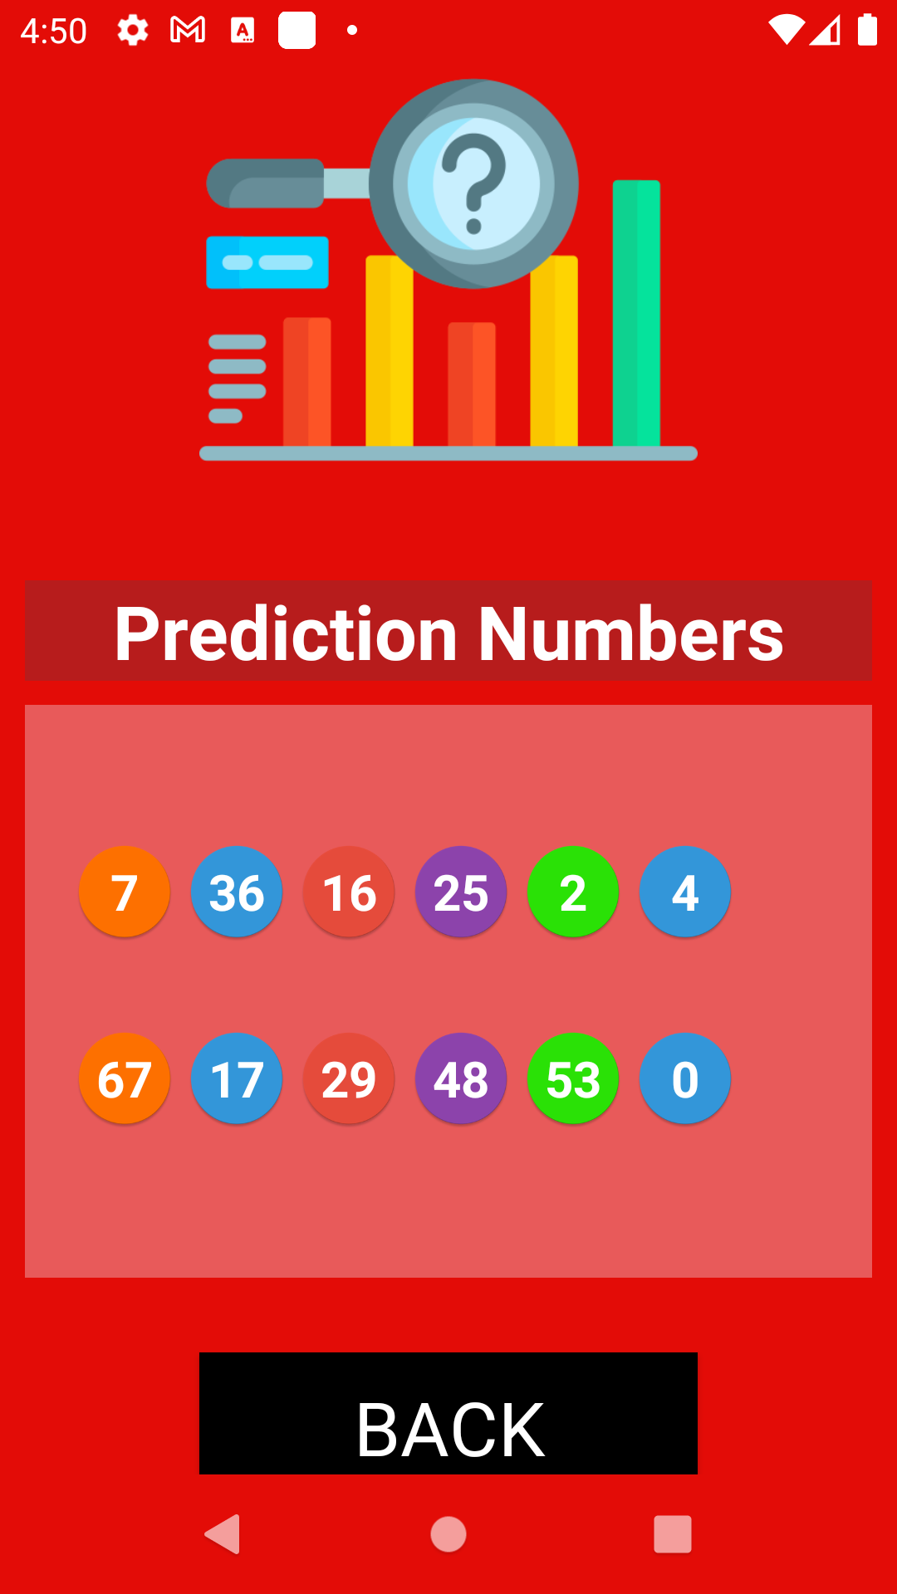
Based AI, BigData
Deep Learning tech

Slide 3
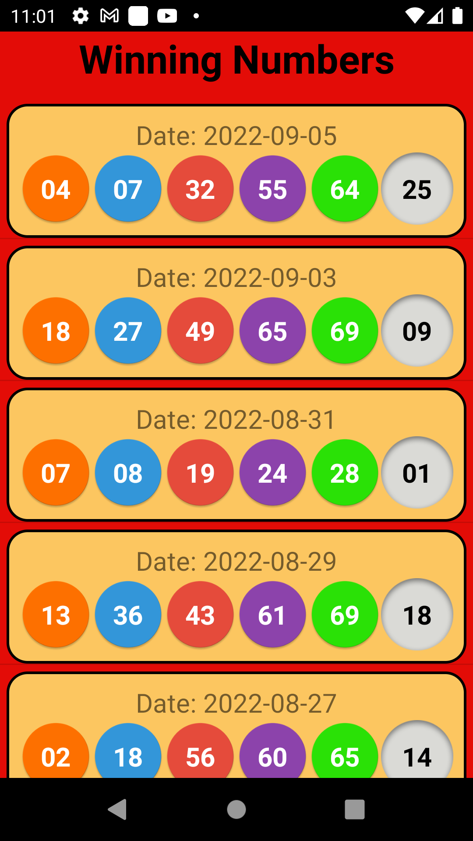
Real time
winning numbers

Slide 4

Help to increase the probability

