Slide 1
Conditionals
Concept: The if statement is used to create a decision structure, which allows a program to have more than one path of execution. The if statement causes one or more statements to execute only when a Boolean expression is true.

Slide 2
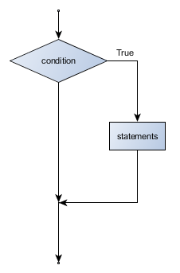
We use the if statement to write a single alternative decision structure. Here is the general format of the if statement.
If (condition is true){
Statement
Statement
Statement
}

Slide 3
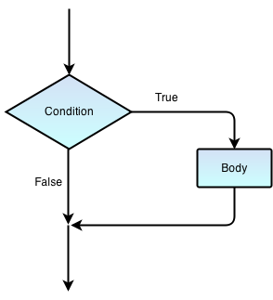
If Condition
Cold Outside?
True:
Wear a Coat
Wear a hat
Wear gloves
False
End

Slide 4
Boolean expressions
Boolean expressions are used in the condition part of an if statement.
A Boolean expression is something that evaluates to true or false
For example : (10 > 8) is a Boolean expression because it evaluates to false.
If you read the expression as 10 is greater than 8 you know that is false.

Slide 5
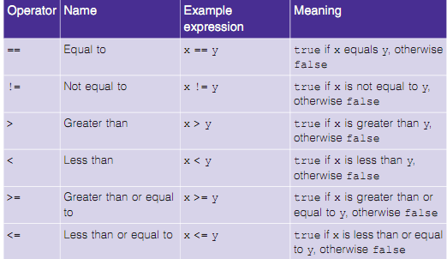
Boolean expressions- operators

Slide 6
syntax for if statements
if (condition) {
code to execute if condition is true
additional code to execute if true
}
code that gets executed whether true or false.

Slide 7
What gets printed?
int x = 4;
print(“this is as test”);
if (x < 5) {
print(“this gets executed only if x is less than 4”);
print(“same with this line”);
}
print (“this gets executed no matter what x is”);
*Remember – print is pseudo code replace with language specific syntax

Slide 8
What gets printed?
int x = 5;
print(“this is as test”);
if (x < 5) {
print(“this gets executed only if x is less than 4”);
print(“same with this line”);
}
print (“this gets executed no matter what x is”);
*Remember – print is pseudo code replace with language specific syntax

Slide 9
Find the error
int x = 5;
print(“this is as test”);
if (x = 5) {
print(“this gets executed only if x is less than 4”);
print(“same with this line”);
}
print (“this gets executed no matter what x is”);
*Remember – print is pseudo code replace with language specific syntax

Slide 10
Program 4-1: Using the if Statement
Kathryn teaches a science class and her students are required to take three tests. She wants to write a program that her students can use to calculate their average score. She also wants the program to congratulate the student enthusiastically if the average is greater than 95. Here is the algorithm in pseudocode:
Get the first test score
Get the second test score
Get the third test score
Calculate the average
Display the average
If the average is greater than 95:
Congratulate the user

Slide 11
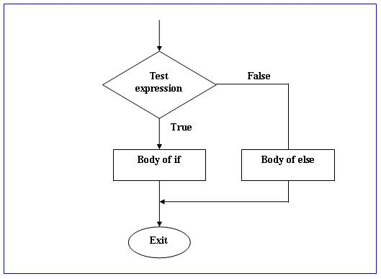
If, else if , and else
if (condition1){
code block 1;
}
else{
code block2
}
rest the program
Condition
Code block 1
Code block 2

Slide 12
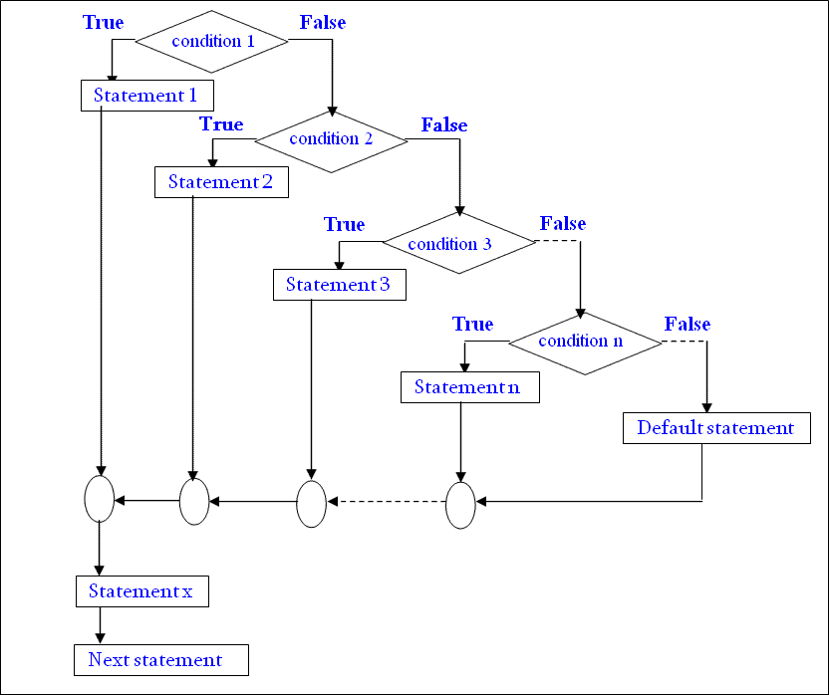
Nested If Else statements
if (condition1){
code block 1;
}
else {
if (condition2){
code block 2
}
else{
if (condition3){
code block 3
}
else{
code block4
}
}
}
rest the program
Code block 1
Code block 2
Code block 3
Code block 4
Rest of program

Slide 13
Nested If Else statements using Else If
if (condition1){
code block 1;
} else if (condition2){
code block 2
} else if (condition3){
code block 3
} else{
code block4
}
rest the program
Code block 1
Code block 2
Code block 3
Code block 4
Rest of program

Slide 14
if else statements examples
int x = 4;
print (“this is as test”);
if (x < 5) {
print(“this gets executed only if x is less than 4”);
print(“same with this line”);
else :
print(“this only gets executed if x >= 4”);
print(“still within else block”);
print (“this gets executed no matter what x is”)

Slide 15
syntax for else if statements (revisited)
int x = 5;
print (‘this is as test’)
if (x < 5) {
print(“this gets executed only if x is less than 4”);
print(“same with this line”);
}
else if (x < 7) {
print(“this only gets executed if 7>x >= 5”);
print(“still within else if block”);
}
else :
print(“this only gets executed if x >= 7”);
print(“still within else block”);
}
print (“this gets executed no matter what x is”);

