Slide 1



Migrating billions records
from SQL to NoSQL
using continuous migration technique
with PySpark and DataProc
Piti Champeethong
23-Apr-2025

Slide 2
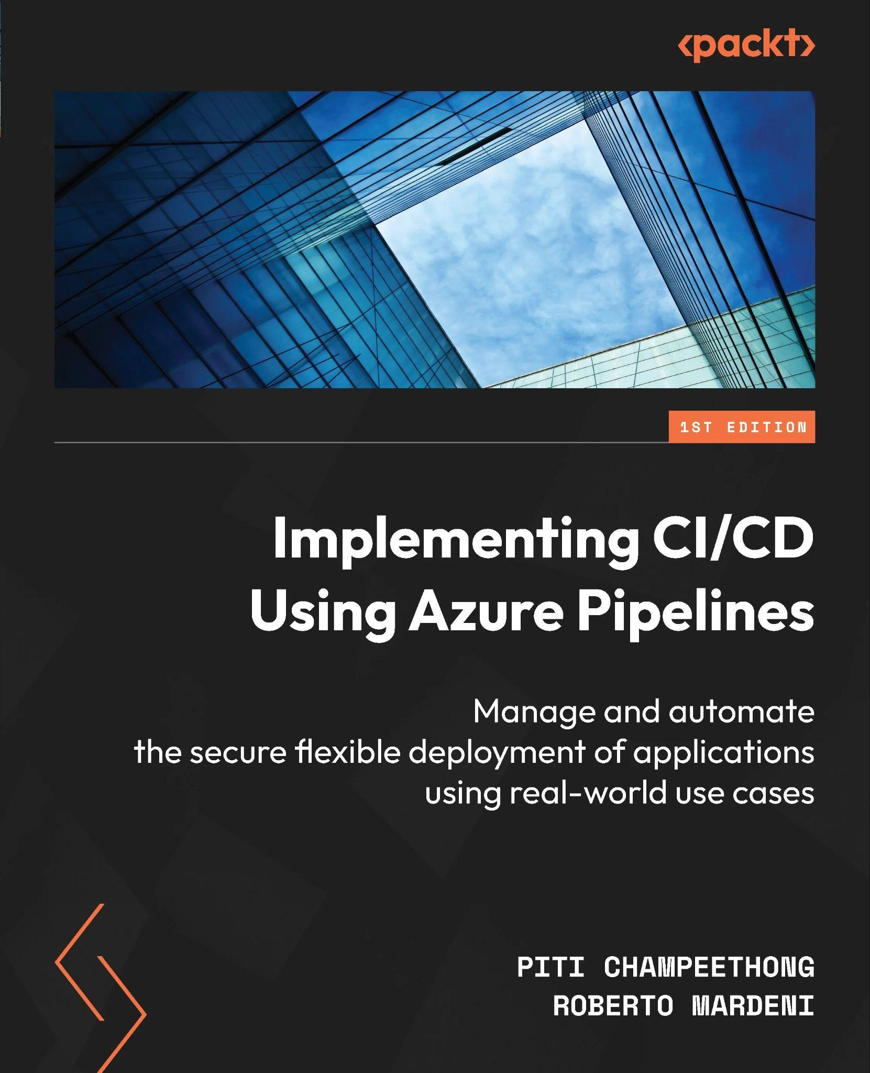



Introduce to myself
Please call me Fyi (ฟี่) from Thailand
I’m the PyCon Thailand team member
Microsoft MVP: Developer Technologies
Book: Implementing CI/CD Using Azure Pipelines: Manage and automate the secure flexible deployment of applications using real-world use cases
Repo: https://github.com/ninefyi
Tech Mentor Volunteer

Slide 3
Agenda
Business context and technical challenge of billion rows data migration.
Data Pipeline Architecture cover below technology
Microsoft SQL Server (MsSQL)
Google Cloud Platform (GCP): DataProc
PySpark
MongoDB Atlas
Migration approach for handling billion-row from MsSQL to MongoDB Atlas
Q&A

Slide 4
Business and Technical Challenges
MongoDB Atlas (GCP)
Massive data (~1B rows)
Denormalization
Data Migration with Minimum Downtime

Slide 5
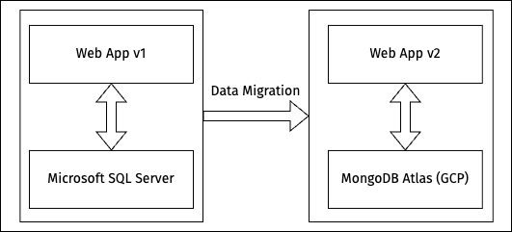
Challenges - Minimum Downtime

Slide 6
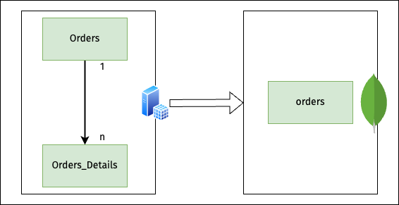
Challenges - Denormalization

Slide 7
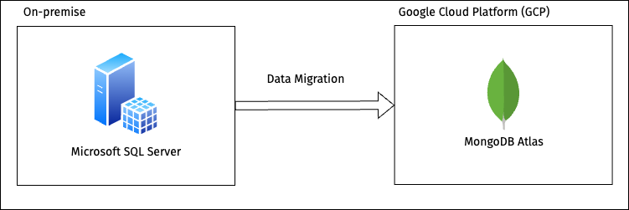
Data Pipeline Architecture (High-Level)

Slide 8
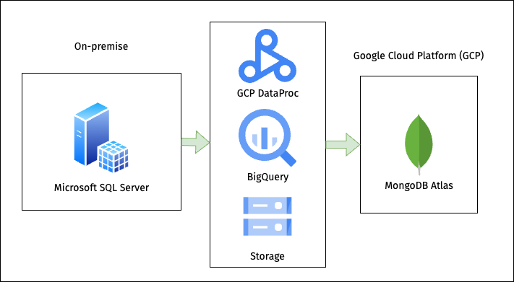
Data Pipeline Architecture (Details)

Slide 9
Data Pipeline Architecture
GCP Cloud Storage (Python files and libraries)
GCP DataProc (Continuous running)
Microsoft SQL Server (Source)
MongoDB Atlas GCP (Destination)

Slide 10
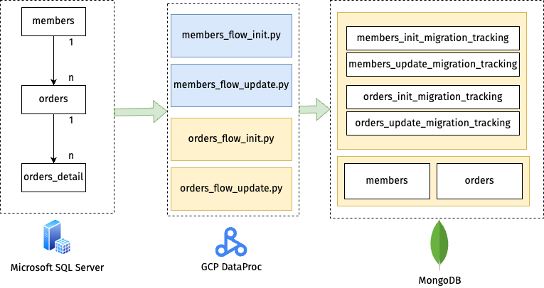
Deep dive to continuous technique

Slide 11
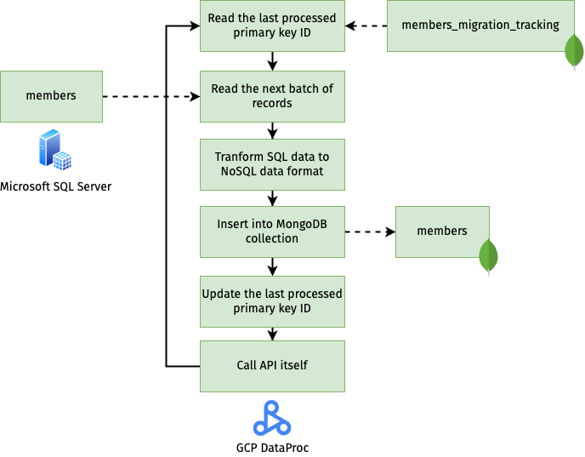
Deep dive to continuous technique

Slide 12
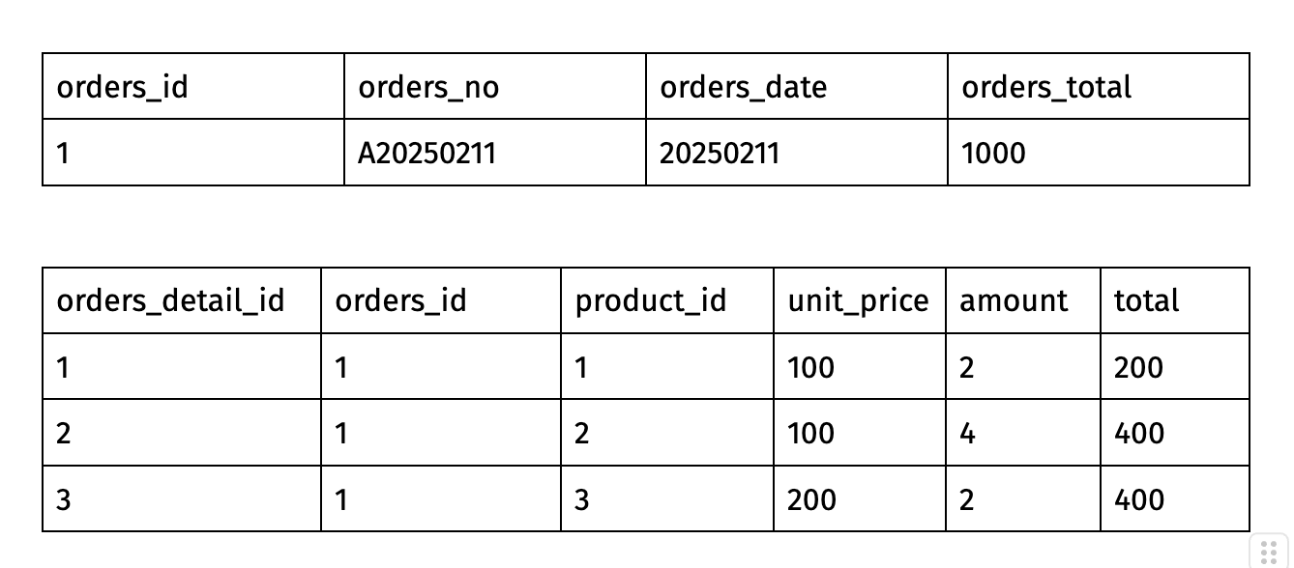
Microsoft SQL Server

Slide 13
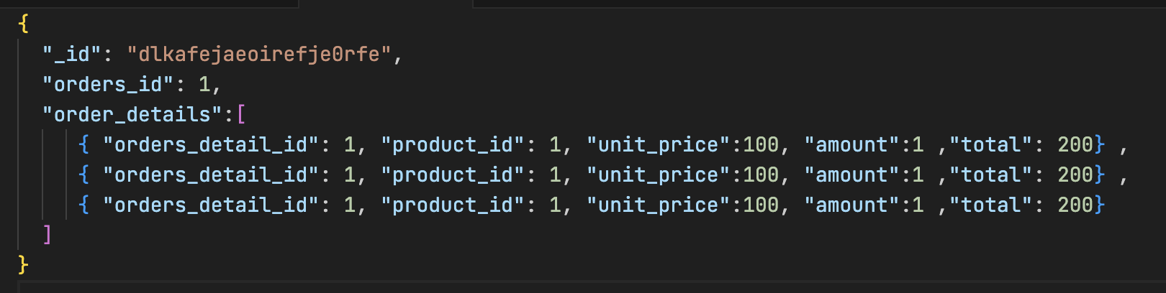
MongoDB Collection

Slide 14
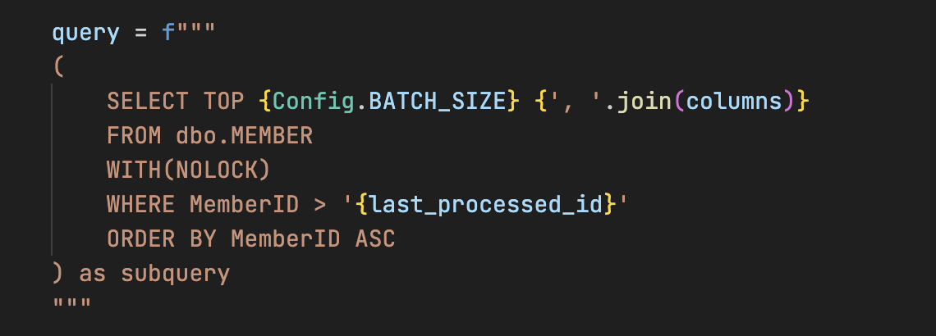
Deep dive to continuous technique

Slide 15
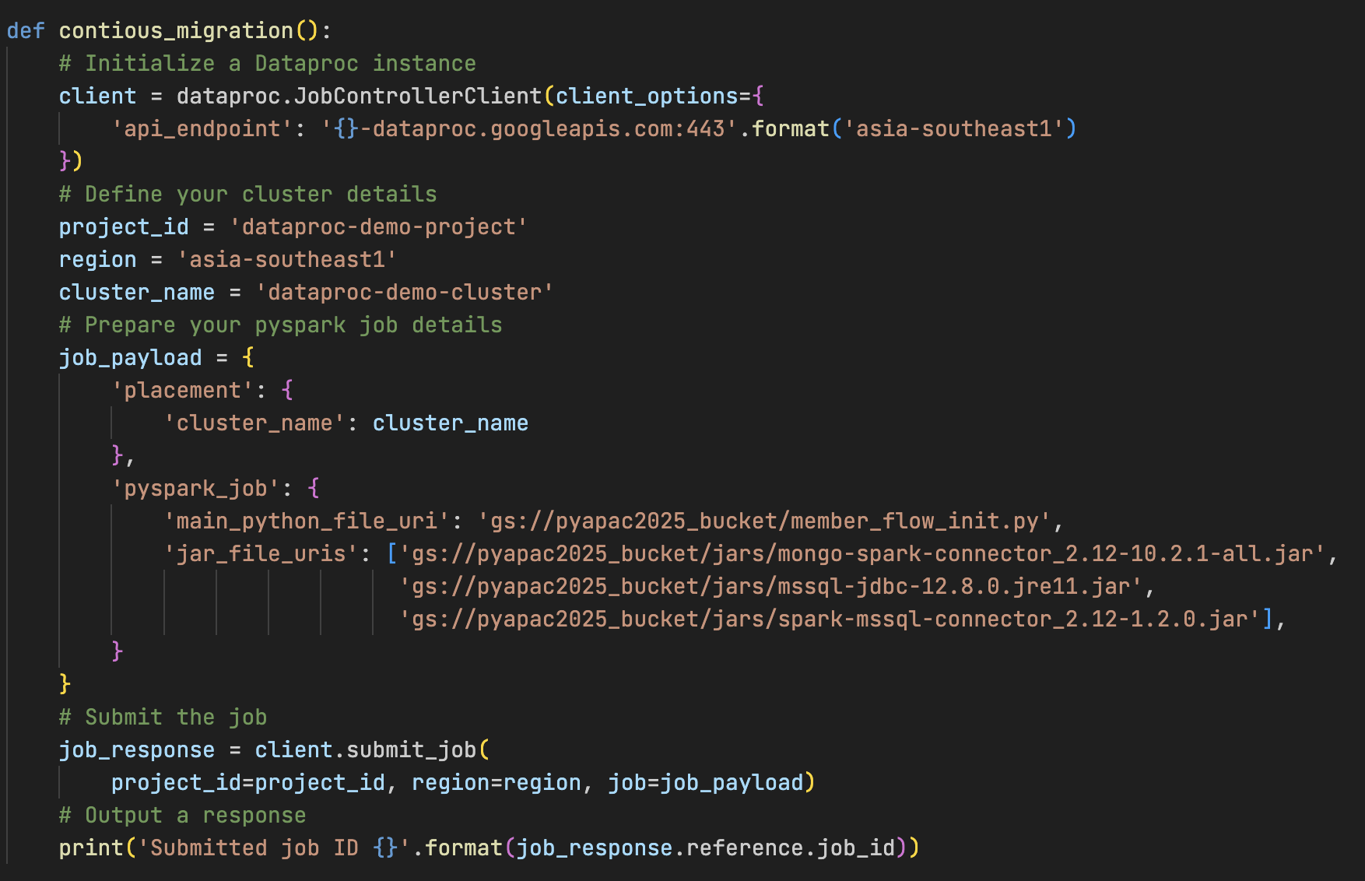

Slide 16
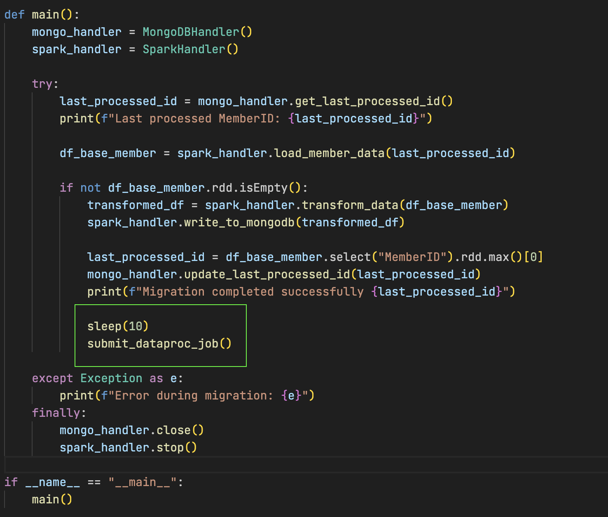

Slide 17
Deep dive to continuous technique
gcloud dataproc jobs submit pyspark dataproc-demo-project \
--cluster=dataproc-demo-cluster \
--region=asia-southeast1 \
--jars gs://pycon2025_bucket/jars/mongo-spark-connector_2.12-10.2.1-all.jar, gs://pycon2025_bucket/jars/mssql-jdbc-12.8.0.jre11.jar, gs://pycon2025_bucket/jars/spark-mssql-connector_2.12-1.2.0.jar \
gs://pybucket/member_flow_init.py

Slide 18
Limitation
No support for running two applications at the same time (App v1 and App v2)
Support only PRIMARY KEY as an auto number
Need Created/Modified date field on source

Slide 19
References
https://cloud.google.com/dataproc/docs/tutorials/python-library-example
https://www.mongodb.com/docs/spark-connector/v10.2/python/api/

Slide 20
Last .. but … not least

Slide 21
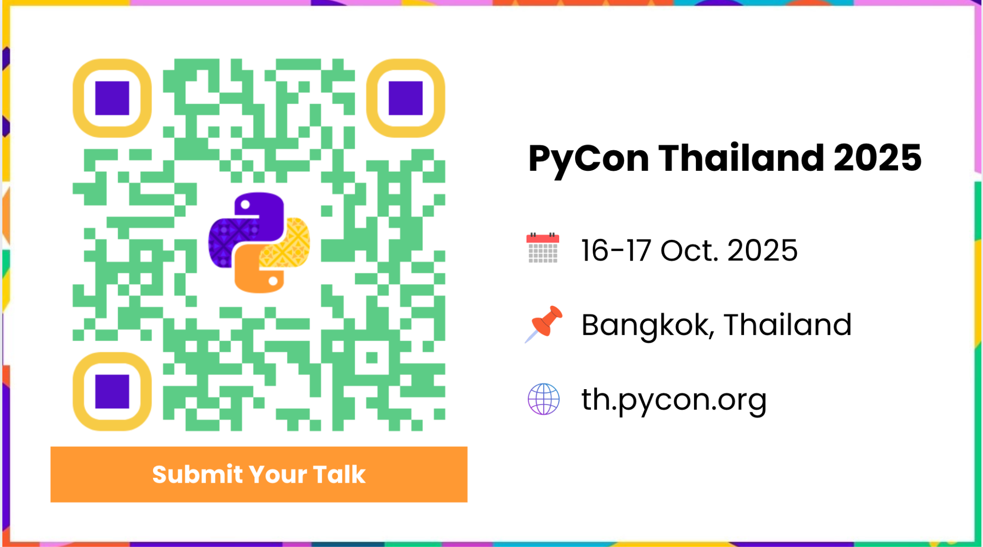

Slide 22
THANK YOU!
ขอบคุณครับ!

