Slide 1
大模型部署多个gpu上
2023-4-5

Slide 2
Meeting Records：
大模型chatgpt located MHA相关性，locality ：minimize communication
每一个head之间没有关联，weight*input之后weight再也不被用到
每个head计算是否速度相同？有没有非同一性？
清华单gpu跑gpt训练
https://research.facebook.com/file/1574548786327032/LLaMA--Open-and-Efficient-Foundation-Language-Models.pdf
head很大代表一个word的表示大，即相关性联系更大。每次怎么大，大多少
一个时间
parallelism有多层，优先大颗粒度
fit into one gpu using pipiline

Slide 3
PAPERs:
https://arxiv.org/pdf/2104.04473.pdf | Efficient Large-Scale Language Model Training on GPU Clusters Using Megatron-LM
https://arxiv.org/pdf/2205.14135.pdf https://www.youtube.com/watch?v=FThvfkXWqtE | FlashAttention ：提出分部计算softmax； 反向传播时重新计算QKV attention前向计算不存储整个softmax的结果，而是存储max + log (sum)
https://arxiv.org/pdf/2302.13971.pdf | LLaMA: Open and Efficient Foundation Language Models
https://arxiv.org/pdf/1805.02867.pdf | Online normalizer calculation for softmax

Slide 4
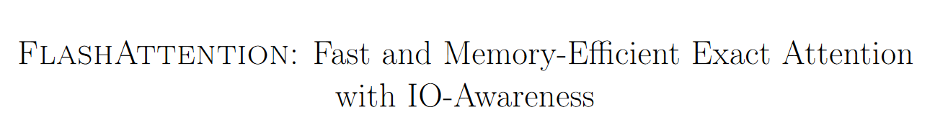
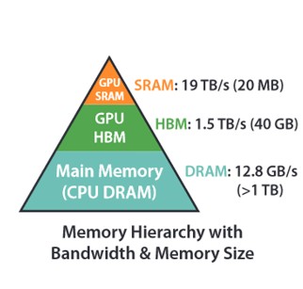
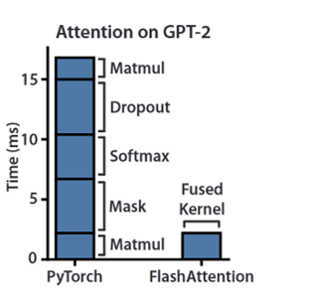
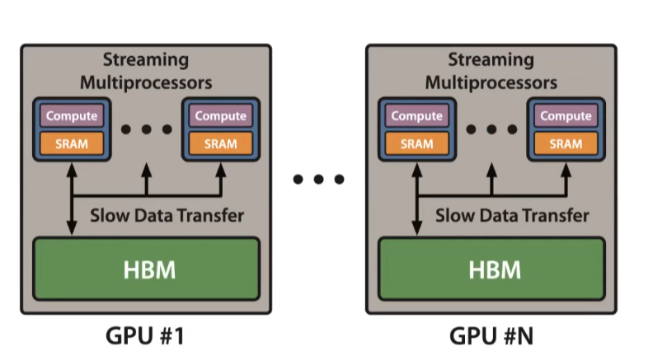
PAPER1:
https://arxiv.org/pdf/2205.14135.pdf

Slide 5
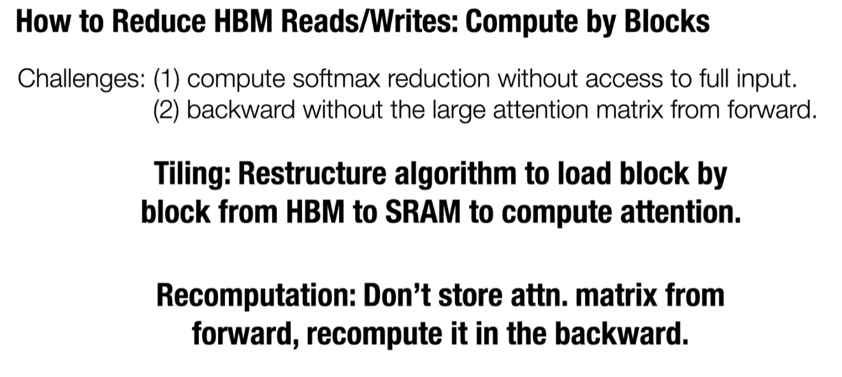

Slide 6
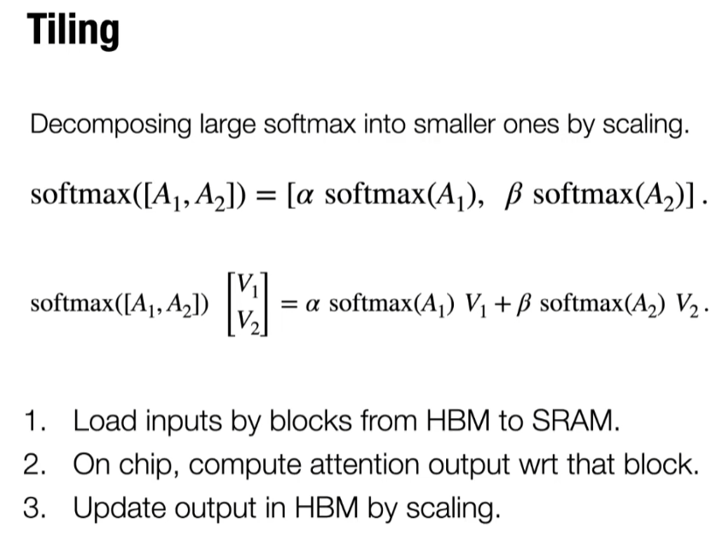
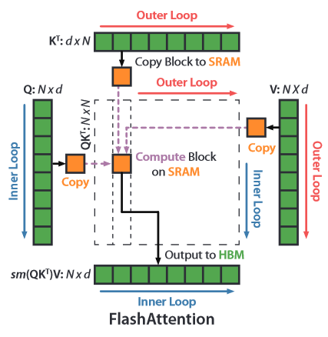

Slide 7
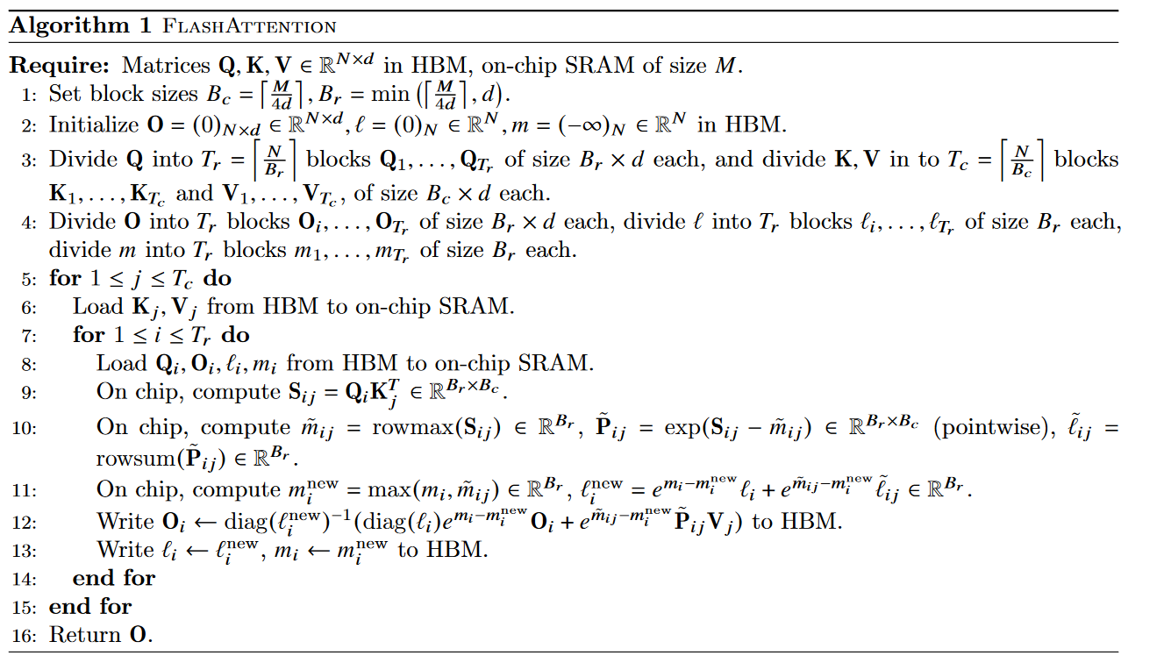

Slide 8
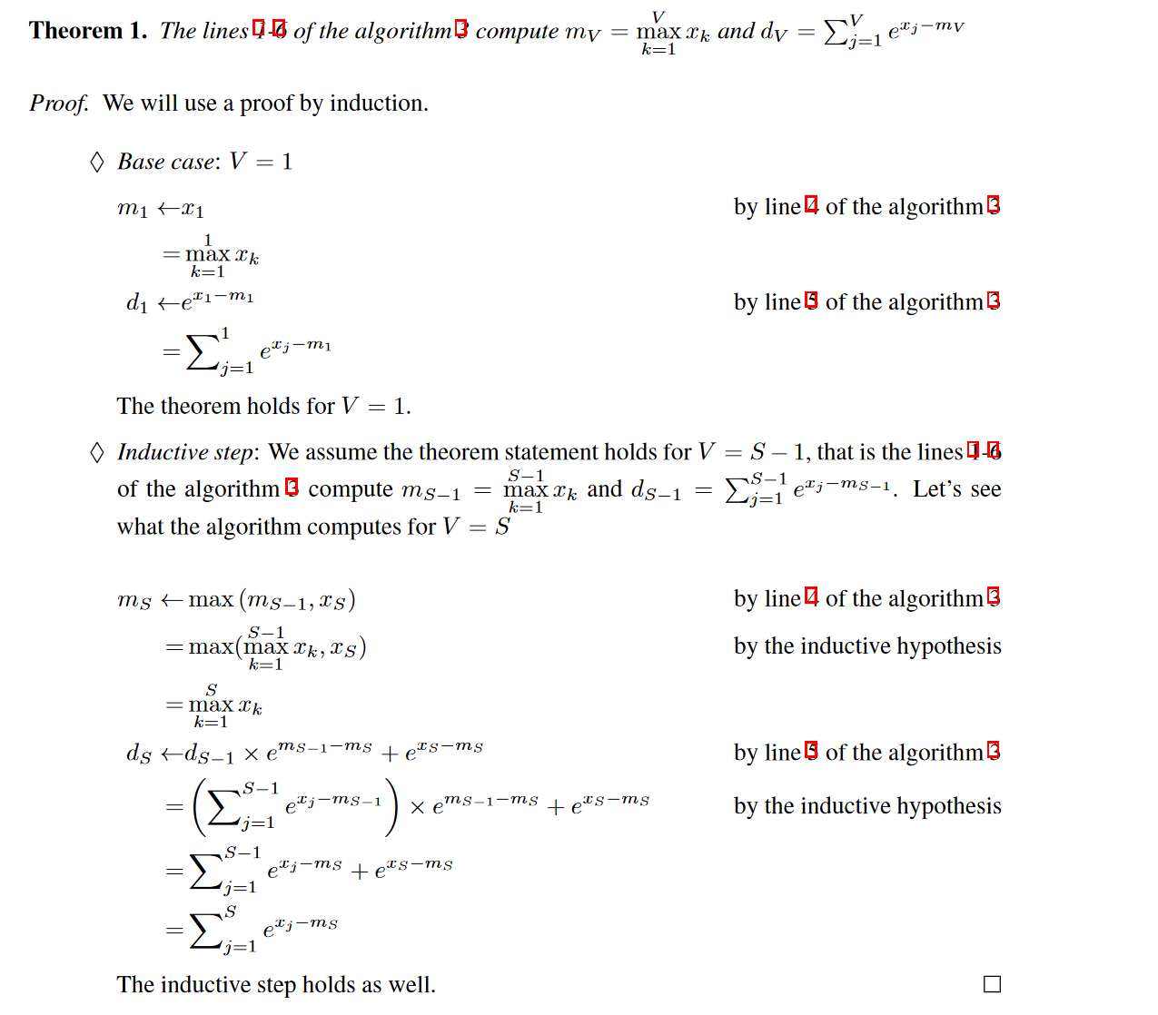
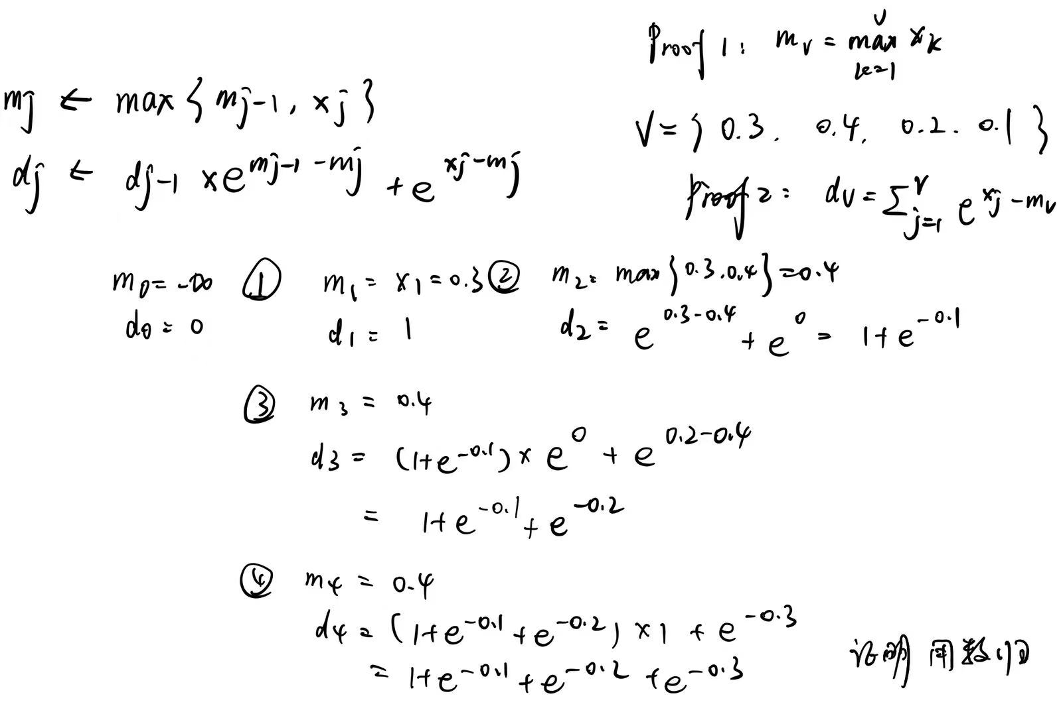
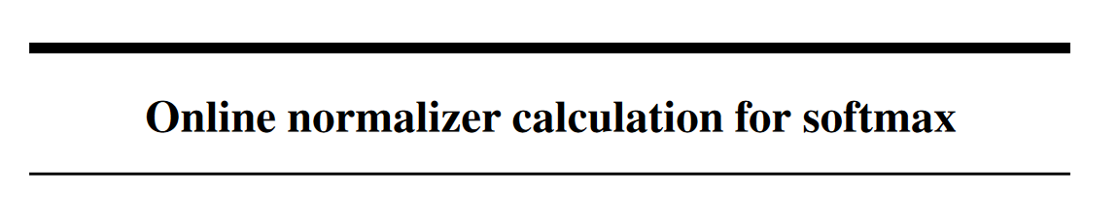
https://arxiv.org/pdf/1805.02867.pdf

Slide 9
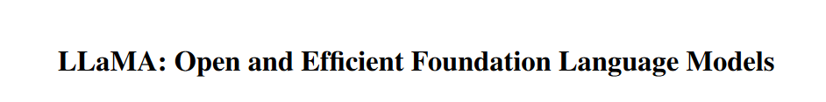
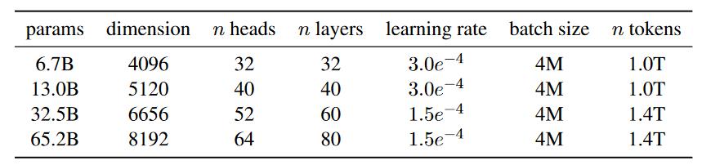
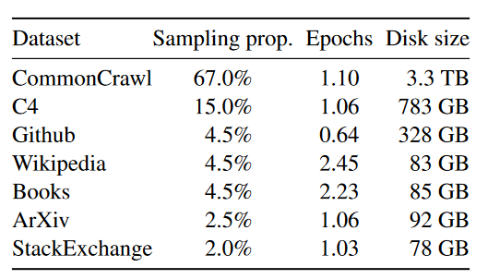
PAPER2:
Architecture: traditional transformer arch
Pre-normalization [GPT3]
SwiGLU activation function [PaLM]
Rotary Embeddings [GPTNeo]
Pre-training Data:
Other efficient implementation:
Multi-head attention operator [FlashAttention]
Reduce the amount of activations
Use all_reduce operations

